Slide 1
Math Solver 🧮
AI-Powered Mathematical Problem Solver
From Image to Solution in Seconds
Presented by [Your Name]

Slide 2
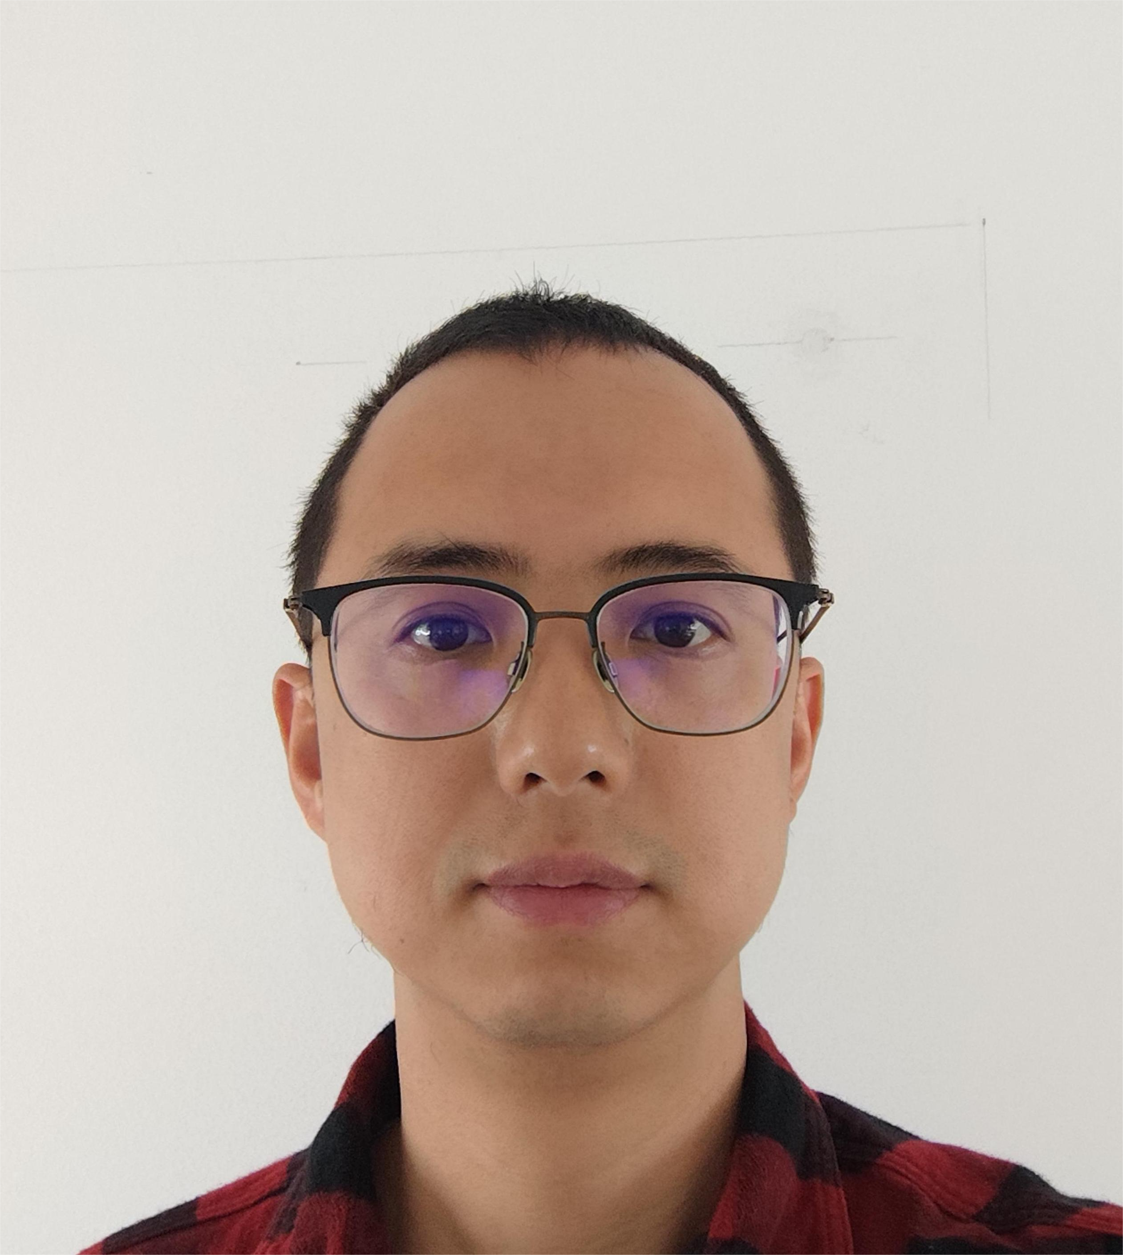
About Me 👨‍💻
🎓 Master in Mathematics (Tu Berlin)
💼 Data Scientist (ca. 6 years)
🚀 Passionate about AI and Education Technology
💡 Built this Math Solver to revolutionize learning

Slide 3
The Problem 🤔
• Students struggle with complex math problems
• No instant step-by-step guidance available
• Time-consuming manual calculations

Slide 4
Our Solution ✨
📸 Snap a photo of any math problem
🤖 AI analyzes and solves instantly
📋 Get detailed step-by-step solutions

Slide 5
How It Works 🔄
1️⃣ Take a photo of your math problem
2️⃣ AI processes the image in <90 seconds
3️⃣ Receive step-by-step solution with verification

Slide 6
Key Features 🌟
⚡ Fast: Results in under 90 seconds
🎯 Accurate: Advanced AI with verification
📱 Easy: Simple photo-to-solution interface

Slide 7
Technology Stack 🏗️
📱 React Native Frontend
🐍 FastAPI Backend
🤖 OpenAI GPT-4o-mini Vision Model

Slide 8
Example: System of Equations 📊
Input: x + y = 31, x - y = 18
Solution Steps:
• Add equations: 2x = 49
• Solve: x = 24.5, y = 6.5
• Verify: ✅ Both equations satisfied

Slide 9
Market Opportunity 🎯
📚 Students: 1.6 billion worldwide
👨‍🏫 Educators: Need better teaching tools
📈 EdTech Market: $89.49 billion globally

Slide 10
Business Model 💰
📱 Freemium: 10 problems/day free
⭐ Premium: Unlimited + priority processing
🏢 Enterprise: Educational institutions

Slide 11
Why We Win 🏆
🔍 Advanced AI vs basic calculators
📝 Step-by-step explanations vs just answers
📸 Image recognition vs manual input

Slide 12
What's Next 🔮
🌍 Multi-language support
📊 Advanced problem types
🎓 Educational content integration

Slide 13
Get Involved 🚀
💰 Investors: Join the EdTech revolution
📱 Users: Try the app today
👥 Developers: Contribute on GitHub
🐱 Repository: github.com/lskenkf/math_solver

Slide 14
Thank You! 🙏
Questions & Discussion
📧 Contact: [your.email@domain.com]
🐱 GitHub: github.com/lskenkf/math_solver
🚀 Let's revolutionize math education together!

