Slide 1
跨视角地理视觉定位
Where am I looking at?
汇报人：李松廉
汇报日期：2021.01.02

Slide 2
大纲：
Geo-localization的定义
研究现状归类
experiment

Slide 3
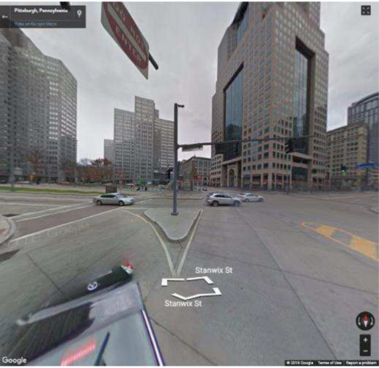
Geo-localization的定义
Where am I looking at ?
Image geo-localization refers to the problem of determining where (i.e. GPS coordinates) an image is taken from based on the visual information only
即仅利用视觉信息去推断图像在哪个位置拍摄的

Slide 4
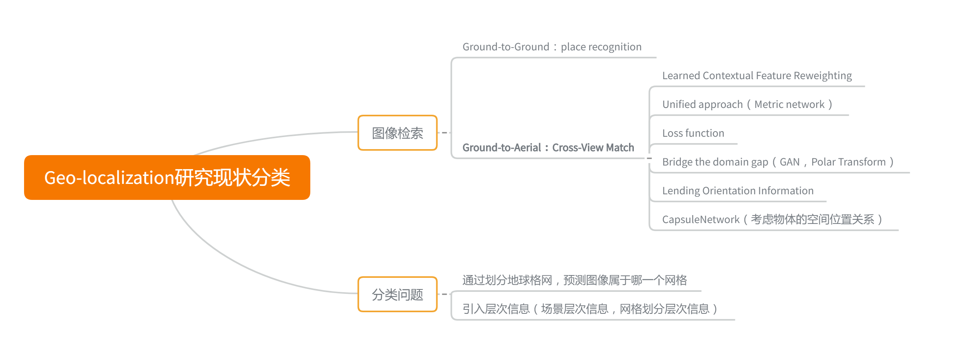

Slide 5
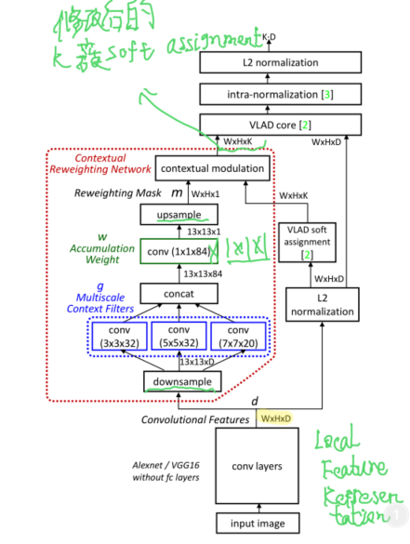
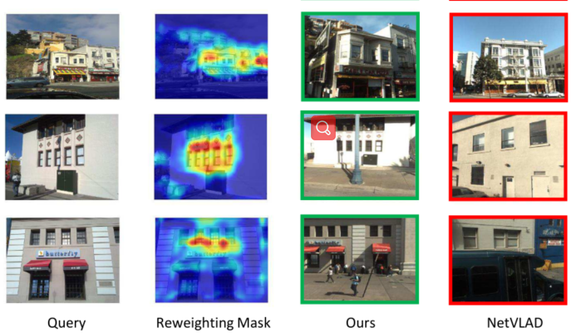
Learned Contextual Feature Reweighting
Learned Contextual Feature Reweighting for Image Geo-Localization Feature Reweighting for Image Geo-Localization

Slide 6
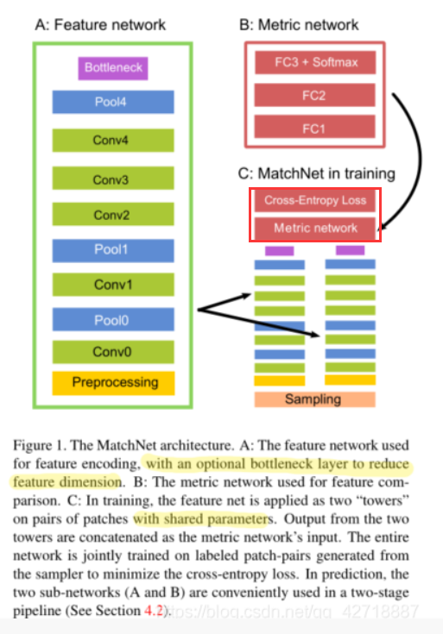
Unified approach（Metric network）
MatchNet: Unifying Feature and Metric Learning for Patch-Based Matching
整个MatchNet就包括Feature Network和Metric Network两个部分。Feature Network就相当于一个Siamese Network，用来提取两个patch的representations。Metric Network就是用全连接网络去学习Metric，而不是直接使用欧式距离，最后以softmax输出2维向量，第一个元素代表这两个图像匹配的概率，第二个元素代表不匹配的概率

Slide 7


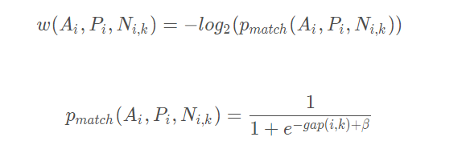
Loss function
Ground-to-Aerial Image Geo-localization With a Hard Examplar Reweighting Triplet Loss

Slide 8
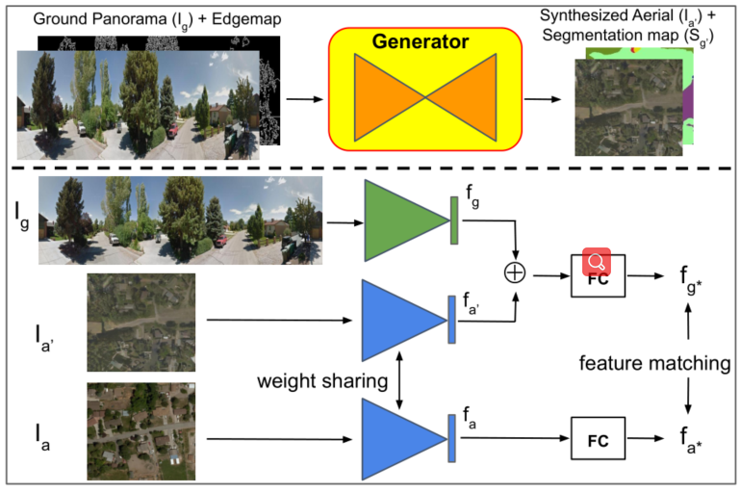
Bridge the domain gap
Bridging the Domain Gap for Ground-to-Aerial Image Matching

Slide 9
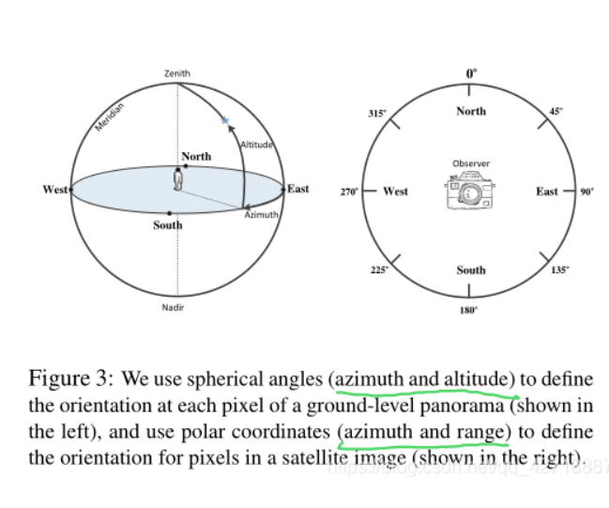
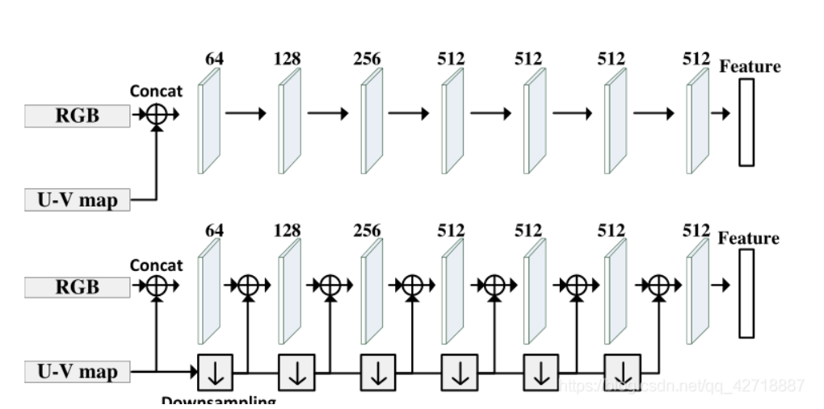
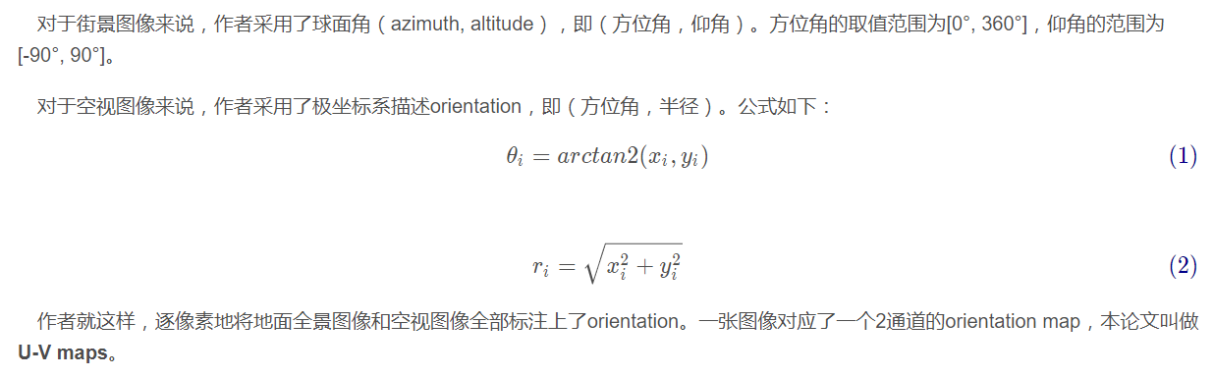
Lending Orientation Information
Lending Orientation to Neural Networks for Cross-view Geo-localization

Slide 10
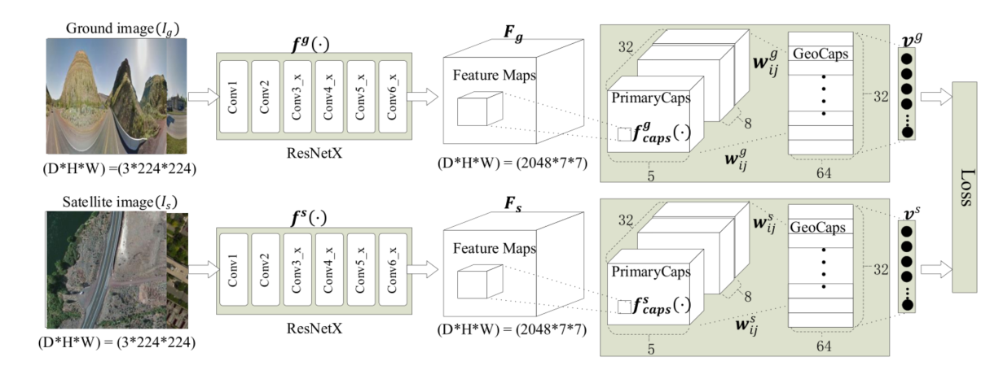
CapsuleNetwork
GeoCapsNet: Aerial to Ground View Image Geo-localization Using Capsule Network

Slide 11
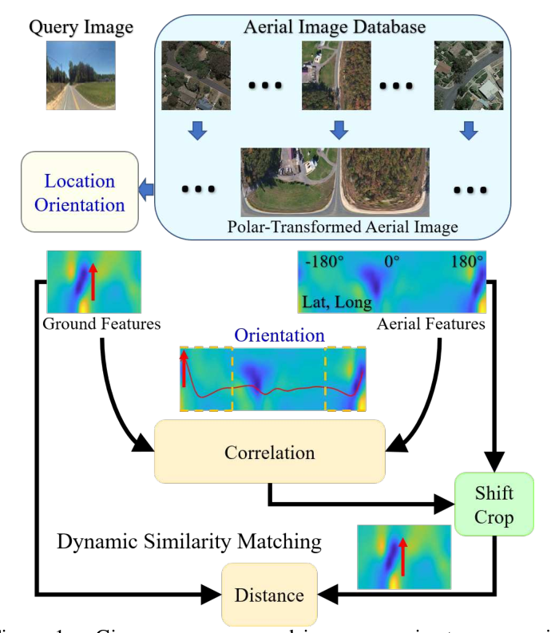
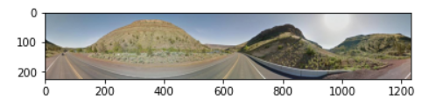
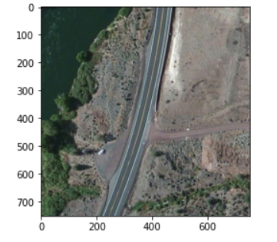
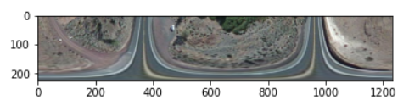
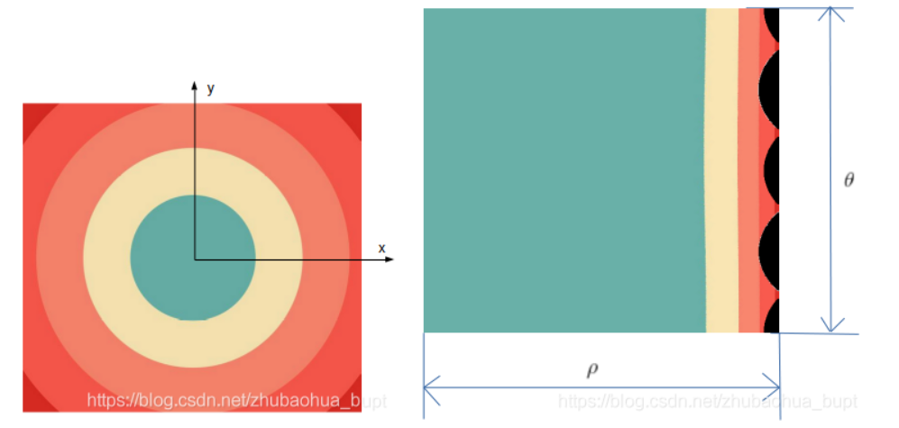
Where am I looking at? Joint Location and Orientation Estimation by Cross-View Matching
SOTA
Ground
Aerial to ground
Polar Transform

Slide 12
Experiment
Methods | CVUSA
 | r@1 | r@1%
Siamese (VGG) | - | 9.9%
Zhai et al CVPR2017 | - | 43.2%
CVM-NET CVPR2018 | 22.47% | 87.2%
Liu & Li CVPR2019 | 40.79% | 96.12%
Siam-FCANet34 ICCV2019 | 42.863% | 98.3%
SOTA CVPR2020 | 91.96% | 99.67%
My experiment CVM-NET+PCA Whitening | 22.98% | 89.2%

