Slide 1

Computer Fundamentals
Lecture 4 :Complimentary
Arithmetic

Slide 2
Objectives
After completing this module you will be able to:
  Perform basic arithmetic operations using binary number system
  Understand two’s complement representation used in computers
  Explain the use of special memory locations in CPU to keep track of the status of last operation
Lecture 03 - Computer Arithmetic

Slide 3
Lecture Outline
Binary Addition
Number Representation
Complementary Arithmetic
How do we perform 2’s complement arithmetic ?
Multiplication and division
Floating Point Numbers
Representing Floating Point Numbers
Lecture 03 - Computer Arithmetic

Slide 4
Complimentary Anathematic
Complements : used in digital computers for simplifying
    the subtraction operation
    the logical manipulation
There are two types of compliments for each base r system
    r’s compliments
    (r-1)’s compliments
the value r is submitted in the name,
  2’s and 1’s compliments – binary numbers
  10’s and 9’s compliments – decimal numbers
Lecture 03 - Computer Arithmetic
Notes:
ics

Slide 5
Complimentary Anathematic (r-1)’s Compliments
(r-1)’s Complements:
  Given a number N in base r having n digits, the (r-1)’s complement of N is defined as
N’ = (r^{n} -1) – N
For decimal numbers r= 10, r-1 = 9
The 9’s compliments of N is (10^{n}-1) - N
10^{n} represents a number that consists of a single 1 followed by n 0’s
Eg. If n=4 , (10⁴ – 1) = 10000 -1 = 9999
Lecture 03 - Computer Arithmetic

Slide 6
Complimentary Anathematic (r-1)’s Compliment
9’s complement:
    9’s compliment of a decimal number is obtained by subtracting each digit from 9.
    Eg. 9’s compliment of 546700
    999999 – 546700 = 453299
  Exercise: calculate the 9’s compliment
  1. 12389
  2. 24367
Lecture 03 - Computer Arithmetic

Slide 7
Complimentary Anathematic (r-1)’s Compliment
1’s Compliment:
  Binary Number r=2 and (r-1) = 1
  2^{n} represents a number that consists of a single 1 followed by n 0’s.
  2^{n}-1 is a binary number represented by n 1’s.
  Eg. n =4, we have 2⁴ = (10000)₂ and
  2⁴ – 1 = (1111)₂
The 1’s compliments of N is (2^{n}-1) - N
Lecture 03 - Computer Arithmetic

Slide 8
Complimentary Anathematic (r-1)’s Compliment
1’s Compliment (contd.)
    1’s compliment of a binary number is obtained by subtracting each digit from 1.
  Eg. n =4, we have 2⁴ = (10000)₂ and
  2⁴ – 1 = (1111)₂
The subtraction of a binary digit from 1 causes the bit to change from 0 to 1 or from 1 to 0.
Therefore the 1’s compliment of a binary number is formed by changing 1’s into 0’s and 0’s into 1’s.
Lecture 03 - Computer Arithmetic

Slide 9
Complimentary Anathematic (r-1)’s Compliment
1’s Compliment (contd.)
Example: 1’s compliment of 1011001 I is 0100110.
Exercise: get the 1’s compliments of the following binary numbers
  1100011
  0001111
  1010100
  1111011
Lecture 03 - Computer Arithmetic

Slide 10
Complimentary Anathematic r’s Compliment
The r’s compliment of an n-digit number N in base r is defined as
N’ = r^{n} – N, N ≠ 0 and 0 for N = 0
Comparing (r-1)’s compliment, r’s compliment can be obtained by adding 1 to the (r-1)’s compliment.
r^{n} – N = [(r^{n} – 1) – N + 1]
Lecture 03 - Computer Arithmetic

Slide 11
Complimentary Anathematic r’s Compliment
10’s Compliment:
  1. The 10’s compliments of N is (10^{n} – N) or
  2. the 10’s compliments of N is [(10^{n} – 1) – N + 1]
(10’s compliment of a given decimal number can be obtained by adding 1 to 9’s compliment value.)
1. The 10’s compliments of N is (10^{n} – N)
  10^{n} is a number represented by a 1 followed by n 0’s
  10’s compliment of N can be formed by leaving all least significant 0’s unchanged, subtracting first nonzero least significant digit from 10 and then subtracting all higher significant digits from 9.
  Eg. 10’s compliment of 246700 is 753300
  ( (9-2)(9-4)(9-6)(10-7)00)
Lecture 03 - Computer Arithmetic

Slide 12
Complimentary Anathematic r’s Compliment
  2. the 10’s compliments of N is [(10^{n} – 1) – N + 1]
Obtain the 10’s compliment of 246700
9’s compliment = 999999 – 246700 = 753299
10’s compliment = 753299 +1 = 753300
Exercise: obtain the 10’s compliments of the following decimal numbers.
  2340 3. 54390
  2. 22897 4. 12770
Lecture 03 - Computer Arithmetic

Slide 13
Complimentary Anathematic r’s Compliment
Subtraction of Decimal numbers using 10’s compliments.
Eg. 11-4
Step 1. obtain the 10’s compliment of 4
method 1: obtain the 9’s compliment of each digit and add 1. 9- 4 +1 = 6
  method 2: subtract first nonzero least significant digit from 10 and then subtracting all higher significant digits from 9.
  10-6 =6
Step 2: subtracting 11-4 is equal to adding 11 and 6.
11+6 = 17 (discarding the carry give 7 which is the correct answer).
Lecture 03 - Computer Arithmetic

Slide 14
Complimentary Anathematic r’s Compliment
Subtract the following 10’s compliments
  23-15
  145 -24
  1453-342
  3451-2350
  14529 - 3900
Lecture 03 - Computer Arithmetic

Slide 15
Complimentary Anathematic r’s Compliment
2’s compliment
Method 1
  Step 1 : get the 1’s compliment of the given number.
  Step 2: add 1 to the 1’s compliment.
Method 2
in binary number leave the all least significant 0’s and first 1 unchanged, and then replacing 1’s by 0’s and 0’s by 1’s in all the higher significant bits.
Lecture 03 - Computer Arithmetic

Slide 16
Complimentary Anathematic r’s Compliment
Example 1 : 2’s compliment using Method 1
  Store -27 in a byte using 2's complement notation.
  Steps 1 and 2 determine the 1's complement:
  Step 1: +27 in binary is 0001 1011.
  Step 2: invert bits to yield 1110 0100. Then the 1's complement of -27 is 1110 0100.
  Step 3 is the additional step needed to find the 2's complement.
  Step 3: add 1 to the 1's complement:
1110 0100
+ 1
1110 0101
The 2's complement of -27 is 1110 0101.
Lecture 03 - Computer Arithmetic

Slide 17
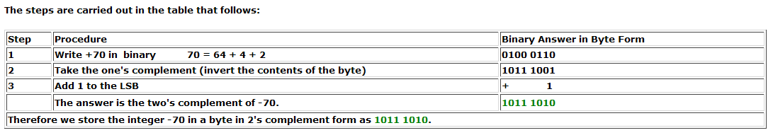
Example 2: 2’s Complement
Store the integer -70 in a byte using the two's complement notation.
Lecture 03 - Computer Arithmetic

Slide 18
Binary Multiplication
Rules of Binary Multiplication
0 x 0 = 0
0 x 1 = 0
1 x 0 = 0
1 x 1 = 1, and no carry or borrow bits
Lecture 03 - Computer Arithmetic

Slide 19
Binary Multiplication – Examples
3 X 3 = 9
0011 X 0011 = 1001
0011
0011
0011
00110<-- the 0 here is the placeholder
1001
Lecture 03 - Computer Arithmetic

Slide 20
Binary Multiplication – Examples
1001 x 0111 =?
1001
0111
1001
10010
100100
0000000
00111111
Lecture 03 - Computer Arithmetic

Slide 21
Binary Multiplication
Achieved by shifting & adding
The two numbers are called multiplicand & multiplier.
Partial product sum –the obtained result at each stage.
  Negative numbers should be converted to positive & once finished the result is complemented back to negative.
  Initialize the partial sum to ‘0’
  Start with left most bit of multiplier, & do until all have been considered.
Lecture 03 - Computer Arithmetic

Slide 22
Binary Multiplication
B
E.g: 15 * 5 = 75, 15=1111,5=101<-multiplier
  0000 0000 initialize to 0
  0000 1111 A =1
  0000 1111 sum
  0001 1110 shift ← (left)
  0000 0000 B = 0
  0001 1110 sum
  0011 1100 shift ← (left)
  0000 1111 C = 1
  0100 1011 sum, no shift
A
C
Lecture 03 - Computer Arithmetic

Slide 23
Binary Division
To perform the binary division follow these steps.
  Align the divisor (Y) with the most significant end of the dividend. Let the portion of the dividend from its MSB to its bit aligned with the LSB of the divisor be denoted X.
  Compare X and Y.
    If X >= Y, the quotient bit is 1 an perform the subtraction X-Y.
    If X < Y, the quotient bit is 0 and do not perform any subtractions.
  Shift Y one bit to the right and go to step 2.
Lecture 03 - Computer Arithmetic

Slide 24
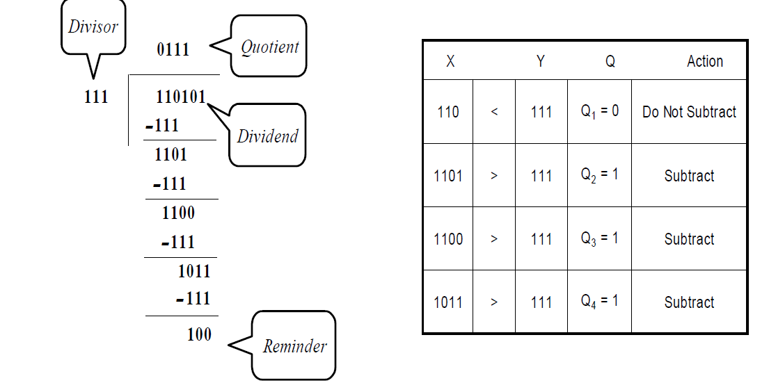
Binary Division –Example-1
Lecture 03 - Computer Arithmetic

Slide 25

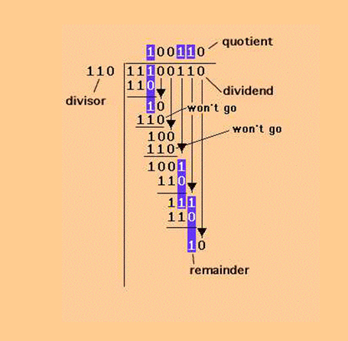
Binary Division –Example-2
Lecture 03 - Computer Arithmetic

Slide 26
Binary Division Exercise
1000 /10
1010 / 11
1111/ 111
Lecture 03 - Computer Arithmetic

Slide 27
Floating Point Numbers
3.625 + 6.5 = 10.125 ₁₀
0011.1010 + 0110.1000
00111010
01101000
10100010 = 1010.0010 ₂ = 10.125 ₁₀
Lecture 03 - Computer Arithmetic

Slide 28
Representing Floating Point Numbers
Range
  2 × 10 ^{–7} to 2 × 10 ⁷ = 2 × 10 ¹⁴
Precision
  Measure of exactness
  Π = 3.142 or 3.141592
Accuracy
  Measure of correctness of quantity
  Π = 3.141 or 3.241592
more precise
accurate
Lecture 03 - Computer Arithmetic

Slide 29
Thank You
Next Lecture
Lecture 05: Logic and Control
Lecture 03 - Computer Arithmetic

