Slide 1
Support Vector Machines in Python using Scikit-learn
Data Science Skills Series
Márcio & Corey
http://scikit-learn.org/

Slide 2
References
http://scikit-learn.org/
http://scikit-learn.org/stable/modules/svm.html/
https://www.analyticsvidhya.com/blog/2015/10/understaing-support-vector-machine-example-code/
http://www.svm-tutorial.com/2014/11/svm-understanding-math-part-1/
http://cs.haifa.ac.il/hagit/courses/seminars/visionTopics/Presentations/SVM_Lecture.ppt/

Slide 3
The goal of SVM is to find an hyperplane that separates two classes
A separating hyperplane

Slide 4
There are many hyperplanes separating the two classes
A separating hyperplane

Slide 5
SVM’s goal is to maximize the Margin
The Margin is twice the distance “d” between the separating hyperplane and the closest sample
This is robust to outliers and hence, strong generalization ability
Support vectors
Support vectors are the samples closest to the separating hyperplane
Margin
d
d
d

Slide 6
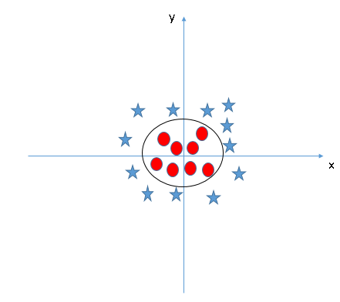
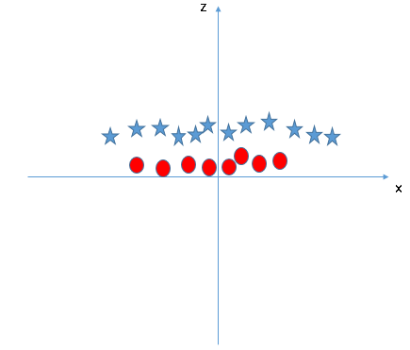
What if the points are not linearly separable?
Key idea: map the points to a space of sufficiently high dimension so that they will be separable by a hyperplane: SVM has Kernel functions which take low dimensional input space and transforms it to a higher dimensional space.

Slide 7
Higher dimensional spaces introduce additional problems
A strong kernel ,which lifts the data to infinite dimension, sometimes may lead us the severe problem of Overfitting:
Low margin → poor classification performance.
Large number of support vectors→ Slows down the computation.

Slide 8
This is solved by introducing soft margins, allowing error in classification
Introduction of parameter C for controlling the error term: this controls the trade off between smooth decision boundary and classifying the training points correctly.

Slide 9
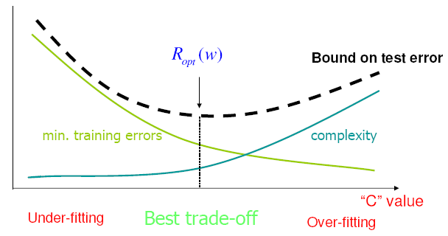
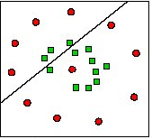
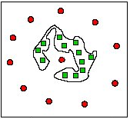
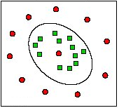
You need to consider the tradeoff between underfitting and overfitting
Under-Fitting
Over-Fitting
Too much simple!
Too much complicated!
Trade-Off

Slide 10
Pros and Cons with SVM
Pros:
It works really well with clear margin of separation
It is effective in high dimensional spaces.
It is effective in cases where number of dimensions is greater than the number of samples.
It uses a subset of training points in the decision function (called support vectors), so it is also memory efficient.
Cons:
It doesn’t perform well, when we have large data set because the required training time is higher
It also doesn’t perform very well, when the data set has more noise i.e. target classes are overlapping
SVM doesn’t directly provide probability estimates, these are calculated using an expensive five-fold cross-validation. It is related SVC method of Python scikit-learn library.

Slide 11
SVM using Scikit-Learn in Python
#Import Library
from sklearn import svm
# Create SVM classification object
model = svm.svc(kernel='linear', c=1, gamma=1)
# Train the model using the training sets
model.fit(X, y)
# Check score
model.score(X, y)
#Predict Output
predicted= model.predict(x_test)

Slide 12
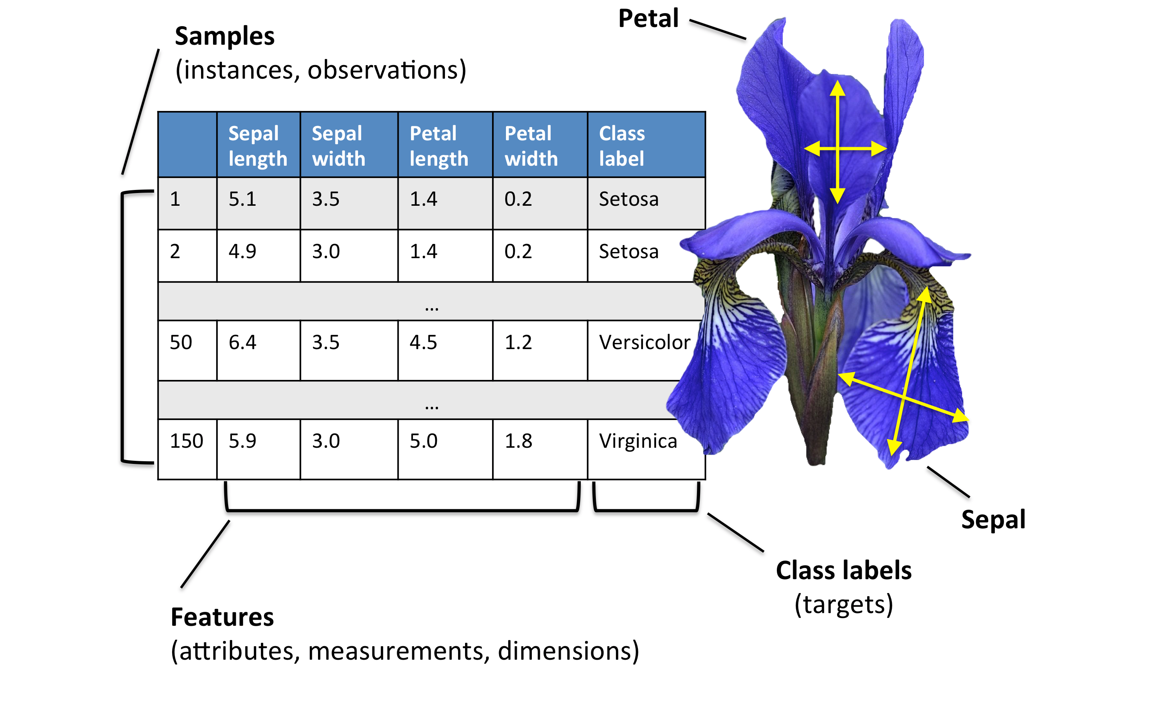
Case study: the Iris dataset

