Slide 1
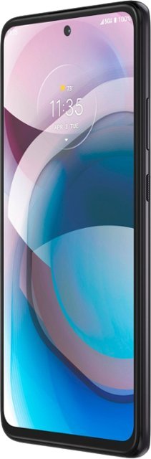
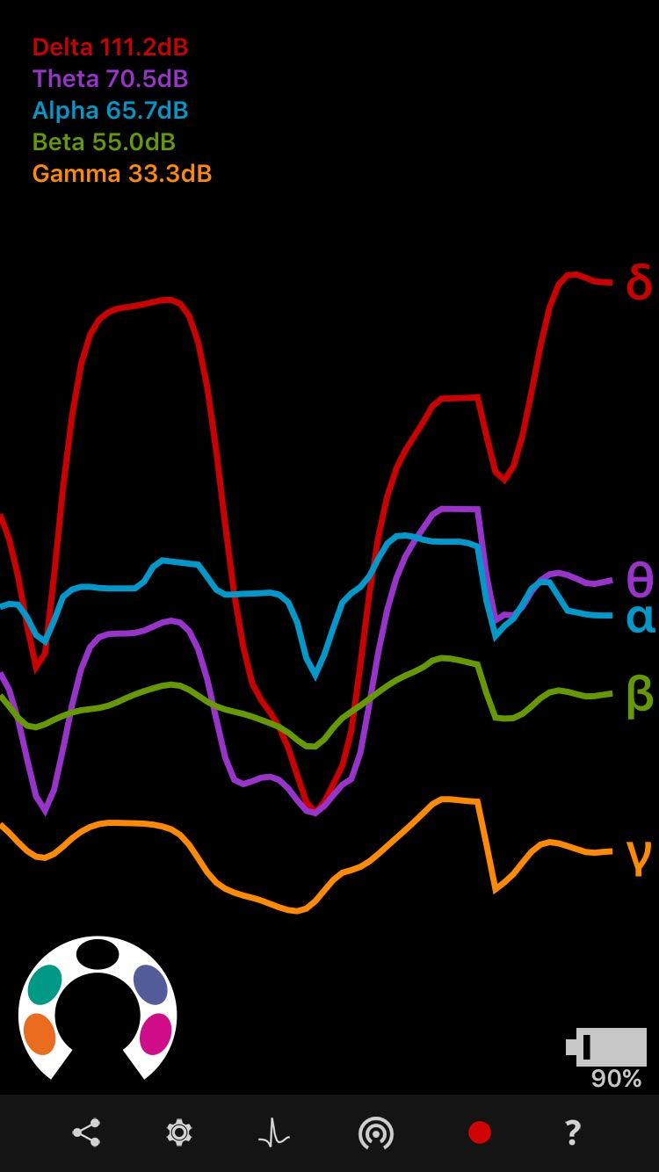
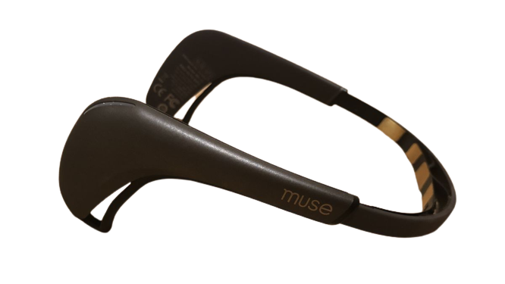

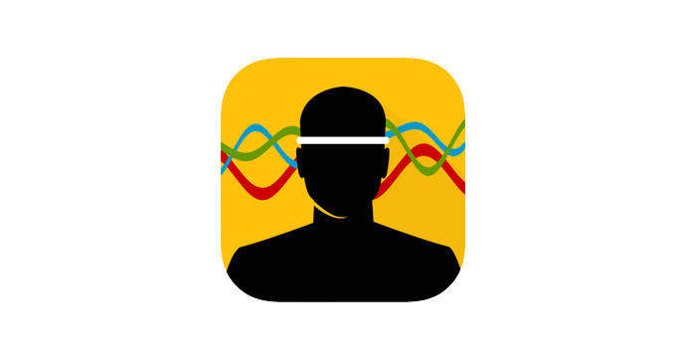
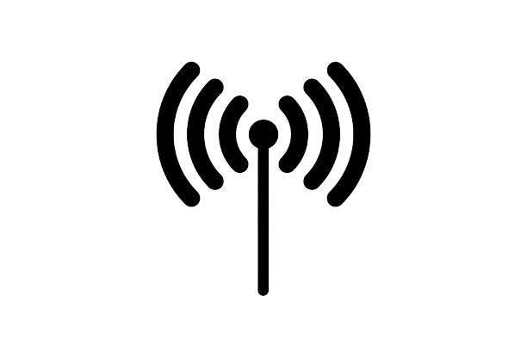
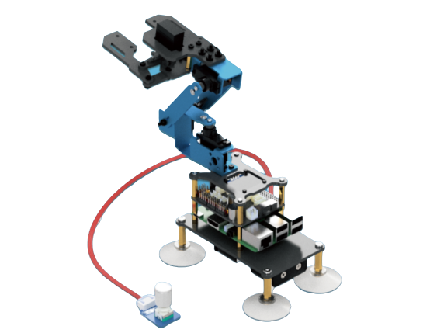
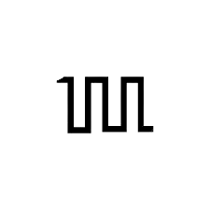

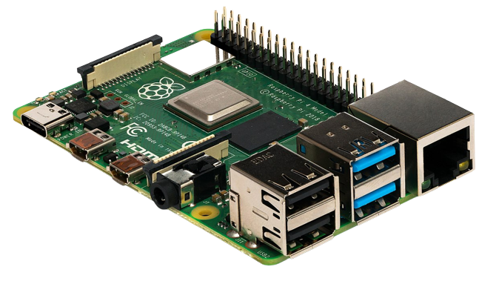

EEG Signal Process Flow in Hardware
1
2
3
5
4

Slide 2
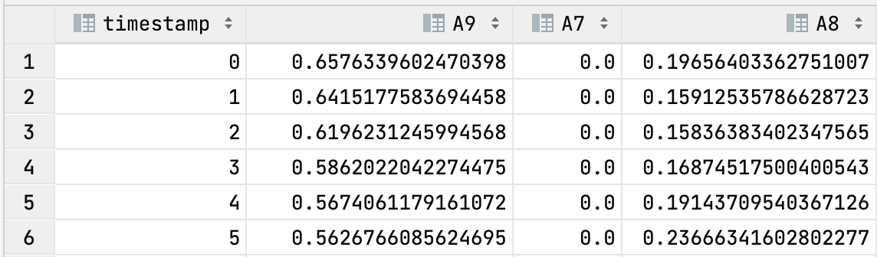
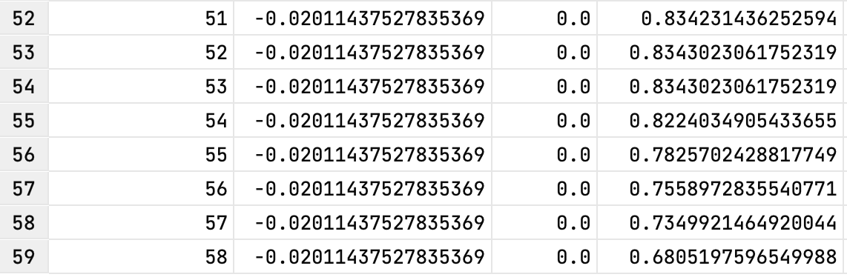
Data Collection, Classifier Training and Deploy (a)
Collect EEG signal from brain
Train classifier model
Deploy model in program
Monitor EEG signal and output class
Use class output to control robot arm
user defines two brain activities, e.g., blink and jaw teeth.
complete one cycle data collection (alpha, beta, delta, theta, and gamma, each has four channels):
a. collecting EEG signals of one activity in 2 to 6 sec
(signal delay).
b. next 3-4 sec main thread sleep (signal recovers).
c. then collecting the EEG signal of the other activity in
next 2 to 6 sec.
3. redo step 2 in next cycle until samples number is enough.
4. it is better if two activities have a clear separation in the
observation.

Slide 3
Data Collection, Classifier Training and Deploy (b)
Collect EEG signal from brain
Train classifier model
Deploy model in program
Monitor EEG signal and output class
Use class output to control robot arm
1. we used the Edge Impulse platform to build a classifier model.
2. set different parameters combination:
a. brain activities (arms, eye/teeth, legs, the catalog number was fixed at 2):
some movements may have a better separation on frequency bands than others.
b. number of samples (30, 50, 100):
more samples should have a clear classification trend.
c. frequency bands (group 1: alpha, beta, and delta, group 2: theta, and gamma, group 3: all):
we observed that some frequency bands varied significantly when movements happen.
d. time duration in the measurement cycles (2 sec, 4 sec, 6 sec):
due to the signal delays and recovers, a proper time range is good to cover the moment of
maximum frequency variation.
3. chosen one of the classifier model with highest accuracy.

Slide 4
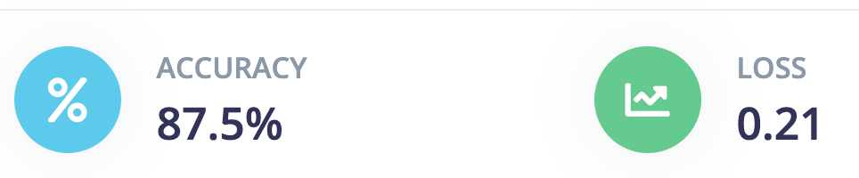
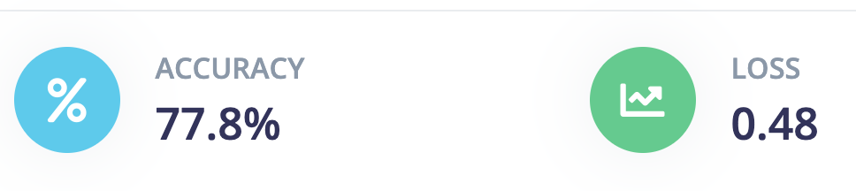
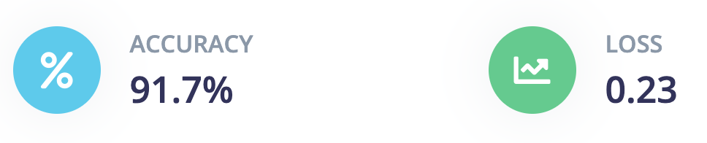
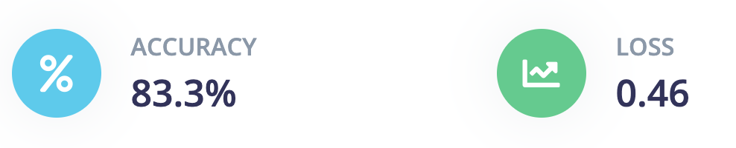
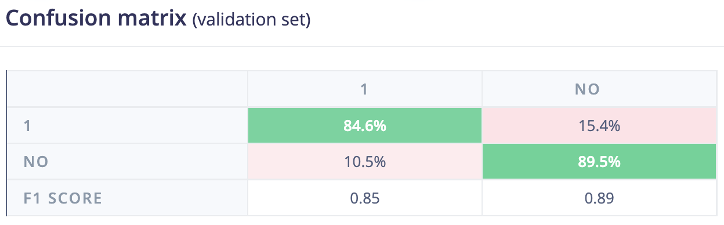
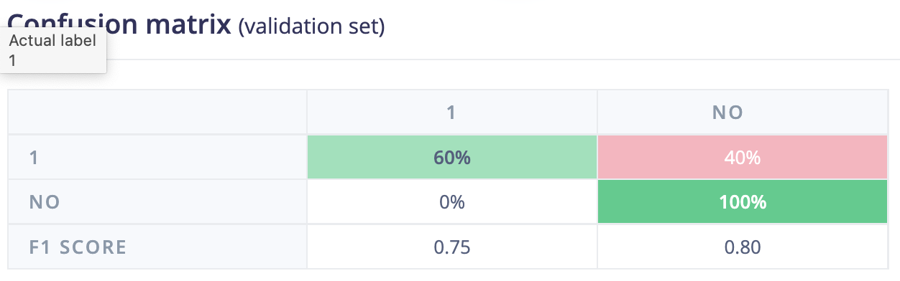
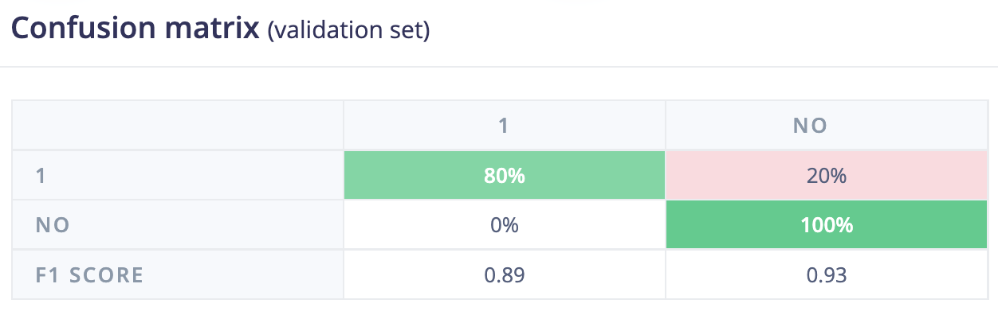
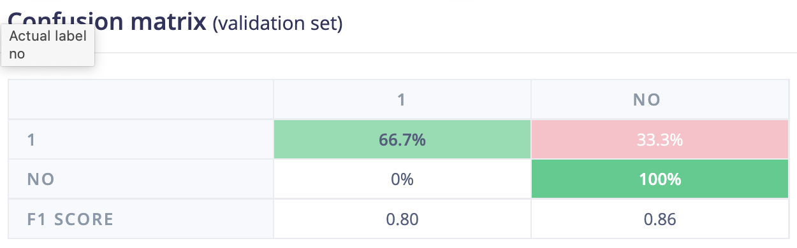
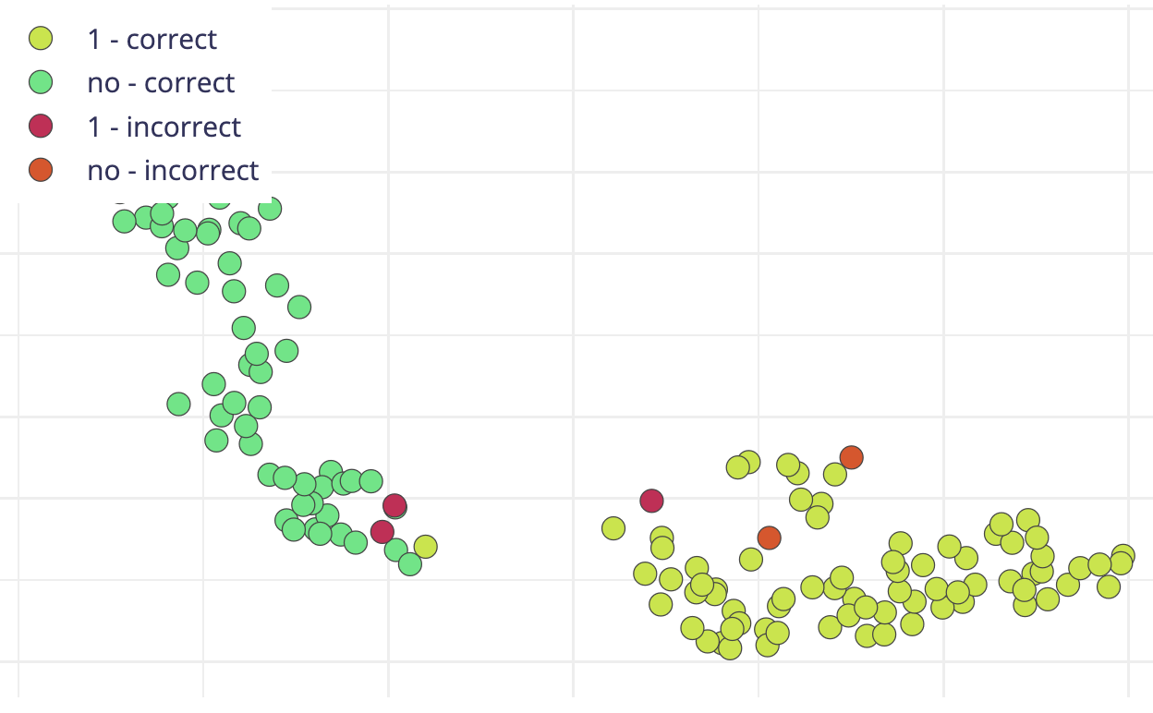
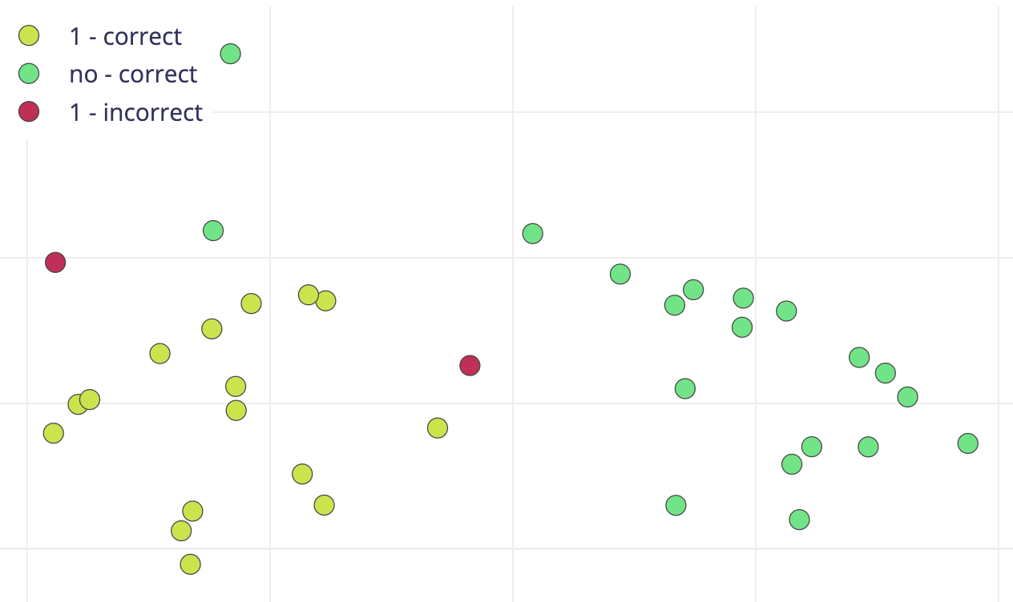
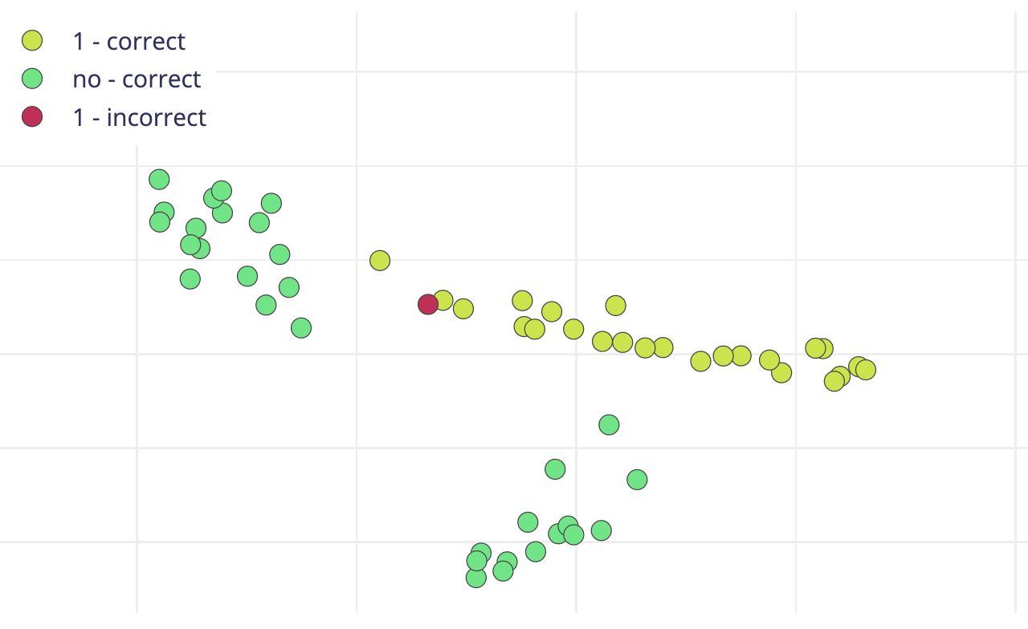
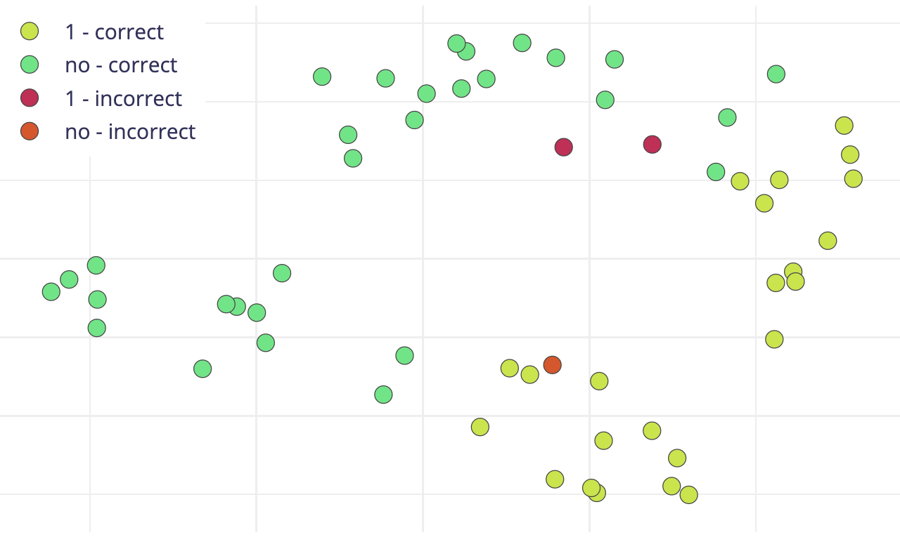
Data Collection, Classifier Training and Deploy (c)
Collect EEG signal from brain
Train classifier model
Deploy model in program
Monitor EEG signal and output class
Use class output to control robot arm
1. 100p/2s/2sec/all
2. 30p/2s/6sec/all
3. 30p/2s/4sec/all
4. 60p/2s/6sec/𝛼𝛽

Slide 5
Data Collection, Classifier Training and Deploy (d)
Collect EEG signal from brain
Train classifier model
Deploy model in program
Monitor EEG signal and output class
Use class output to control robot arm
after training and deploying the classifier model, we used the same setting to get new EEG signals.
and we used the classifier model to predict the brain activity catalog.
in our experiments, so far, 2 brain activities classification is usually better than 3 or 4 status (noise).
the output class will be used to control the robot arm.

Slide 6
Limitation, Challenges and Solutions
there are too much noise in the real measurements, it is difficult to identify the output class because we do not know it is from the right brain activity or the noise (e.g., eye blink automatically when jaw teeth).
the moment to capture EEG signal with delay is significantly vital, because at certain moment, the variance of EEG signal at different frequency band could be large enough for classification.
we consider some dimensionality reduction methods such as PCA or t-SNE to get rid of irrelevant frequency components.
considering metric learning to maximize the intra class variance and minimize the inter class variance (e.g., Mahalanobis Distance).

