Slide 1
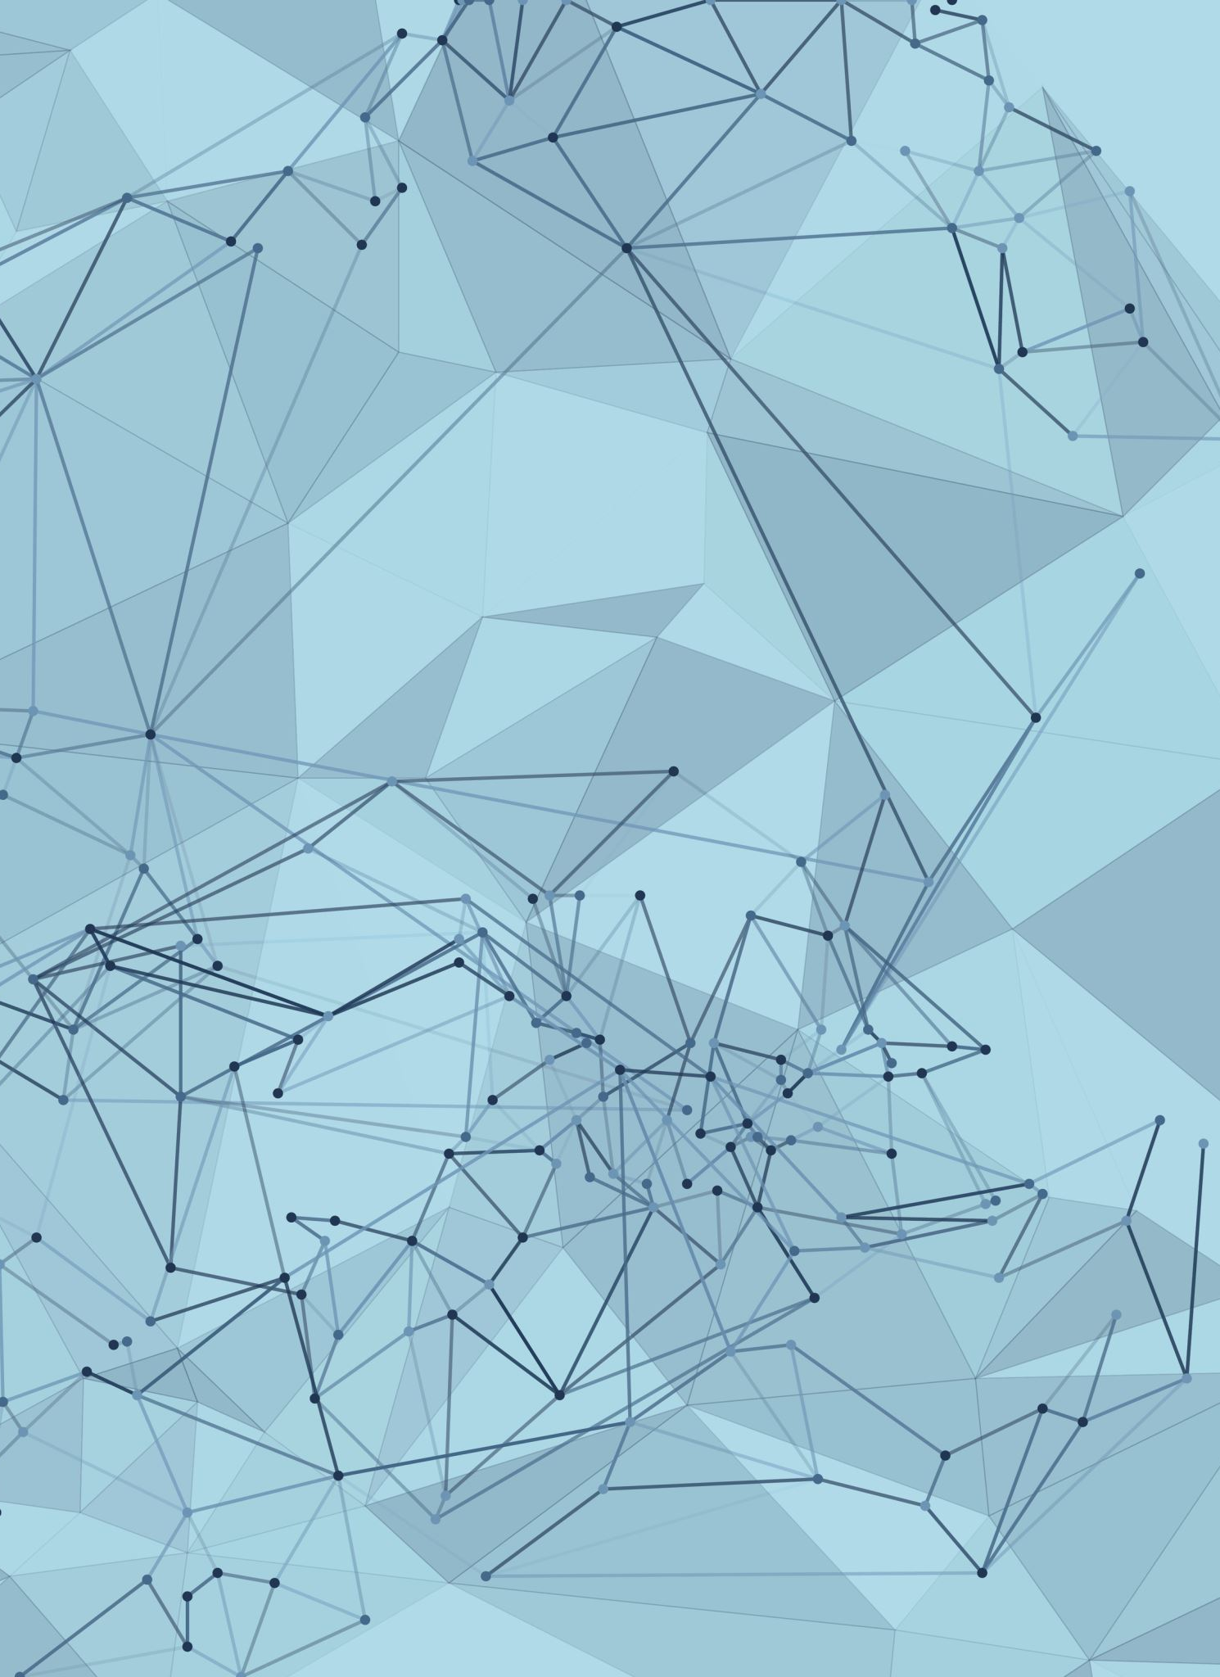
Mind-Controlled Robotic Arm IoT COMP5060 Project
Team members:
Nazim A.Belabbaci
Yibo Li
Prism Prajapati
Bibi Hajira M

Slide 2
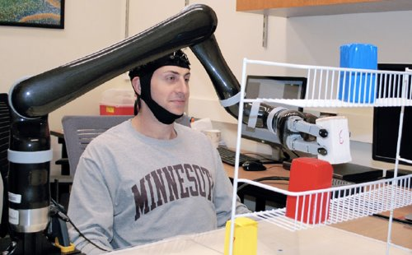
Introduction
Individuals with neuromuscular disorders or damage to motor system lose the ability to control their muscles
Brain Computer Interface (BCI) aim to directly bridge the brain and outside world
Use non-invasive BCI for controlling robotic arm to complete reach-and-grasp tasks in 3 dimensions
Non-invasive technique is called Electroencephalography(EEG) based brain-computer interface.
Notes:
The noninvasive technique, called electroencephalography (EEG) based brain-computer interface, records weak electrical activity of the subjects’ brain through a specialized, high-tech EEG cap fitted with 64 electrodes and converts the “thoughts” into action by advanced signal processing and machine learning.

Slide 3
EEG Features Extraction and Classification Model
The original EEG temporal signal contains different frequency bands information.
Feature Extraction
Step 1: decomposition of original EEG signal into sub-frequency bands (Discrete Wavelet Transform).
Feature Visualization and Standardization
Step 2: standardization of extracted features to zero mean and unit variance.
Feature Selection
Step 3: filtering the critical features for classification (Fisher’s Discriminant Ratio or Principal Component Analysis).
Feature Classification
Step 4: classifying of selected feature sets via KNN, SVM, MLP or NB.
* “Classification of EEG Signals Based on Pattern Recognition Approach” Hafeez Ullah Amin and et al.
Notes:
The noninvasive technique, called electroencephalography (EEG) based brain-computer interface, records weak electrical activity of the subjects’ brain through a specialized, high-tech EEG cap fitted with 64 electrodes and converts the “thoughts” into action by advanced signal processing and machine learning.

Slide 4
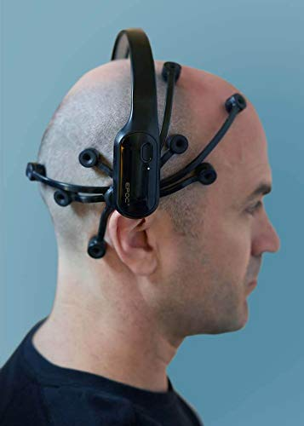
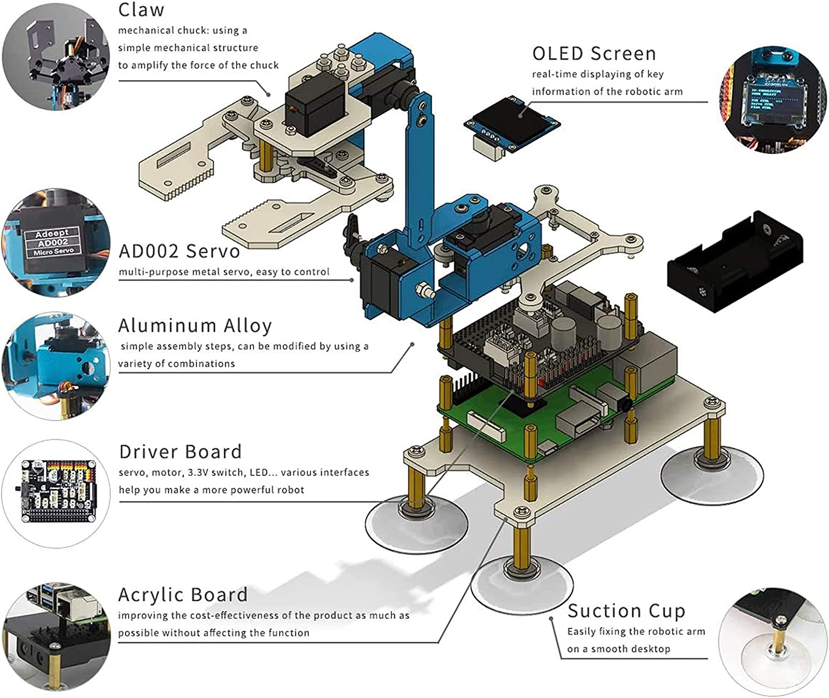
Devices Required
ROBOTIC ARM KIT
EPOC+

Slide 5
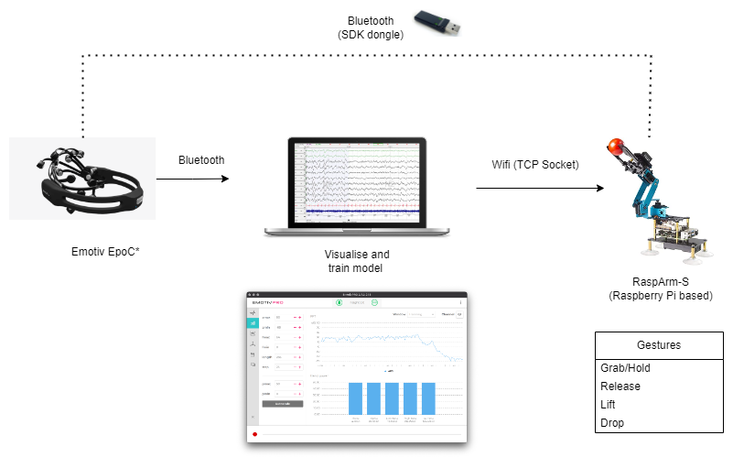
Final Demo Plan

Slide 6
Questions/Feedback

