Slide 1

muduo_base库源码分析
第十四章

Slide 2
本章目标
MutexLock/MutexLockGuard
Condition
CountDownLatch

Slide 3
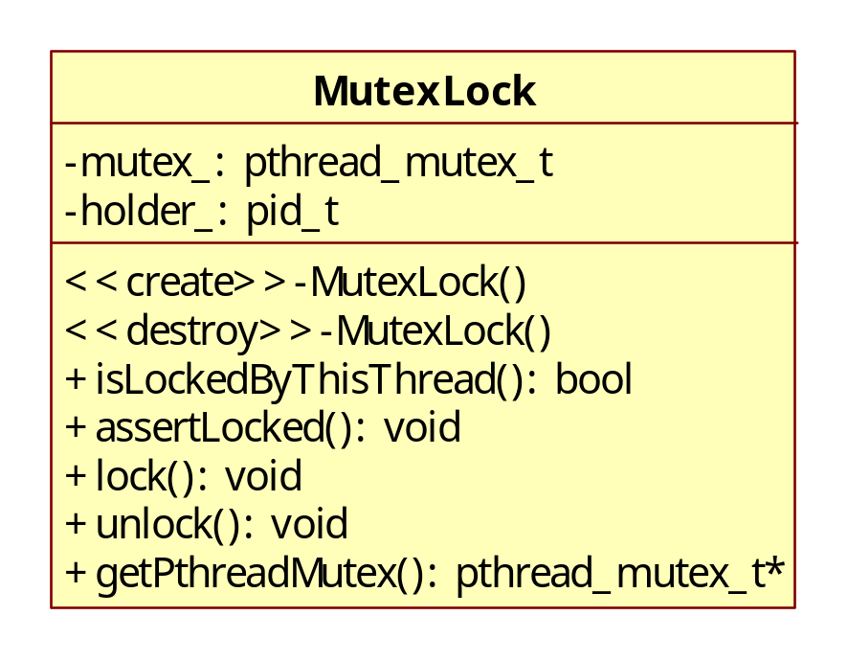
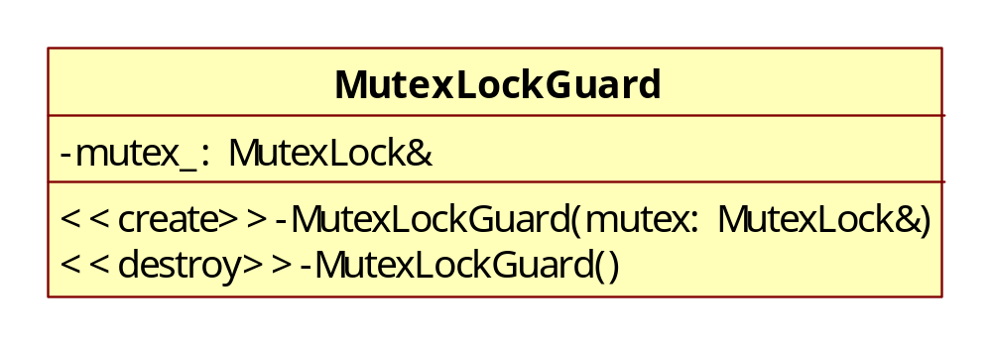
Mutex类图
使用RAII技法封装

Slide 4
mutex_test测试输出
single thread without lock 0.236612
single thread with lock 1.307962
1 thread(s) with lock 1.289032
2 thread(s) with lock 2.552723
3 thread(s) with lock 3.815750
4 thread(s) with lock 5.169259
5 thread(s) with lock 6.392334
6 thread(s) with lock 7.560353
7 thread(s) with lock 8.858318

Slide 5
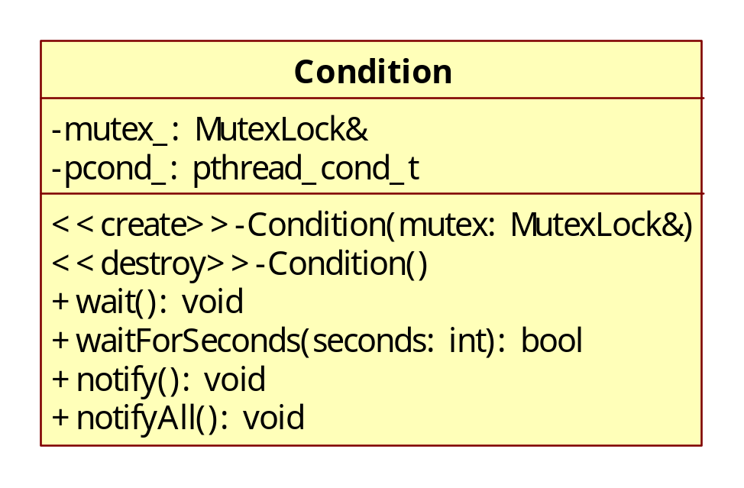
Condition类图

Slide 6
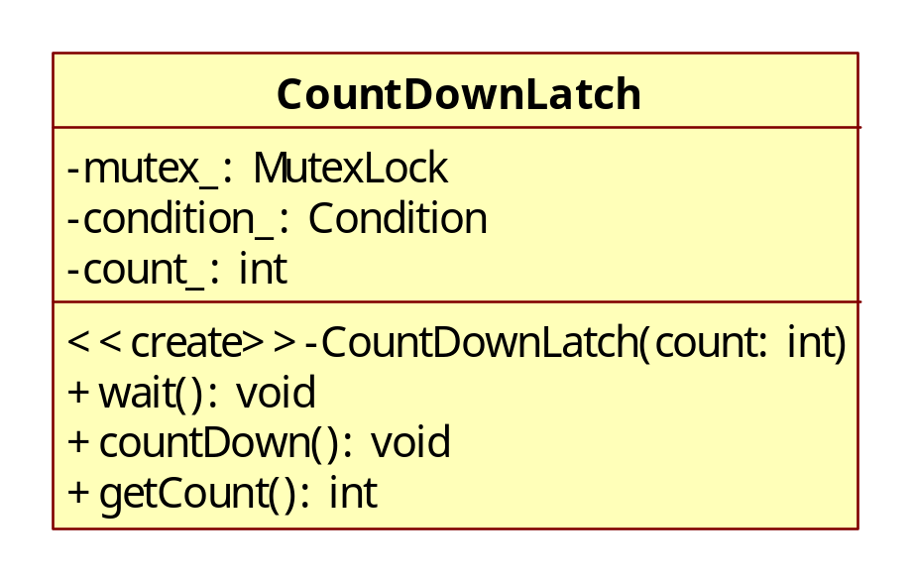
CountDownLatch类图
既可以用于所有子线程等待主线程发起 “起跑”
也可以用于主线程等待子线程初始化完毕才开始工作

