Slide 1
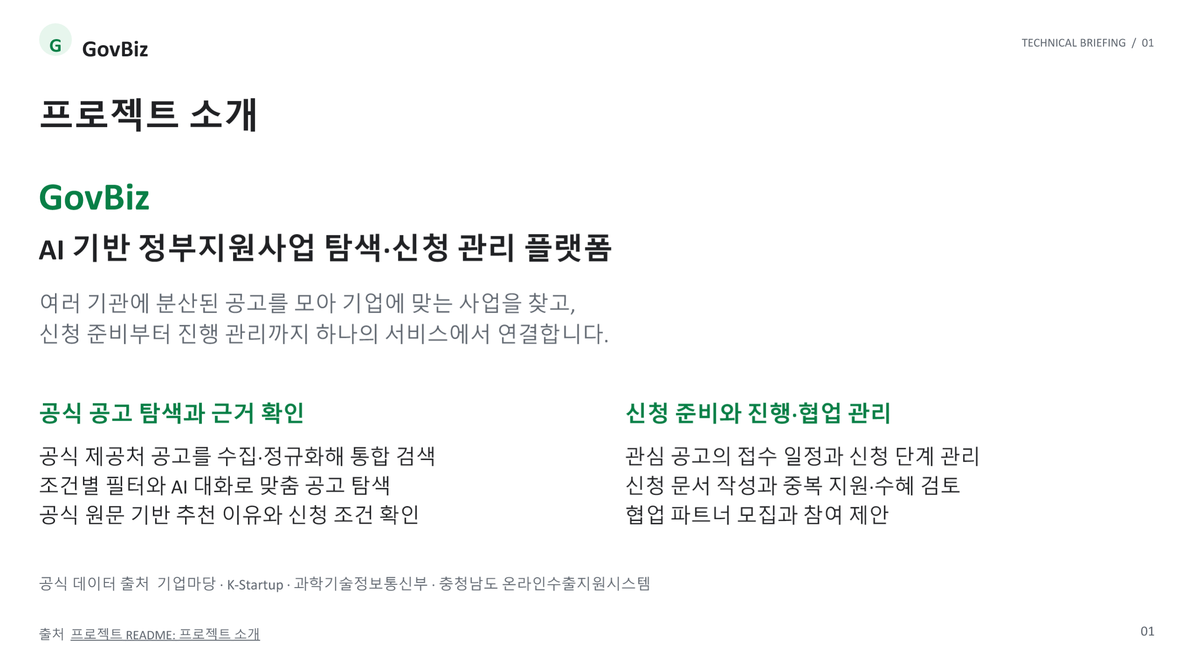
Notes:
프로젝트 소개
출처
https://github.com/SKNETWORKS-FAMILY-AICAMP/SKN34-3rd-1Team/blob/main/README.md#-프로젝트-소개

Slide 2
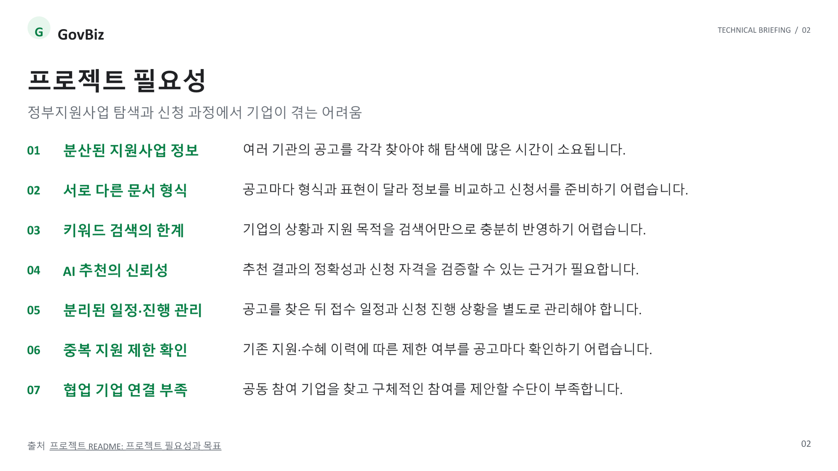
Notes:
프로젝트 필요성
출처
https://github.com/SKNETWORKS-FAMILY-AICAMP/SKN34-3rd-1Team/blob/main/README.md#-프로젝트-필요성과-목표

Slide 3
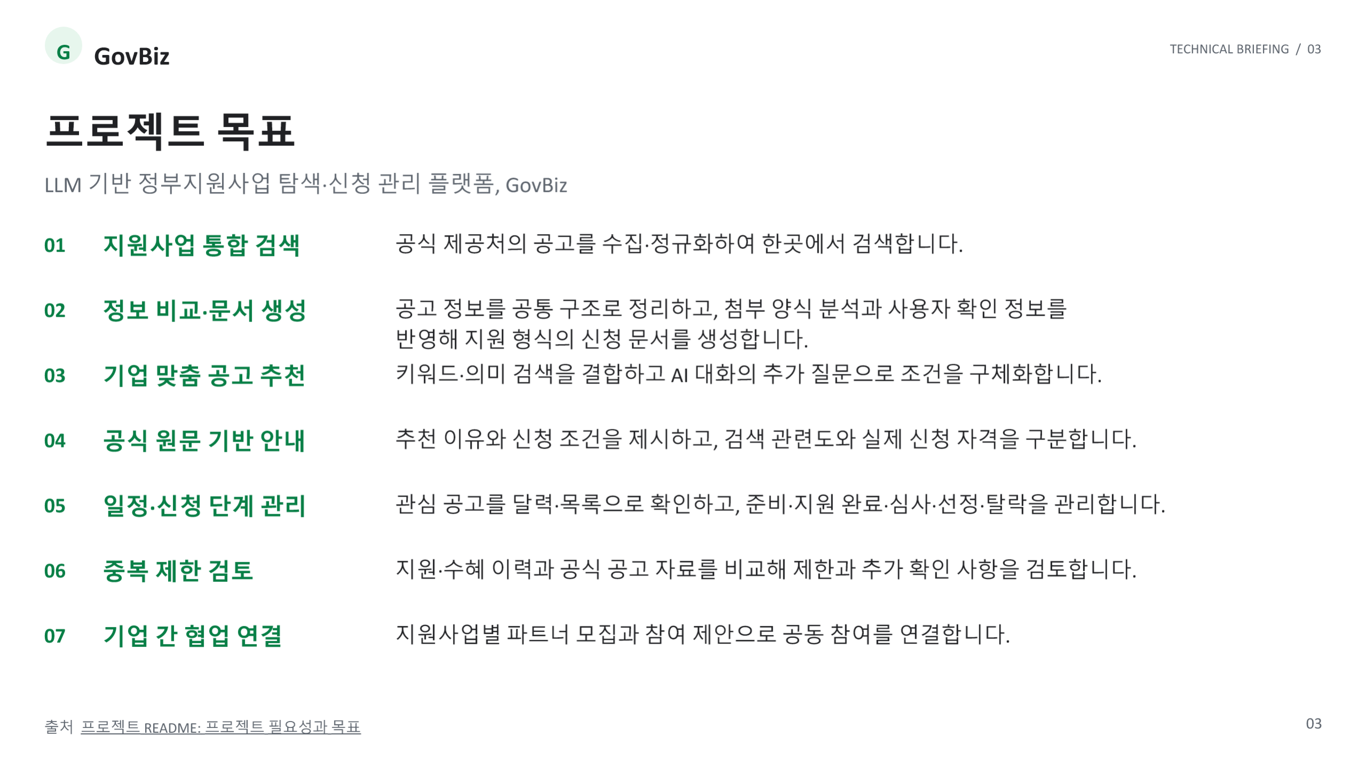
Notes:
프로젝트 목표
출처
https://github.com/SKNETWORKS-FAMILY-AICAMP/SKN34-3rd-1Team/blob/main/README.md#-프로젝트-필요성과-목표

Slide 4
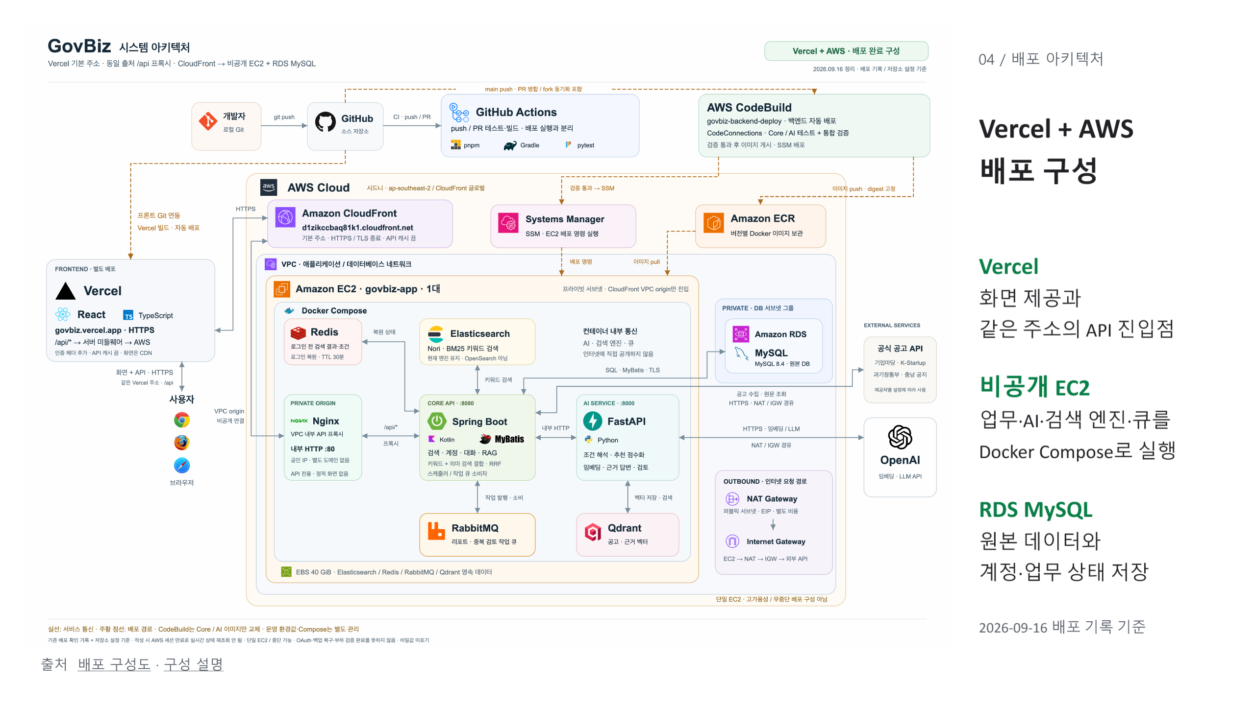
Notes:
GovBiz Vercel + AWS 배포 구성
출처
https://github.com/SKNETWORKS-FAMILY-AICAMP/SKN34-3rd-1Team/blob/main/docs/assets/architecture/govbiz-aws-architecture-deployed.png
https://github.com/SKNETWORKS-FAMILY-AICAMP/SKN34-3rd-1Team/blob/main/docs/assets/architecture/README-aws-deployed.md

Slide 5
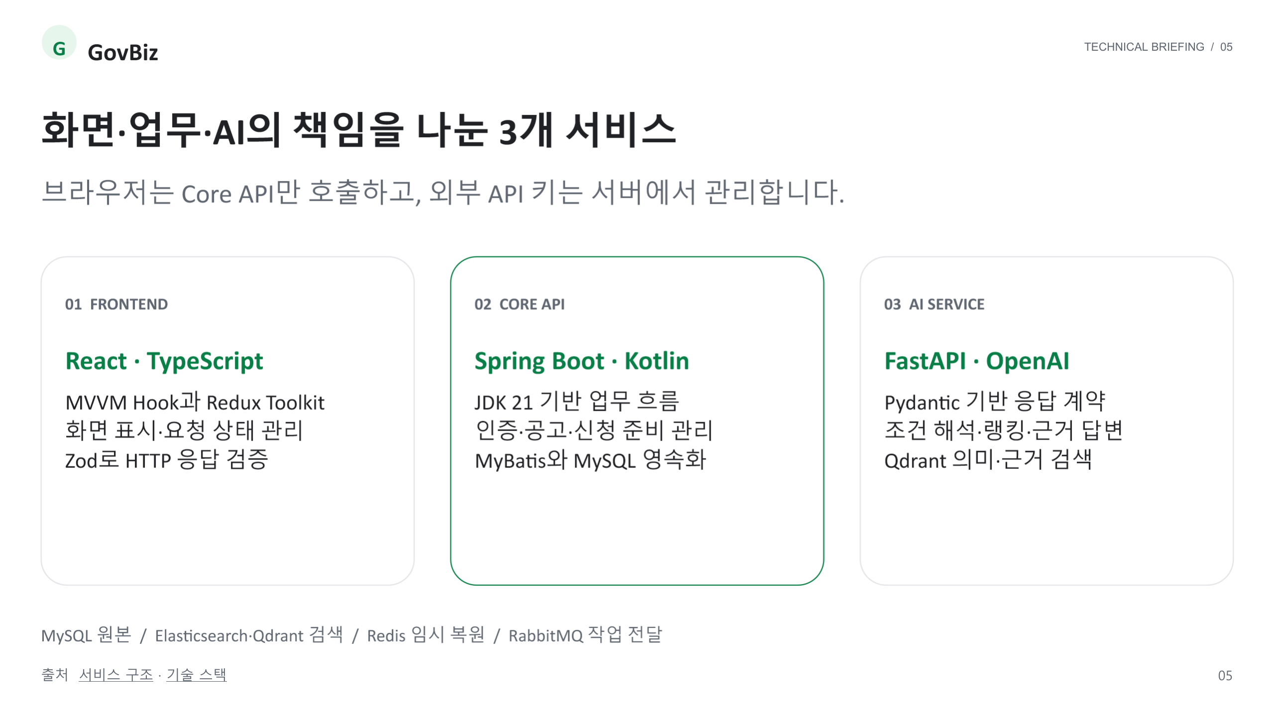
Notes:
화면·업무·AI의 책임을 나눈 3개 서비스
출처
https://github.com/SKNETWORKS-FAMILY-AICAMP/SKN34-3rd-1Team/blob/main/docs/architecture/README.md
https://github.com/SKNETWORKS-FAMILY-AICAMP/SKN34-3rd-1Team/blob/main/docs/technology.md

Slide 6
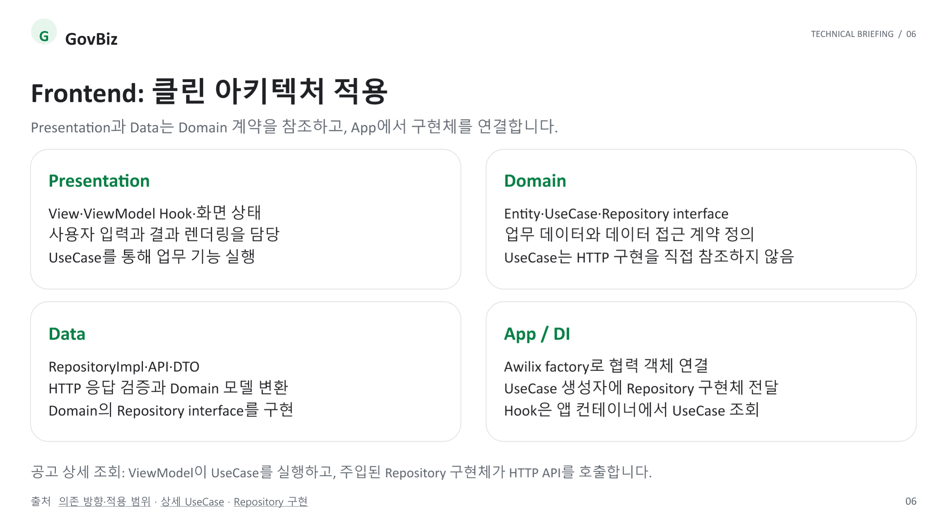
Notes:
Frontend: 클린 아키텍처 적용
출처
https://github.com/SKNETWORKS-FAMILY-AICAMP/SKN34-3rd-1Team/blob/main/docs/architecture/README.md#클린-아키텍처의-의존-방향
https://github.com/SKNETWORKS-FAMILY-AICAMP/SKN34-3rd-1Team/blob/main/frontend/src/domain/usecases/GetSupportProgramDetailUseCase.ts
https://github.com/SKNETWORKS-FAMILY-AICAMP/SKN34-3rd-1Team/blob/main/frontend/src/data/repositories/SupportProgramRepositoryImpl.ts

Slide 7
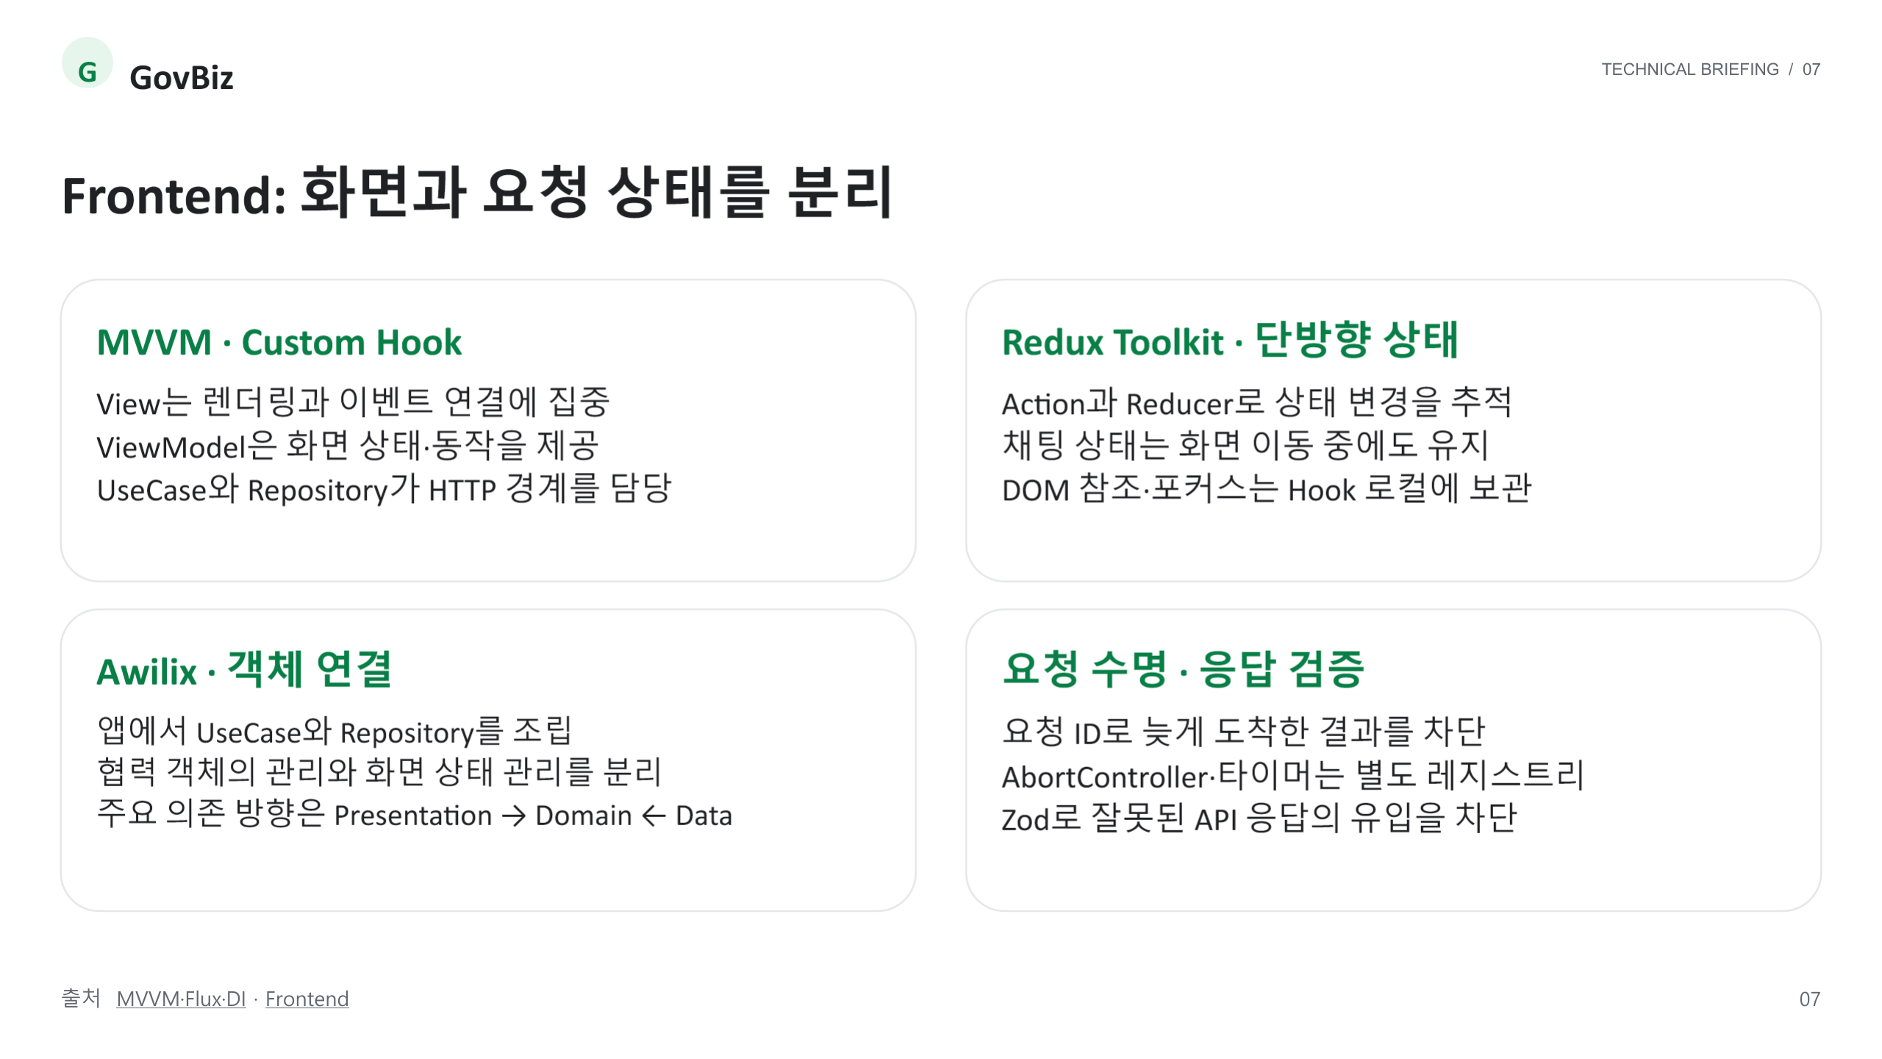
Notes:
Frontend: 화면과 요청 상태를 분리
출처
https://github.com/SKNETWORKS-FAMILY-AICAMP/SKN34-3rd-1Team/blob/main/docs/architecture/README.md
https://github.com/SKNETWORKS-FAMILY-AICAMP/SKN34-3rd-1Team/blob/main/frontend/README.md

Slide 8
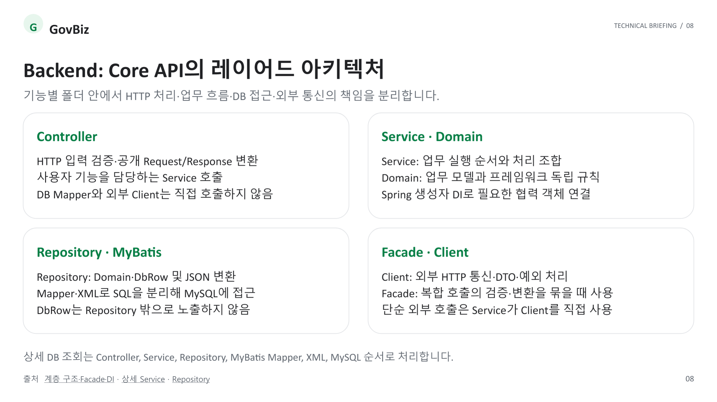
Notes:
Backend: Core API의 레이어드 아키텍처
출처
https://github.com/SKNETWORKS-FAMILY-AICAMP/SKN34-3rd-1Team/blob/main/docs/architecture/README.md#기능-중심-레이어드-아키텍처
https://github.com/SKNETWORKS-FAMILY-AICAMP/SKN34-3rd-1Team/blob/main/backend/core-api/src/main/kotlin/ai/govbiz/core/supportprogram/service/detail/SupportProgramDetailService.kt
https://github.com/SKNETWORKS-FAMILY-AICAMP/SKN34-3rd-1Team/blob/main/backend/core-api/src/main/kotlin/ai/govbiz/core/supportprogram/repository/SupportProgramRepository.kt

Slide 9
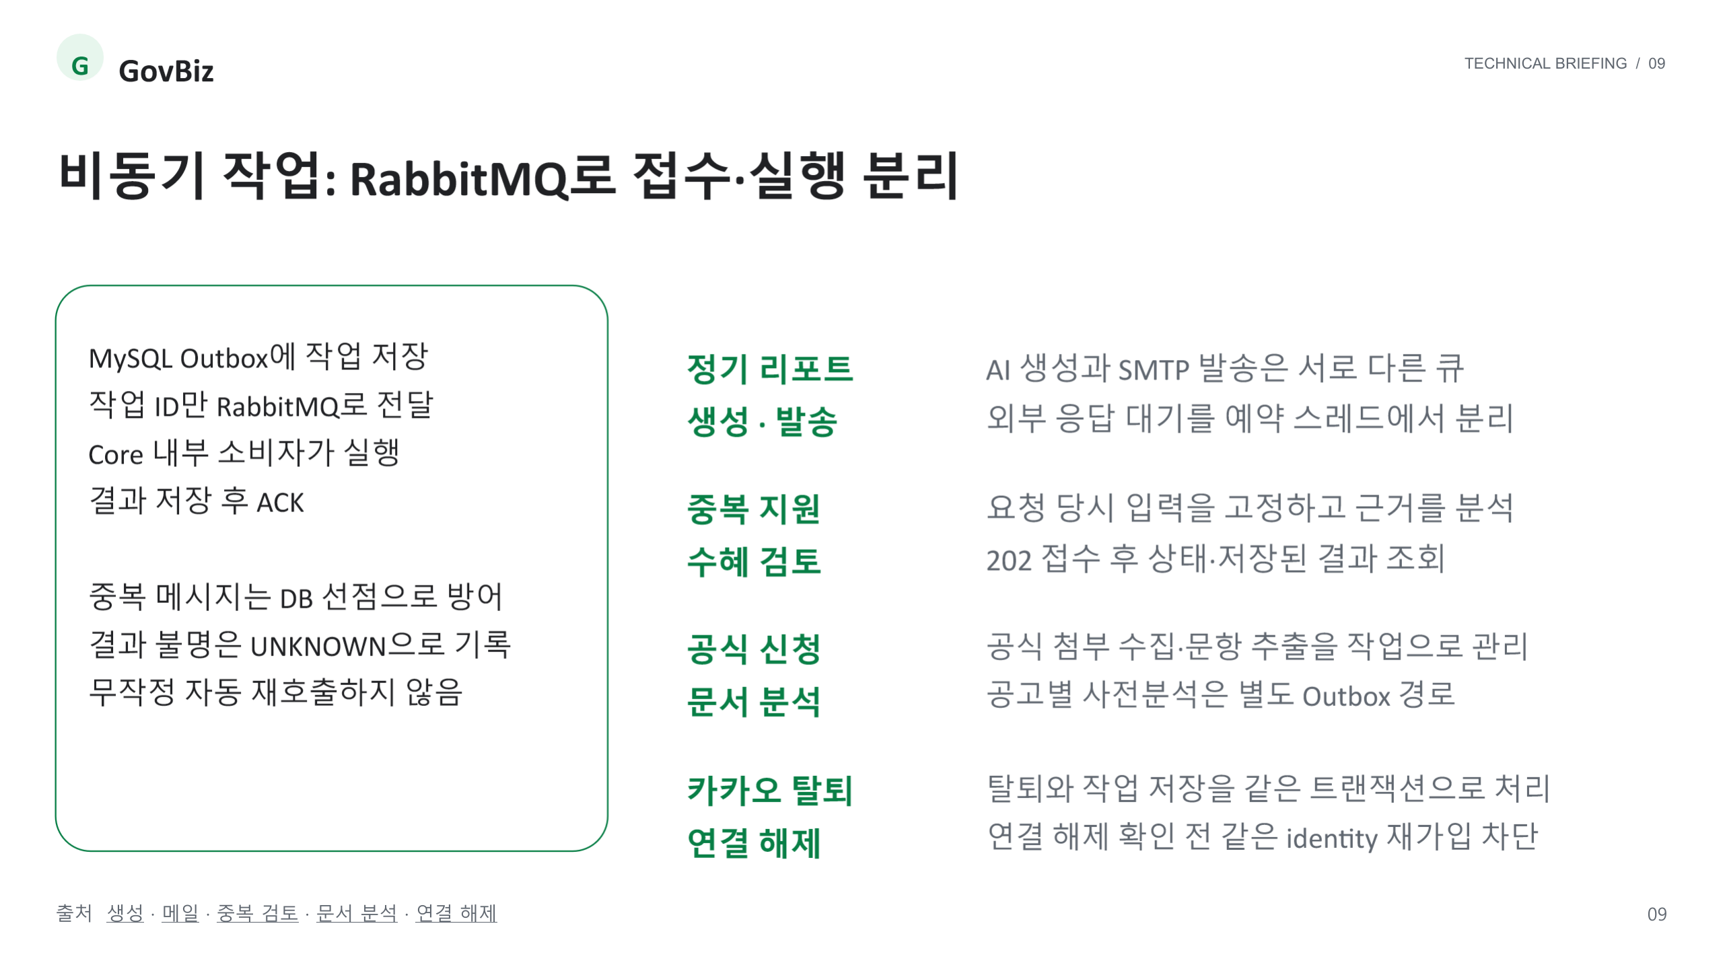
Notes:
비동기 작업: RabbitMQ로 접수·실행 분리
출처
https://github.com/SKNETWORKS-FAMILY-AICAMP/SKN34-3rd-1Team/blob/main/docs/rabbitmq-daily-report-generation.md
https://github.com/SKNETWORKS-FAMILY-AICAMP/SKN34-3rd-1Team/blob/main/docs/rabbitmq-daily-report-delivery.md
https://github.com/SKNETWORKS-FAMILY-AICAMP/SKN34-3rd-1Team/blob/main/docs/rabbitmq-combination-review.md
https://github.com/SKNETWORKS-FAMILY-AICAMP/SKN34-3rd-1Team/blob/main/docs/rabbitmq-application-form-discovery.md
https://github.com/SKNETWORKS-FAMILY-AICAMP/SKN34-3rd-1Team/blob/main/docs/rabbitmq-account-oauth-unlink.md

Slide 10
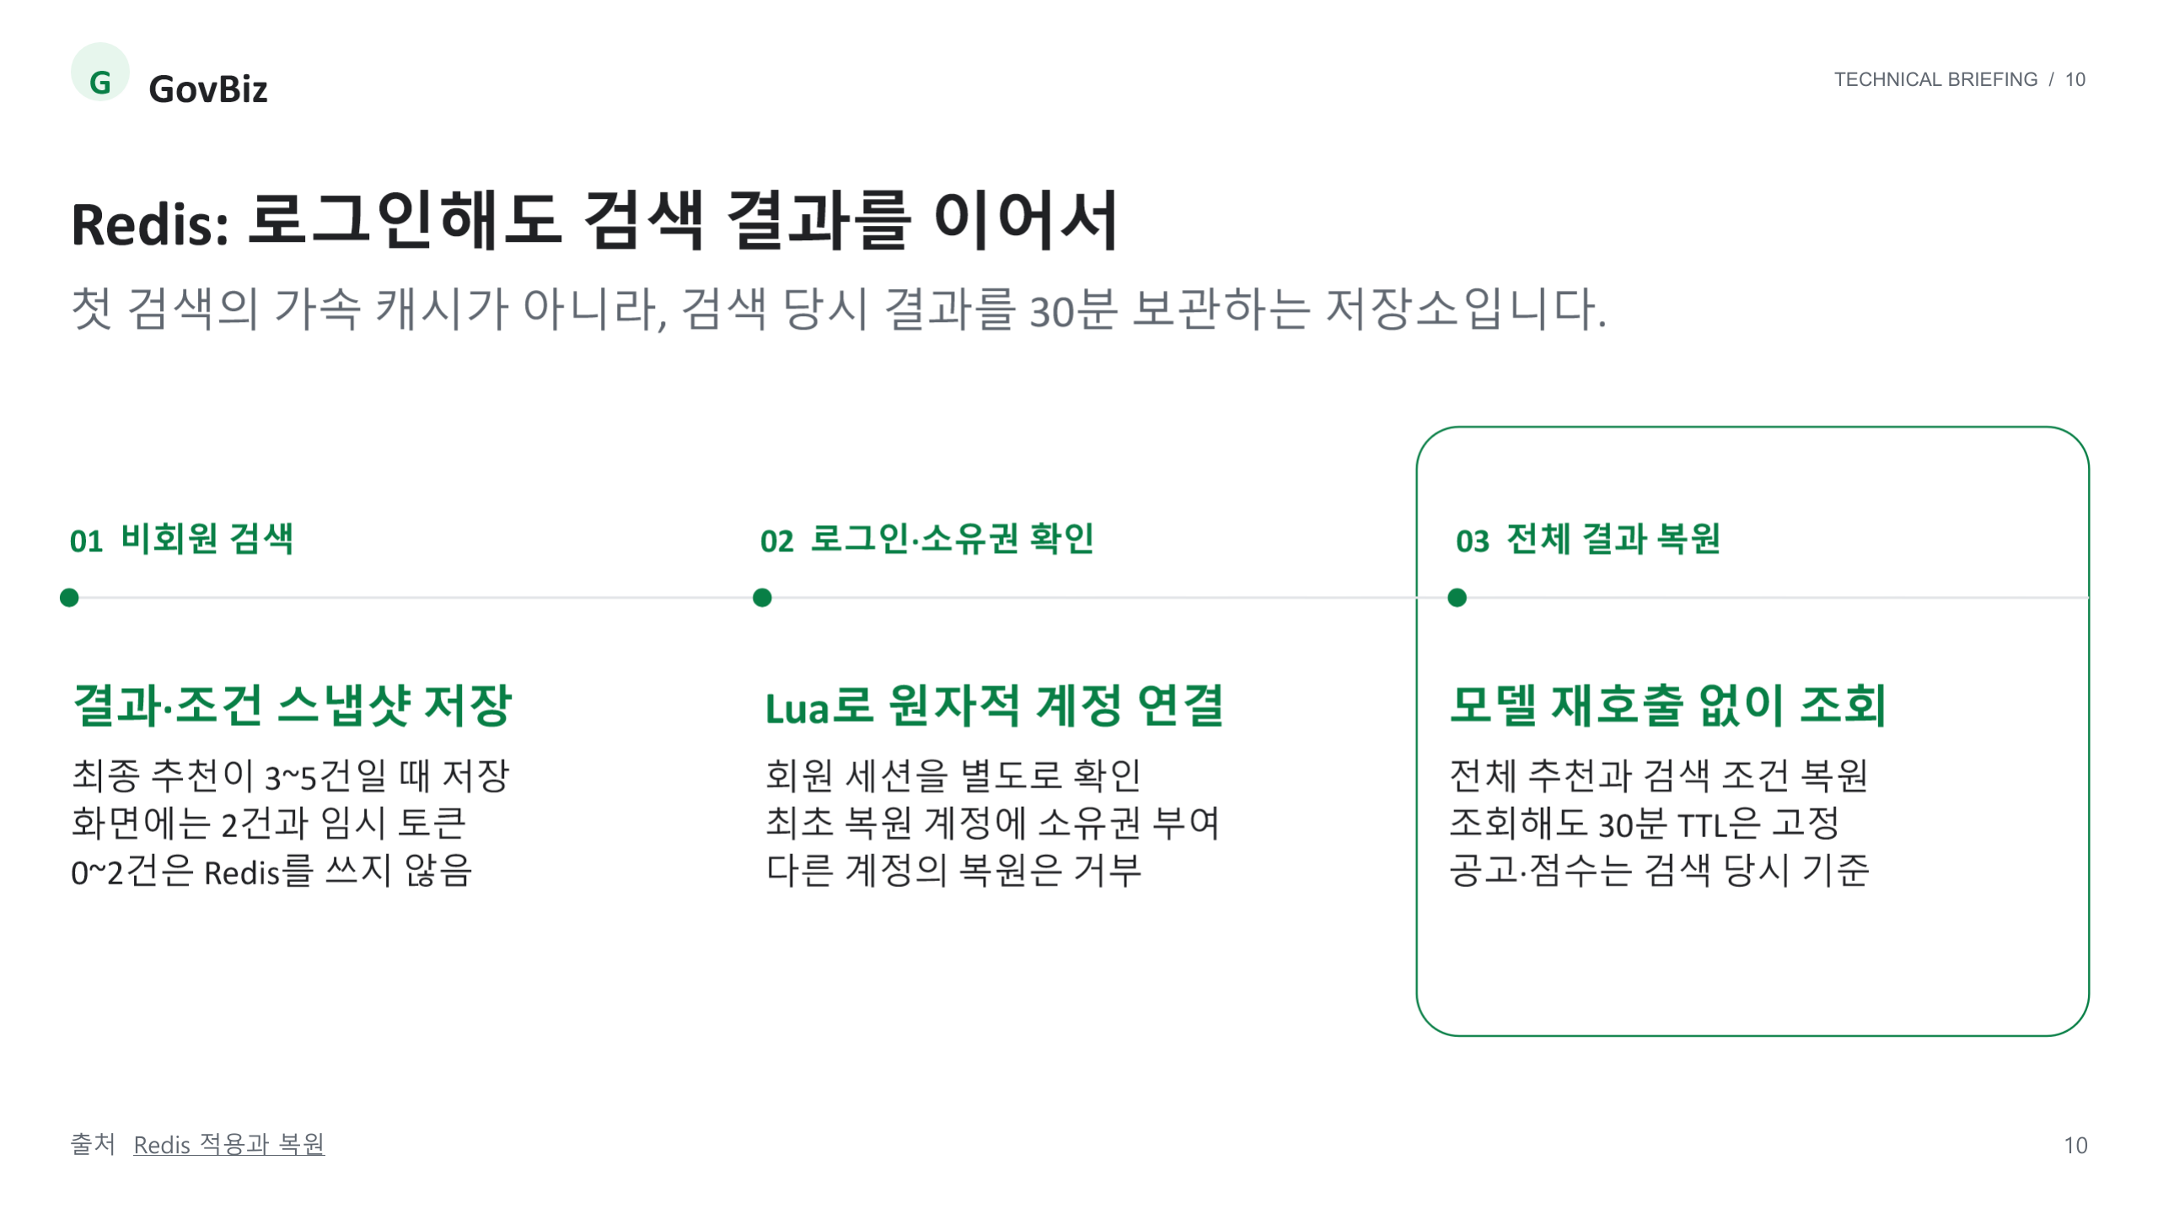
Notes:
Redis: 로그인해도 검색 결과를 이어서
출처
https://github.com/SKNETWORKS-FAMILY-AICAMP/SKN34-3rd-1Team/blob/main/docs/redis-search-result-restoration.md

Slide 11
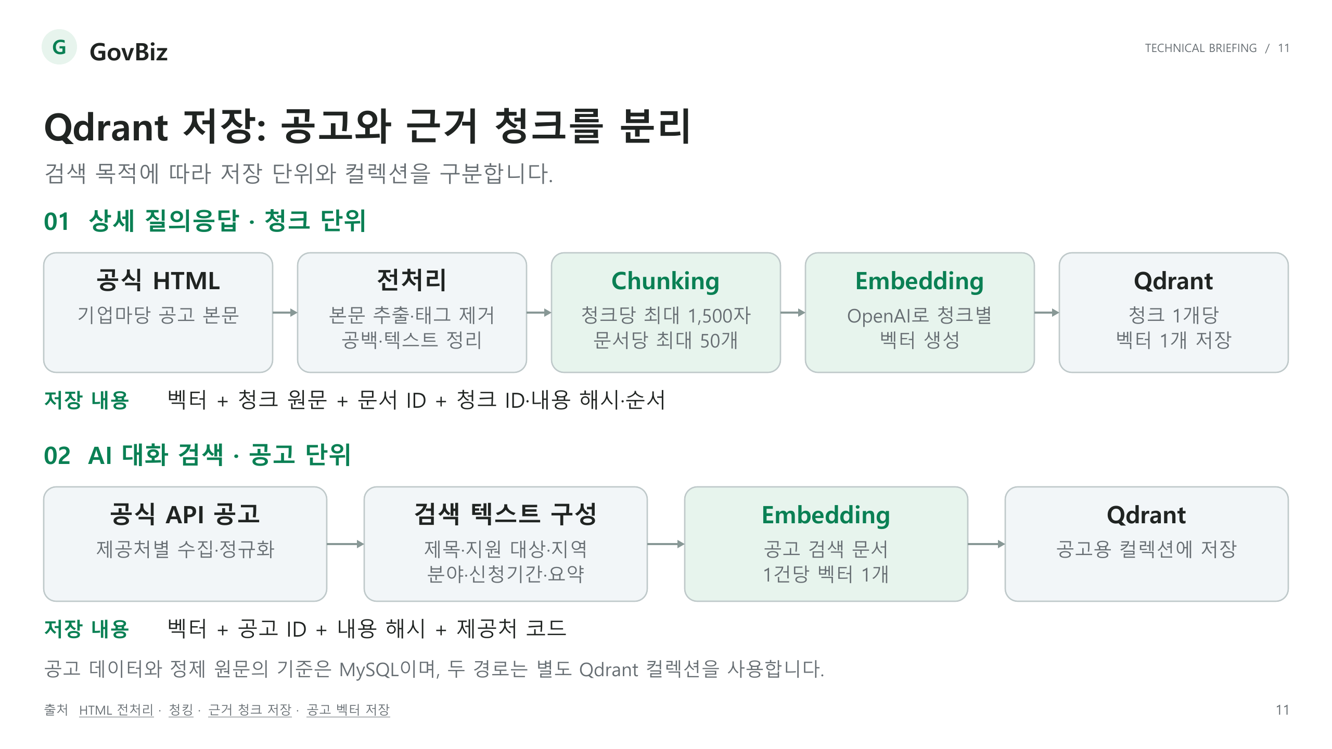
Notes:
Qdrant 저장: 공고와 근거 청크를 분리
출처
https://github.com/SKNETWORKS-FAMILY-AICAMP/SKN34-3rd-1Team/blob/main/backend/core-api/src/main/kotlin/ai/govbiz/core/supportprogram/client/bizinfo/mapper/BizInfoSourceDocumentMapper.kt
https://github.com/SKNETWORKS-FAMILY-AICAMP/SKN34-3rd-1Team/blob/main/backend/core-api/src/main/kotlin/ai/govbiz/core/supportprogram/service/evidence/SupportProgramEvidenceChunker.kt
https://github.com/SKNETWORKS-FAMILY-AICAMP/SKN34-3rd-1Team/blob/main/backend/ai-service/app/support_program_evidence/service.py
https://github.com/SKNETWORKS-FAMILY-AICAMP/SKN34-3rd-1Team/blob/main/backend/ai-service/app/support_program_index/service.py

Slide 12
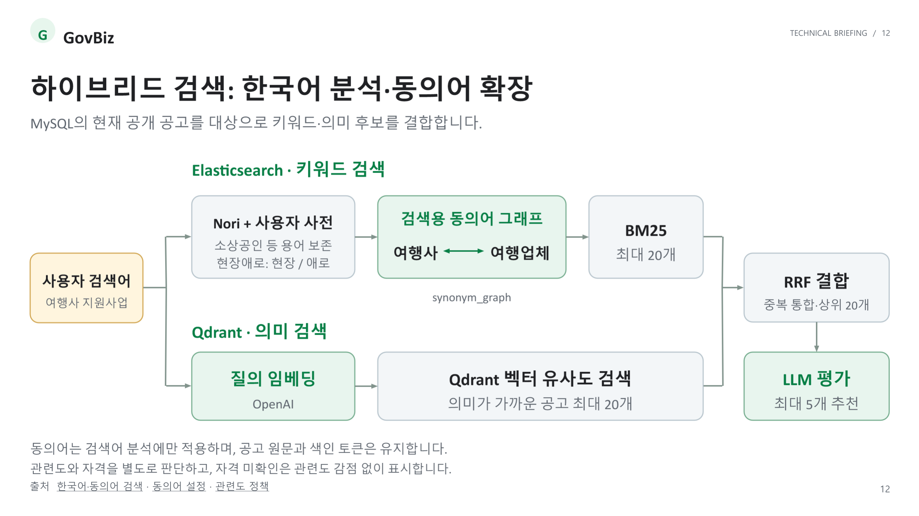
Notes:
하이브리드 검색: 한국어 분석·동의어 확장
출처
https://github.com/SKNETWORKS-FAMILY-AICAMP/SKN34-3rd-1Team/blob/main/docs/elasticsearch-lexical-search.md
https://github.com/SKNETWORKS-FAMILY-AICAMP/SKN34-3rd-1Team/blob/main/backend/core-api/src/main/resources/elasticsearch/support-program-lexical-v2.json
https://github.com/SKNETWORKS-FAMILY-AICAMP/SKN34-3rd-1Team/blob/main/docs/search-relevance-v5-fix.md

Slide 13
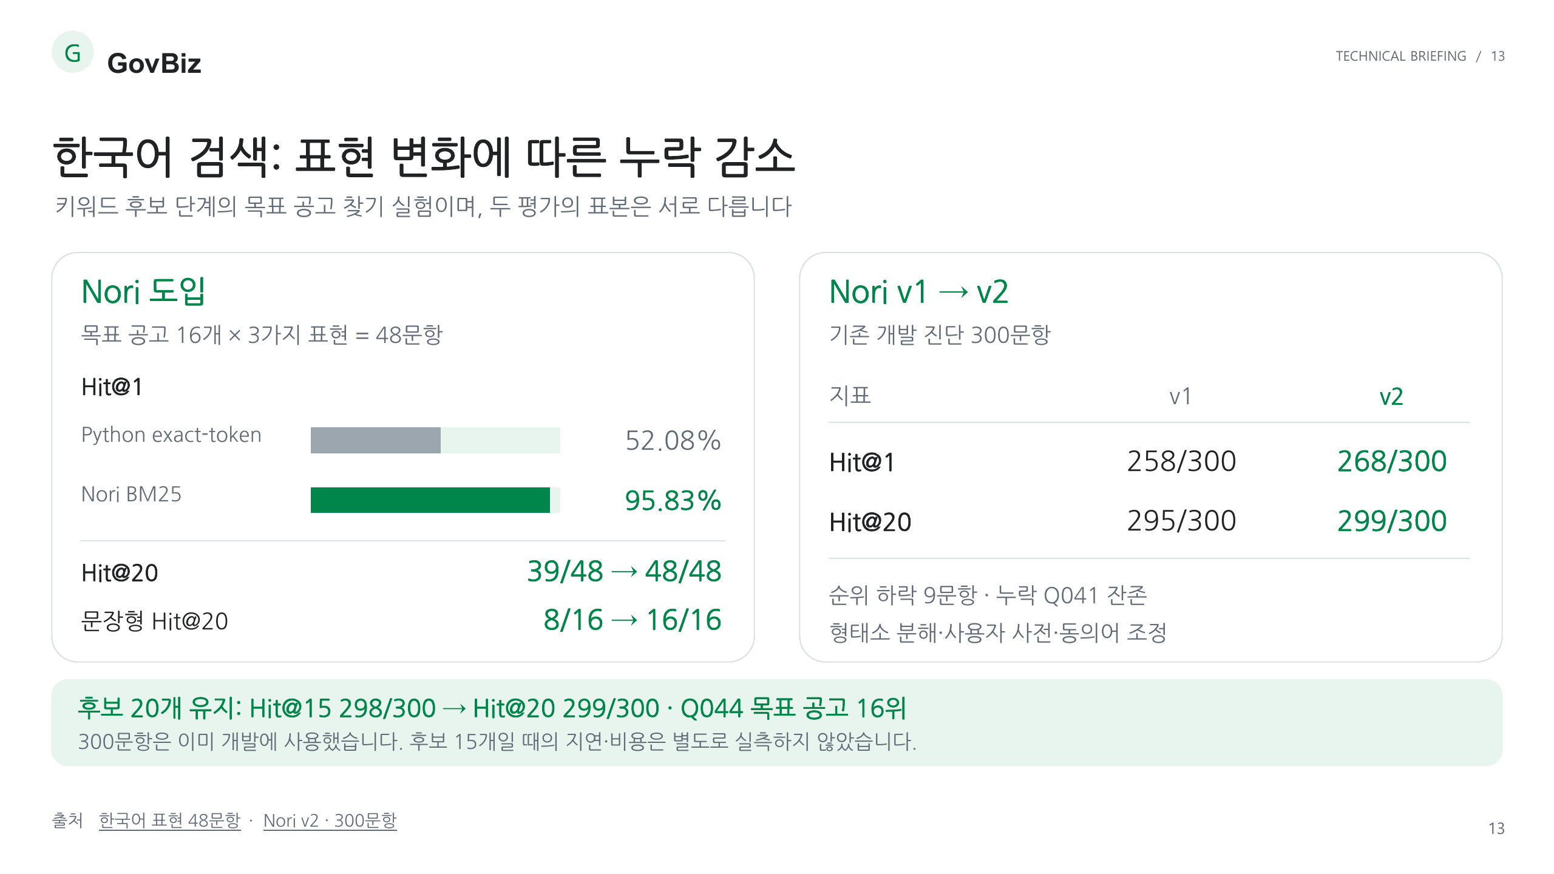
Notes:
한국어 검색: 표현 변화에 따른 누락 감소
출처
https://github.com/ilil1/SKN34-3rd-1Team/blob/acd4b8a6c38ca87c09e29960218561136c1fe505/evaluation/support-program-search/runs/elasticsearch-korean-queries-20260912-v1/README.md
https://github.com/ilil1/SKN34-3rd-1Team/blob/acd4b8a6c38ca87c09e29960218561136c1fe505/evaluation/support-program-search/runs/lexical-v2-20260913-v1/README.md

Slide 14
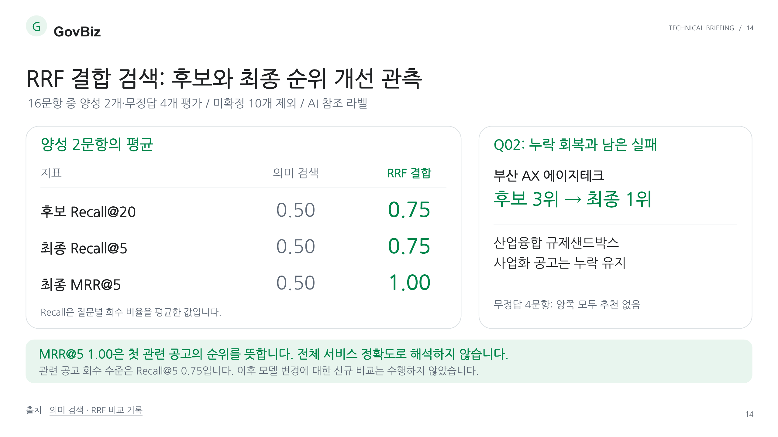
Notes:
RRF 결합 검색: 후보와 최종 순위 개선 관측
출처
https://github.com/ilil1/SKN34-3rd-1Team/blob/acd4b8a6c38ca87c09e29960218561136c1fe505/evaluation/support-program-search/runs/support-program-catalog-20260906-v1/stage4-v1/README.md

Slide 15
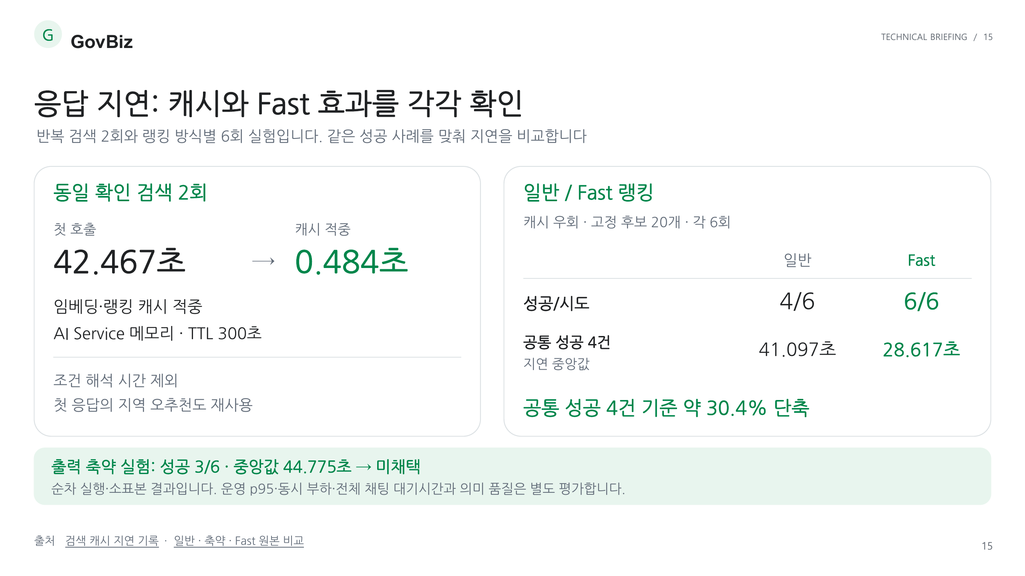
Notes:
응답 지연: 캐시와 Fast 효과를 각각 확인
출처
https://github.com/ilil1/SKN34-3rd-1Team/blob/acd4b8a6c38ca87c09e29960218561136c1fe505/docs/search-latency-20260908.md
https://github.com/ilil1/SKN34-3rd-1Team/blob/acd4b8a6c38ca87c09e29960218561136c1fe505/evaluation/support-program-search/runs/search-latency-20260908-v1/report.json

Slide 16
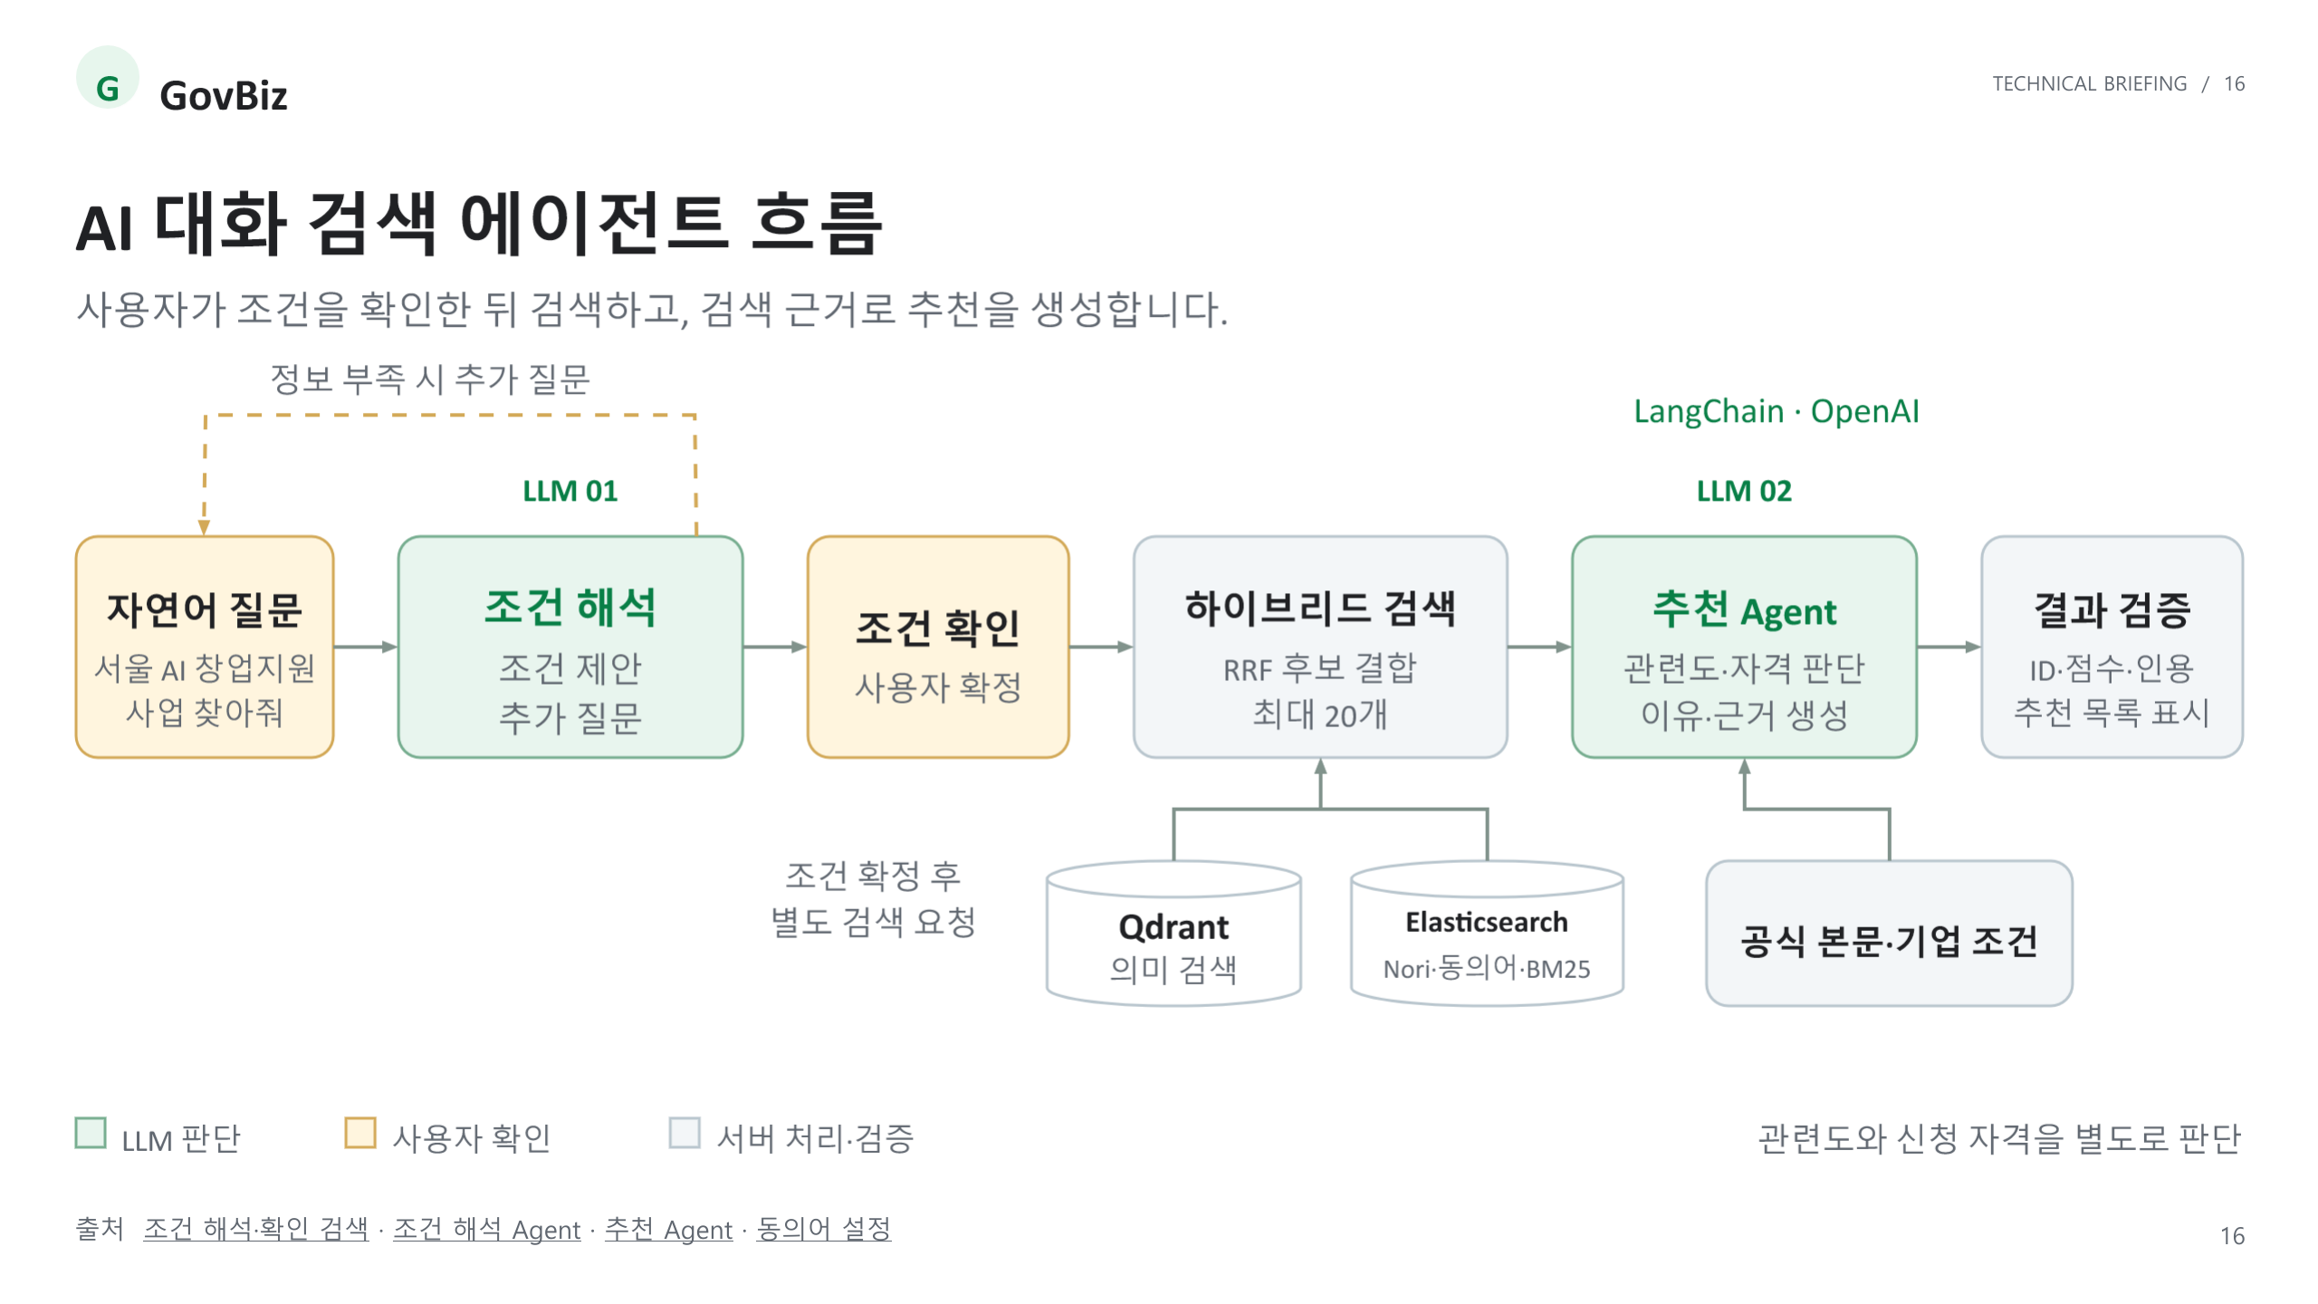
Notes:
AI 대화 검색 에이전트 흐름
출처
https://github.com/SKNETWORKS-FAMILY-AICAMP/SKN34-3rd-1Team/blob/main/docs/architecture.md#후속-대화의-조건-변경-해석
https://github.com/SKNETWORKS-FAMILY-AICAMP/SKN34-3rd-1Team/blob/main/backend/ai-service/app/support_program_conversation/agent.py
https://github.com/SKNETWORKS-FAMILY-AICAMP/SKN34-3rd-1Team/blob/main/backend/ai-service/app/support_program_ranking/agent.py
https://github.com/SKNETWORKS-FAMILY-AICAMP/SKN34-3rd-1Team/blob/main/backend/core-api/src/main/resources/elasticsearch/support-program-lexical-v2.json

Slide 17
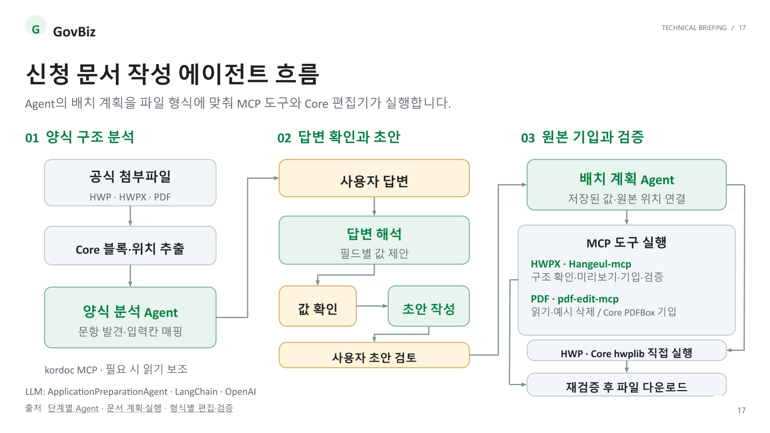
Notes:
신청 문서 작성 에이전트 흐름
출처
https://github.com/SKNETWORKS-FAMILY-AICAMP/SKN34-3rd-1Team/blob/main/backend/ai-service/app/application_preparation/agent.py
https://github.com/SKNETWORKS-FAMILY-AICAMP/SKN34-3rd-1Team/blob/main/backend/ai-service/app/application_preparation/document_pipeline.py
https://github.com/SKNETWORKS-FAMILY-AICAMP/SKN34-3rd-1Team/blob/main/docs/application-document-mcp-architecture.md

Slide 18
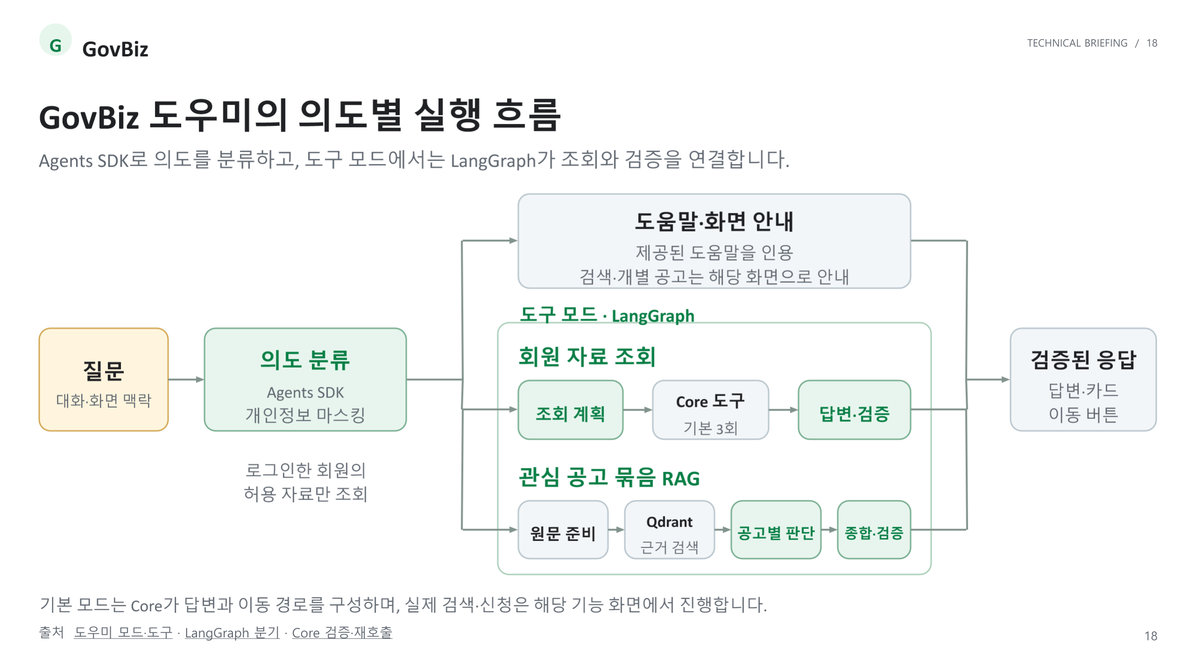
Notes:
GovBiz 도우미의 의도별 실행 흐름
출처
https://github.com/SKNETWORKS-FAMILY-AICAMP/SKN34-3rd-1Team/blob/main/backend/ai-service/README.md#도우미-도구-에이전트-langgraph
https://github.com/SKNETWORKS-FAMILY-AICAMP/SKN34-3rd-1Team/blob/main/backend/ai-service/app/assistant_agent/graph.py
https://github.com/SKNETWORKS-FAMILY-AICAMP/SKN34-3rd-1Team/blob/main/backend/core-api/src/main/kotlin/ai/govbiz/core/assistant/service/AssistantMessageService.kt

