Slide 1
LHS Data Analysis
Capstone project
August 8, 2025

Slide 2
Contents
Problem Overview
Key Findings
Data Inconsistencies and Quality Issues
Future Analysis
Conclusion

Slide 3
Problem overview
For an individual considering a career change in the later stages of their working years, it’s important to be able to clearly analyze salary ranges, including the amount of seniority and/or experience required to reach that salary threshold. In addition, having a good understanding of the demand for certain skills and/or job titles is key to effective decision making.
Unfortunately, public salary and job information for the tech industry is difficult to navigate. Job titles are inconsistent and seniority/experience level impacts on earning potential are not clearly defined. In addition, one must consider company size, mission, vision, and culture to determine what the best fit for both income and career satisfaction.
This project addresses these challenges by analyzing two datasets - one with salary information and the other with machine learning job postings. After cleaning and normalizing the data, the datasets were joined, and I was able to see clear data-driven insights into salary trends and how seniority level and company size vel.

Slide 4
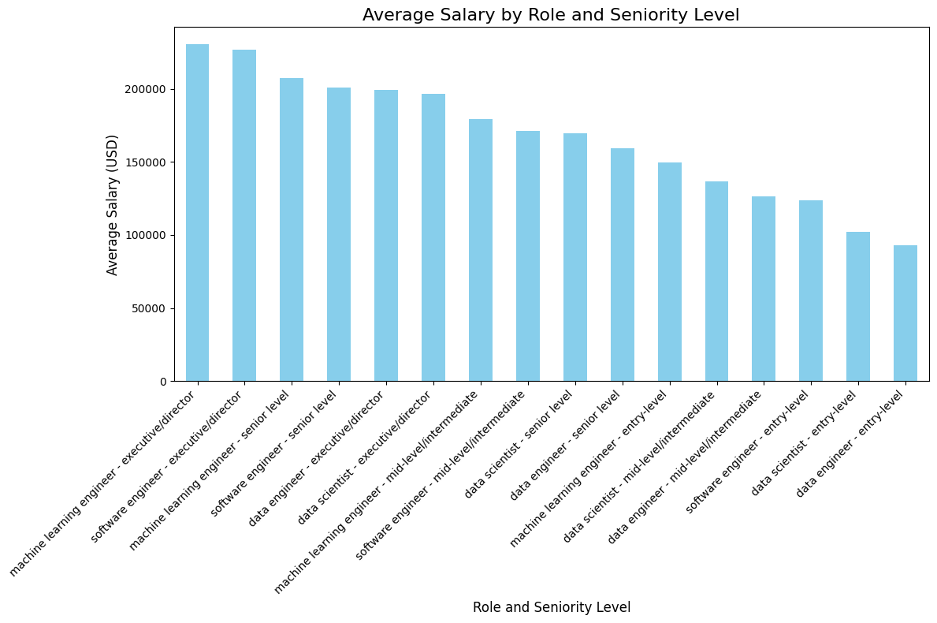
Key Finding #1
Highest Paying Roles:
Machine Learning Engineer -
Executive/Director
Senior Level
Software Engineer –
Executive/Director
Senior Level

Slide 5
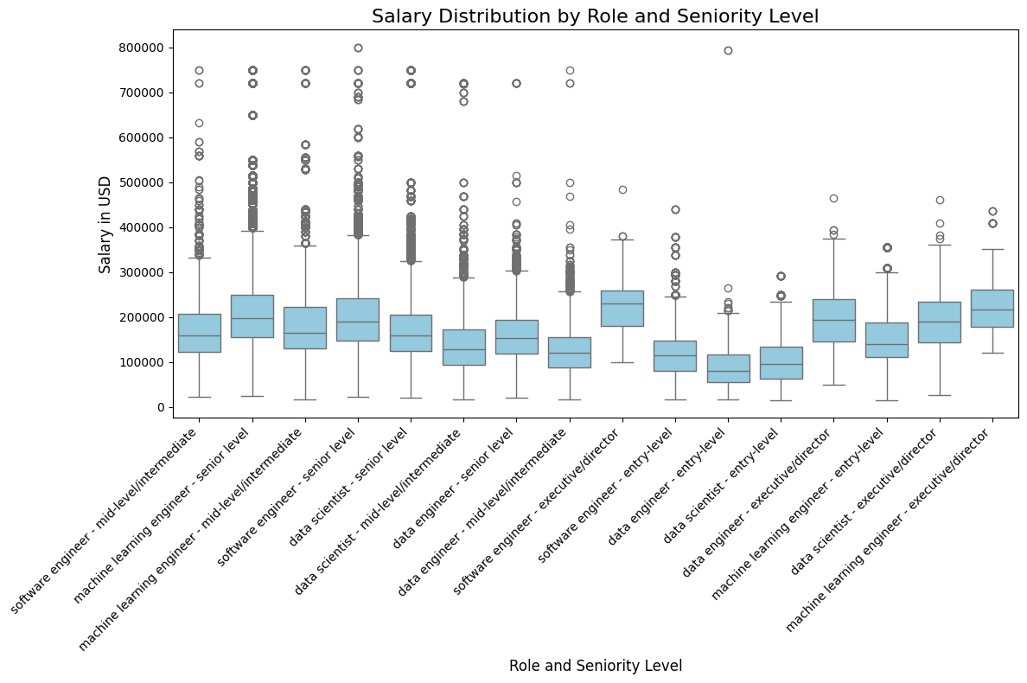
Key Finding #2
Senior level roles have wider salary ranges and greater variability, while entry level positions have lower, more consistent pay with narrower ranges.
High paying outliers are especially visible for Machine Learning Engineer and Software Engineer roles.

Slide 6
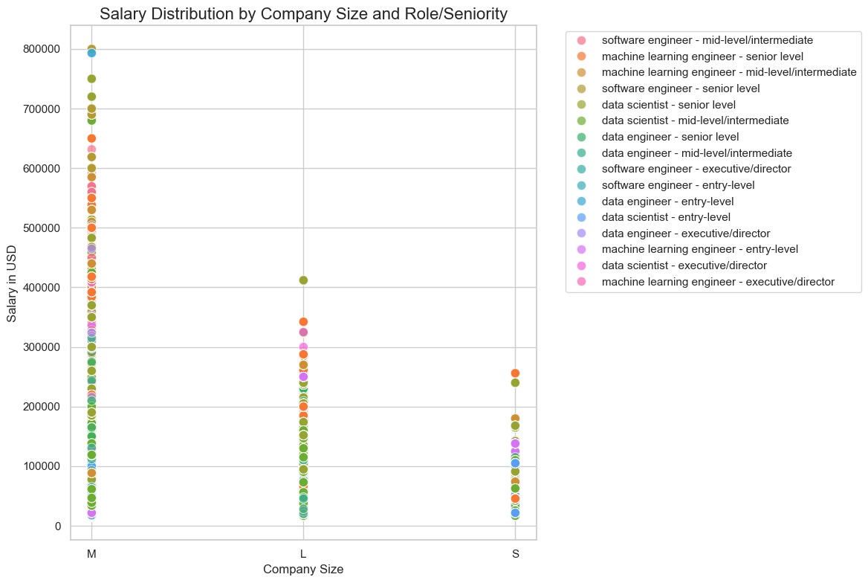
Key Finding #3
Salaries vary across company sizes, with medium-sized employers appearing to offer the highest pay for most roles.
Machine Learning Engineer and Software Engineer roles top the earnings charts across companies of all size.

Slide 7
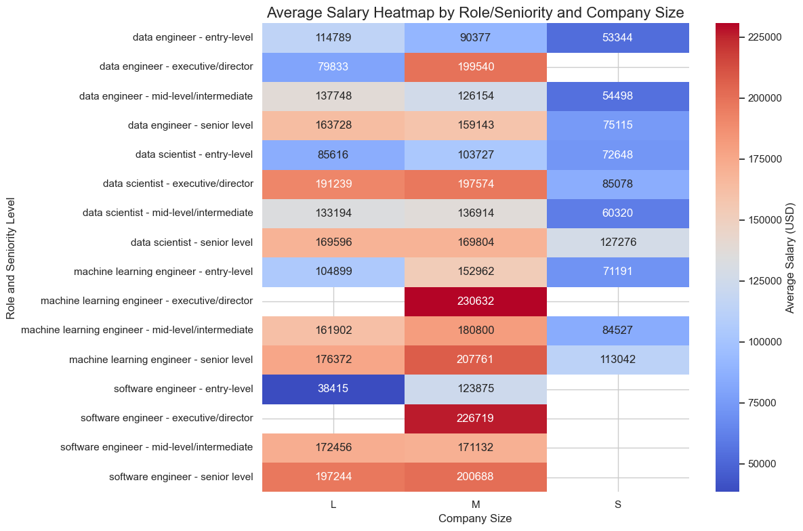
To the right is an additional visualization, Heatmap, showing key finding #3 stated in previous slide.

Slide 8
Data Inconsistencies/quality issues
Job titles varied significantly and required significant normalizing to be able to compare effectively.
Seniority land experience levels were not consistently used, so these had to be standardized. These levels were not defined by number of years of experience or service in the role.
Of the Salaries dataset, 97.22% were reported as employed in a medium-sized company, 2.63% were employee by a large company and .15% were employed at a small company. The very small sample sizes from the small and large employers could lend to less reliable averages. This is a limitation to the data and future analysis should include a more balanced dataset to more accurately compare average salaries across company sizes.

Slide 9
Future Analysis
Other possibilities for future analysis include:
- Salary comparison by % of remote work
- % of job postings by state
- Most frequently used "keywords" in job descriptions
- Using company description, categorize employer by type and compare salaries accordingly

Slide 10
Conclusion
This analysis highlights attractive earnings potential in the tech industry and a strong market demand for these skills.
As someone considering a change in the later stages of their career, the data encouraged me to continue efforts to increase my knowledge and continue to gain skills required for jobs in the tech industry.

Slide 11
THANK YOU
Lisa H. Smith
606-767-1876
aprojectoflove@gmail.com

