Slide 1
Automatic Dog Feeder 🐾
Lucas Santos
CSC-5201 Microservices and Cloud Computing
Milwaukee School of Engineering

Slide 2
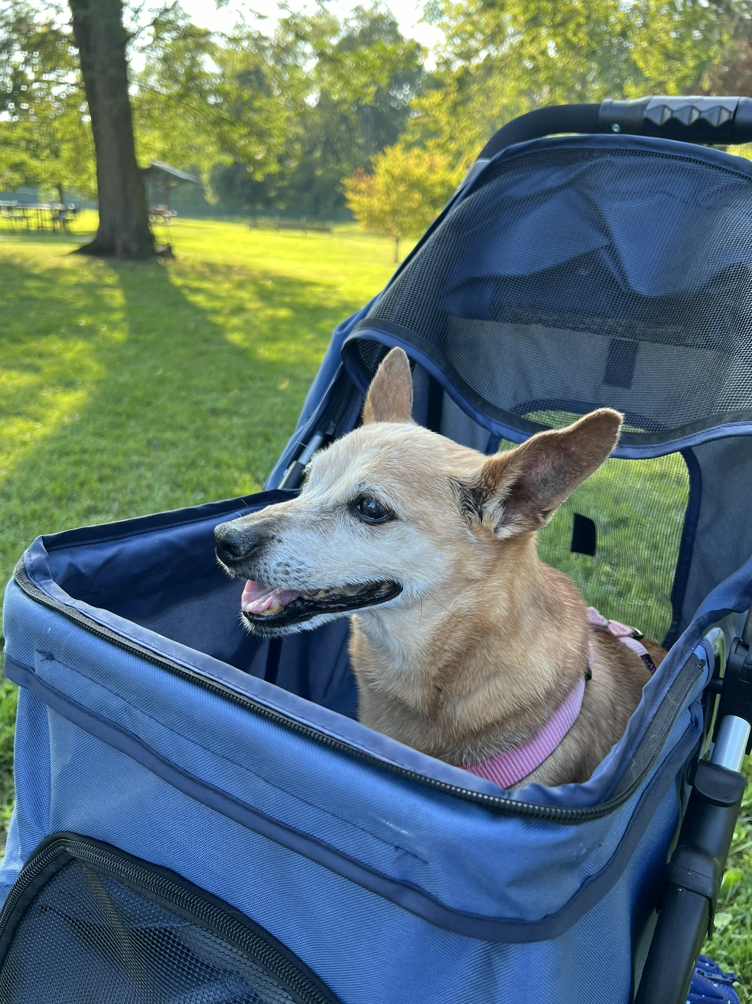
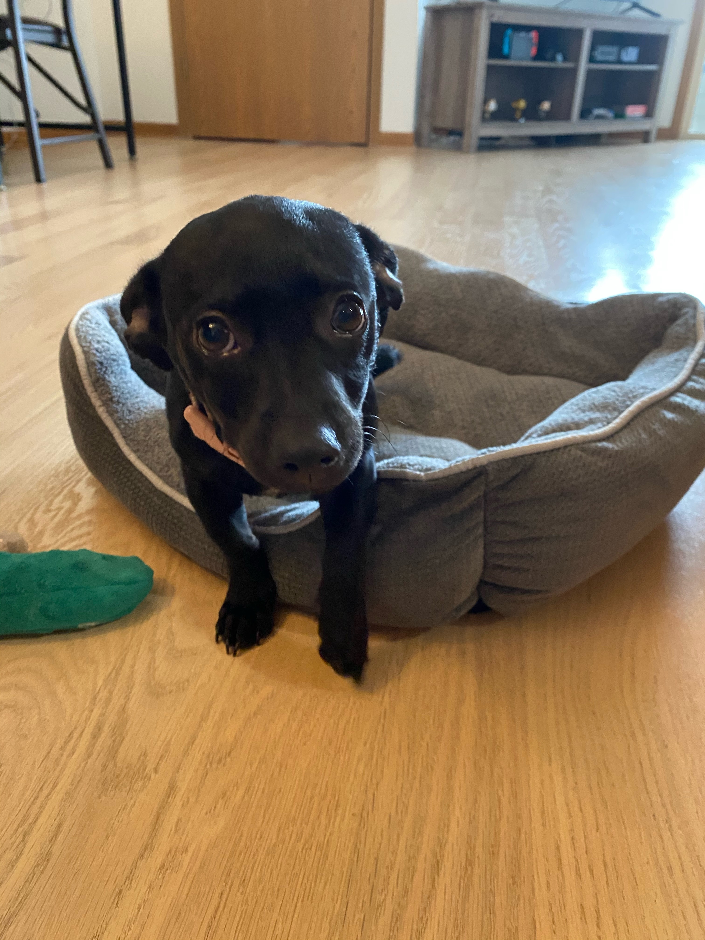
Motivation
Name: Mia
Age: 17
Occupation: Senior Freeloader
Name: Leia
Age: 4
Occupation: Noise Pollution Specialist

Slide 3
Project Overview
Dispense dog treats remotely via the web and Arduino cloud
Adjustable Fedding Amount
Buzzer to let the dogs know about incoming treats
Log feeding times

Slide 4
Components Used
Micro-controller Arduino R4 WiFi
Small Servo motor for treat dispensing.
Buzzer to alert when treats are dispensed.
Flask application for user interaction.

Slide 5
How It Works
1. User selects treat settings through a web interface.
2. Flask server sends signals to Arduino Cloud.
3. Arduino dispenses treats based on user input (amount).
4. Feeding logs are stored in a database for tracking and displayed on the application.

Slide 6
Live Demo (Hopefully)

Slide 7
Challenges and Improvements
Arduino Cloud & Python Integration
Mechanical Design
Possibly include a vision solution to only feed one dog at a time
Make a mobile app using arduino cloud

Slide 8
Outcomes
Learned more about Python/Arduino integration
Learned more about front end development
Acquired base knowledge for future IoT projects using arduino.
Buying an automatic dog feeder on amazon is much easier but not as fun!

Slide 9
Thank You!
We hope your dog loves the Automatic Feeder!

