Slide 1
Site Flow and Page Sketch

Slide 2
Design the User Experience (UX)
Step 1: Competitive Analysis
Step 2: Sketch the competitor’s flow
Step 3: Sketch your flow

Slide 3
What’s the point?
The steps of designing the user experience allow you to get a high-level idea of:
What other people do
What you should do

Slide 4
Step 1: Competitive Analysis
Find two websites that accomplish the same goal
Compare the aesthetics, efficiency, intuitiveness
Pay attention to what they do well and what they do poorly
Keep those in mind when building your own idea

Slide 5
For example...
Tip: Answer for bumps!!!
To answer “How should I watch TV shows?”, you could compare Hulu and Netflix
Which one is prettier?
Which one makes more sense to you?
How easy is it to navigate to a specific show?
How easy is it to navigate to a genre of shows?

Slide 6
Step 2: Sketch a competitor’s flow
Choose the website you liked better from your competitive analysis
Sketch the “flow” of the website
Boxes represent a page of the website
(and boxes within that box represent elements on that page)
Each box should contain information about what is on that page
Arrows between boxes represent the “flow”, AKA where you click to get from one page to the next

Slide 7

Let’s try with Netflix

Slide 8
Let’s try with Netflix
Profiles
Netflix
Users
Manage profiles

Slide 9
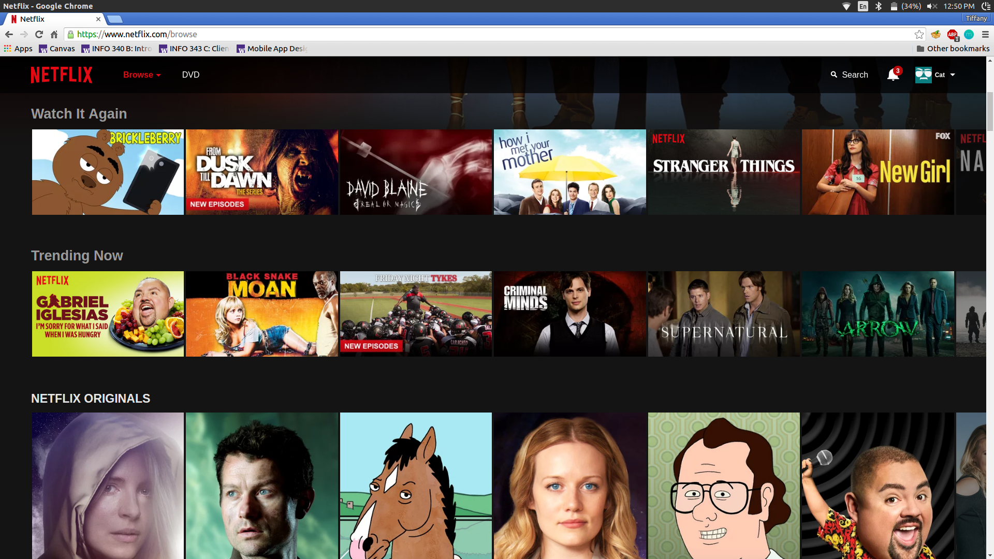

Slide 10
Home
Netflix
Browse
DVD
Search
Notifications
Users
Watch Again
Trending Now
Netflix Originals

Slide 11
Profiles
Home
Netflix
Browse
DVD
Search
Notifications
Users
Watch Again
Users
Trending Now
Netflix Originals
Manage profiles

Slide 12
Step 3: Sketch your flow
Decide what content you want on each page of your website
Sketch the flow between your pages
Same idea as sketching the competitor’s flow, but now with your own ideas!

Slide 13
User Testing
Sketch out your pages again (without constructing the page flow)
Group up with a nearby team
Swap pages
Take turns walking each other through your pages
Talk with your users to guide them through the process and help them keep in mind what their goal should be at each point
https://www.youtube.com/watch?v=e2W9L1kk6yQ

