Slide 1
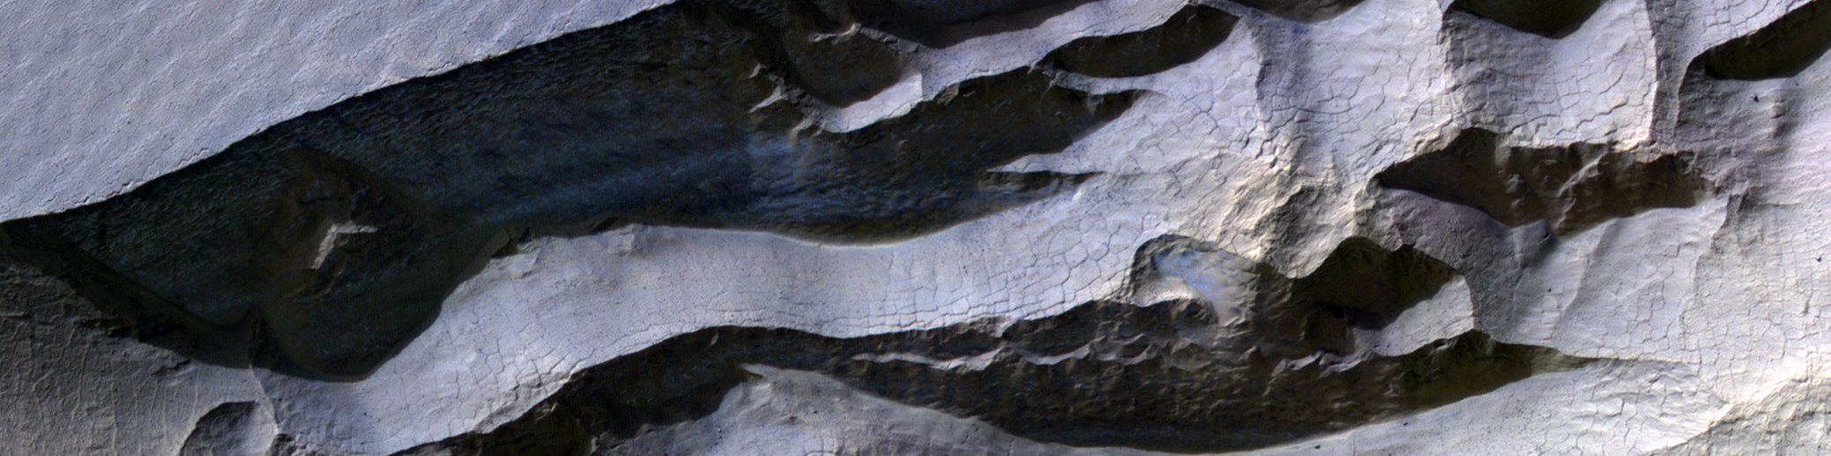
Ages of Mars’ Mid-Latitude Ice Exposing Scarps and Relating Ridge Morphology to Climate Cycles
HIRISE ESP_058971_1230
Prof. Ali M. Bramson
Laura S. Pérez Mancipe, Kris L. Laferriere, David M. H. Baker
Purdue University
Notes:
Also could use fig 6 from Dundas et al. 2021 for brighter blue on scarp face

Slide 2
Orbital Variations Drive Climate
Obliquity = 0°
Obliquity, Eccentricity, and Longitude of Perihelion drive Milankovitch-like climate cycles
Sunlight
Earth’s Variations
Sunlight
(Laskar et al. 2004)
Obliquity = 60°

Slide 3
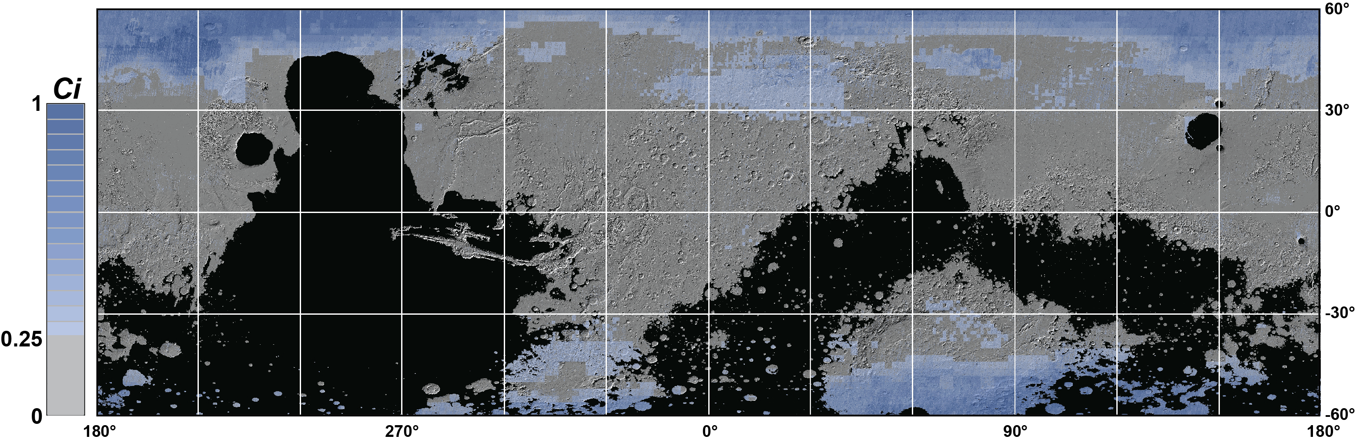
Ice deposits are widespread across Mars’ midlatitudes
Ice-exposing scarps confirm the presence of massive ice deposits found by remote sensing techniques
SWIM Ice Consistency map
Notes:
Could also use fig 1 from https://iopscience.iop.org/article/10.3847/PSJ/ad9b24#psjad9b24f1

Slide 4
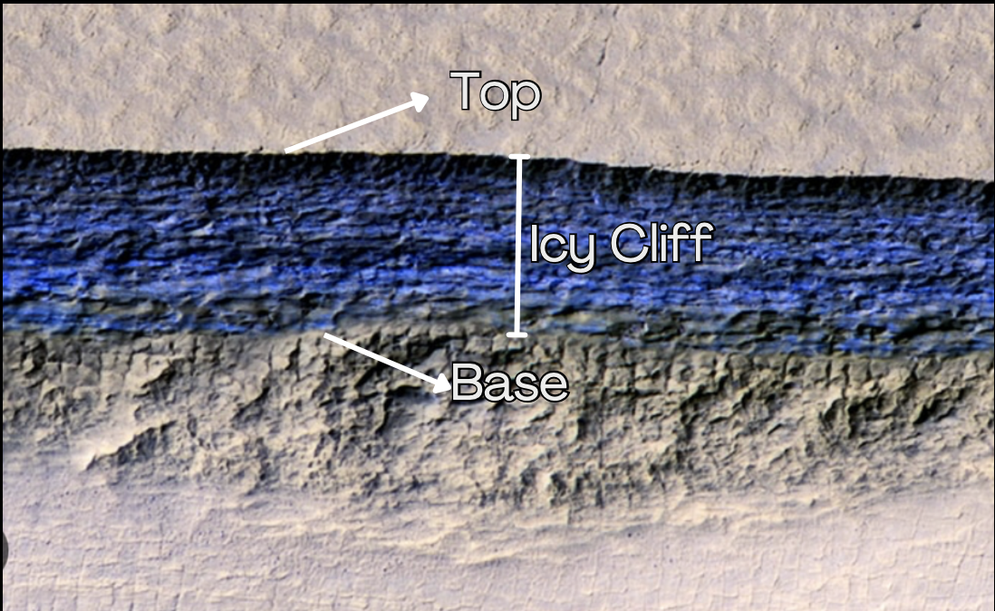
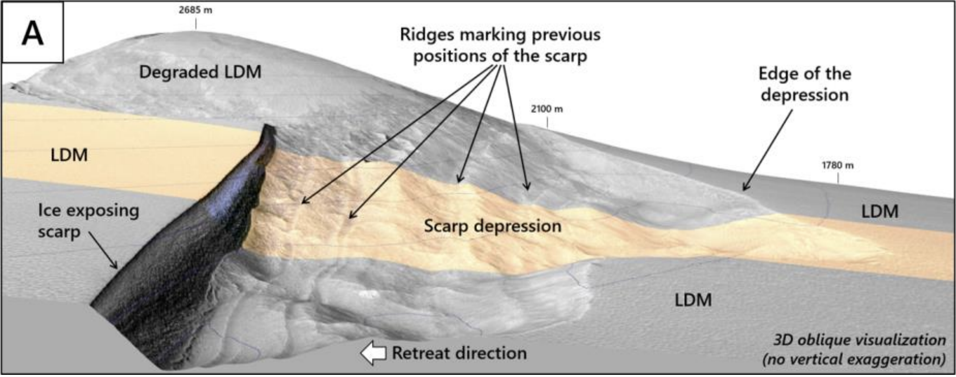
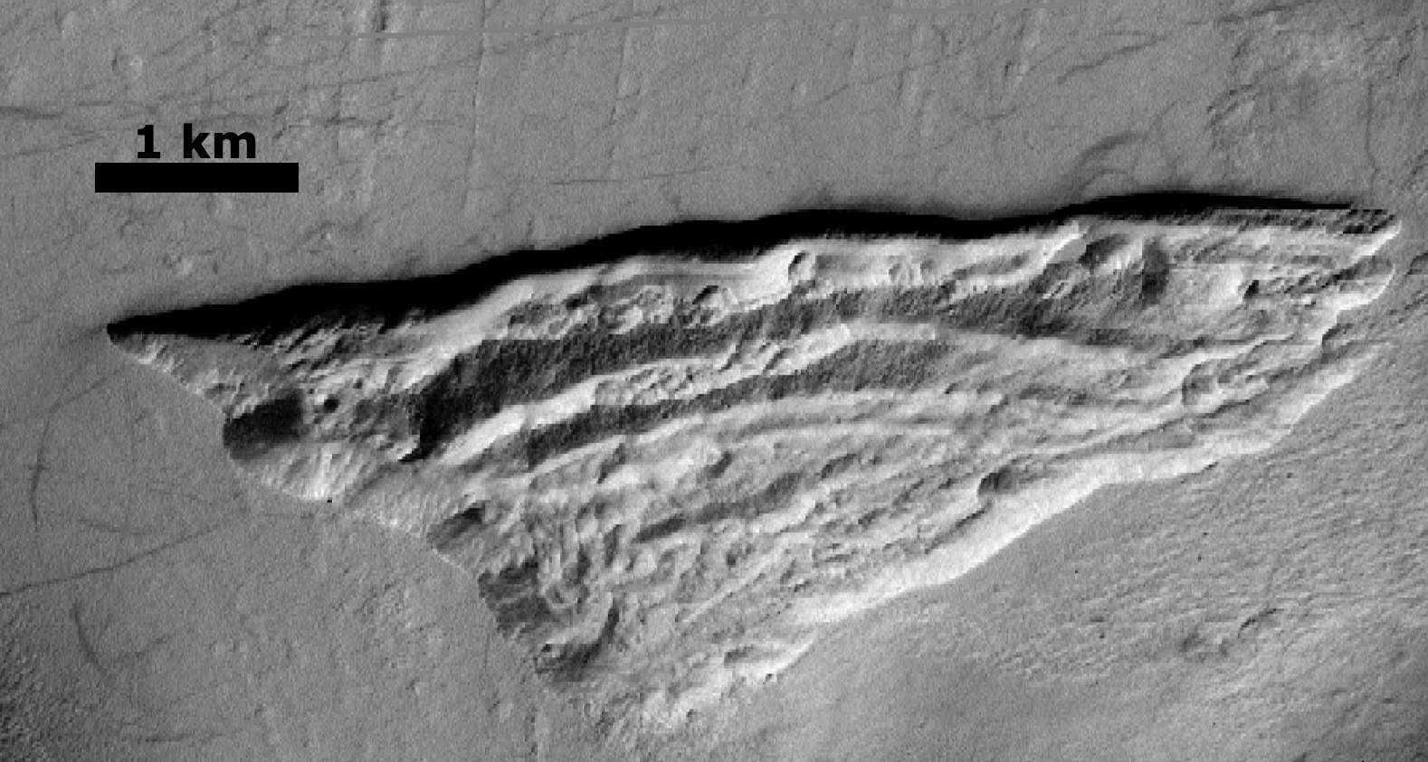
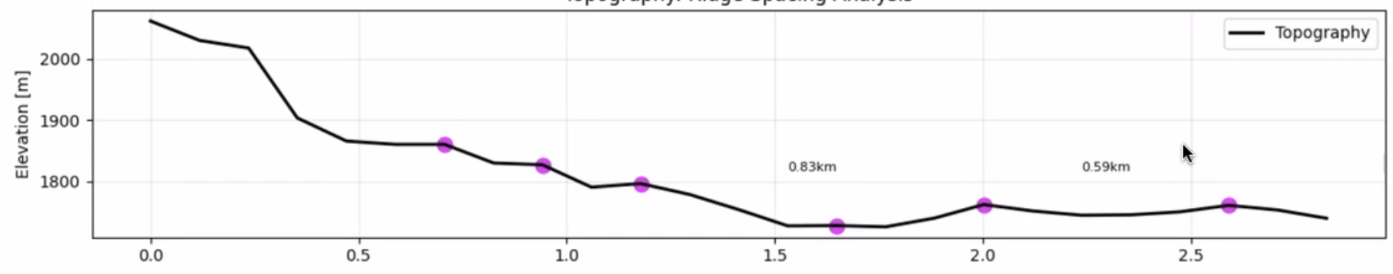
Ice-exposing scarps
“Scarp 1”
Scarps tend to be poleward facing (Dundas et al. 2021), steep (~45°), and are part of a larger pit-like feature
Scarp-parallel ridges within pit are hypothesized to form by scarp retreat
the number of ridges may correlate with periodic variations in sublimation rate
Le Becq et al. (2025)
N
Notes:
Left options are place-holders, either topo profile showing ridges or a 3D view

Slide 5
Geomorpohology
We also survey ridge morphology using HiRISE data to look for patterns in number and spacing of ridges
Does laura have any good planar view mappings of the ridges, maybe for multiple scarps?

Slide 6
Thermal modeling of Mid-Latitude Ice
Surface, z=0
Dry Regolith (“lag”)
1-D semi-implicit Crank-Nicholson
2 to 3 layer model
Infinite ice sheet below lag deposit
Ice stability depth, z_{i}
Pore-filling Ice within lag
Excess ice interface, z_{ei}
z
Calculate loss from the excess ice layer to address if periodic variations in sublimation could be related to the observed ridges
Excess Ice Sheet

Slide 7
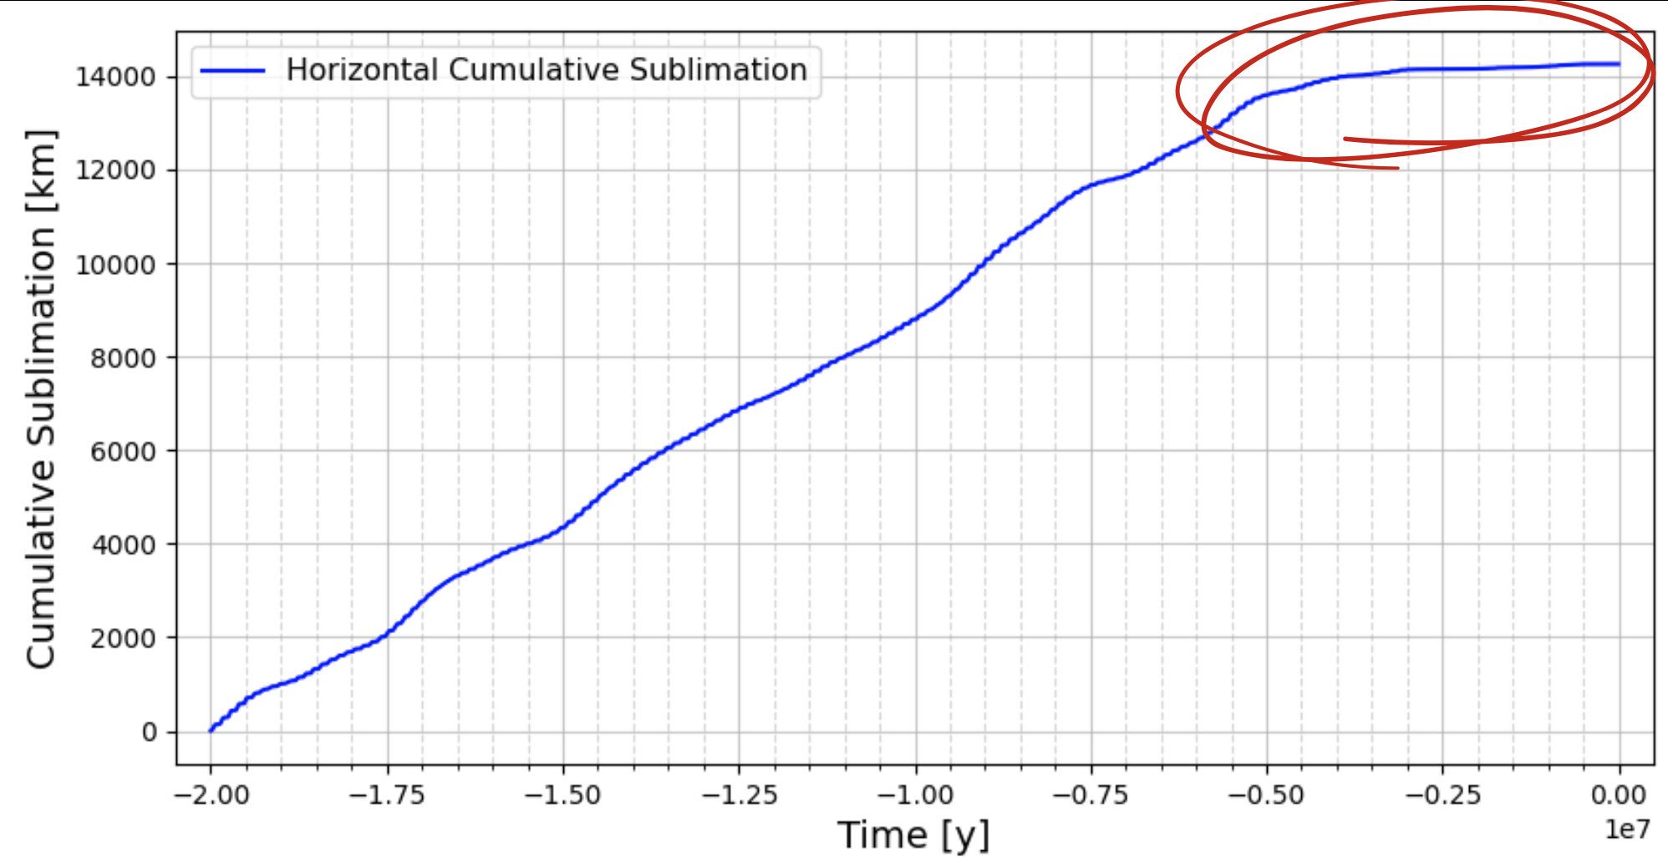
Results
These features must be young (~0.5 Myr) if formed by retreat of scarp retreat.
Younger than the 2.6 Myr timescale previously proposed (Williams et al. 2022)
Notes:
Younger b/c Williams presumed a constant retreat rate.

Slide 8
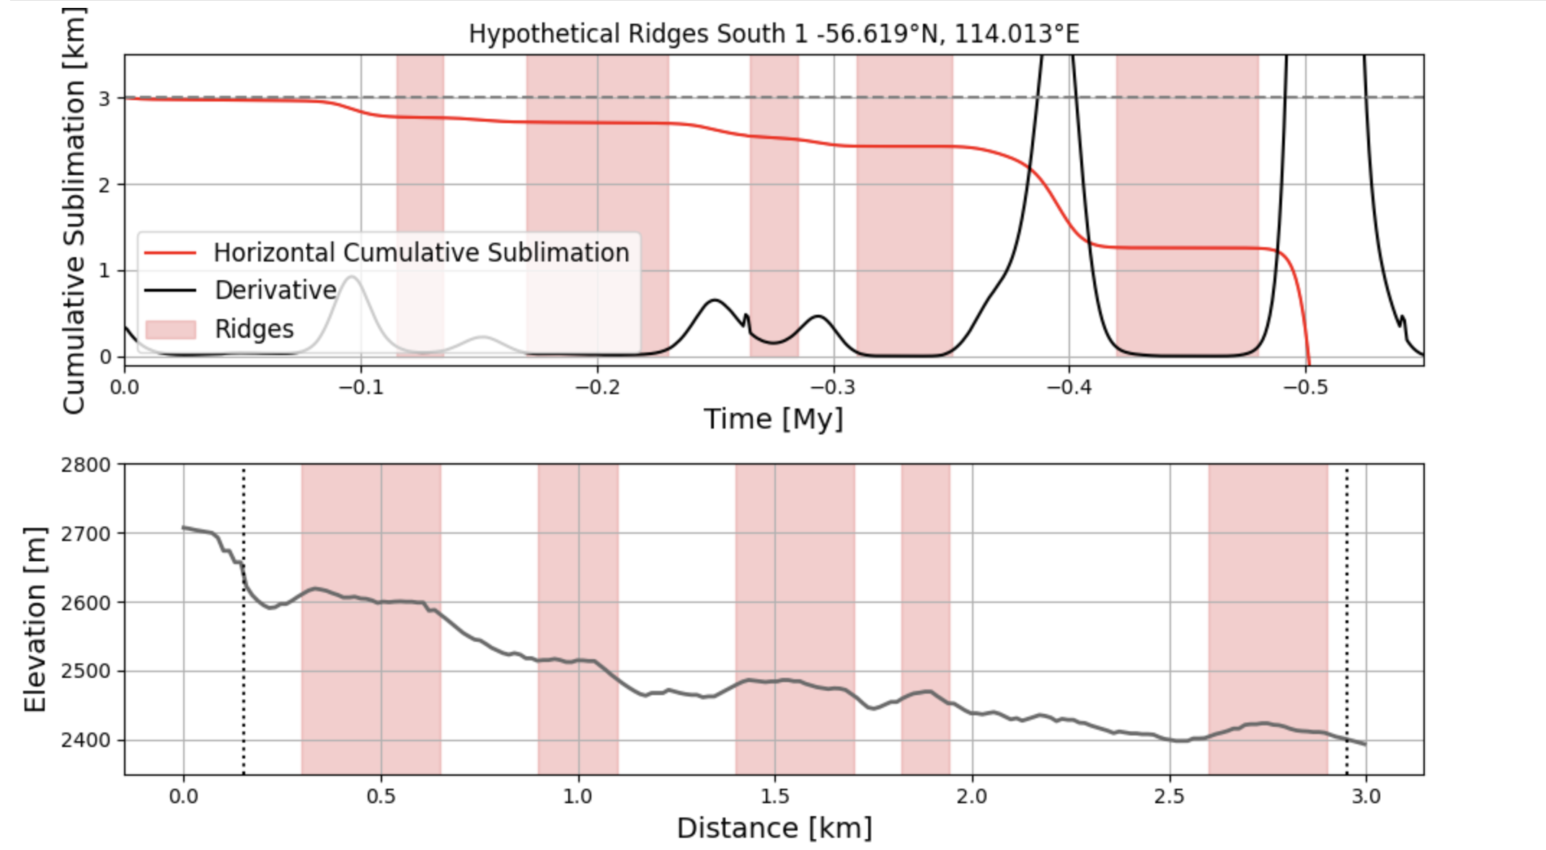
Results
These features must be young (~0.5 Myr) if formed by retreat of scarp retreat.
Younger than the 2.6 Myr timescale previously proposed (Williams et al. 2022)
5 inflections in sublimation rates, which is similar to the number of observed ridges
Notes:
Younger b/c Williams presumed a constant retreat rate.

Slide 9
Summary
Deciphering the climate record that is stored in ice deposits is key for unlocking new understandings of planetary climate systems.
Our work provides a method to constrain the age of formation of each ridge, and advocates for the scarps as venues for understanding climate change on Mars on timescales directly analogous to Earth’s Quaternary glacial-interglacial periods.

