Slide 1
Edge Detection
609410146
廖宇宸

Slide 2
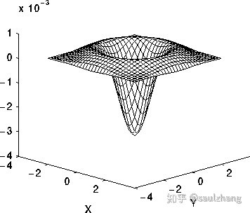
Technical description -LoG
LoG邊緣檢測算法步驟：
1.平滑：高斯濾波器
2.增強：Laplacian算子計算二階導
3.檢測：二階導零交叉點並對應於一階導數的較大峰值
4.定位：線性內插

Slide 3
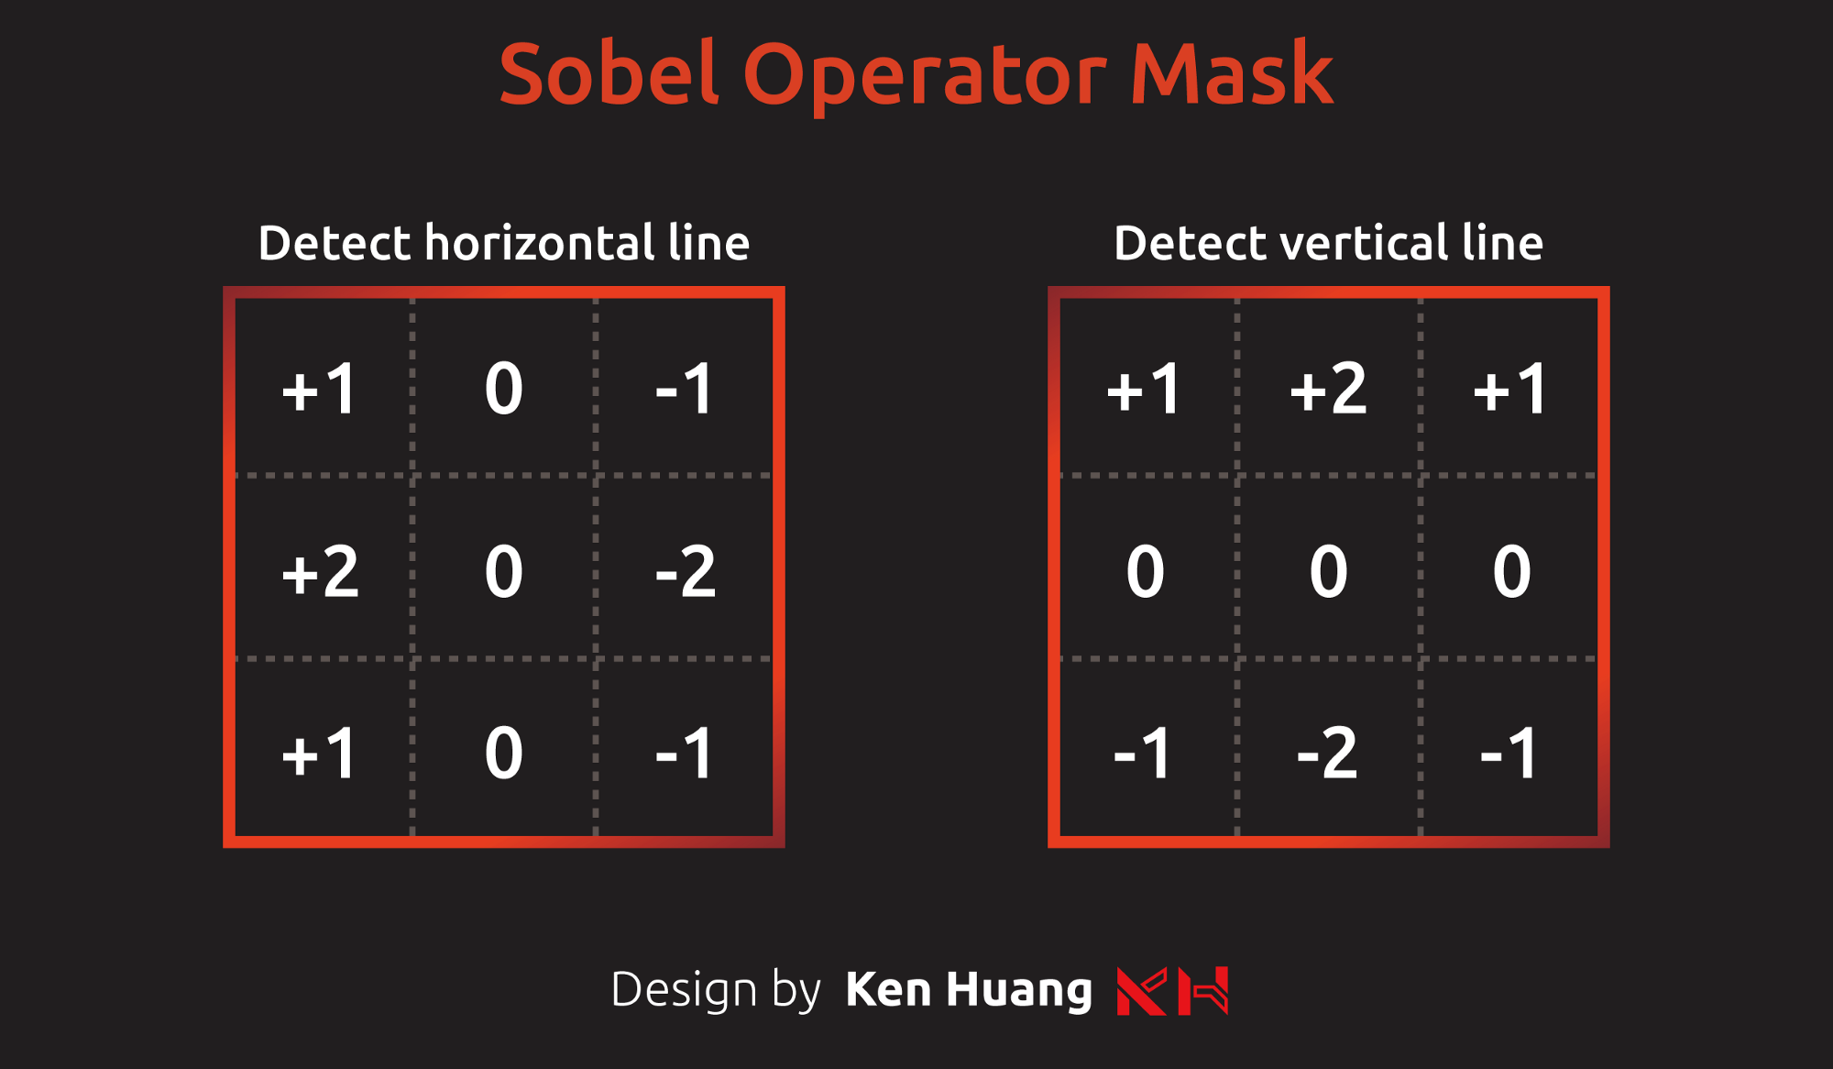
Technical description -sobel
索伯算子對應到的面罩分為上圖的左右兩個，左邊負責偵測水平向的邊界，右邊負責偵測垂直向的邊界。

Slide 4
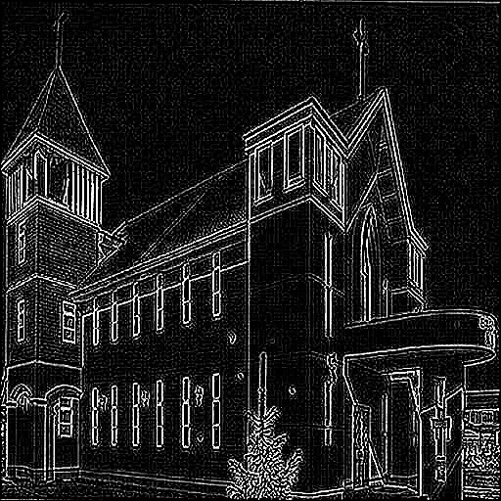
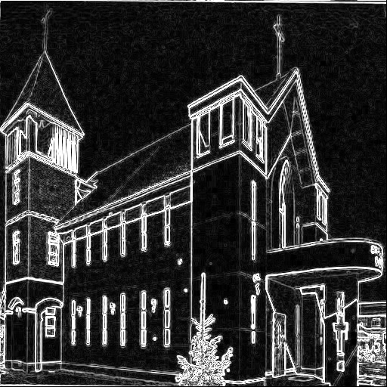
Experimental results –image1
LoG
sobel

Slide 5
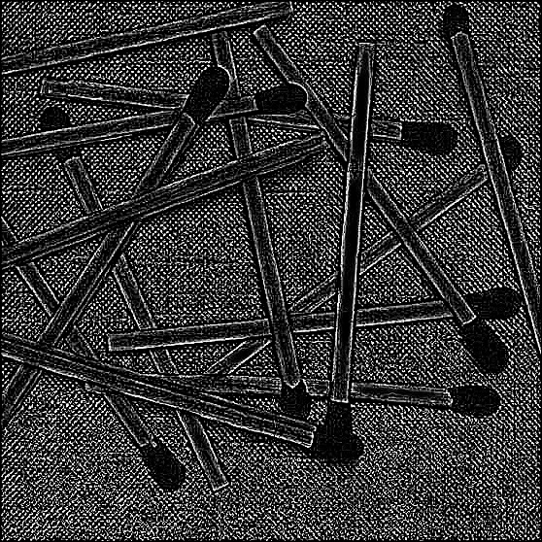
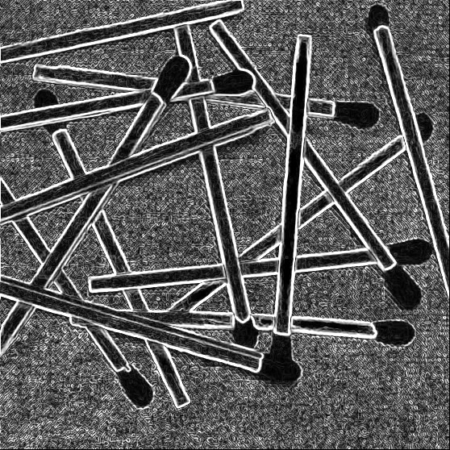
Experimental results –image2
LoG
sobel

Slide 6

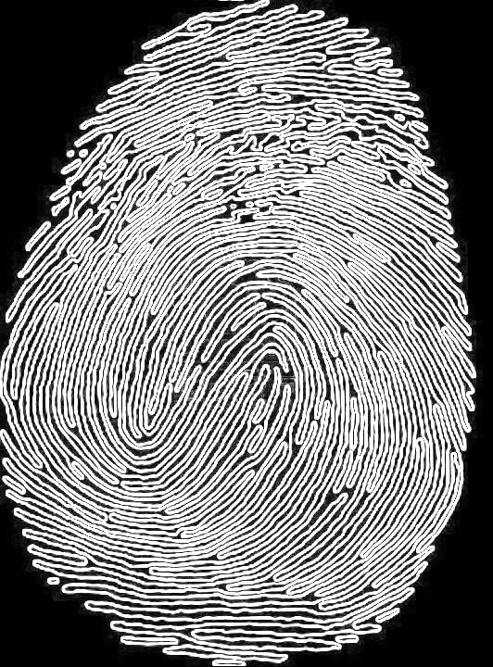
Experimental results –image3
LoG
sobel

Slide 7
References and Appendix
https://www.itread01.com/articles/1475954727.html
https://medium.com/%E9%9B%BB%E8%85%A6%E8%A6%96%E8%A6%BA/%E9%82%8A%E7%B7%A3%E5%81%B5%E6%B8%AC-%E7%B4%A2%E4%BC%AF%E7%AE%97%E5%AD%90-sobel-operator-95ca51c8d78a

