Slide 1
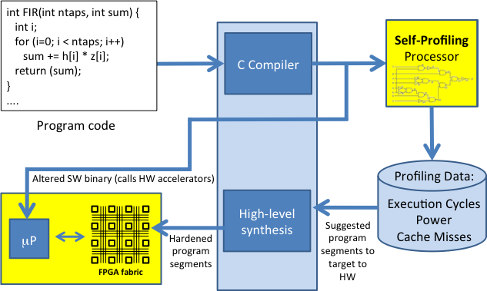
Partition into Hybrid Processor/Accelerator System
Hybrid Design Flow
Compilation
Execution & Profiling
Partition Analysis
LegUp HLS
Hybrid System
Partition is based on benefits of acceleration
Notes:
1

Slide 2
Hybrid System Cycle Prediction
Slow to profile a hybrid system
Synthesize to FPGA programming bit-stream
Simulate the system via ModelSim
Goal
Quick/early prediction of the speed benefits of accelerating a function in HW
Gain = SW cycle / Hybrid Cycle
SW cycle: HW profiler
Hybrid cycle: Prediction
Notes:
2

Slide 3
Hybrid System Execution Flow
µP
4 Components:
SW wrapper
fetch instruction
store arguments
trigger start signal
FSM in accelerator
Data loads
Data stores
000: addi a0, 0, a0
004: jal 0x100 //call wrapper
…
100: sw a0, 0(v1) //store argument
104: sw a1, 0(v0) //start accelerator
108: jr ra //return
Instr. Cache
SDRAM
Accelerator
BB_0:
s0: reg <= data;
s1: ****
BB_1:
s2: ****
s3: ****
s4: ****
Data Cache
BB_2:
s5: load from global memory
s6: store to global memory
Notes:
3

Slide 4
Component I - SW Wrapper
Instruction Fetch
(# of hits) + 13*(# of misses)
Argument Overhead
~2 cycles to store each argument
2*(# of arguments)*(# of runs)
SW/HW Transition
Constantly 2 cycle to transit b/w HW & SW
2*(# of runs)
Pure SW Program Binary
Instr. Trace in
Pure SW System
Estimated Instr. Trace in
Hybrid System
MIPS Emulator
Substitute Wrapper
Instr. $:
# of hits
# of misses
Cache Simulator
Notes:
4

Slide 5
Component I - SW Wrapper
Contribution to Total Tolerance
(actual cycle – estimated cycle) / actual hybrid cycle
Average: 3.01%
StdDev: 4.04%
Note: Total Tolerance =
(actual hybrid cycle – predicted hybrid cycle) / actual hybrid cycle
Notes:
5

Slide 6
Component II – HW Cycle
LegUp
Schedule the Accel. Function
Sched. Length in Cycle of each BB
Combine
# of BB runs w/ sched. lengthes
Estimated. HW cycle of accelerator
IR interpreter
Execute Program in SW
# of times each BB runs
∑ foreach BB (sched. length) * (# of runs)
Accurate if no mem. access
Contribution to Total Tolerance
Average: 0.02%
StdDev: 0.16%
Note: 1 of 47 tests contributes 1.09% tolerance; all other 46 tests: 0%
Notes:
6

Slide 7
Component III – Data Loads
Load Trace:
load A1
load A2
load A3
load A4
load A5
...
…
Pure SW Program Binary
Address Filter
Global CONST
Local Stack
MIPS Emulator
Load Trace:
load A1
load A3
load A5
...
…
Data $:
# of hits
# of misses
Cache Simulator
Cycles to load data:
(# of hits) + 31*(# of misses)
Notes:
7

Slide 8
Component III – Data Loads
Contribution to Total Tolerance
Average: 0.97%
StdDev: 1.73%
Notes:
8

Slide 9
Component IV – Data Stores
Similar Methodology as Data Loads
Generate address trace in the same way as Data Loads
Write-through policy of data cache
1.85*(# of stores)
Contribution to Total Tolerance
Average: 5.35%
StdDev: 7.86%
Most Inaccurate – “Key Contributor” to total tolerance
Notes:
9

Slide 10
Final Result – Predicted Hybrid Cycle
Sum of
SW Wrapper Cycle
HW Cycle
Data Load Cycle
Data Store Cycle
Average: 7.21%
StdDev: 7.79%
Notes:
10

Slide 11
“Key Contributor” to Tolerance
– Data Store Cycle
The only 2 tests that have tolerance greater 20%
Data Store Cycle = 1.85 * (# of stores)
 | Function A | Function B
Hybrid Cycle Tolerance | 32.26% | 34.39%
Tolerance Contributed by Data Store Cycle | 32.32% | 31.56%
Estimated # of Stores | 4000 | 18432
Actual # of Stores | 4100 | 18624
Estimated Store Cycles | 7400 | 34099
Actual Store Cycles | 22445 | 110524
Varying Coefficient | 5.47 | 5.93
Open-Row architecture in the SDRAM on DE-II
~1 cycle to store data in currently open row
A lot more cycles to store data in a different row
Notes:
11

Slide 12
“Key Contributor” to Tolerance
– Data Store Cycle
Most of the tolerances come from data store cycle estimation
Notes:
12

Slide 13
THANK YOU !

