Slide 1

Seeing the Unseen: Finding the Shadow Economy using the MIMIC Approach
Les Stanaland
Partial Fulfillment of Structural Equation and Multilevel Modeling,
Dr Harold Clarke, Professor

Slide 2
Research Question / Motivation
What factors construct the existence of the shadow economy?
SE leads to lost tax revenue, illegal activities
Current Supreme Court case South Dakota v. Wayfair
Negative effects on GDP?
Issue of tax morale
Values, social norms, attitudes about taxes and regulation (Alm and Torgler 2006)

Slide 3
Theory
Legal shadow economy can be approximated by looking at variables such as electricity usage and LFPR (Wiseman 2013)
My hypothesis – tax rates also influence the SE
Higher income tax rates are positively associated with SE
Goods and Services tax rates are negatively associated with SE

Slide 4
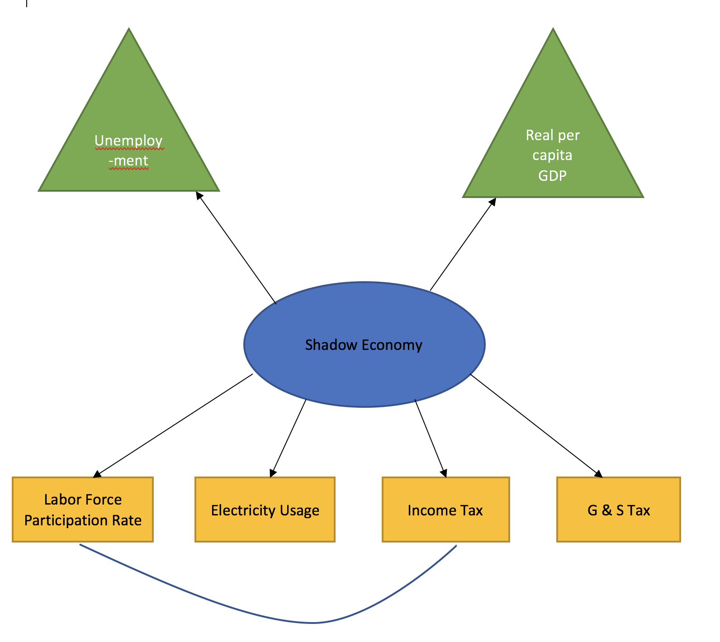
Main Hypothesis

Slide 5
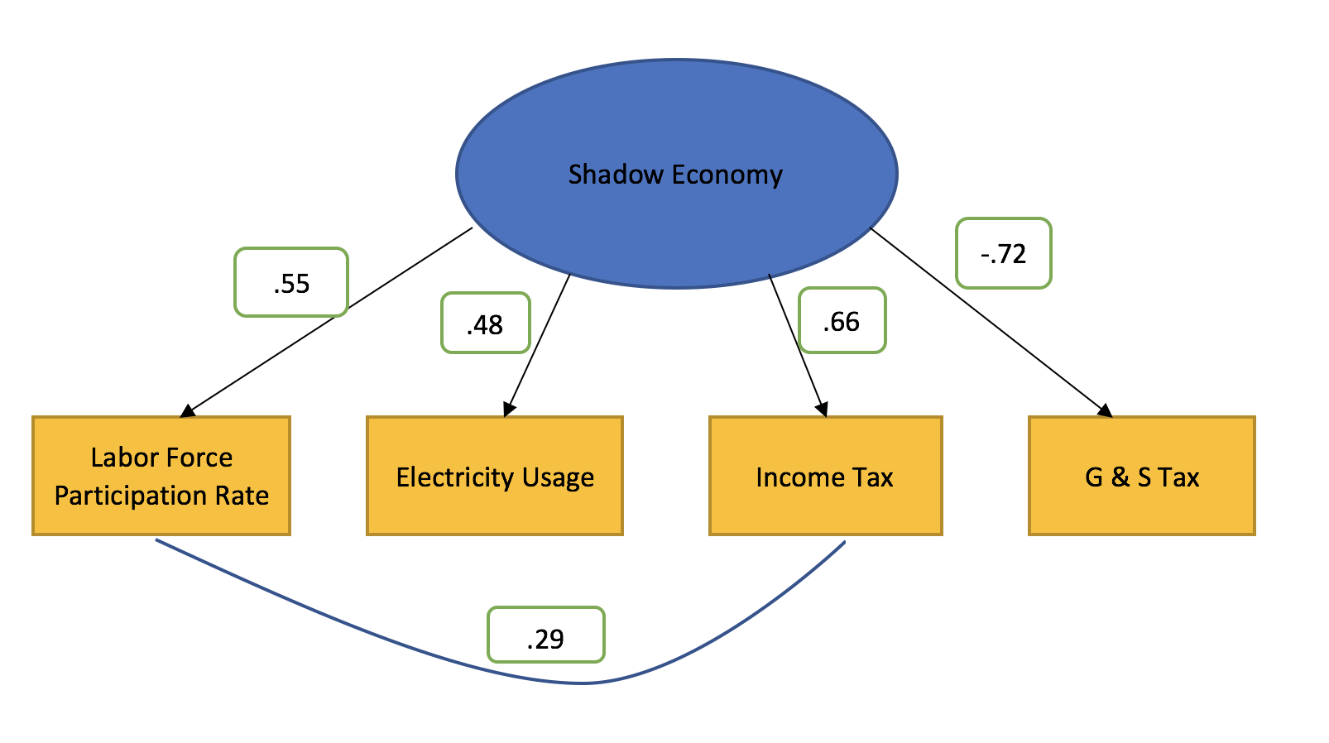
Analysis – Measurement Model

Slide 6
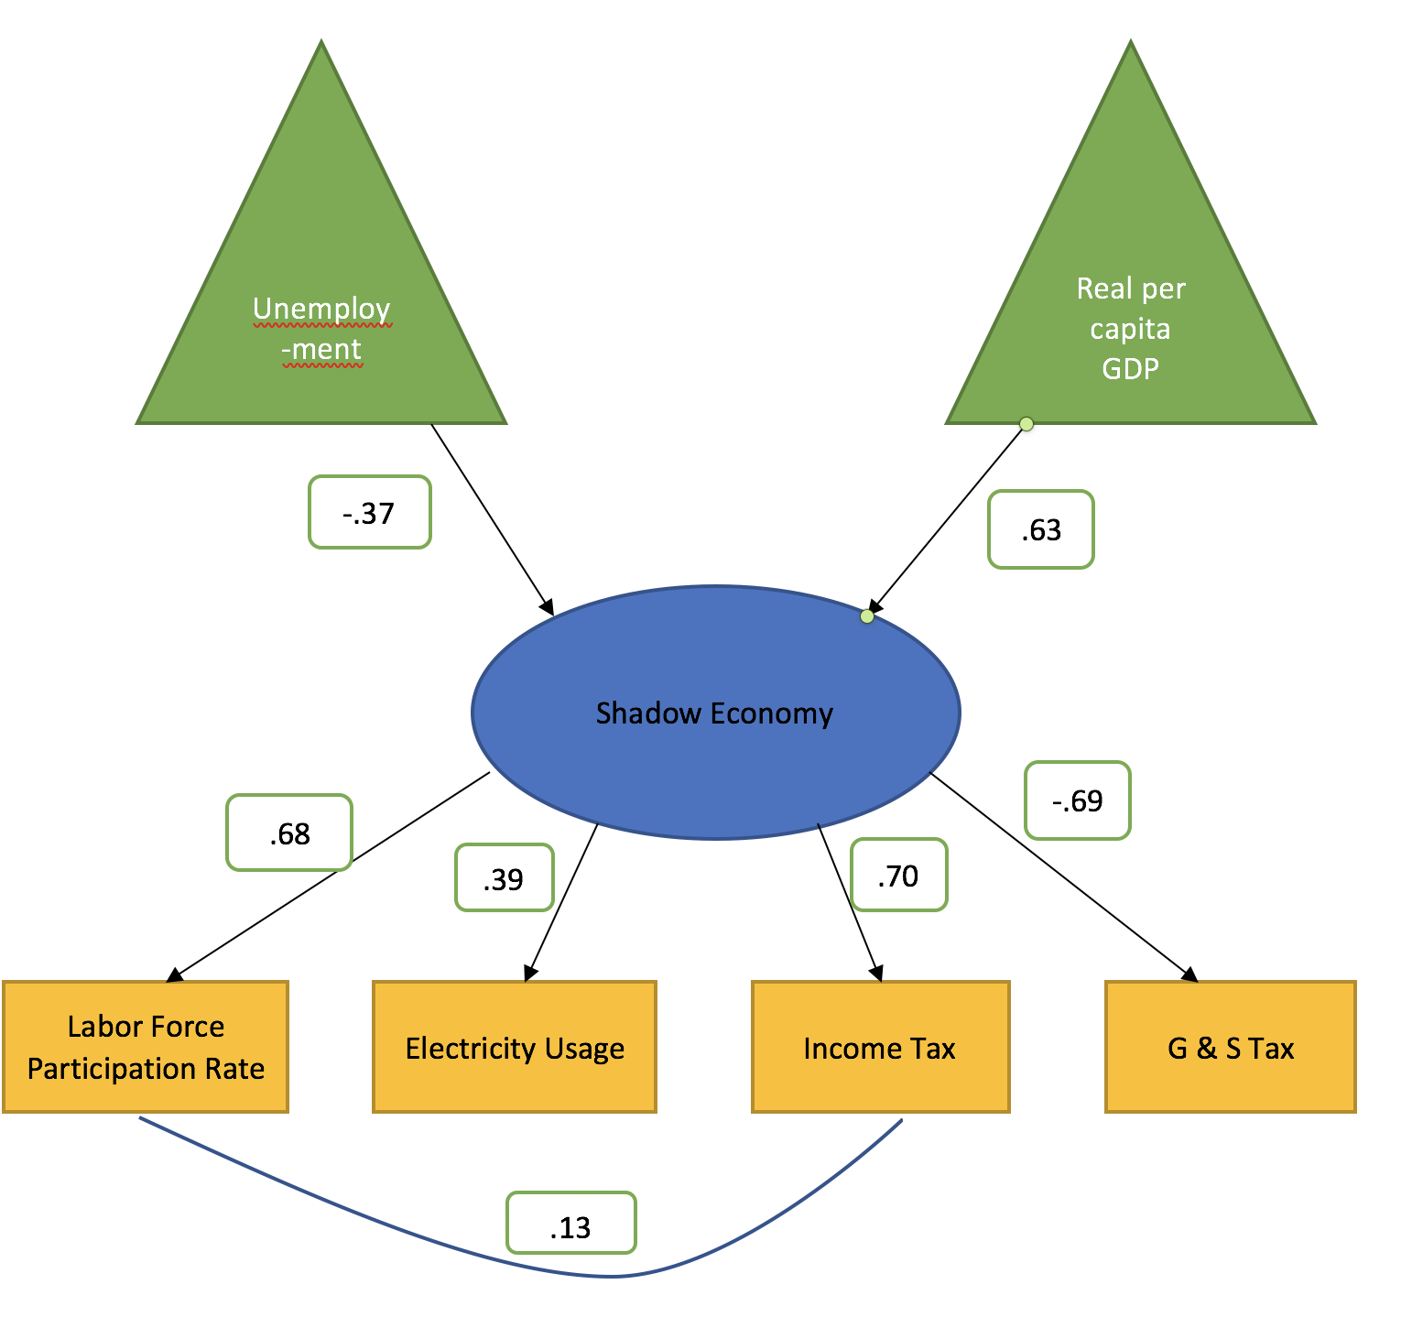
Analysis – Full Model

Slide 7
Findings
Indicators of Income Tax, Goods & Services Tax, Electricity Usage, and Labor Force Participation Rate lead to a well-fitted model for the Shadow Economy
However, standardized coefficients could be higher
Tax hypothesis explains SE better than LFPR or electricity usage
As unemployment goes up, the shadow economy goes down
As real per capita GDP goes up, so does the shadow economy
Indicates legal shadow economy may not be a bad thing

Slide 8
Future Research / Conclusion
Unemployment is negatively related to SE, opposite of theory, and real per capita GDP is positively correlated, indicating the legal SE may not be anything policymakers need to curb
Need to incorporate governmental behavior factors
Need to correct for time series data

