Slide 1
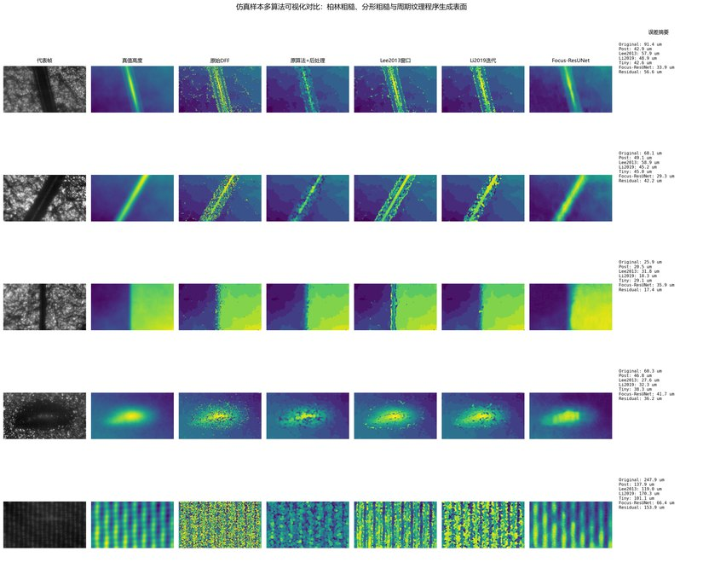
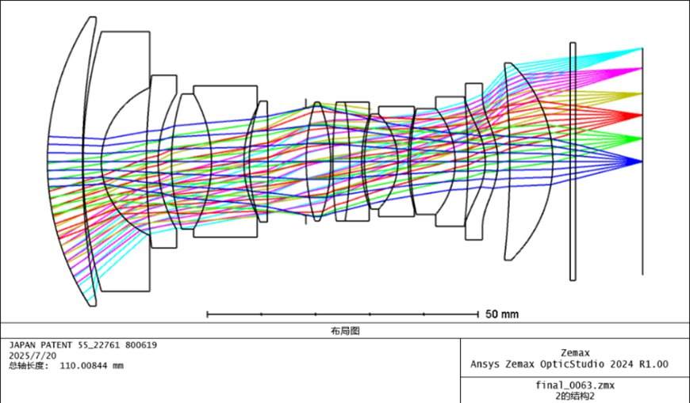
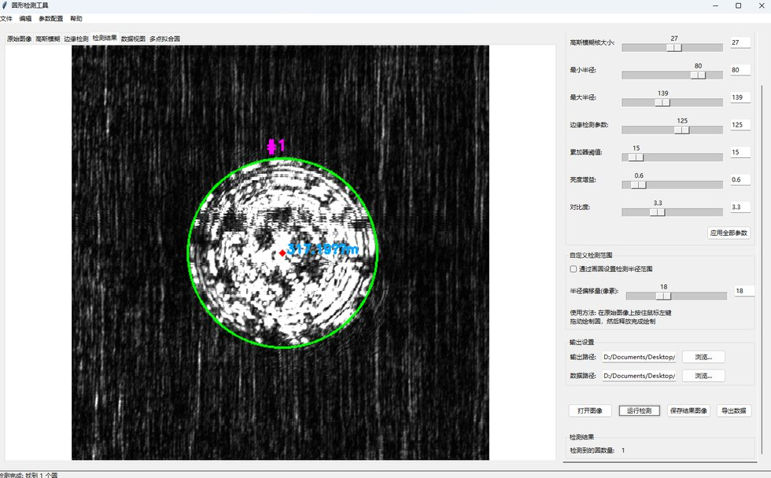
Shenshi Li
李申适
Computational Imaging, Optical Metrology,
and 3D Reconstruction
B.Eng. Student in Optoelectronic Information Science and Engineering
College of Optical Science and Engineering, Zhejiang University
Expected graduation: June 2027
Meeting with Prof. Evan Peng / WeLight Lab team
June 17, 2026 | 8-10 min academic self-introduction
3230105050@zju.edu.cn | lssnake0105.github.io/profile/
Shenshi Li | ZJU Optics | June 2026
1/16

Slide 2
My training connects optical systems, imaging algorithms, and reproducible research software.
One-minute profile
3.94/4.00
2024
108
5
SL
GPA, ranked 18/103
National Scholarship
TOEFL score
Optics-focused projects
Shenshi Li
Optical Systems
Vision Algorithms
Research Software
ZJU Optics
B.Eng. 2023-2027
Optoelectronic Information
Science and Engineering
Zemax lens design
Confocal microscopy concept
Fluorescence microscope prototype
Depth-from-focus reconstruction
OpenCV measurement software
UNet-style segmentation workflow
Python pipelines
Reproducible figures and reports
GUI tools for parameter tuning
Computational imaging
Optical metrology
3D reconstruction
Optics-AI co-design
Shenshi Li | ZJU Optics | June 2026
2/16

Slide 3
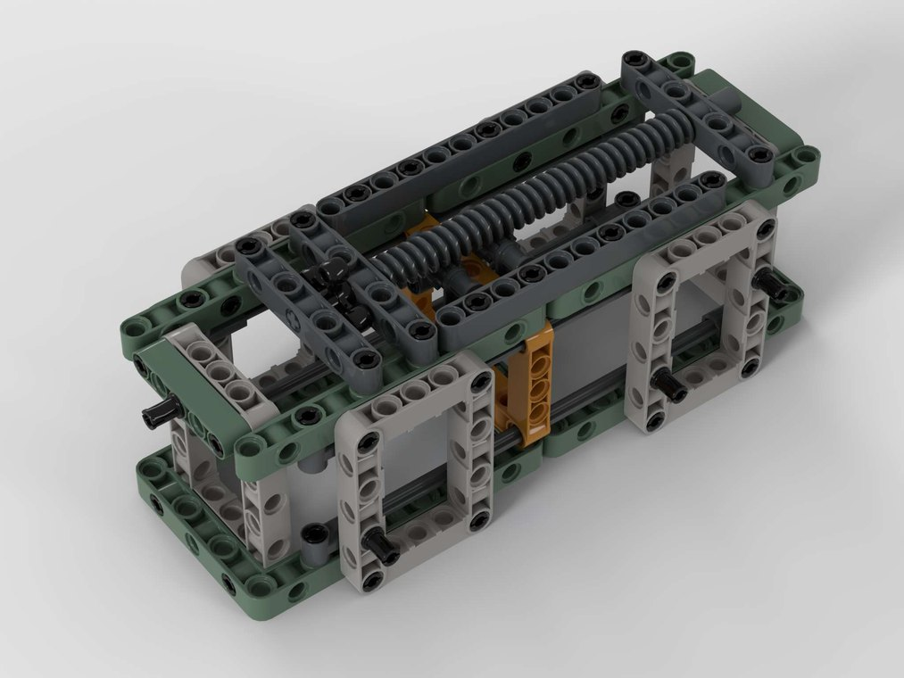
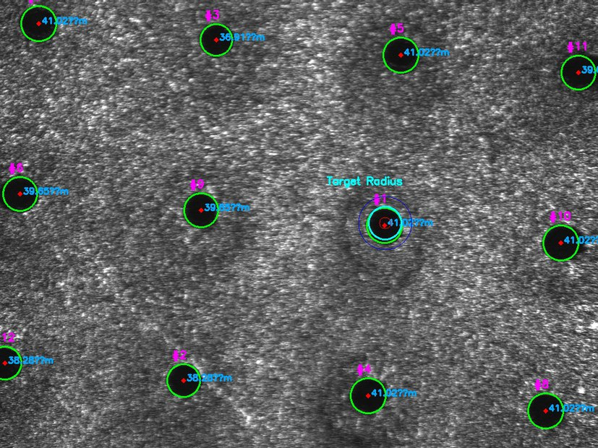
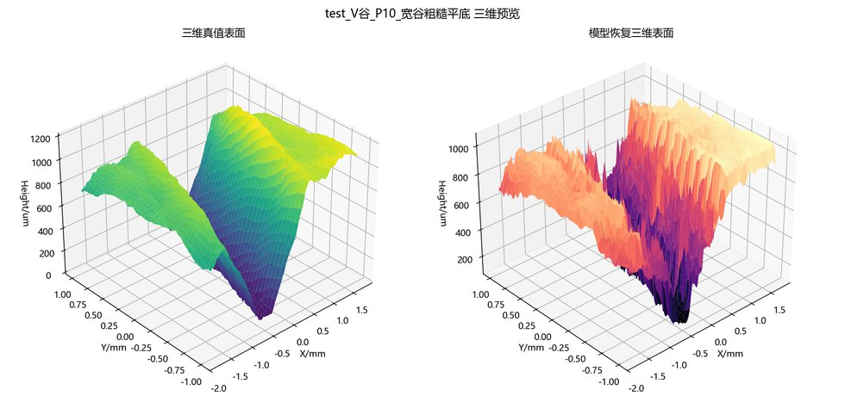
My projects have moved from optical measurement to computational reconstruction and defect analysis.
Research trajectory
research
training
2024.05
2024.11
2025.05
2025.04
2025.06
Research Initiation
Camp
LEGO-based
fluorescence microscope
Micro-hole
metrology
DFF defect
reconstruction
Mirrorless camera
lens design
Proposal writing,
literature review,
poster training
Mechanical modules,
Zemax optical path,
working prototype
Confocal scanning idea,
OpenCV aperture fitting,
aspect-ratio calculator
Focus-stack imaging,
DFF + learning,
heterogeneous surfaces
Zemax optimization,
MTF/tolerance,
Monte Carlo yield
Trajectory signal
I have repeatedly worked at the boundary where optical capture, physical constraints, and software reconstruction meet.
Shenshi Li | ZJU Optics | June 2026
3/16

Slide 4
Heterogeneous surfaces make defect detection difficult because texture, glare, and height variation interfere with visual cues.
Main project motivation
Why DFF?
Defocus changes across a focus stack can provide a surface-depth cue when single images are ambiguous.
Metal
Ceramic
Polymer
specular glare
grain texture
low-contrast defects
Research framing
Build a pipeline that combines focus-stack imaging, DFF reconstruction, glare-aware evaluation, and learning-based correction for defect visualization.
Shenshi Li | ZJU Optics | June 2026
4/16

Slide 5
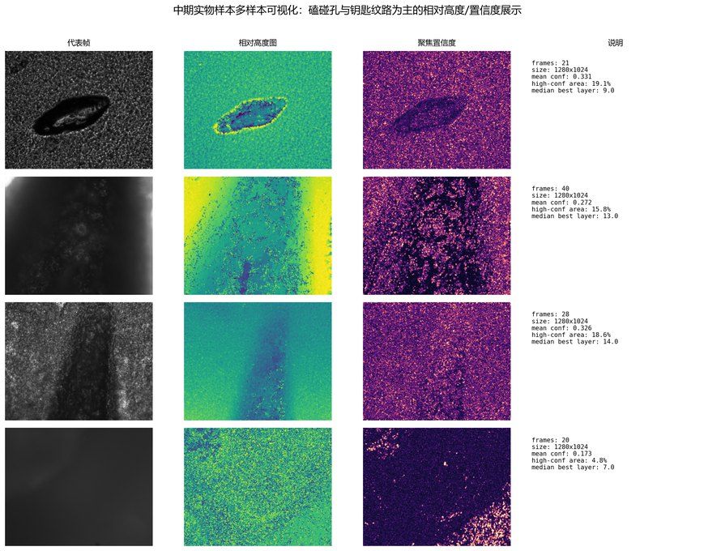
Focus-stack imaging turns axial focus variation into a relative 3D surface cue.
DFF reconstruction pipeline
1
2
3
4
5
6
Focus-stack
acquisition
Focus
measure
Depth map
estimation
Glare-aware
evaluation
Learning-based
correction
Defect
visualization
multiple z positions
local sharpness score
best-focus index
reflective risk control
depth/defect refinement
surface-level evidence
Synthetic multi-sample comparison
Surface reconstruction
Real-sample relative reconstruction
Shenshi Li | ZJU Optics | June 2026
5/16

Slide 6
I built the reproducible pipeline and separated simulated quantitative validation from real-sample relative reconstruction.
DFF results and contribution
MY ROLE
Built Python pipeline for synthetic surface generation and focus-stack simulation.
Implemented the project-wide focus-stack height convention.
Ran traditional and learning-based algorithm comparisons.
Prepared figures with explicit real/simulated evidence boundaries.
Simulated validation
Used for controlled comparison because ground-truth-like surface information can be specified.
Real-sample results
Presented as relative reconstruction and visual evidence under real imaging constraints.
Shenshi Li | ZJU Optics | June 2026
6/16

Slide 7
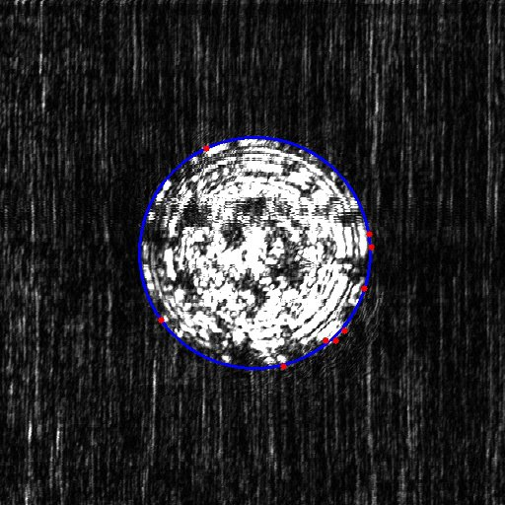
For high-aspect-ratio micro-holes, I combined optical measurement thinking with robust image-analysis software.
Optical metrology project
Confocal scanning concept
SOFTWARE WORKFLOW
1
Top / bottom
image pair
objective
2
Hough circle
detection
3
Manual least-
squares fitting
4
Aspect-ratio
calculation
tomographic z-scan
Takeaway: optical metrology needs both a physically meaningful acquisition model and resilient user-facing measurement tools.
Shenshi Li | ZJU Optics | June 2026
7/16

Slide 8
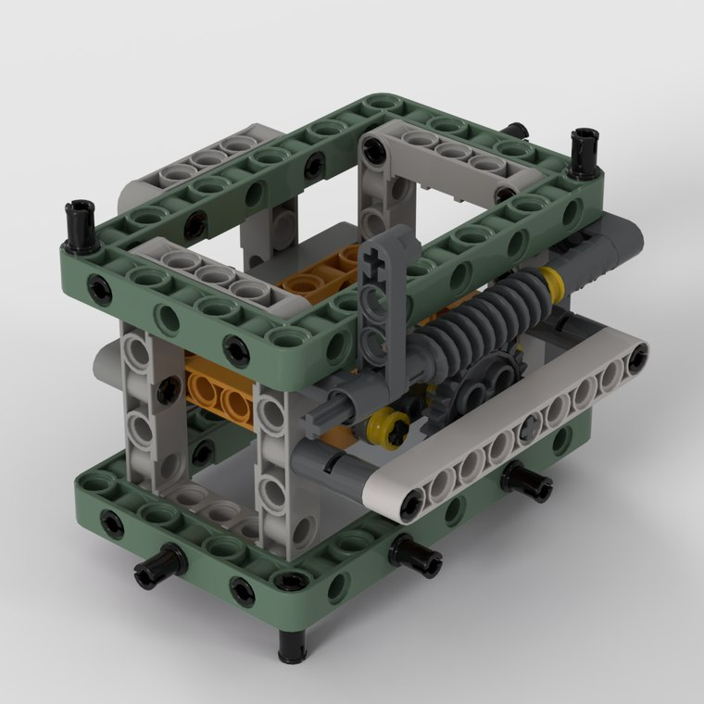
Zemax and prototype projects gave me system-level optical design experience beyond image processing.
Optical engineering practice
Mirrorless camera lens design
LEGO-based fluorescence microscope
Zemax
MTF
Athermal
Tolerance
Prototype
Optical path
Mechanical modules
Structure optimization, ghost-image review, cost and tolerance analysis, lens-barrel planning, Monte Carlo validation.
Mechanical LEGO Studio design plus collaboration on Zemax optical-path design for a working fluorescence microscope prototype.
Shenshi Li | ZJU Optics | June 2026
8/16

Slide 9
My strongest implementation stack is Python/OpenCV/PyTorch for imaging pipelines, with Zemax/SolidWorks for optical-system work.
Technical toolkit
Capability
Tools
Output evidence
Imaging reconstruction
Python, OpenCV, PyTorch
DFF reconstruction, focus-stack simulation, defect visualization
Measurement software
OpenCV, Tkinter, least-squares fitting
Micro-hole radius detection, manual/automatic modes, exported overlays
Optical design
Zemax, SolidWorks, AutoCAD
Lens optimization, MTF/tolerance review, microscope module planning
Scientific communication
LaTeX, Markdown, Office, Photoshop
Reports, project documentation, presentation figures, reproducible notes
Programming base
C/C++, Python, MATLAB
Coursework and project implementation across optics and vision tasks
Preparation signal for WeLight Lab: comfortable crossing optical-system constraints, reconstruction algorithms, and implementation details.
Shenshi Li | ZJU Optics | June 2026
9/16

Slide 10
I hope to grow toward optics-vision-AI co-design for computational imaging, 3D vision, holography, and display systems.
Fit with WeLight Lab
My preparation
Overlap
WeLight directions
Optical imaging intuition
Computational optics / imaging / display
Computational imaging
Coded / learned optics
DFF and 3D/depth reconstruction practice
Holography, VR/AR/MR, 3D vision
3D reconstruction
Low-level vision
OpenCV/PyTorch/Zemax implementation
Optics + graphics + vision + AI
Experimental constraints
Public alignment source: WeLight Lab website and Prof. Peng opening/research pages.
Shenshi Li | ZJU Optics | June 2026
10/16

Slide 11
The next step I want to learn is how to co-design optics, capture, and reconstruction under real experimental constraints.
Near-term research questions
Q1
Focus / defocus cues
Q2
Physical priors
Q3
Calibration and data
How can focus and defocus cues be integrated with learned optics for more robust 3D perception?
How can physical priors improve reconstruction on reflective or heterogeneous surfaces?
What experimental calibration and data-acquisition habits are essential for optics-AI systems?
Discussion goal
Use the meeting to learn what preparation would be most valuable for PhD / RA / visiting research opportunities.
Shenshi Li | ZJU Optics | June 2026
11/16

Slide 12
I would appreciate feedback on whether my preparation fits current PhD, RA, or visiting research directions.
Closing
Thank you.
Contact and materials
Email: 3230105050@zju.edu.cn
Personal website: https://lssnake0105.github.io/profile/
GitHub: https://github.com/lssnake0105
CV: available from the personal website
I am happy to share transcripts, project reports, source code, or additional result figures after the meeting.
Shenshi Li | Zhejiang University
Focus areas: computational imaging, optical metrology, 3D reconstruction, optics-AI co-design.
Shenshi Li | ZJU Optics | June 2026
12/16

Slide 13
Backup: DFF comparison keeps real-sample evidence separate from simulated algorithm validation.
Backup 1
READING GUIDE
Use simulated surfaces for controlled comparison and method iteration.
Use real samples for relative reconstruction and visual plausibility.
Avoid claiming absolute quantitative performance where ground truth is unavailable.
Shenshi Li | ZJU Optics | June 2026
13/16

Slide 14
Backup: Micro-hole measurement software supports both automatic detection and manual fitting for difficult images.
Backup 2
Implementation details
Hough circle transform, least-squares fitting, annotated exports, parameter presets, and automatic aspect-ratio computation.
Shenshi Li | ZJU Optics | June 2026
14/16

Slide 15
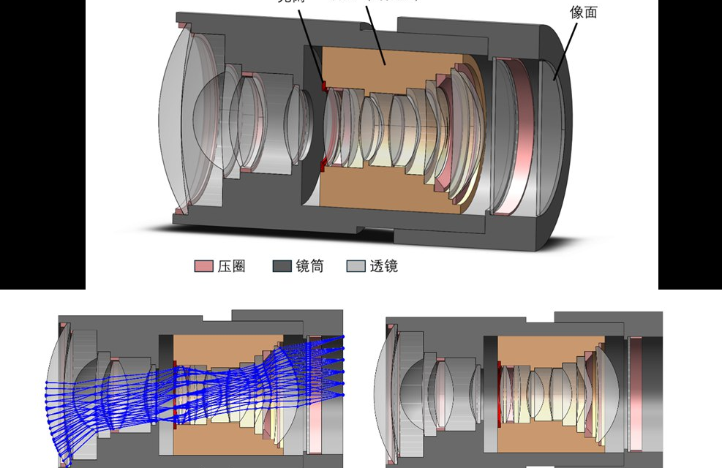
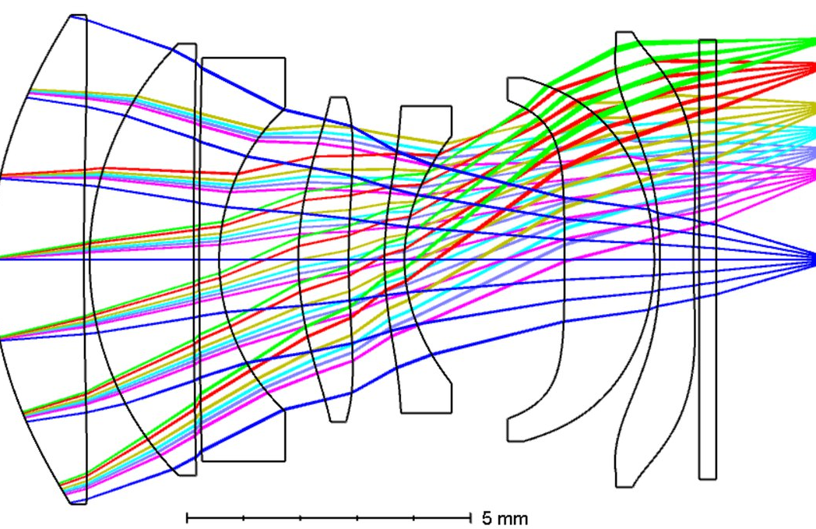
Backup: Lens-design work trained me to evaluate optical systems with performance, tolerance, and manufacturability in mind.
Backup 3
MTF evaluation
Athermal analysis
Ghost-image review
Cost analysis
Tolerance analysis
Monte Carlo yield
Shenshi Li | ZJU Optics | June 2026
15/16

Slide 16
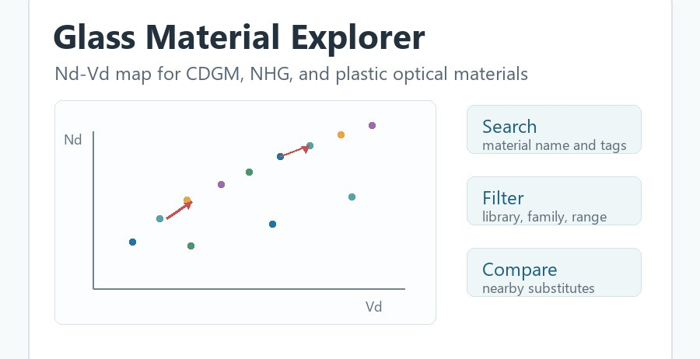
Backup: Selected coursework, outputs, and links support the academic preparation claim.
Backup 4
Coursework highlights
Selected links
Silicon Photonics
96/100
Personal website
https://lssnake0105.github.io/profile/
GitHub
https://github.com/lssnake0105
Representative repositories
DFF reconstruction, solar-cell crack detection,
depth-ratio detector, glass material explorer
Electromagnetic Fields and Waves
94/100
Physical Optics
92/100
Computer-Aided Optical System Design
93/100
Machine Vision and Image Processing
92/100
Shenshi Li | ZJU Optics | June 2026
16/16

