Slide 1
Source Measurement & Tables
Jim Bosch
October 7, 2015
LSST DM Stack Bootcamp
October 5-7, 2015 | Princeton/Tucson/Seattle

Slide 2
Outline
Measurement
  Detection, Deblending, and Measurement
  Inside Measurement
  Using SingleFrameMeasurementTask
  Writing a SingleFramePlugin
    Error Handling
    Unit Transformation
    C++ Algorithms
    Utility Classes
  Forced Measurement
Tables
  Records, Tables, and Catalogs
  Deep and Shallow Copies
  Blocks, Columns, and Contiguousness
  SchemaMapper
  Slots and Aliases
  FunctorKeys

Slide 3
Detect, Deblend, Measure
SourceDetectionTask
parent
Footprints
DETECT mask plane
pixels, Psf
Exposure
SourceCatalog

Slide 4
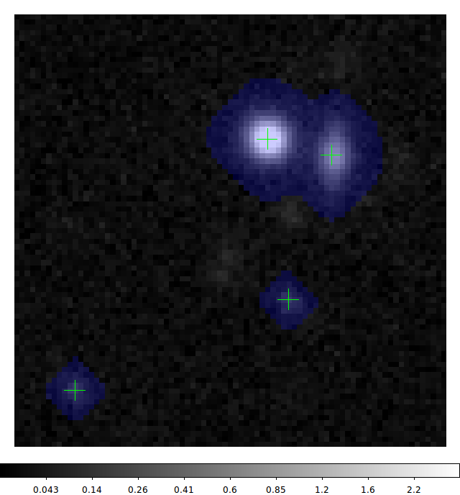
Detect, Deblend, Measure
id | parent | nchild | (measurements) | (footprint)
1 | 0 | 0 |  | regular
2 | 0 | 0 |  | regular
3 | 0 | 0 |  | regular
3
2
1

Slide 5
Detect, Deblend, Measure
SourceDetectionTask
SourceDeblendTask
child
HeavyFootprints
Exposure
pixels
parent
Footprints
SourceCatalog

Slide 6
Detect, Deblend, Measure
id | parent | nchild | (measurements) | (footprint)
1 | 0 | 0 |  | regular
2 | 0 | 0 |  | regular
3 | 0 | 2 |  | regular
4 | 3 | 0 |  | heavy
5 | 3 | 0 |  | heavy
4
3
5
2
1

Slide 7
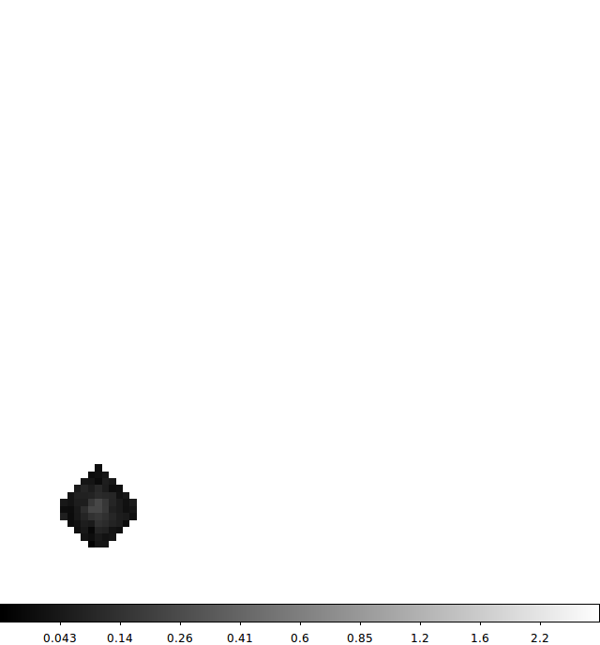
Detect, Deblend, Measure
id | parent | nchild | (measurements) | (footprint)
1 | 0 | 0 |  | regular
2 | 0 | 0 |  | regular
3 | 0 | 2 |  | regular
4 | 3 | 0 |  | heavy
5 | 3 | 0 |  | heavy
1

Slide 8
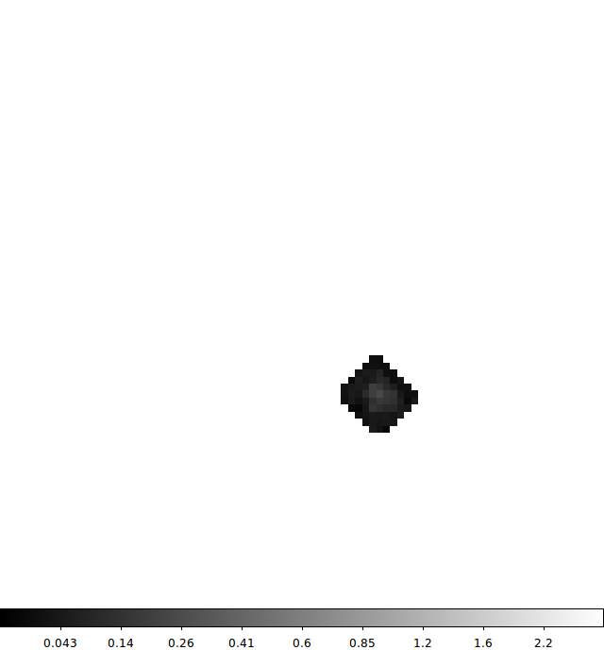
Detect, Deblend, Measure
id | parent | nchild | (measurements) | (footprint)
1 | 0 | 0 |  | regular
2 | 0 | 0 |  | regular
3 | 0 | 2 |  | regular
4 | 3 | 0 |  | heavy
5 | 3 | 0 |  | heavy
2

Slide 9
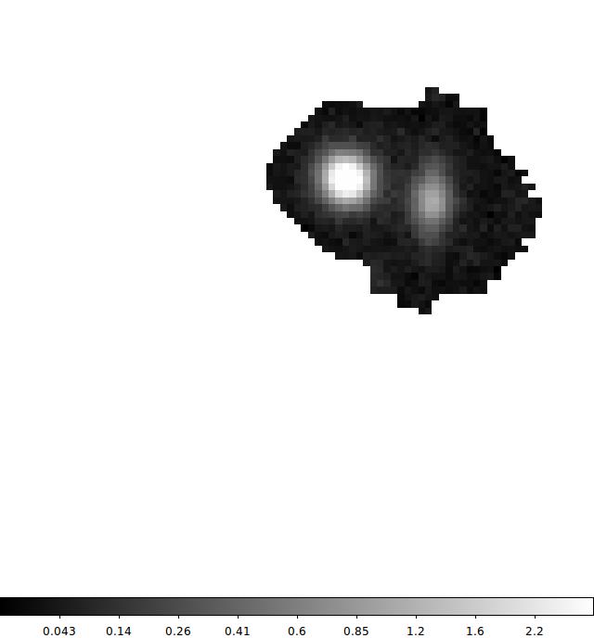
Detect, Deblend, Measure
id | parent | nchild | (measurements) | (footprint)
1 | 0 | 0 |  | regular
2 | 0 | 0 |  | regular
3 | 0 | 2 |  | regular
4 | 3 | 0 |  | heavy
5 | 3 | 0 |  | heavy
3

Slide 10
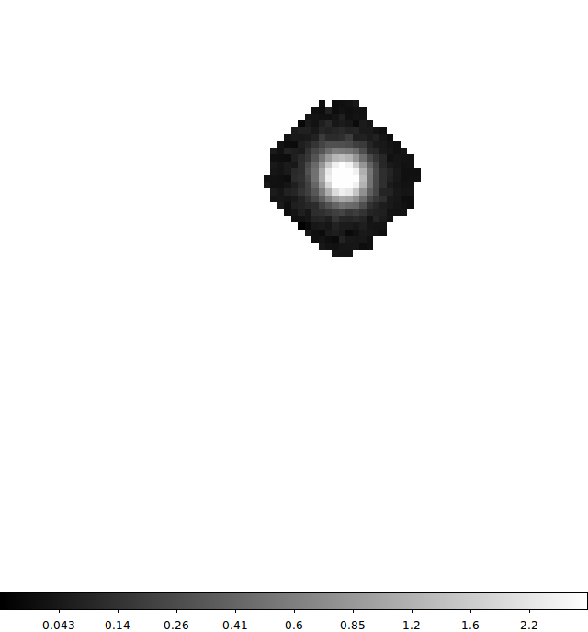
Detect, Deblend, Measure
id | parent | nchild | (measurements) | (footprint)
1 | 0 | 0 |  | regular
2 | 0 | 0 |  | regular
3 | 0 | 2 |  | regular
4 | 3 | 0 |  | heavy
5 | 3 | 0 |  | heavy
4

Slide 11
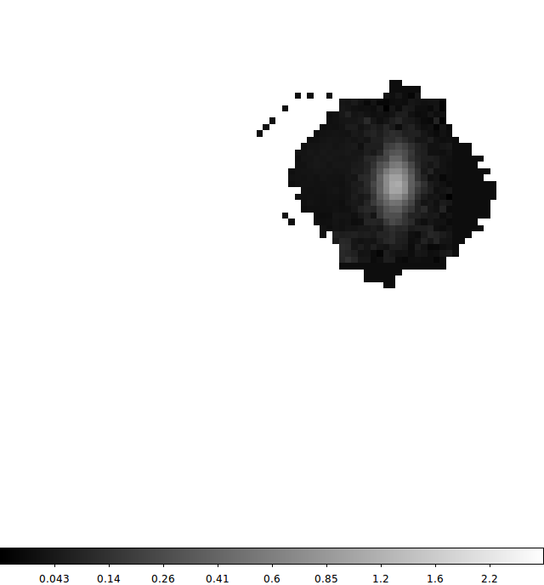
Detect, Deblend, Measure
id | parent | nchild | (measurements) | (footprint)
1 | 0 | 0 |  | regular
2 | 0 | 0 |  | regular
3 | 0 | 2 |  | regular
4 | 3 | 0 |  | heavy
5 | 3 | 0 |  | heavy
5

Slide 12
Detect, Deblend, Measure
SourceDetectionTask
SourceDeblendTask
Exposure
pixels, Psf, Wcs, ApCorrMap, ...
SourceCatalog
parent, child
[Heavy]Footprints
SingleFrameMeasurementTask
measurement field values

Slide 13
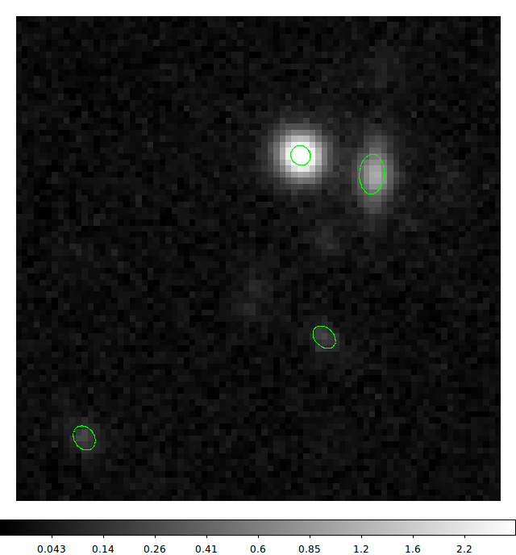
Detect, Deblend, Measure
id | parent | nchild | (measurements) | (footprint)
1 | 0 | 0 | (filled) | regular
2 | 0 | 0 | (filled) | regular
3 | 0 | 2 | (filled) | regular
4 | 3 | 0 | (filled) | heavy
5 | 3 | 0 | (filled) | heavy
4
3
5
2
1

Slide 14
Inside Measurement
replace all detections with noise
for record in catalog:
restore pixels from HeavyFootprint
run plugins
re-replace pixels with noise
apply aperture corrections
4
3
5
2
1

Slide 15
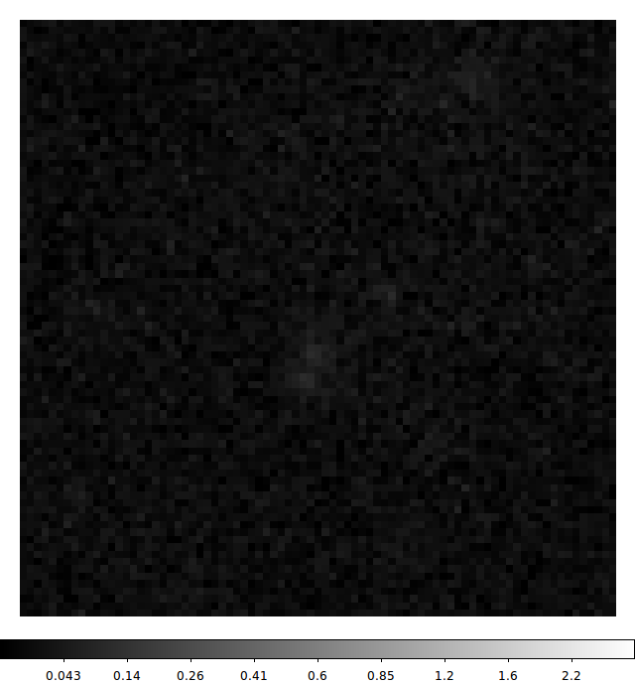
Inside Measurement
replace all detections with noise
for record in catalog:
restore pixels from HeavyFootprint
run plugins
re-replace pixels with noise
apply aperture corrections

Slide 16
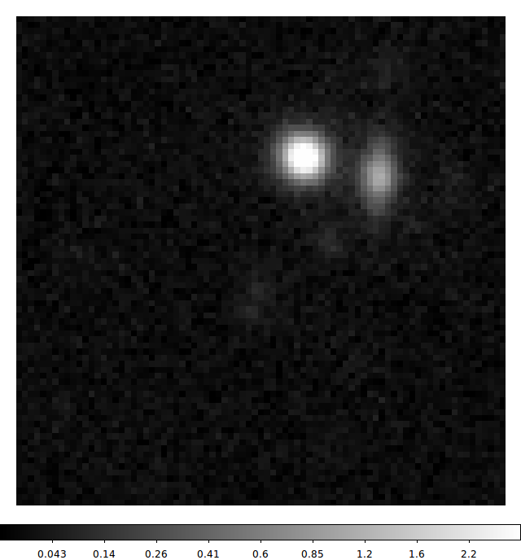
Inside Measurement
replace all detections with noise
for record in catalog:
restore pixels from HeavyFootprint
run plugins
re-replace pixels with noise
apply aperture corrections
3

Slide 17
Inside Measurement
replace all detections with noise
for record in catalog:
restore pixels from HeavyFootprint
run plugins
re-replace pixels with noise
apply aperture corrections

Slide 18
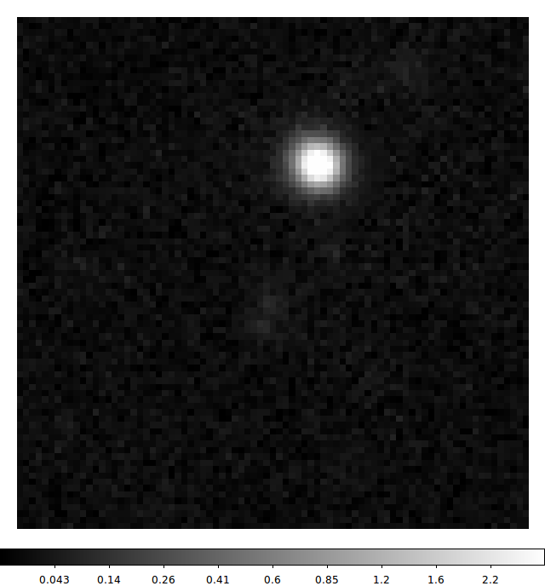
Inside Measurement
replace all detections with noise
for record in catalog:
restore pixels from HeavyFootprint
run plugins
re-replace pixels with noise
apply aperture corrections
4

Slide 19
Inside Measurement
replace all detections with noise
for record in catalog:
restore pixels from HeavyFootprint
run plugins
re-replace pixels with noise
apply aperture corrections

Slide 20
Before Initializing SingleFrameMeasurementTask
# We have to initialize all tasks before using any of them:
# multiple tasks will write to the same Schema, and we can't create an output
# catalog until we've finished defining that Schema.
# Start with a minimal schema - only the fields all SourceCatalogs need
schema = lsst.afw.table.SourceTable.makeMinimalSchema()
# Customize the detection task a bit (optional)
detectConfig = lsst.meas.algorithms.SourceDetectionConfig()
detectConfig.returnOriginalFootprints = False # should be the default
detectConfig.thresholdValue = 10 # only 10-sigma detections
# Create the detection task. We pass the schema so the task can declare a few flag fields
detectTask = lsst.meas.algorithms.SourceDetectionTask(config=detectConfig, schema=schema)
# Create a task for deblending (optional, but almost always a good idea).
# Again, the task defines a few flag fields it will later fill.
deblendTask = lsst.meas.deblender.SourceDeblendTask(schema=schema)

Slide 21
Configuring SingleFrameMeasurementTask
measureConfig = lsst.meas.base.SingleFrameMeasurementConfig()
# Modify the set of active plugins ('.names' behaves like a Python set)
measureConfig.plugins.names.remove("base_GaussianCentroid")
# Enable some plugins - import the Python module first to make them available
measureConfig.plugins.names |= ["modelfit_ShapeletPsfApprox", "modelfit_CModel"]
# Change which plugin's output we "bless" as the "Model Flux"
measureConfig.slots.modelFlux = "modelfit_CModel"
# Modify the internal configuration of one of the plugins
measureConfig.plugins["base_ClassificationExtendedness"].fluxRatio = 0.985
# Disable aperture correction, which requires having an ApCorrMap attached to
# the Exposure (it'll warn if it's not present and we don't explicitly disable it).
measureConfig.doApplyApCorr = "no"
# Actually create the Task. This initializes all the plugins and that defines the
# rest of the schema
measureTask = lsst.meas.base.SingleFrameMeasurementTask(
config=measureConfig,
schema=schema
)

Slide 22
Running SingleFrameMeasurementTask
# Create a SourceTable from the Schema. SourceTable is somewhat misleadingly named; it's
# really a factory for SourceRecords, not a container for them.
table = lsst.afw.table.SourceTable.make(schema)
# We pass the SourceTable and an Exposure to SourceDetectionTask.run(), and it'll return
# a SourceCatalog with empty records for the parents only. Those will have Footprints
# attached to them.
detectResult = detectTask.run(table, exposure)
catalog = detectResult.sources
# We then pass the exposure and the catalog to the SourceDeblendTask, which adds new
# records for all the children, and attaches HeavyFootprints to them.
# Annoyingly, we have to pass the psf separately (DM-3987)
deblendTask.run(exposure, catalog, psf=exposure.getPsf())
# Finally, we can now run measurement. Note the transposed argument order :/
measureTask.run(catalog, exposure)

Slide 23
Writing a SingleFramePlugin (in Python)
class BoxFluxConfig(lsst.meas.base.SingleFramePluginConfig):
<new code here>
@lsst.meas.base.register("ext_BoxFlux")
class BoxFluxPlugin(lsst.meas.base.SingleFramePlugin):
ConfigClass = BoxFluxConfig
@classmethod
def getExecutionOrder(cls):
return cls.FLUX_ORDER
def __init__(self, name, schema, metadata):
lsst.meas.base.SingleFramePlugin.__init__(self, name, schema, metadata)
<new code here>
def measure(self, measRecord, exposure):
<new code here>

Slide 24
Writing a SingleFramePlugin (in Python)
class BoxFluxConfig(lsst.meas.base.SingleFramePluginConfig):
width = lsst.pex.config.Field(
dtype=float, default=50,
doc="approximate width of rectangular aperture"
)
height = lsst.pex.config.Field(
dtype=float, default=50,
doc="approximate height of rectangular aperture"
)

Slide 25
Writing a SingleFramePlugin (in Python)
def measure(self, measRecord, exposure):
centroid = <get a previously-measured centroid from measRecord>
# Create a single-pixel box
point = lsst.afw.geom.Point2I(centroid)
box = lsst.afw.geom.Box2I(point, point)
# Grow the box to the desired size
box.grow(lsst.afw.geom.Extent2I(self.config.width//2, self.config.height//2))
# Horrible syntax to create a subimage. Can't use [] because it doesn't pay
# attention to xy0 :-(
subMaskedImage = exposure.getMaskedImage().Factory(
exposure.getMaskedImage(),
box,
lsst.afw.image.PARENT
)
# compute the flux by extracting and summing NumPy arrays.
flux = subMaskedImage.getImage().getArray().sum()
fluxSigma = subMaskedImage.getVariance().getArray().sum()**0.5
<stuff the results into measRecord>

Slide 26
Writing a SingleFramePlugin (in Python)
def __init__(self, config, name, schema, metadata):
lsst.meas.base.SingleFramePlugin.__init__(self, config, name, schema, metadata)
# Get a FunctorKey that can quickly look up the "blessed" centroid value.
self.centroidKey = lsst.afw.table.Point2DKey(schema["slot_Centroid"])
# Add some fields for our outputs, and save their Keys.
doc = "flux in a {0.width} x {0.height} rectangle".format(self.config)
self.fluxKey = schema.addField(
schema.join(name, "flux"), type=float, units="dn", doc=doc
)
self.fluxSigmaKey = schema.addField(
schema.join(name, "fluxSigma"), type=float, units="dn",
doc="1-sigma uncertainty for BoxFlux"
)

Slide 27
Writing a SingleFramePlugin (in Python)
def measure(self, measRecord, exposure):
centroid = measRecord.get(self.centroidKey)
# Create a single-pixel box
point = lsst.afw.geom.Point2I(centroid)
box = lsst.afw.geom.Box2I(point, point)
# Grow the box to the desired size
box.grow(lsst.afw.geom.Extent2I(self.config.width//2, self.config.height//2))
# Horrible syntax to create a subimage. Can't use [] because it doesn't pay
# attention to xy0 :-(
subMaskedImage = exposure.getMaskedImage().Factory(
exposure.getMaskedImage(),
box,
lsst.afw.image.PARENT
)
# compute the flux by extracting and summing NumPy arrays.
flux = subMaskedImage.getImage().getArray().sum()
fluxSigma = subMaskedImage.getVariance().getArray().sum()**0.5
measRecord[self.fluxKey] = flux
measRecord[self.fluxSigmaKey] = fluxSigma
why not measRecord[self.centroidKey]?

Slide 28
Error Handling in Plugins
If we try running the plugin as it stands now, we get:
lsst::pex::exceptions::LengthError: 'Box2I(Point2I(-14,-15),Extent2I(51,51)) doesn't fit in image 81x81'
...
NotImplementedError: The algorithm 'BoxFluxPlugin' thinks it cannot fail, but it did; please report this as a bug (the full traceback is above).
That's because we haven't overridden fail(), and the default implementation assumes the algorithm is infallible.

Slide 29
Error Handling in Plugins
If it's a misconfiguration or something else that will cause every measurement to fail on every single source, raise lsst.meas.base.FatalAlgorithmError.
If it's a known failure mode, the plugin should set at least two flags: a general failure flag for the plugin, and a specific flag indicating what went wrong. That can be done in two ways:
  Just set the flags in measure().
  Re-raise as lsst.meas.base.MeasurementError, and set flags in fail().
All other exceptions will trigger warnings, and fail() will be called to set the general failure flag.

Slide 30
Error Handling in Plugins
def __init__(self, config, name, schema, metadata):
lsst.meas.base.SingleFramePlugin.__init__(self, config, name, schema, metadata)
# Get a FunctorKey that can quickly look up the "blessed" centroid value.
self.centroidKey = lsst.afw.table.Point2DKey(schema["slot_Centroid"])
# Add some fields for our outputs, and save their Keys.
doc = "flux in a {0.width} x {0.height} rectangle".format(self.config)
self.fluxKey = schema.addField(
schema.join(name, "flux"), type=float, units="dn", doc=doc
)
self.fluxSigmaKey = schema.addField(
schema.join(name, "fluxSigma"), type=float, units="dn",
doc="1-sigma uncertainty for BoxFlux"
)
self.flagKey = schema.addField(
schema.join(name, "flag"), type="Flag",
doc="general failure flag for BoxFlux"
)
self.edgeFlagKey = schema.addField(
schema.join(name, "flag", "edge"), type="Flag",
doc="flag set when rectangle used by BoxFlux doesn't fit in the image"
)

Slide 31
Error Handling in Plugins
@lsst.meas.base.register("ext_BoxFlux")
class BoxFluxPlugin(lsst.meas.base.SingleFramePlugin):
ConfigClass = BoxFluxConfig
FAILURE_EDGE = 1
@classmethod
def getExecutionOrder(cls):
return cls.FLUX_ORDER
def __init__(self, config, name, schema, metadata):
...
def measure(self, measRecord, exposure):
...
def fail(self, measRecord, error=None):
measRecord.set(self.flagKey, True)
if error is not None:
assert error.getFlagBit() == self.FAILURE_EDGE
measRecord.set(self.edgeFlagKey, True)
error is guaranteed to be either an instance of MeasurementError or None

Slide 32
Error Handling in Plugins
If we try running the plugin again, we get a warning:
measurement WARNING: Error in ext_BoxFlux.measure on record 1:
...
lsst::pex::exceptions::LengthError: 'Box2I(Point2I(-14,-15),Extent2I(51,51)) doesn't fit in image 81x81'
That's because we're still throwing a LengthError in measure(), and that means we're not setting our new edge flag.

Slide 33
Error Handling in Plugins
def measure(self, measRecord, exposure):
...
# Horrible syntax to create a subimage. Can't use [] because it doesn't pay
# attention to xy0 :-(
try:
subMaskedImage = exposure.getMaskedImage().Factory(
exposure.getMaskedImage(),
box,
lsst.afw.image.PARENT
)
except lsst.pex.exceptions.LengthError as err:
raise lsst.meas.base.MeasurementError(err, self.FAILURE_EDGE)
# compute the flux by extracting and summing NumPy arrays.
flux = subMaskedImage.getImage().getArray().sum()
fluxSigma = subMaskedImage.getVariance().getArray().sum()**0.5
measRecord[self.fluxKey] = flux
measRecord[self.fluxSigmaKey] = fluxSigma

Slide 34
Unit Transformations
Measurement algorithms always produce outputs in raw units (pixels, dn).
Each plugin also has an associated TransformClass, which implements the interface defined by MeasurementTransform. Most new plugins can either use one of the existing subclasses or a trivial subclass.
TransformTask can be used to calibrate a catalog produced by SingleFrameMeasurementTask, by calling all of the TransformClasses associated with the plugins that were run.

Slide 35
Unit Transformations
class BoxFluxTransform(lsst.meas.base.FluxTransform):
def __init__(self, config, name, mapper):
lsst.meas.base.FluxTransform.__init__(self, name, mapper)
mapper.addMapping(mapper.getInputSchema().find(name + "_flag_edge").key)
@lsst.meas.base.register("ext_BoxFlux")
class BoxFluxPlugin(lsst.meas.base.SingleFramePlugin):
...
@classmethod
def getTransformClass(cls):
return BoxFluxTransform
...

Slide 36
Plugins in C++
Plugins can also be written in C++ (and in fact most of the current ones are). The steps are:
Define a control struct (the C++ version of the config class).
Inherit from SingleFrameAlgorithm, and override measure() and fail().
Swig both classes as usual.
Call the wrapSingleFrameAlgorithm function at module scope (so it's executed when the module is imported).

Slide 37
Utility Classes for Plugins
We've been doing things the hard way. There are a number of utility classes in lsst.meas.base to make things easier:
FlagHandler will manage a set of flag keys for different error conditions, and implement fail() for you. Unfortunately this can only be used from C++ at the moment (DM-4009).
SafeCentroidExtractor and SafeShapeExtractor get centroid and shape values from previous measurements while handling flags appropriately. These depend on FlagHandler, though, so they can only be used from C++ as well.
FluxResult[Key], CentroidResult[Key], and ShapeResult[Key] map simple structs to records and make it easier to create output fields for common types of measurements.

Slide 38
Forced Measurement
It's also important to be able to measure sources in one image while holding some properties (e.g. centroids) fixed to values measured in another image.
For this, there's ForcedMeasurementTask (and a ForcedPlugin base class for plugins).
These work pretty much the same way as their single-frame counterparts, with additional arguments to deal with the reference catalog.
ProcessImageForcedTask and its subclasses provide command-line drivers for forced measurement, and are probably easier to use than ForcedMeasurementTask itself when the reference catalog is an LSST stack output.

