Slide 1
afw Simon Krughoff UW DM T/CAM October 6, 2015
DM Bootcamp 2015
October 4-6 | The internet

Slide 2
Contents of afw
cameraGeom
A system for representing transformation between different coordinate systems in the optical system.
Utilities for building cameras
Cameras are typically built by the instrument mapper (in the obs_ package)
Utilities for visualizing camera layouts

Slide 3
Contents of afw
Coord
Coordinate construction and conversion utilities
Implements the following coordinate system
FK5
ICRS
Ecliptic
Galactic
Topocentric
Very basic Observatory container (lat, lon, elevation)

Slide 4
Contents of afw
Detection
Footprint (and HeavyFootprint)
Threshold
bitmask, value, sigma, sigma per pixel
Psf

Slide 5
Contents of afw
geom (not lsst.geom…)
Simple geometry constructs – Angle, Box, Extent, Point, Span
More complicated geometry – Ellipse, Polygon
XYTransforms – Affine, Identity, Inverted, Multi, Radial, Separable

Slide 6
Contents of afw
image
Image like things:
Image – a single grid of pixels (float, double, int, uint)
Mask – a grid of bit mask pixels with associated mask plane definitions.
DecoratedImage – Image with metadata (deprecated)
MaskedImage – Image + Mask + Variance
Exposure – MaskedImage with associated image things: WCS, Psf, metadata, calibration info
Other associated things – Defect, Filter, Calib (this is really photometric calibration), Wcs
Utilities for dealing with images

Slide 7
Contents of afw
math
Statistics – mean, stdev, var, median, inner quartile range, clipped stats, min, max, sum
Kernels
Convolution
Interpolation and approximation
Fitting
Functions – Gaussian, Polynomial, Chebyshev, Double Gaussian
Splines
Random number generator
Warping – Lanczos, bilinear, NN

Slide 8
Contents of afw
table
Tables are really catalogs with fixed schema. The schema is flexible and can be set up to do lots of things.
Store amplifier electronics info: AmpInfoTable
Source catalogs
Matched reference catalogs to source catalogs

Slide 9
How to find things
Doxygenhttp://lsst-web.ncsa.illinois.edu/doxygen/x_masterDoxyDoc/afw.html
GitHub code search
Can be useful, but has significant limitations (full word search only)
I find the tree browsing features very useful
Unit tests
Help strings in Python
Useful info is not always forwarded from C++
Searching with an editor
Sublime Text, Emacs, and vim are all popular choices

Slide 10
Let’s take a look at afw
This code comes from the short script at:
https://github.com/lsst-dm/Oct15_bootcamp/blob/master/code/afw_talk.py
The intent is just to introduce a few of the useful afw classes in a toy scenario.
Make sure you setup the display_ds9 package if you want to display to be output to your local ds9.

Slide 11
Let’s take a look at afw
Start by making an image from a bounding box:
import lsst.afw.image as afwImage
import lsst.afw.geom as afwGeom
from lsst.pex.exceptions import LengthError
n_objects = 1000
box = afwGeom.BoxI(afwGeom.PointI(300, 500),
afwGeom.ExtentI(2000, 2048))
im = afwImage.ImageF(box)
print im.getXY0()
>>> (300, 500)

Slide 12
Let’s take a look at afw
Note that the LLC is not at 0,0. This bounding box is relative to a global coordinate system called PARENT (the default).
Now try to construct a view into a sub-region of the image we just made:
subbox = afwGeom.BoxI(afwGeom.PointI(10, 10),
afwGeom.ExtentI(100, 100))
try:
im2 = afwImage.ImageF(im, subbox)
except LengthError:
im2 = afwImage.ImageF(im, subbox, afwImage.LOCAL)

Slide 13
Let’s take a look at afw
We have an image. Let’s put something in it. First create some random positions to put down Gaussian spots.
import lsst.afw.math as afwMath
rand = afwMath.Random()
buffer_xy = 150 # Don't put objects near the edges
x_positions = [rand.uniformInt(im.getWidth() - 2*buffer_xy)
+ buffer_xy for i in xrange(n_objects)]
y_positions = [rand.uniformInt(im.getHeight() - 2*buffer_xy)
+ buffer_xy for i in xrange(n_objects)]

Slide 14
Let’s take a look at afw
Set up the display and create an image of a Gaussian PSF to put in the image.
import lsst.afw.detection as afwDetect
import lsst.afw.display as afwDisplay
display = afwDisplay.getDisplay()
display.setMaskTransparency(50, None
psf_size = 121 # This has to be odd
sigma = 0.7/0.2 # seeing in arcsec/pixel size in arcsec
peak_val = 6000
psf = afwDetect.GaussianPsf(psf_size, psf_size, sigma)
psf_im = psf.computeImage()

Slide 15
Let’s take a look at afw
Not shown, the PSF image is normalized to a realistic value. Now add the images at the random positions. Look out for the gotcha.
for x, y in zip(x_positions, y_positions):
x0 = x - (psf_size - 1)/2
y0 = y - (psf_size - 1)/2
box = afwGeom.BoxI(afwGeom.PointI(x0, y0),
afwGeom.ExtentI(psf_size, psf_size))
subim = afwImage.ImageF(im, box, afwImage.LOCAL)
try:
subim += psf_im
except NotImplementedError:
psf_im = psf_im.convertF()
subim += psf_im

Slide 16
Let’s take a look at afw
We now have an image populated with Gaussian blobs. Let’s add some background noise, and turn this into a proper MaskedImage.
back_im = afwImage.ImageF(im.getBBox())
afwMath.randomPoissonImage(back_im, rand, 1000)
im += back_im
display.mtv(im)
display.incrDefaultFrame()
mask = afwImage.MaskU(im.getBBox())
masked_im = afwImage.MaskedImageF(im, mask, im)

Slide 17
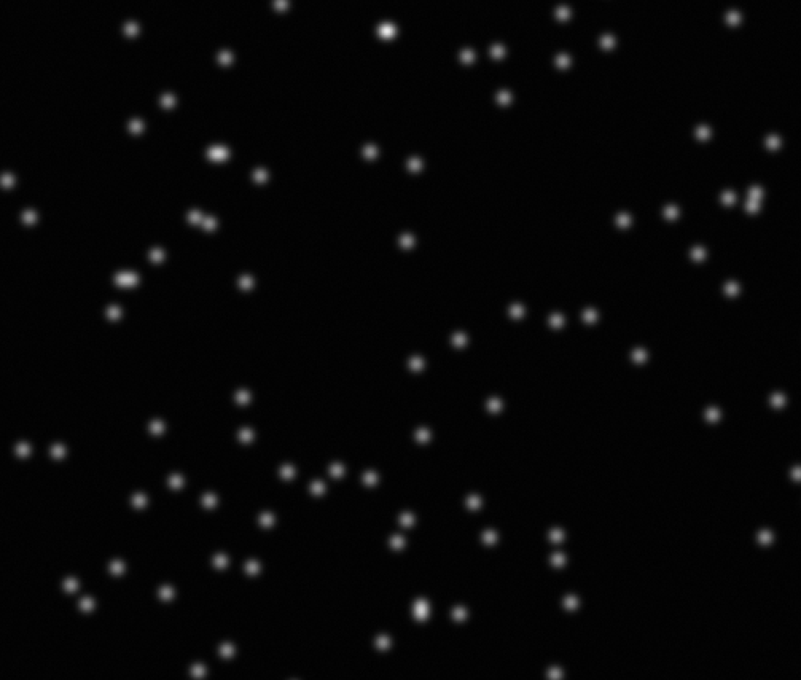

Slide 18
Let’s take a look at afw
And now to do a naïve detection. This will set the DETECTED mask plane so we should be able to look at the footprints in ds9.
threshold = afwDetect.createThreshold(5., 'stdev')
fs = afwDetect.FootprintSet(masked_im, threshold,
'DETECTED')
display.mtv(masked_im)
display.incrDefaultFrame()

Slide 19
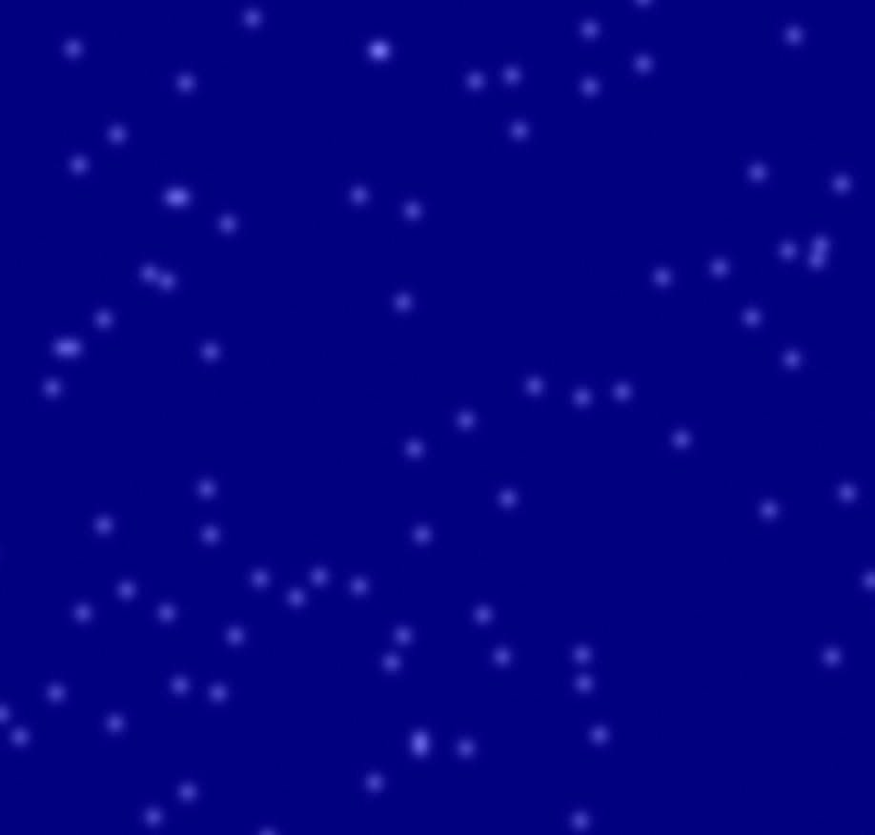

Slide 20
Let’s take a look at afw
Of course everything is detected because the background noise floor is more than 5 sigma from zero. We need to estimate then subtract the background.
bctrl = afwMath.BackgroundControl(11, 11)
bkgd = afwMath.makeBackground(masked_im, bctrl)
masked_im -= bkgd.getImageF()
masked_im.getMask().set(0) # reset mask
fs = afwDetect.FootprintSet(masked_im, threshold,
'DETECTED')
display.mtv(masked_im)
display.incrDefaultFrame()

Slide 21
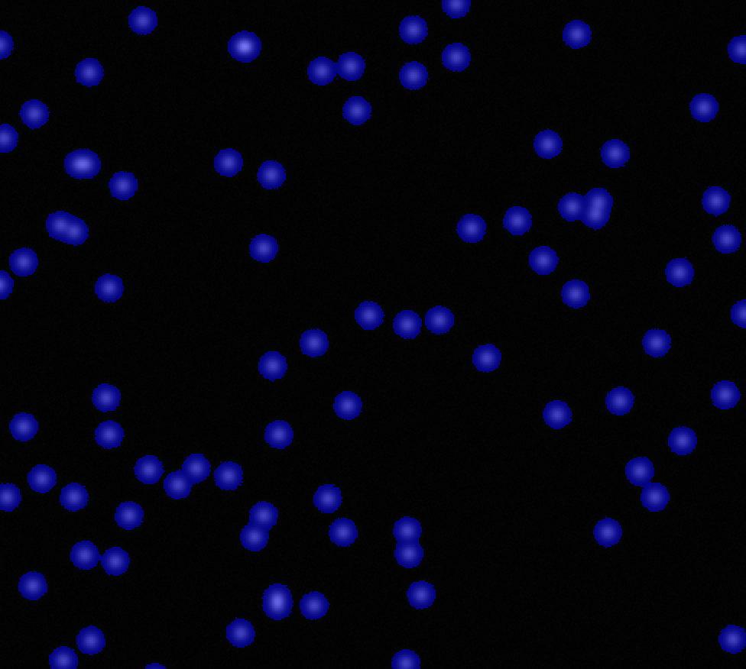

Slide 22
Let’s take a look at afw
There are lots of other features of afw. Here are a few.
# numpy arrays from images
im, mask, var = masked_im.getArrays()
print type(im)
print im.dtype

Slide 23
Let’s take a look at afw
There are lots of other features of afw. Here are a few.
# arrays are views
xy0 = masked_im.getXY0()
xy0 = masked_im.getXY0()
xy0.shift(afwGeom.ExtentI(100, 120))
box = afwGeom.BoxI(xy0, afwGeom.ExtentI(100, 100))
subim = afwImage.ImageF(masked_im.getImage(), box)
sub_arr = subim.getArray()
sub_arr[:][:] = im.max()
display.mtv(masked_im)

Slide 24
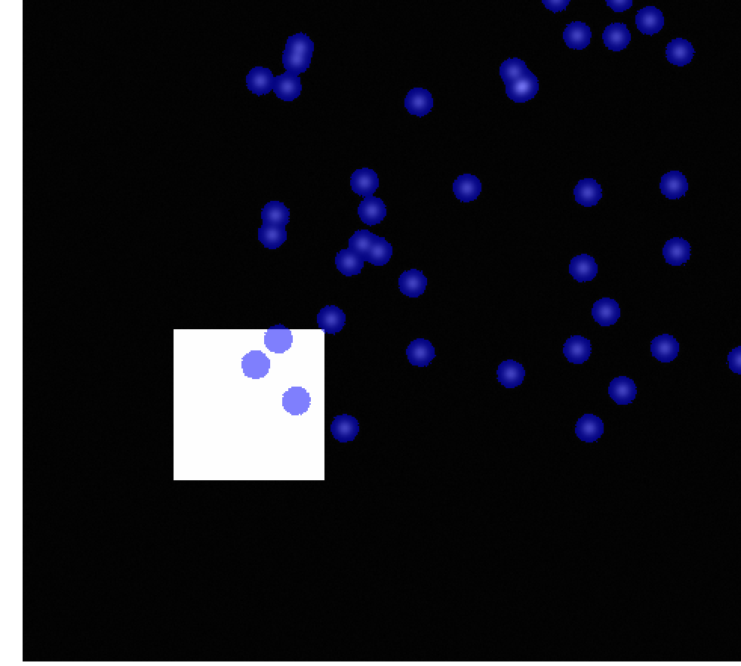

Slide 25
Let’s take a look at afw
There are lots of other features of afw. Here are a few.
# The >>= operator
left_box = afwGeom.BoxI(afwGeom.PointI(0,0),
afwGeom.ExtentI(1000, 2048))
right_box = afwGeom.BoxI(afwGeom.PointI(1000, 0),
afwGeom.ExtentI(1000, 2048))
im = masked_im.getImage()
new_im = afwImage.ImageF(masked_im.getBBox())
left_subim = afwImage.ImageF(im, left_box, afwImage.LOCAL)
right_subim = afwImage.ImageF(im, right_box, afwImage.LOCAL)
left_subim *= -1
new_subim = afwImage.ImageF(new_im, left_box, afwImage.LOCAL)
new_subim <<= left_subim
new_subim = afwImage.ImageF(new_im, right_box, afwImage.LOCAL)
new_subim <<= right_subim

Slide 26
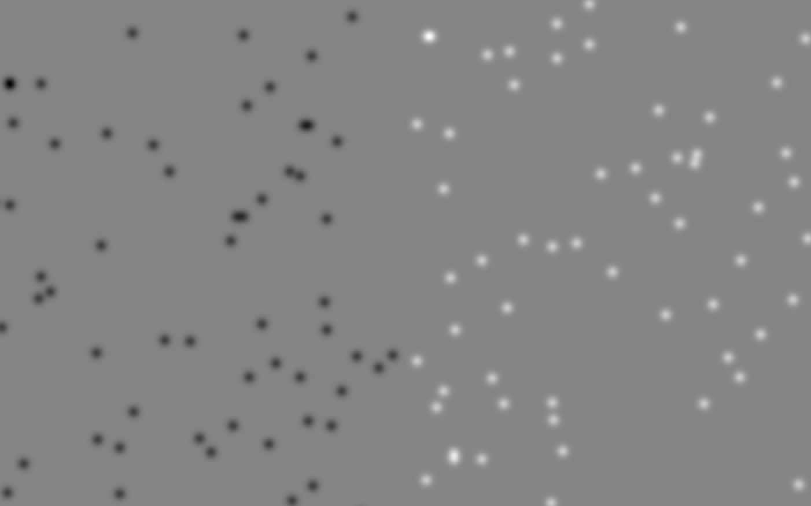

Slide 27
Understanding afw
The original intent was to keep the C++ environment rich.
This leads to classes (not just functions) defined in C++
There is a strong effort to expose as much C++ in Python as possible.
This can lead to more than one way to do things.
Takeaway: The Python/C++ line is hard to draw. We should continue to be observant and strive to make the stack as generally useful/useable as possible.

