Slide 1
Orchestration and Control Stephen Pietrowicz Senior Research Programmer - NCSA October 7, 2015
DM Boot Camp
Oct 5-7, 2015

Slide 2
Applications
Develop and test locally
Run the same code across a number of machines

Slide 3
LSST package ctrl_orca - Orca
Orca coordinates software setup, execution, monitoring and shutdown of application across multiple machines
User specifies user specific defaults in Config files
Can be confusing if switching between environments because of platform requirements

Slide 4
LSST package ctrl_execute
Simplifies the execution of Orca
Writes configuration files and executes Orca
Executes apps in varied host execution environments
Duplicates local execution environment remotely
The local packages that are setup with EUPS are duplicated remotely to more easily replicate any errors locally.

Slide 5
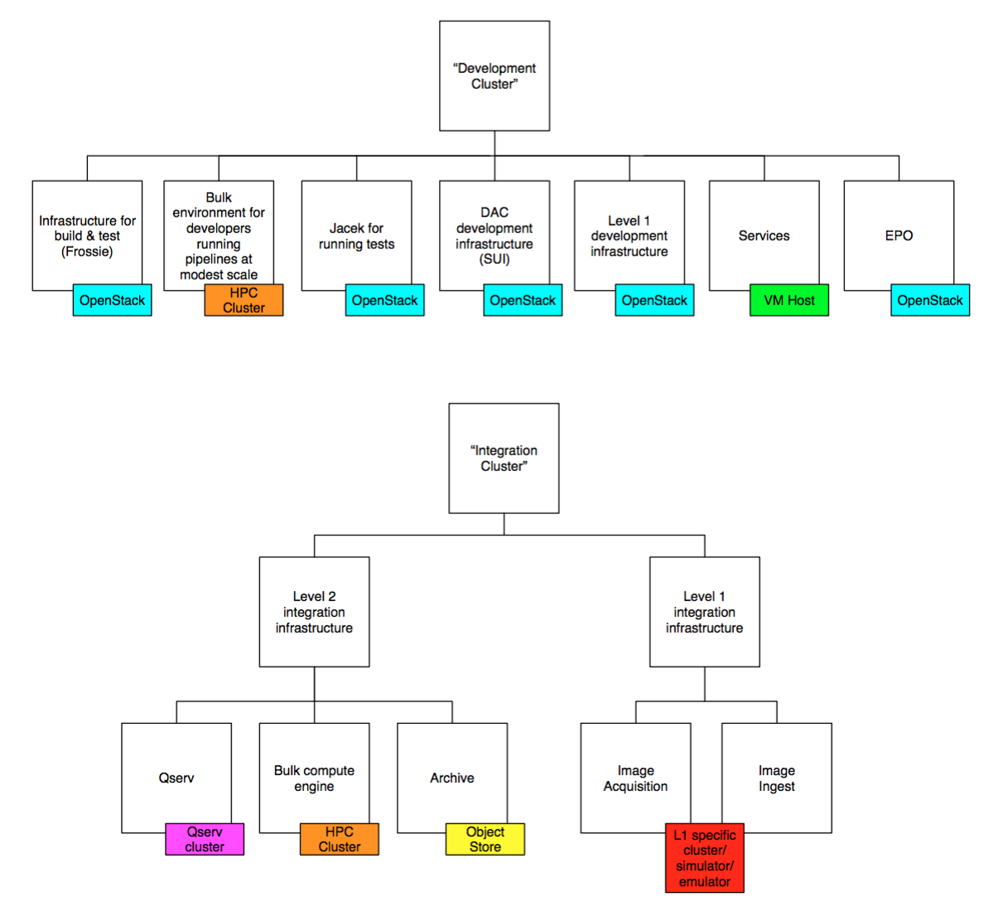
Platform

Slide 6
Orchestration Quick Start
From lsst-dev:
$ setup ctrl_execute
$ setup ctrl_platform_lsst
$ runOrca.py -p lsst -c "processCcdSdss.py sdss /home/user/input --output ./output" -i $HOME/input.txt -e /lsst/stack
Where:
-p lsst target platform is the lsst cluster
-c “cmd” command to run
-i $HOME/input.txt data id input file
-e /lsst/stack location of execution stack

Slide 7
Data ids
$ runOrca.py -p lsst -c "processCcdSdss.py sdss /home/user/input --output ./output" -i $HOME/input.txt -e /lsst/stack
Data ids from the “-i $HOME/input.txt” are appended as “--id <id>”, one per job by default.
You can execute multiple ids per job by using the –n option to runOrca.py:
$ runOrca.py -p lsst -c "processCcdSdss.py sdss /home/user/input --output ./output" –n 12 -i $HOME/input.txt -e /lsst/stack
In this case, Orca will append 12 data ids per job, giving the last job 12 or less data ids, depending on how many were in the input.txt file.
The input file format is one item per line, with the item depending on the command being executed.

Slide 8
runOrca.py example
$ runOrca.py -p lsst -c "/bin/echo" -i $HOME/ids.txt -e ~/lsstsw
This will:
Launch Orca, executing on the lsst cluster, running the command “/bin/echo –id <id>” using the stack located at ~/lsstsw

Slide 9
runOrca.py example
$ runOrca.py -p lsst -c "/bin/echo" -i $HOME/ids.txt -e ~/lsstsw
runid for this run is srp_2015_0930_141934
condor_submit_dag S2012Pipe.diamond.dag
I am: hostname: lsst-dev, fully qualified doman name: lsst-dev.ncsa.illinois.edu, IP: 141.142.237.30, IPv4: 141.142.237.30, IPv6:
I am: hostname: lsst-dev, fully qualified doman name: lsst-dev.ncsa.illinois.edu, IP: 141.142.237.30, IPv4: 141.142.237.30, IPv6:
Condor dag submitted as job 94022
Production launched.
Waiting for shutdown request.
(Note that the “I am: hostname…” lines are output from the current version of HTCondor and will be removed in a subsequent release).
Remember this

Slide 10
What’s happening in HTCondor (1/3)
lsst-dev> condor_q
-- Schedd: lsst-dev.ncsa.illinois.edu : <141.142.237.30:61973?...
ID OWNER SUBMITTED RUN_TIME ST PRI SIZE CMD
79561.0 coughlin 9/18 12:00 11+17:16:25 R 0 0.3 condor_dagman -p 0
79562.0 coughlin 9/18 12:00 0+14:37:37 H 0 1220.7 run_fisheye.py -o
94022.0 srp 9/30 14:19 0+00:00:02 R 0 0.3 condor_dagman -p 0
3 jobs; 0 completed, 0 removed, 0 idle, 2 running, 1 held, 0 suspended
lsst-dev> condor_q
-- Schedd: lsst-dev.ncsa.illinois.edu : <141.142.237.30:61973?...
ID OWNER SUBMITTED RUN_TIME ST PRI SIZE CMD
79561.0 coughlin 9/18 12:00 11+17:16:33 R 0 0.3 condor_dagman -p 0
79562.0 coughlin 9/18 12:00 0+14:37:37 H 0 1220.7 run_fisheye.py -o
94022.0 srp 9/30 14:19 0+00:00:10 R 0 0.3 condor_dagman -p 0
94023.0 srp 9/30 14:19 0+00:00:00 I 0 0.0 preJob.sh

Slide 11
What’s happening in HTCondor (2/3)
lsst-dev> condor_q
-- Schedd: lsst-dev.ncsa.illinois.edu : <141.142.237.30:61973?...
ID OWNER SUBMITTED RUN_TIME ST PRI SIZE CMD
79561.0 coughlin 9/18 12:00 11+17:16:46 R 0 0.3 condor_dagman -p 0
79562.0 coughlin 9/18 12:00 0+14:37:37 H 0 1220.7 run_fisheye.py -o
94022.0 srp 9/30 14:19 0+00:00:23 R 0 0.3 condor_dagman -p 0
3 jobs; 0 completed, 0 removed, 0 idle, 2 running, 1 held, 0 suspended
lsst-dev> condor_q
-- Schedd: lsst-dev.ncsa.illinois.edu : <141.142.237.30:61973?...
ID OWNER SUBMITTED RUN_TIME ST PRI SIZE CMD
79561.0 coughlin 9/18 12:00 11+17:16:54 R 0 0.3 condor_dagman -p 0
79562.0 coughlin 9/18 12:00 0+14:37:37 H 0 1220.7 run_fisheye.py -o
94022.0 srp 9/30 14:19 0+00:00:31 R 0 0.3 condor_dagman -p 0
94024.0 srp 9/30 14:20 0+00:00:02 R 0 0.0 worker.sh srp_2015
94025.0 srp 9/30 14:20 0+00:00:00 I 0 0.0 worker.sh srp_2015
94026.0 srp 9/30 14:20 0+00:00:00 I 0 0.0 worker.sh srp_2015
6 jobs; 0 completed, 0 removed, 2 idle, 3 running, 1 held, 0 suspended

Slide 12
What’s happening in HTCondor (3/3)
lsst-dev> condor_q
-- Schedd: lsst-dev.ncsa.illinois.edu : <141.142.237.30:61973?...
ID OWNER SUBMITTED RUN_TIME ST PRI SIZE CMD
79561.0 coughlin 9/18 12:00 11+17:17:01 R 0 0.3 condor_dagman -p 0
79562.0 coughlin 9/18 12:00 0+14:37:37 H 0 1220.7 run_fisheye.py -o
94022.0 srp 9/30 14:19 0+00:00:38 R 0 0.3 condor_dagman -p 0
3 jobs; 0 completed, 0 removed, 0 idle, 2 running, 1 held, 0 suspended
By default, HTCondor output files are put into:
$HOME/condor_scratch/your_runid
in this case:
$HOME/condor_scratch/srp_2015_0930_141934

Slide 13
runOrca.py example (cont’d)
$ runOrca.py -p lsst -c "/bin/echo" -i $HOME/ids.txt -e ~/lsstsw
runid for this run is srp_2015_0930_141934
condor_submit_dag S2012Pipe.diamond.dag
I am: hostname: lsst-dev, fully qualified doman name: lsst-dev.ncsa.illinois.edu, IP: 141.142.237.30, IPv4: 141.142.237.30, IPv6:
I am: hostname: lsst-dev, fully qualified doman name: lsst-dev.ncsa.illinois.edu, IP: 141.142.237.30, IPv4: 141.142.237.30, IPv6:
Condor dag submitted as job 94022
Production launched.
Waiting for shutdown request.
sending last Logger Event
logger.pid = 1582307
logger handled... and... done!
$
By default, application output is put into /lsst/DC3root/your_runid
In this case, that would be /lsst/DC3root/srp_2015_0930_141934

Slide 14
Application output
$ pwd
/lsst/DC3root/srp_2015_0930_141934
$ ls
eups.list logs output
$ ls -R logs
logs:
lsst5
logs/lsst5:
slot1
logs/lsst5/slot1:
S2012Pipe-1.log S2012Pipe-2.log S2012Pipe-3.log
$ cd logs/lsst5/slot1
$ cat S2012Pipe-1.log
--id 1
$ cat S2012Pipe-2.log
--id 2
$ cat S2012Pipe-3.log
--id 3
$

Slide 15
HTCondor output
$ pwd
/home/srp/condor_scratch/srp_2015_0930_141934
$ ls
logs S2012Pipe.diamond.dag.lib.err
S2012Pipe.config S2012Pipe.diamond.dag.lib.out
S2012Pipe.diamond.dag S2012Pipe.diamond.dag.metrics
S2012Pipe.diamond.dag.condor.sub S2012Pipe.diamond.dag.nodes.log
S2012Pipe.diamond.dag.dagman.log S2012Pipe.mapping
S2012Pipe.diamond.dag.dagman.out workers
$

Slide 16
HTCondor
$ condor_q
-- Schedd: lsst-dev.ncsa.illinois.edu : <141.142.225.160:37253>
ID OWNER SUBMITTED RUN_TIME ST PRI SIZE CMD
7092.0 srp 8/21 09:04 0+03:40:23 R 0 0.3 condor_dagman
7094.0 srp 8/21 09:05 0+00:43:04 I 0 97.7 matrix.sh visit=88
7095.0 srp 8/21 09:05 0+00:42:54 I 0 97.7 matrix.sh visit=88
7096.0 srp 8/21 09:05 0+00:42:54 I 0 97.7 matrix.sh visit=88
4 jobs; 0 completed, 0 removed, 3 idle, 1 running, 0 held, 0 suspended
$ condor_rm 7096
Cluster 7096 has been marked for removal.
$ condor_q
-- Submitter: lsst-dev.ncsa.illinois.edu : <141.142.225.160:37253> : lsst-dev.ncsa.illinois.edu
ID OWNER SUBMITTED RUN_TIME ST PRI SIZE CMD
7092.0 srp 8/21 09:04 0+03:48:26 R 0 0.3 condor_dagman
7094.0 srp 8/21 09:05 0+00:43:04 I 0 97.7 matrix.sh visit=88
7095.0 srp 8/21 09:05 0+00:42:54 I 0 97.7 matrix.sh visit=88
3 jobs; 0 completed, 0 removed, 2 idle, 1 running, 0 held, 0 suspended
$
The command condor_status will show how many slots are available.

Slide 17
Further information
$ condor_q
-- Schedd: lsst-dev.ncsa.illinois.edu : <141.142.225.160:37253>
ID OWNER SUBMITTED RUN_TIME ST PRI SIZE CMD
7092.0 srp 8/21 09:04 0+03:40:23 R 0 0.3 condor_dagman
7094.0 srp 8/21 09:05 0+00:43:04 I 0 97.7 matrix.sh visit=88
7095.0 srp 8/21 09:05 0+00:42:54 I 0 97.7 matrix.sh visit=88
7096.0 srp 8/21 09:05 0+00:42:54 I 0 97.7 matrix.sh visit=88
4 jobs; 0 completed, 0 removed, 3 idle, 1 running, 0 held, 0 suspended
$ condor_rm 7096
Cluster 7096 has been marked for removal.
$ condor_q
-- Submitter: lsst-dev.ncsa.illinois.edu : <141.142.225.160:37253> : lsst-dev.ncsa.illinois.edu
ID OWNER SUBMITTED RUN_TIME ST PRI SIZE CMD
7092.0 srp 8/21 09:04 0+03:48:26 R 0 0.3 condor_dagman
7094.0 srp 8/21 09:05 0+00:43:04 I 0 97.7 matrix.sh visit=88
7095.0 srp 8/21 09:05 0+00:42:54 I 0 97.7 matrix.sh visit=88
3 jobs; 0 completed, 0 removed, 2 idle, 1 running, 0 held, 0 suspended
$
The command condor_status will show how many slots are available.

Slide 18
Further information
Further information, including information about ctrl_execute templates and HTCondor statistics is available at:
https://confluence.lsstcorp.org/display/DM/Orchestration

