Slide 1
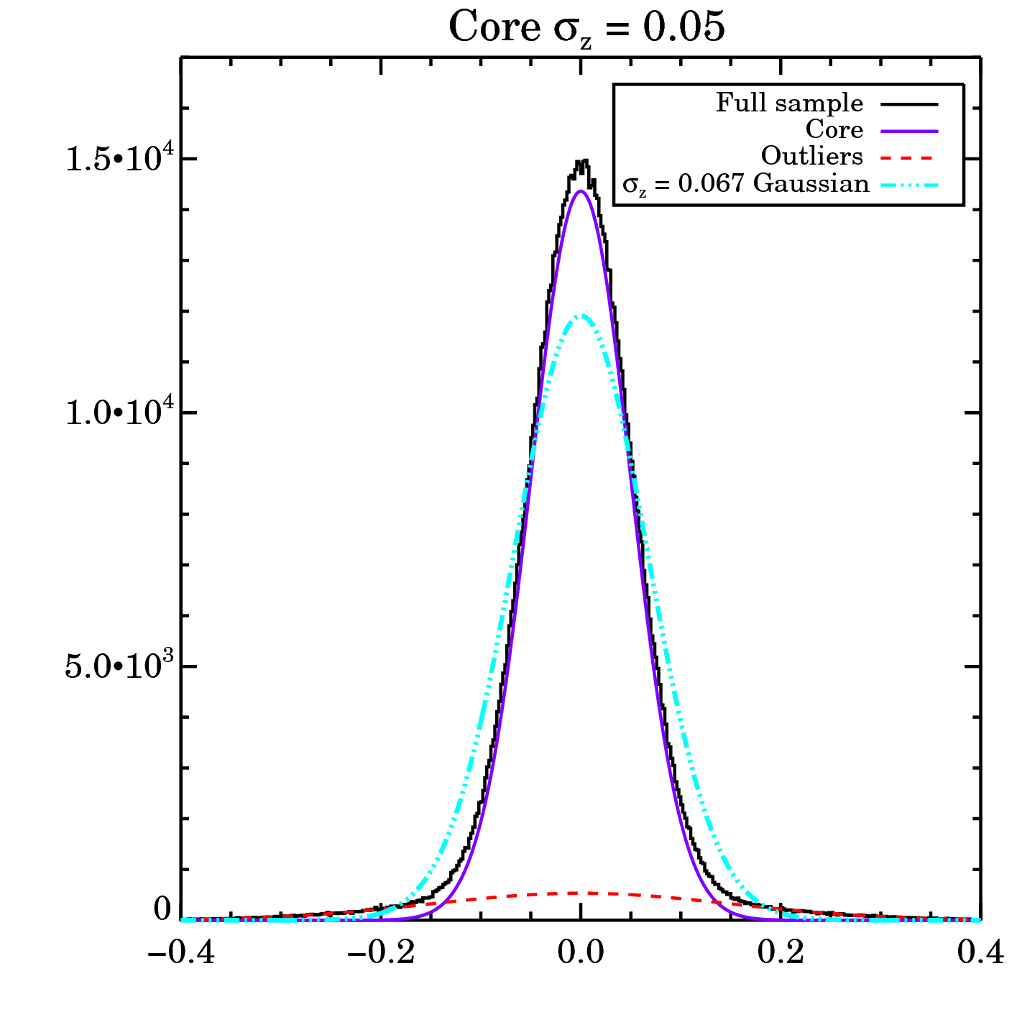
Flowdown of requirements for LSST photometric redshifts
Wish to reach DETF FoM of ~750 in maximum-probability, SRD scenario
Lensing + BAO + SN FoM is a slow function of σ_{z}
Desired FoM is achieved when RMS redshift error <~0.07-0.09 (1+z)
Requirement on error distribution: typical σ_{z}=0.05(1+z) with <10% >3σ outliers (assuming σ_{outlier} = 3σ_{typical})

Slide 2
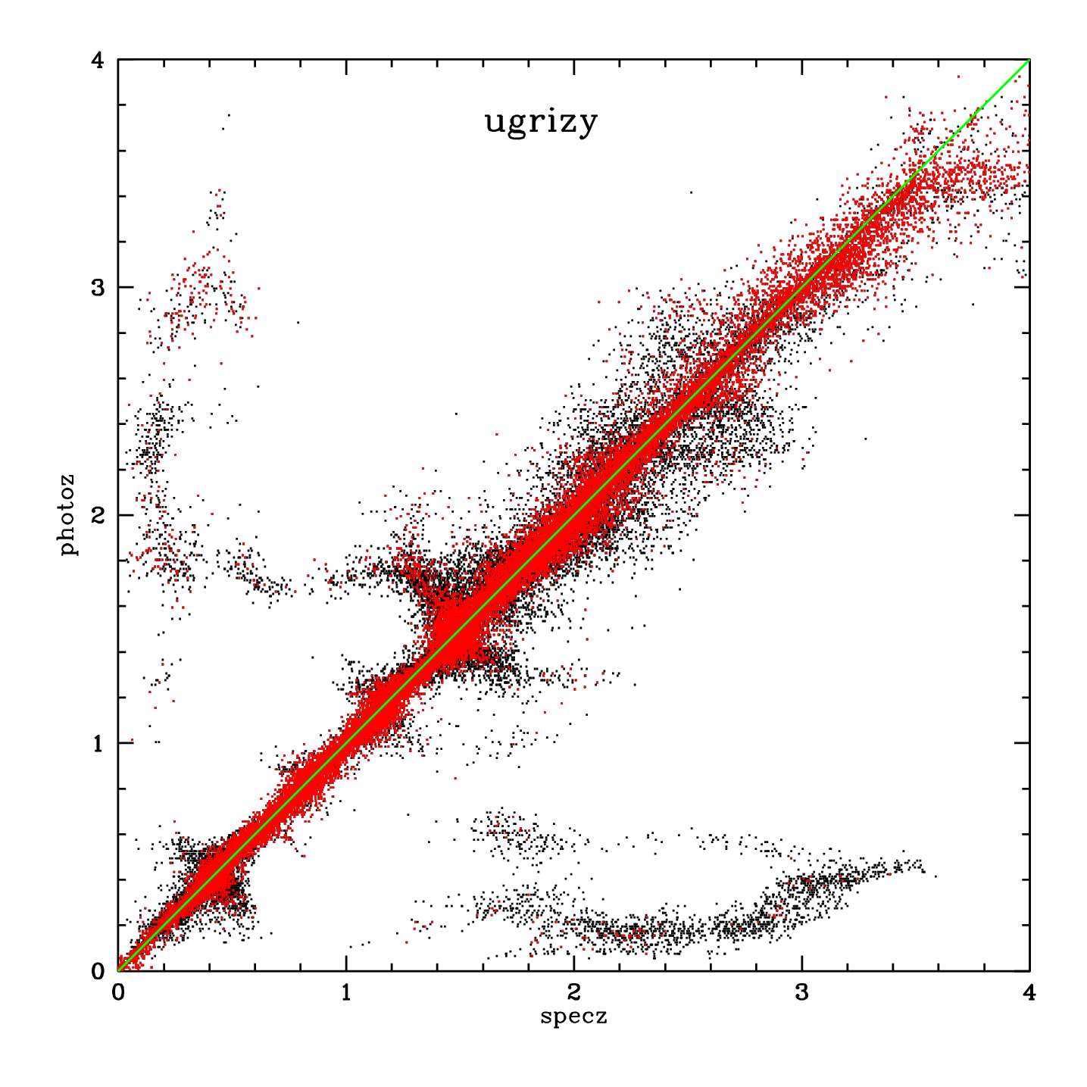
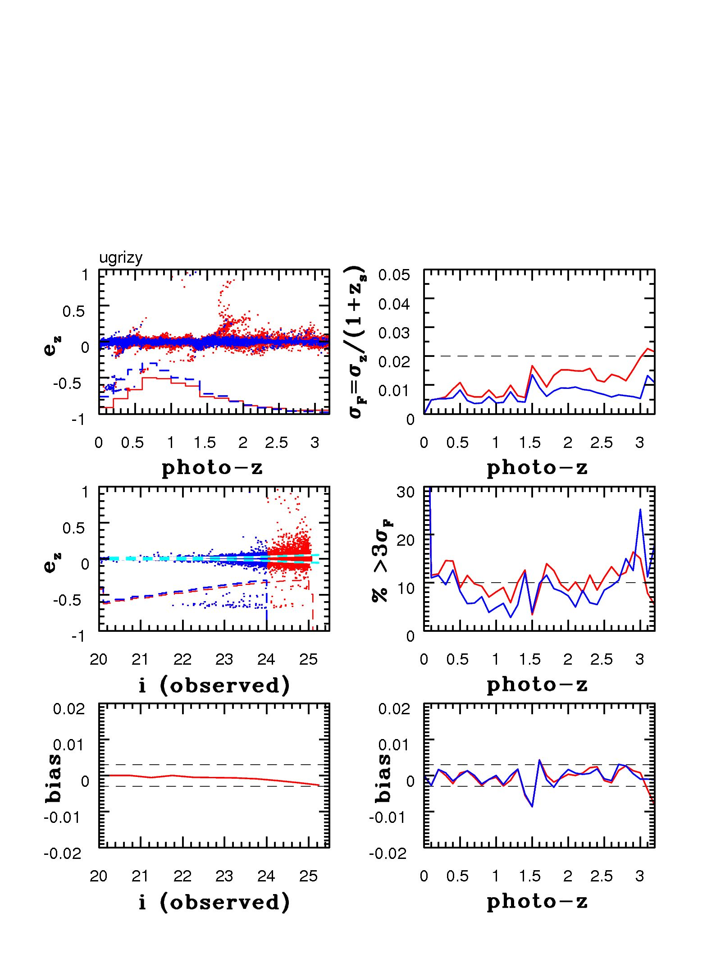
Flowdown of requirements for LSST photometric redshifts
Based on simulations with restricted sets of templates, astrophysical uncertainties could degrade photo-z errors by a factor of ~2
Hence if we want actual typical σ_{z} to be <0.05(1+z), then the typical σ_{z} delivered by the system with perfect templates must be < 0.02(1+z)
Requirement on system-limited photometric redshift performance : typical σ_{z}=0.02(1+z) & <10% outliers

Slide 3
Expected performance for LSST exceeds these requirements
Green dashed lines = requirement on actual performance
Grey dashed lines = requirement on system-limited performance (where different)
Current simulations show SRD goals can be achieved: ugrizy to LSST depths provides sufficient information to determine photo-z
Simulations by Sam Schmidt (UC Davis), using LSST error model

Slide 4
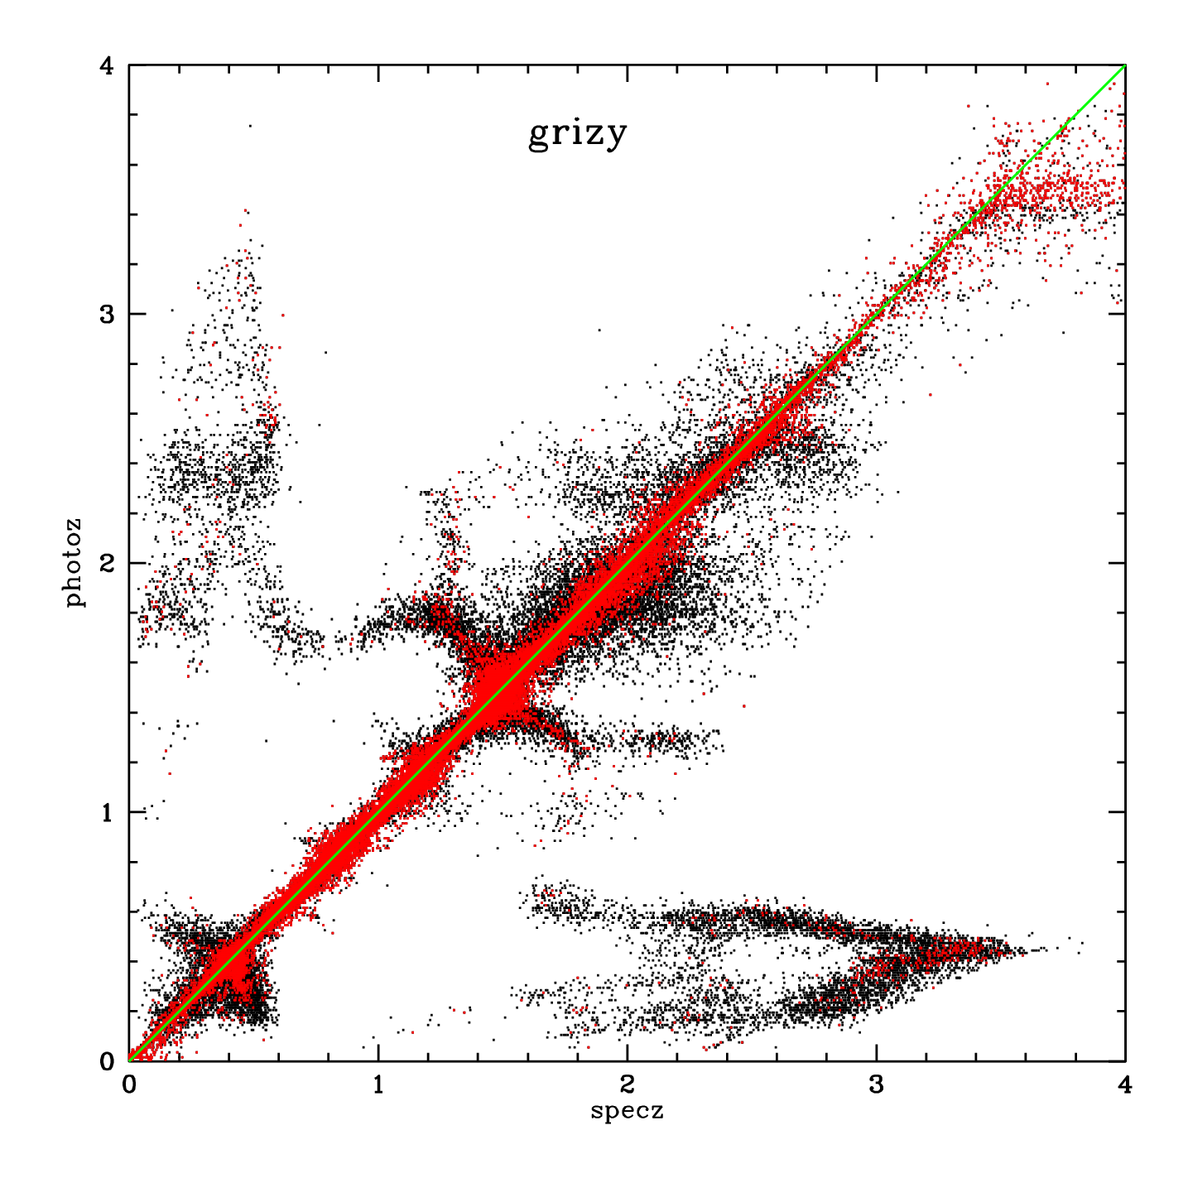
Without u or y, we would have to sacrifice either photo-z accuracy or sample size
All bands
No u
If drop u or y, >35% of objects rejected for poor photo-z quality; catastrophic failure rates are still substantially higher

Slide 5
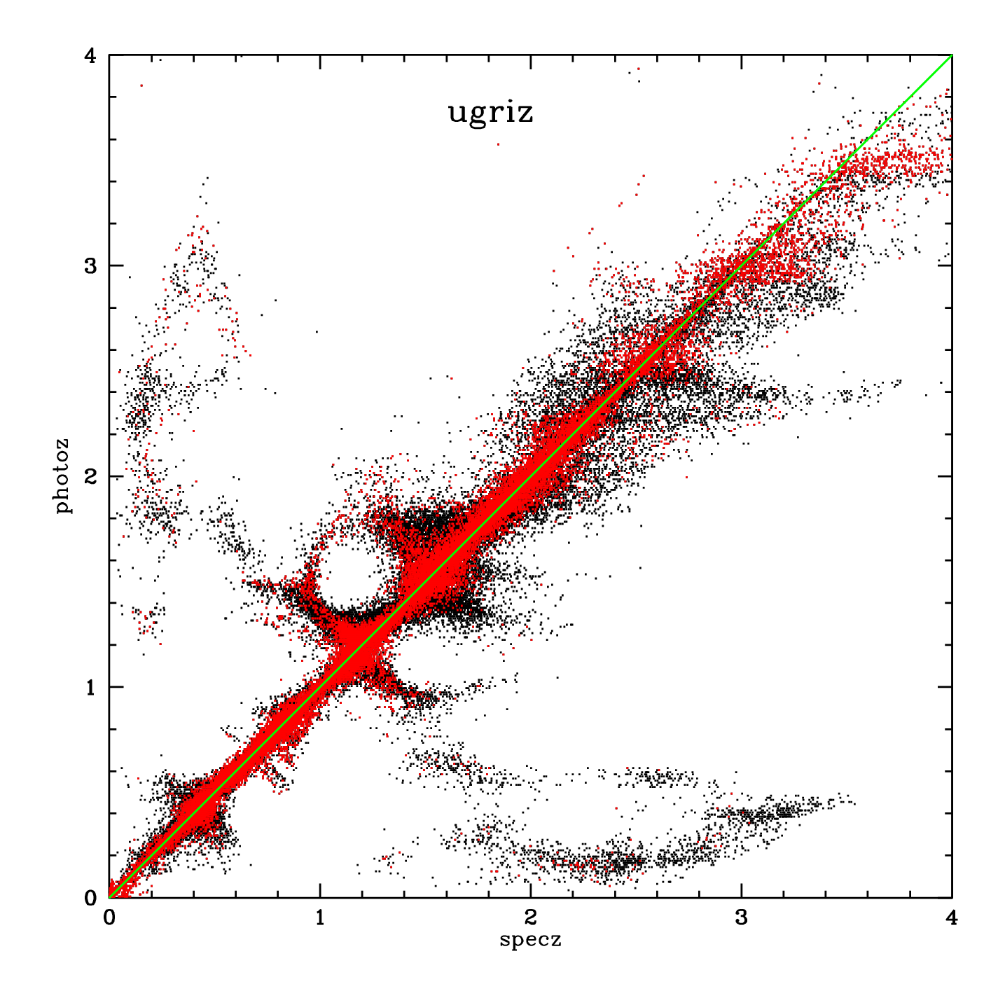
Without u or y, we would have to sacrifice either photo-z accuracy or sample size
All bands
No y
If drop u or y, >35% of objects rejected for poor photo-z quality; catastrophic failure rates are still substantially higher

Slide 6
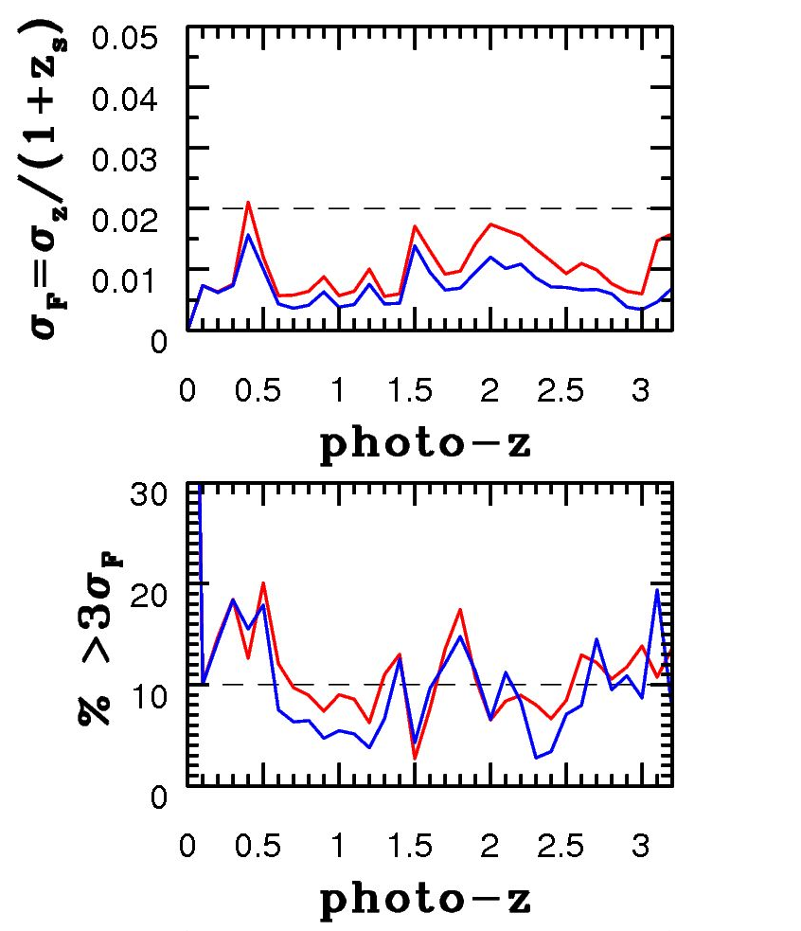
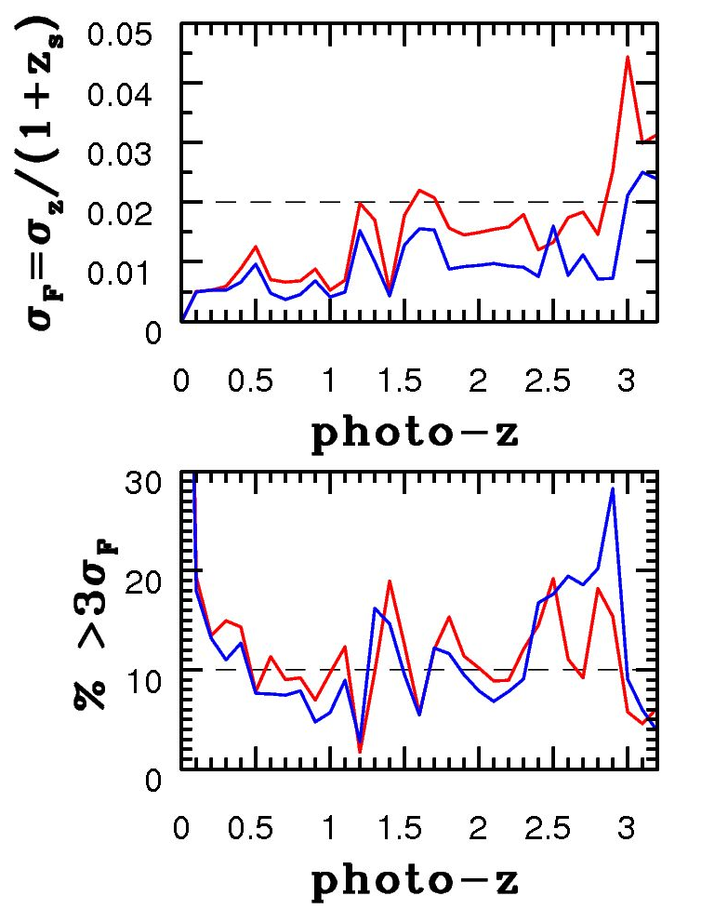
Comparison of errors and outlier rates
ugrizy
No u
No y
20% rejected as outliers
35% rejected as outliers
38% rejected as outliers

