Slide 1
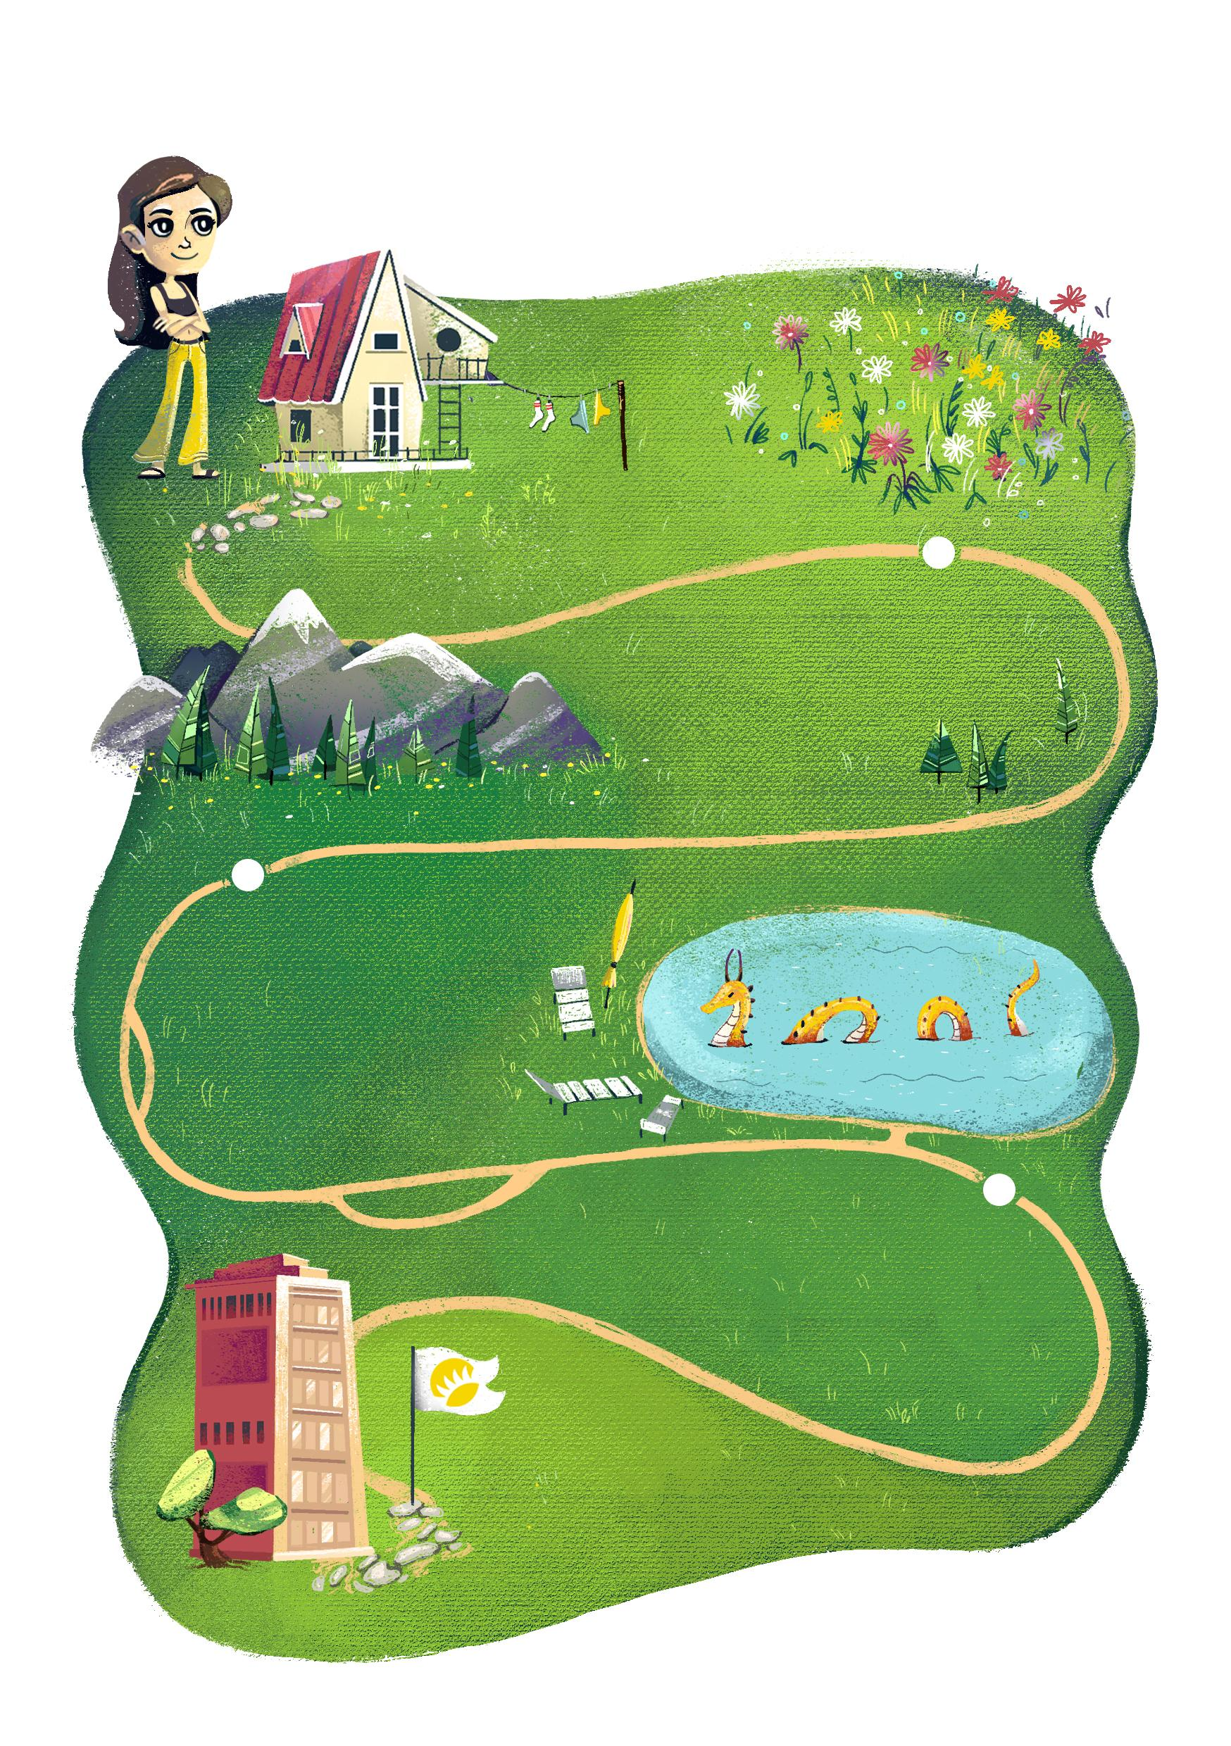
DEAR {name}!
ANDERSEN WISHES YOU:
gorgeous blooming
mood
wonderful
atmosphere
around you
explore
the depth of your capabilities
to be there,
where you are loved*
*ANDERSEN loves you

