Slide 1
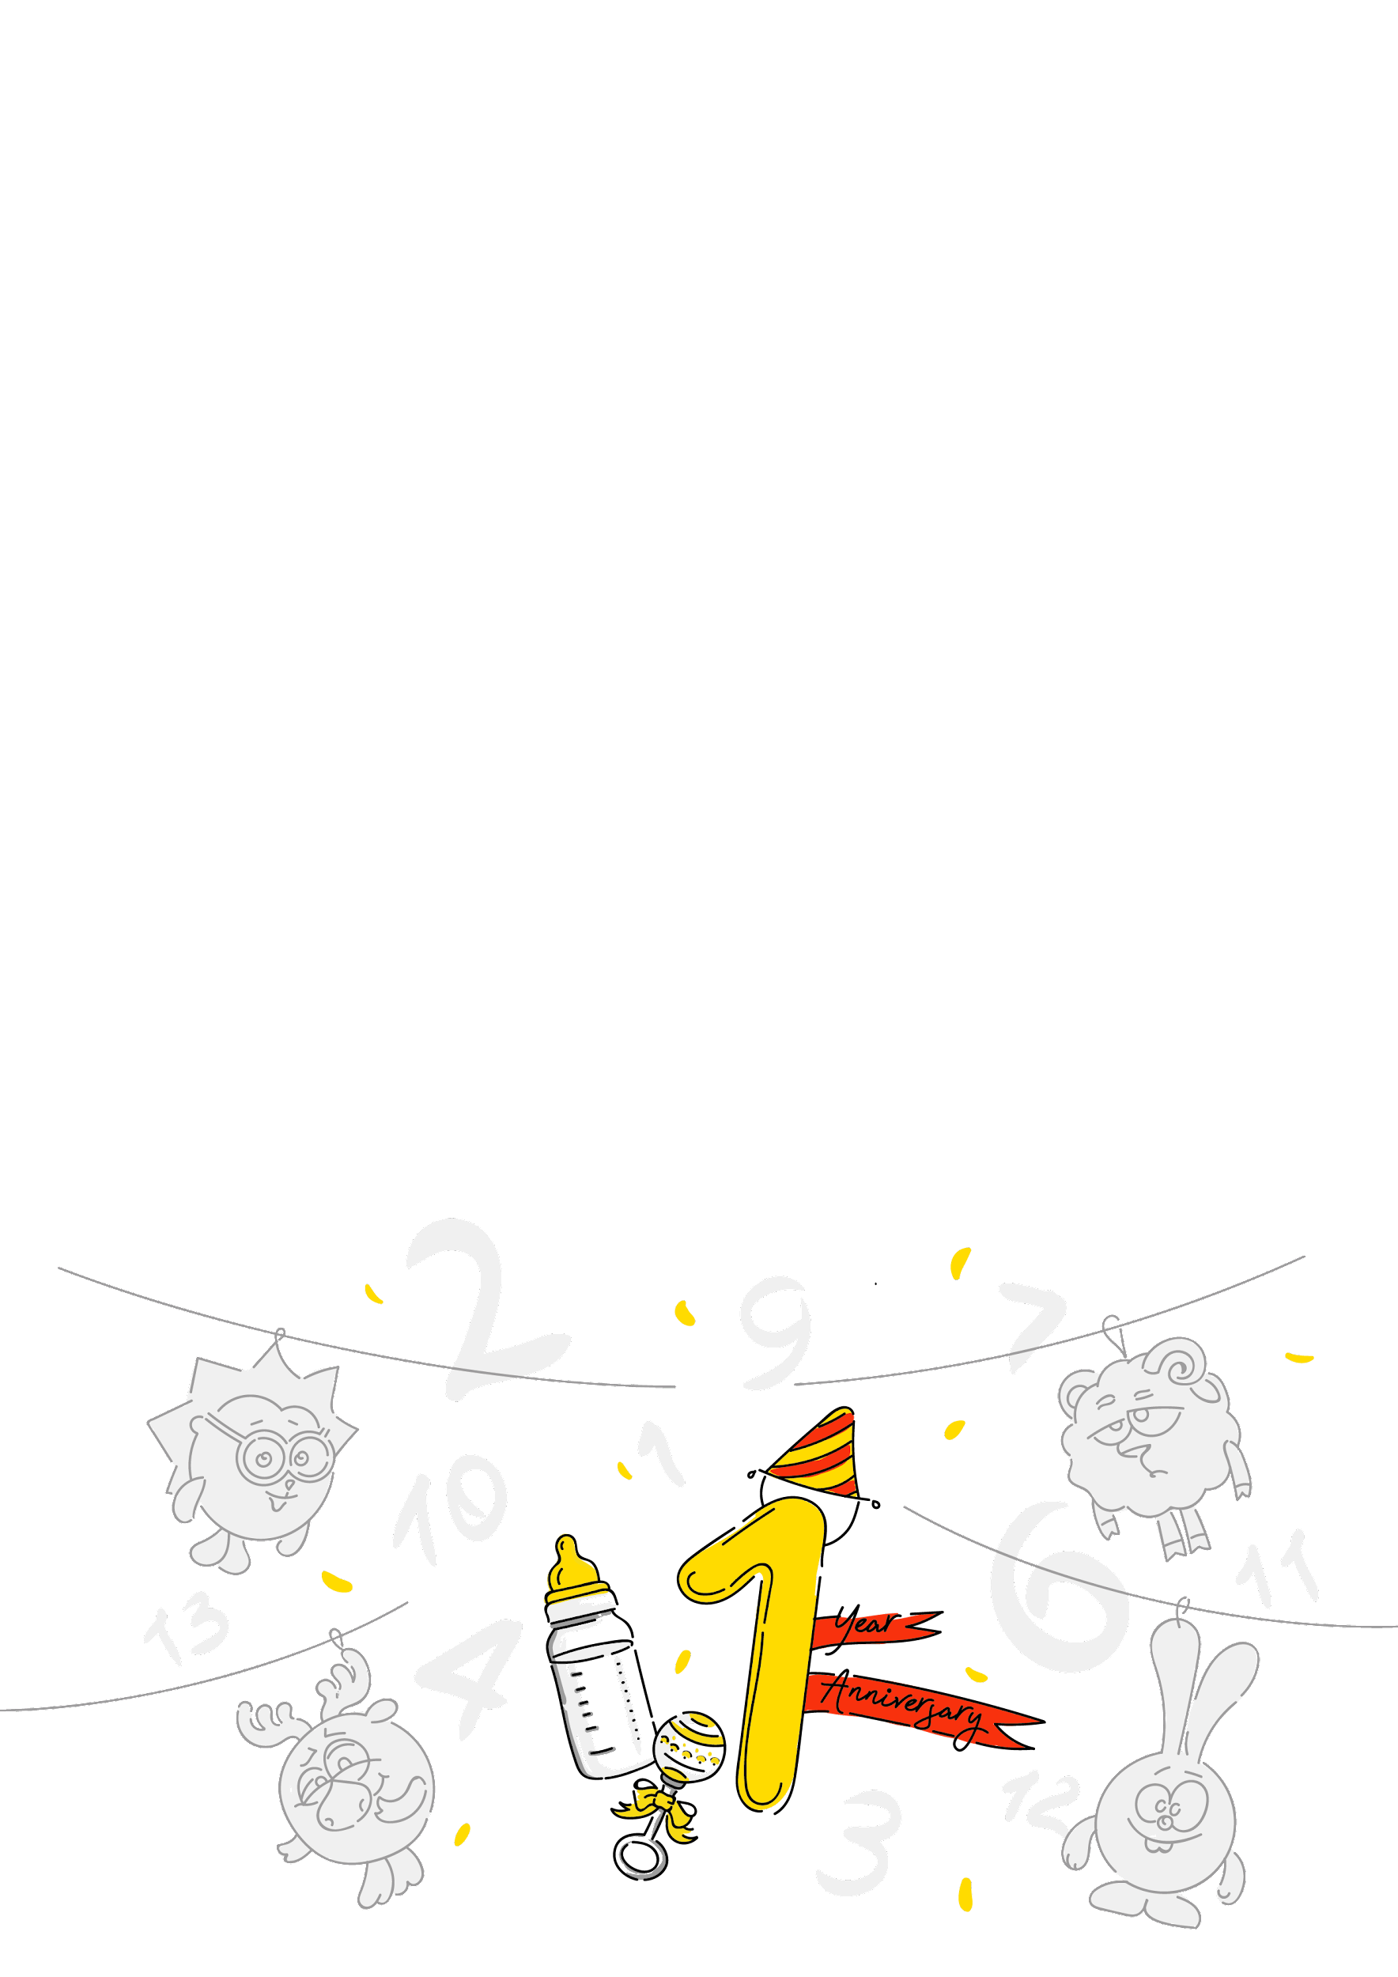



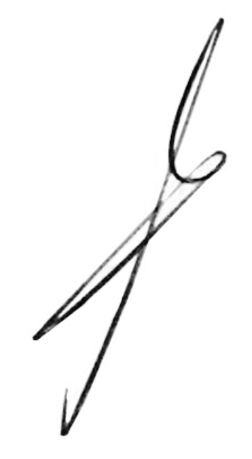
{name}!
One year of our work at Andersen!
Congratulations! Hooray!
We wish you confident progress, achievements, well-coordinated work and the implementation of grandiose plans. Let the work be fun and bring only joyful emotions, and you can easily achieve new goals.
Thank you for being part of the Andersen team.
A. Khomich

