Slide 1
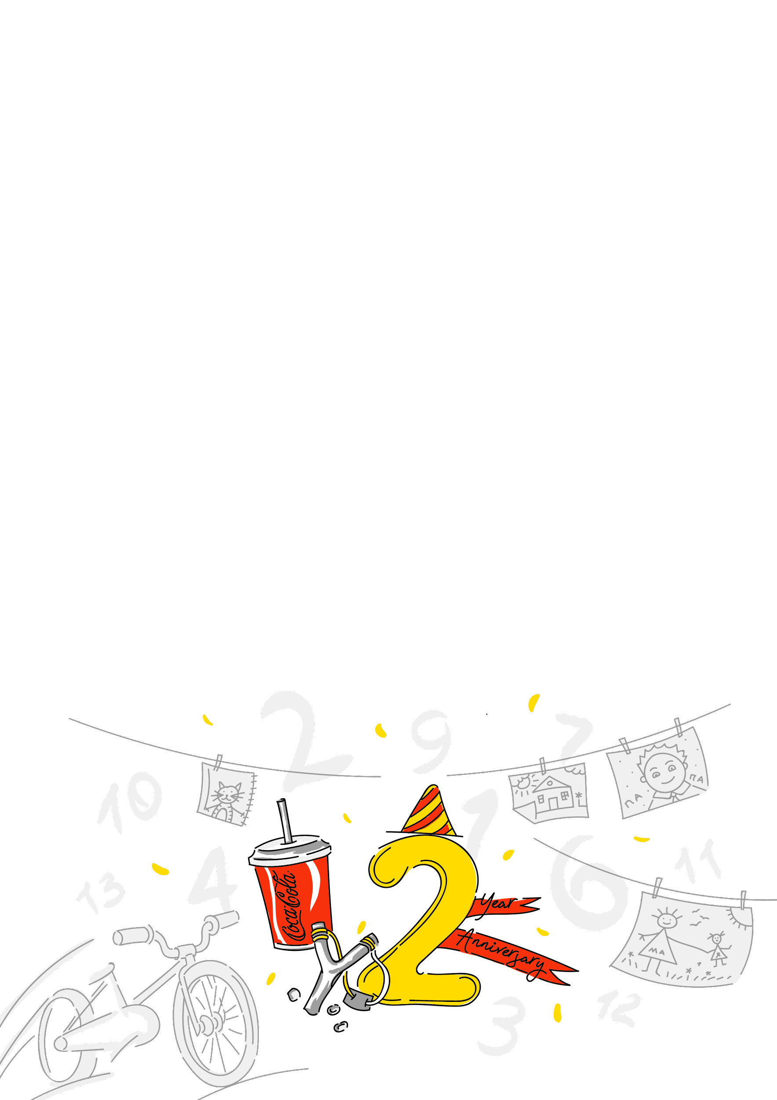

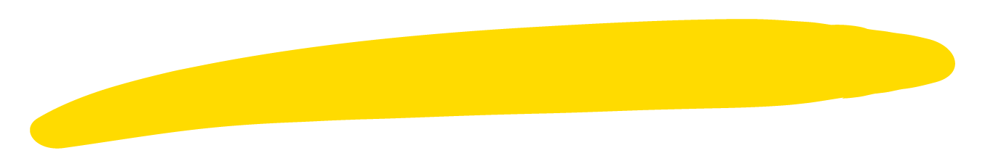
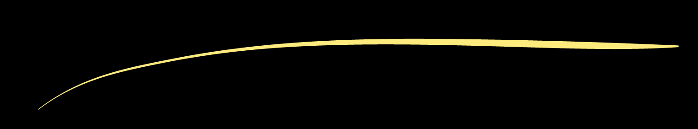
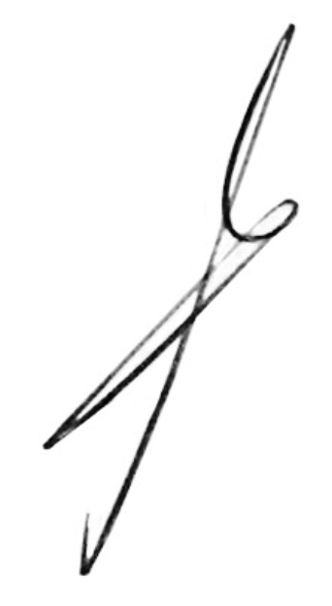
{name}!
For two years now we have been working together at Andersen!
Congratulations!
We wish you confident progress, achievements, well-coordinated work and the implementation of grandiose plans. Let the work be fun and bring only joyful emotions, and you will easily achieve new goals. Congratulations and good luck!
Thank you for being part of the Andersen team.
A. Khomich

