Slide 1
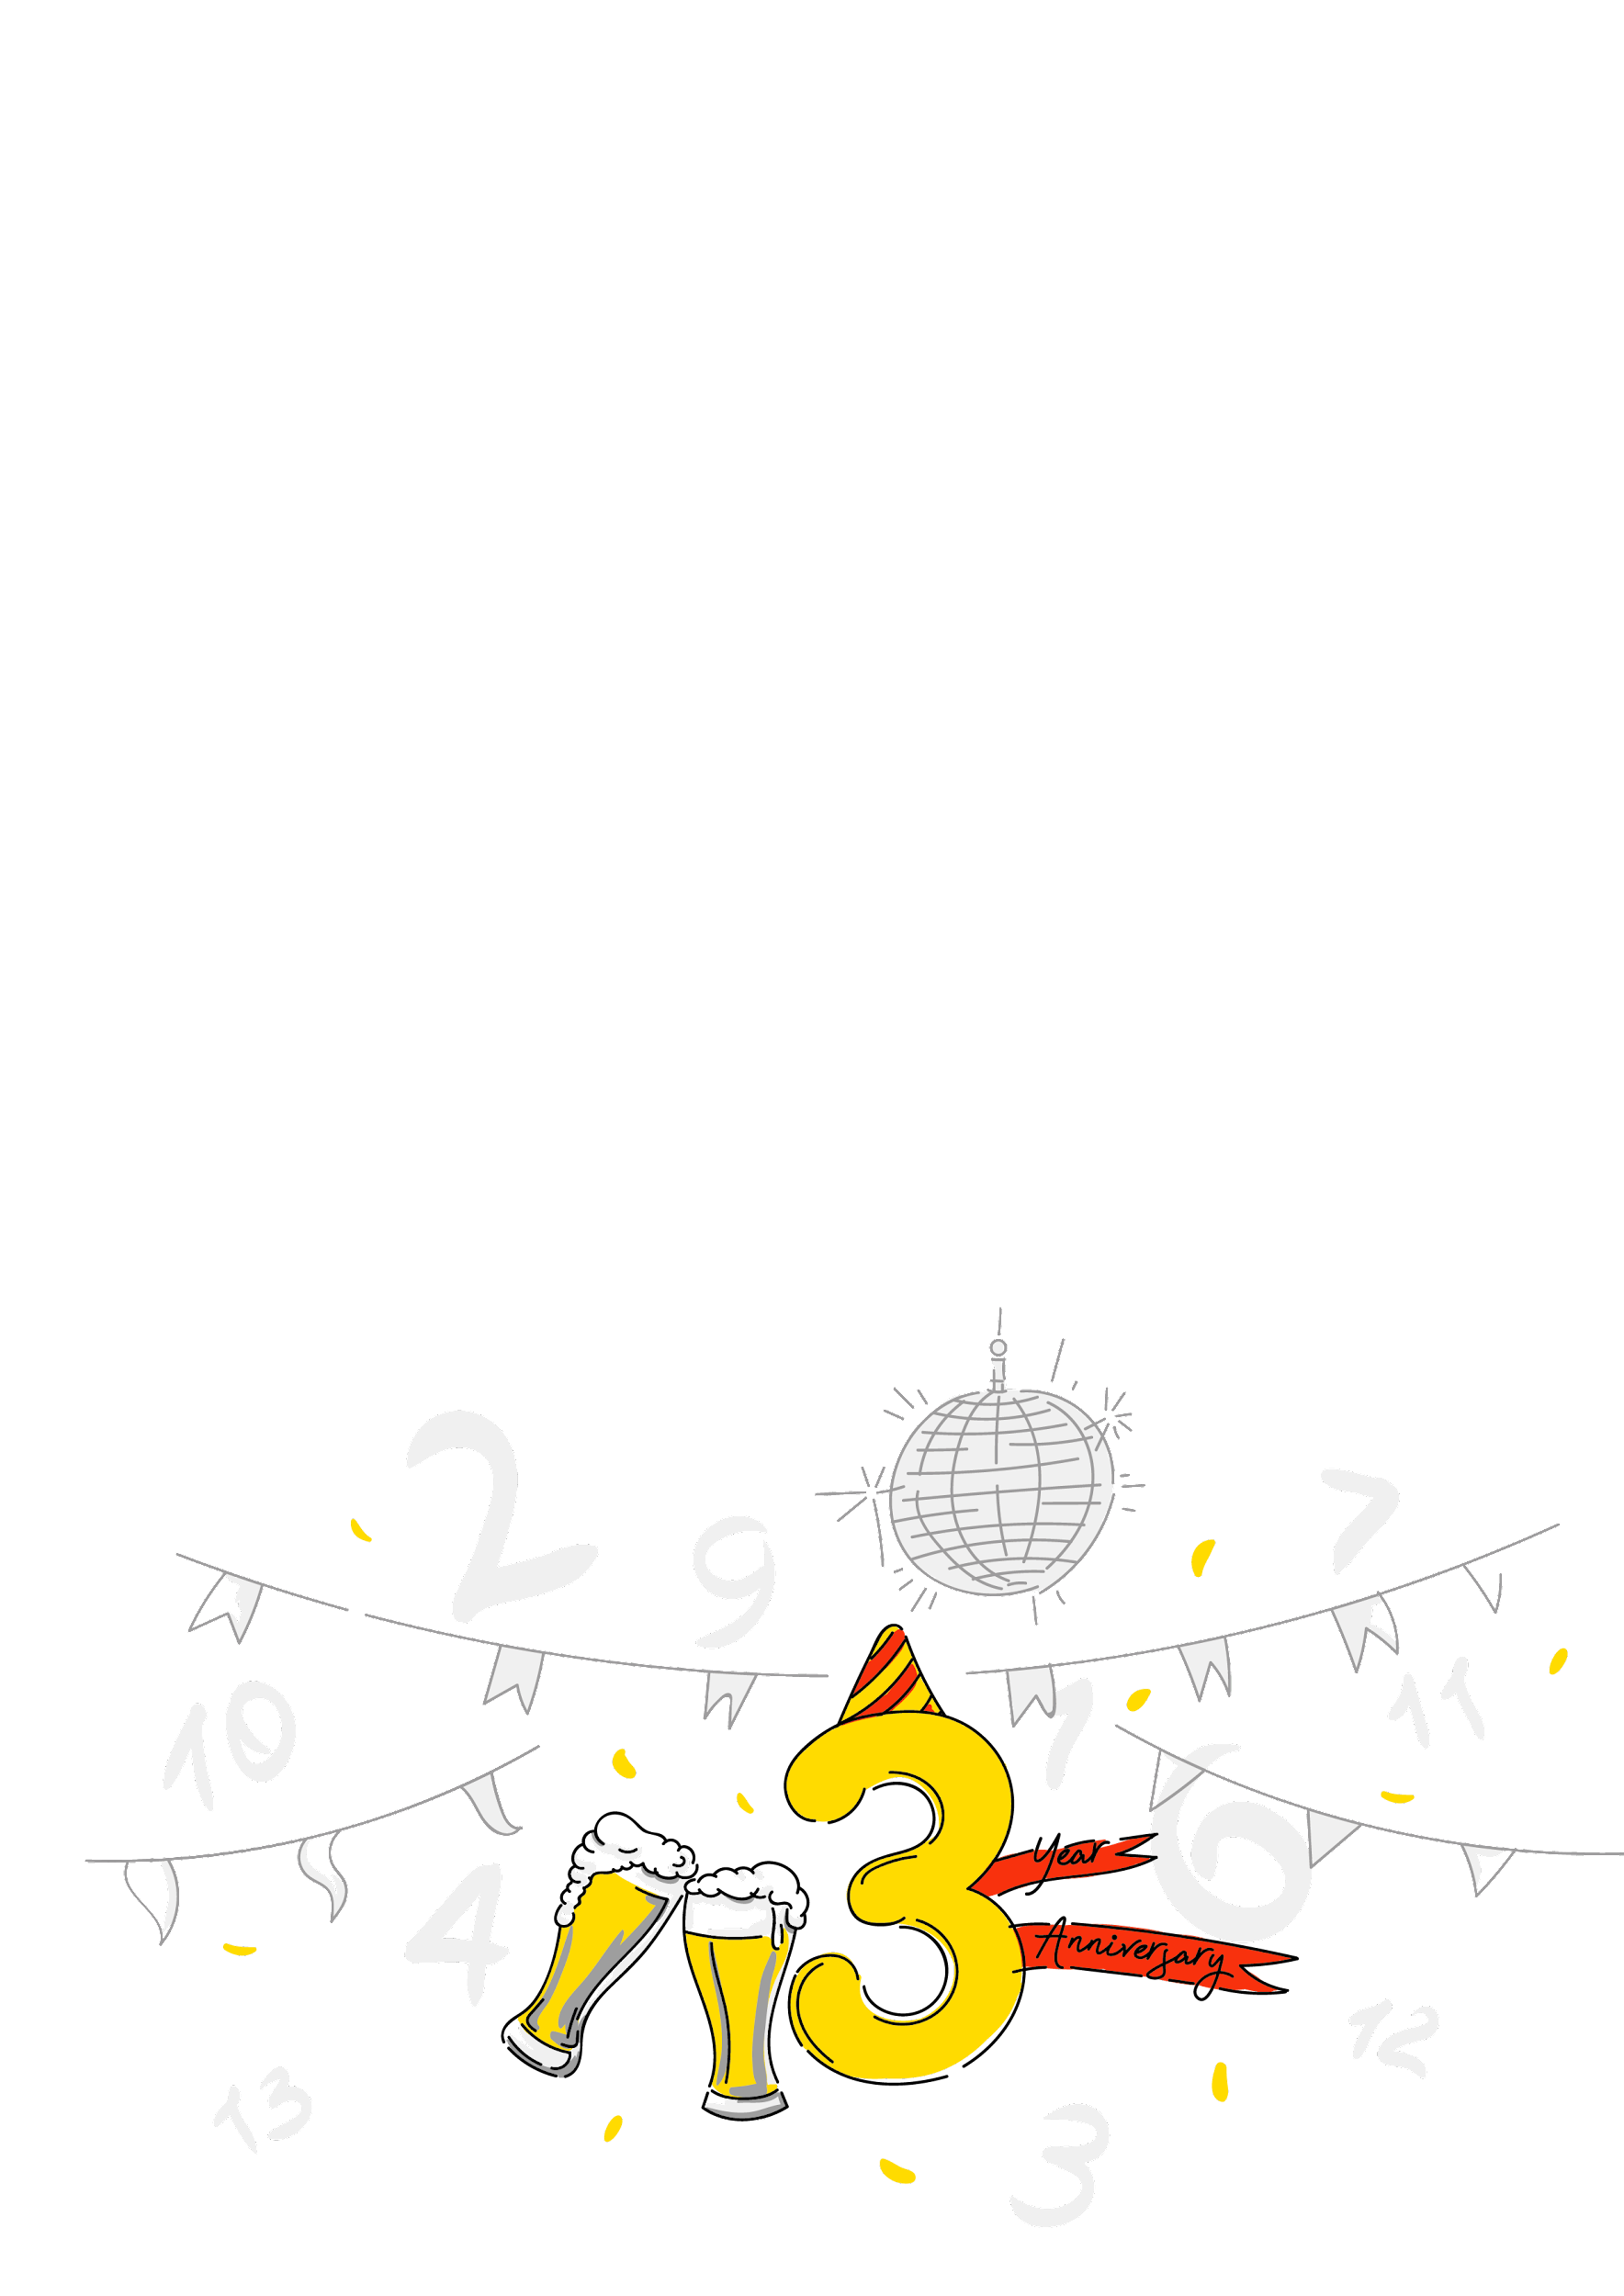

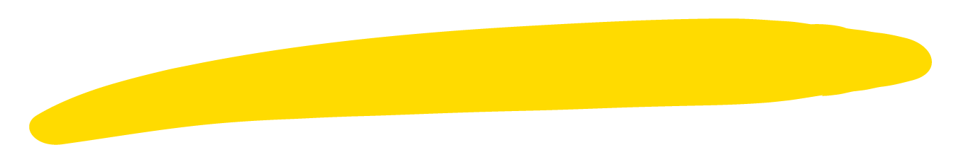

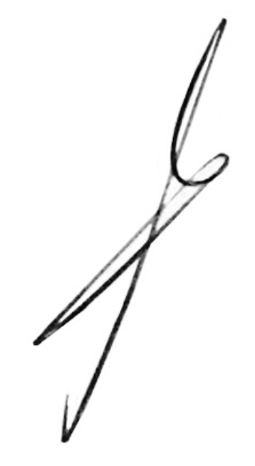
{name}!
For three years now we have been working together at Andersen! Congratulations!.
We wish you creative inspiration, joy and happiness, sincere smiles and good luck in all your endeavors. And, of course, financial well-being to you, success in work, career growth. We believe that the best is yet to come!
Thank you for being part of the Andersen team.
A. Khomich

