Slide 1
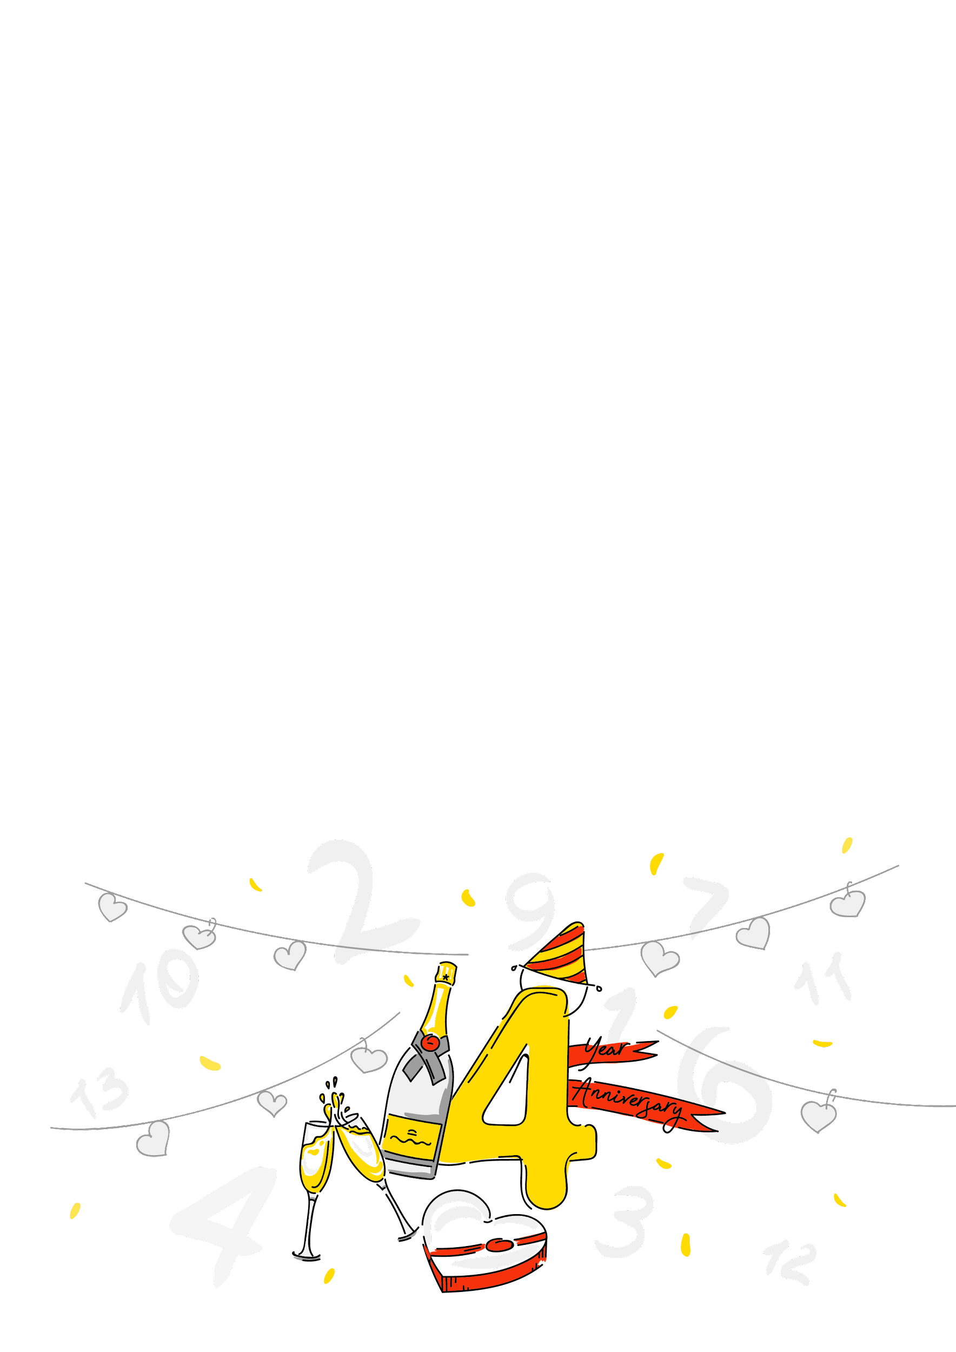



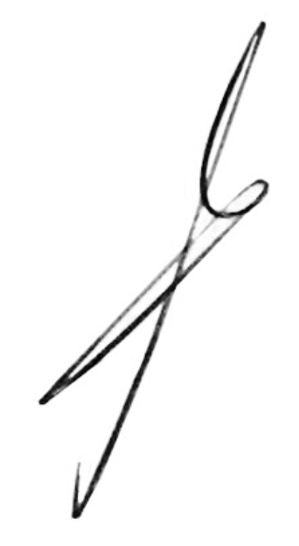
{name}!
It has been four years of our joint work at Andersen! Congratulations!.
We wish you inspiration in everything, a positive mood and the fulfillment of all plans.
We thank you for your prompt work and efficiency. You have shown yourself to be a true professional.
Your personal and professional qualities are a constructive basis for new joint victories.
We believe that our further cooperation will be
fruitful and together we will continue to move towards new successes.
Thank you for being part of the Andersen team.
A. Khomich

