Slide 1
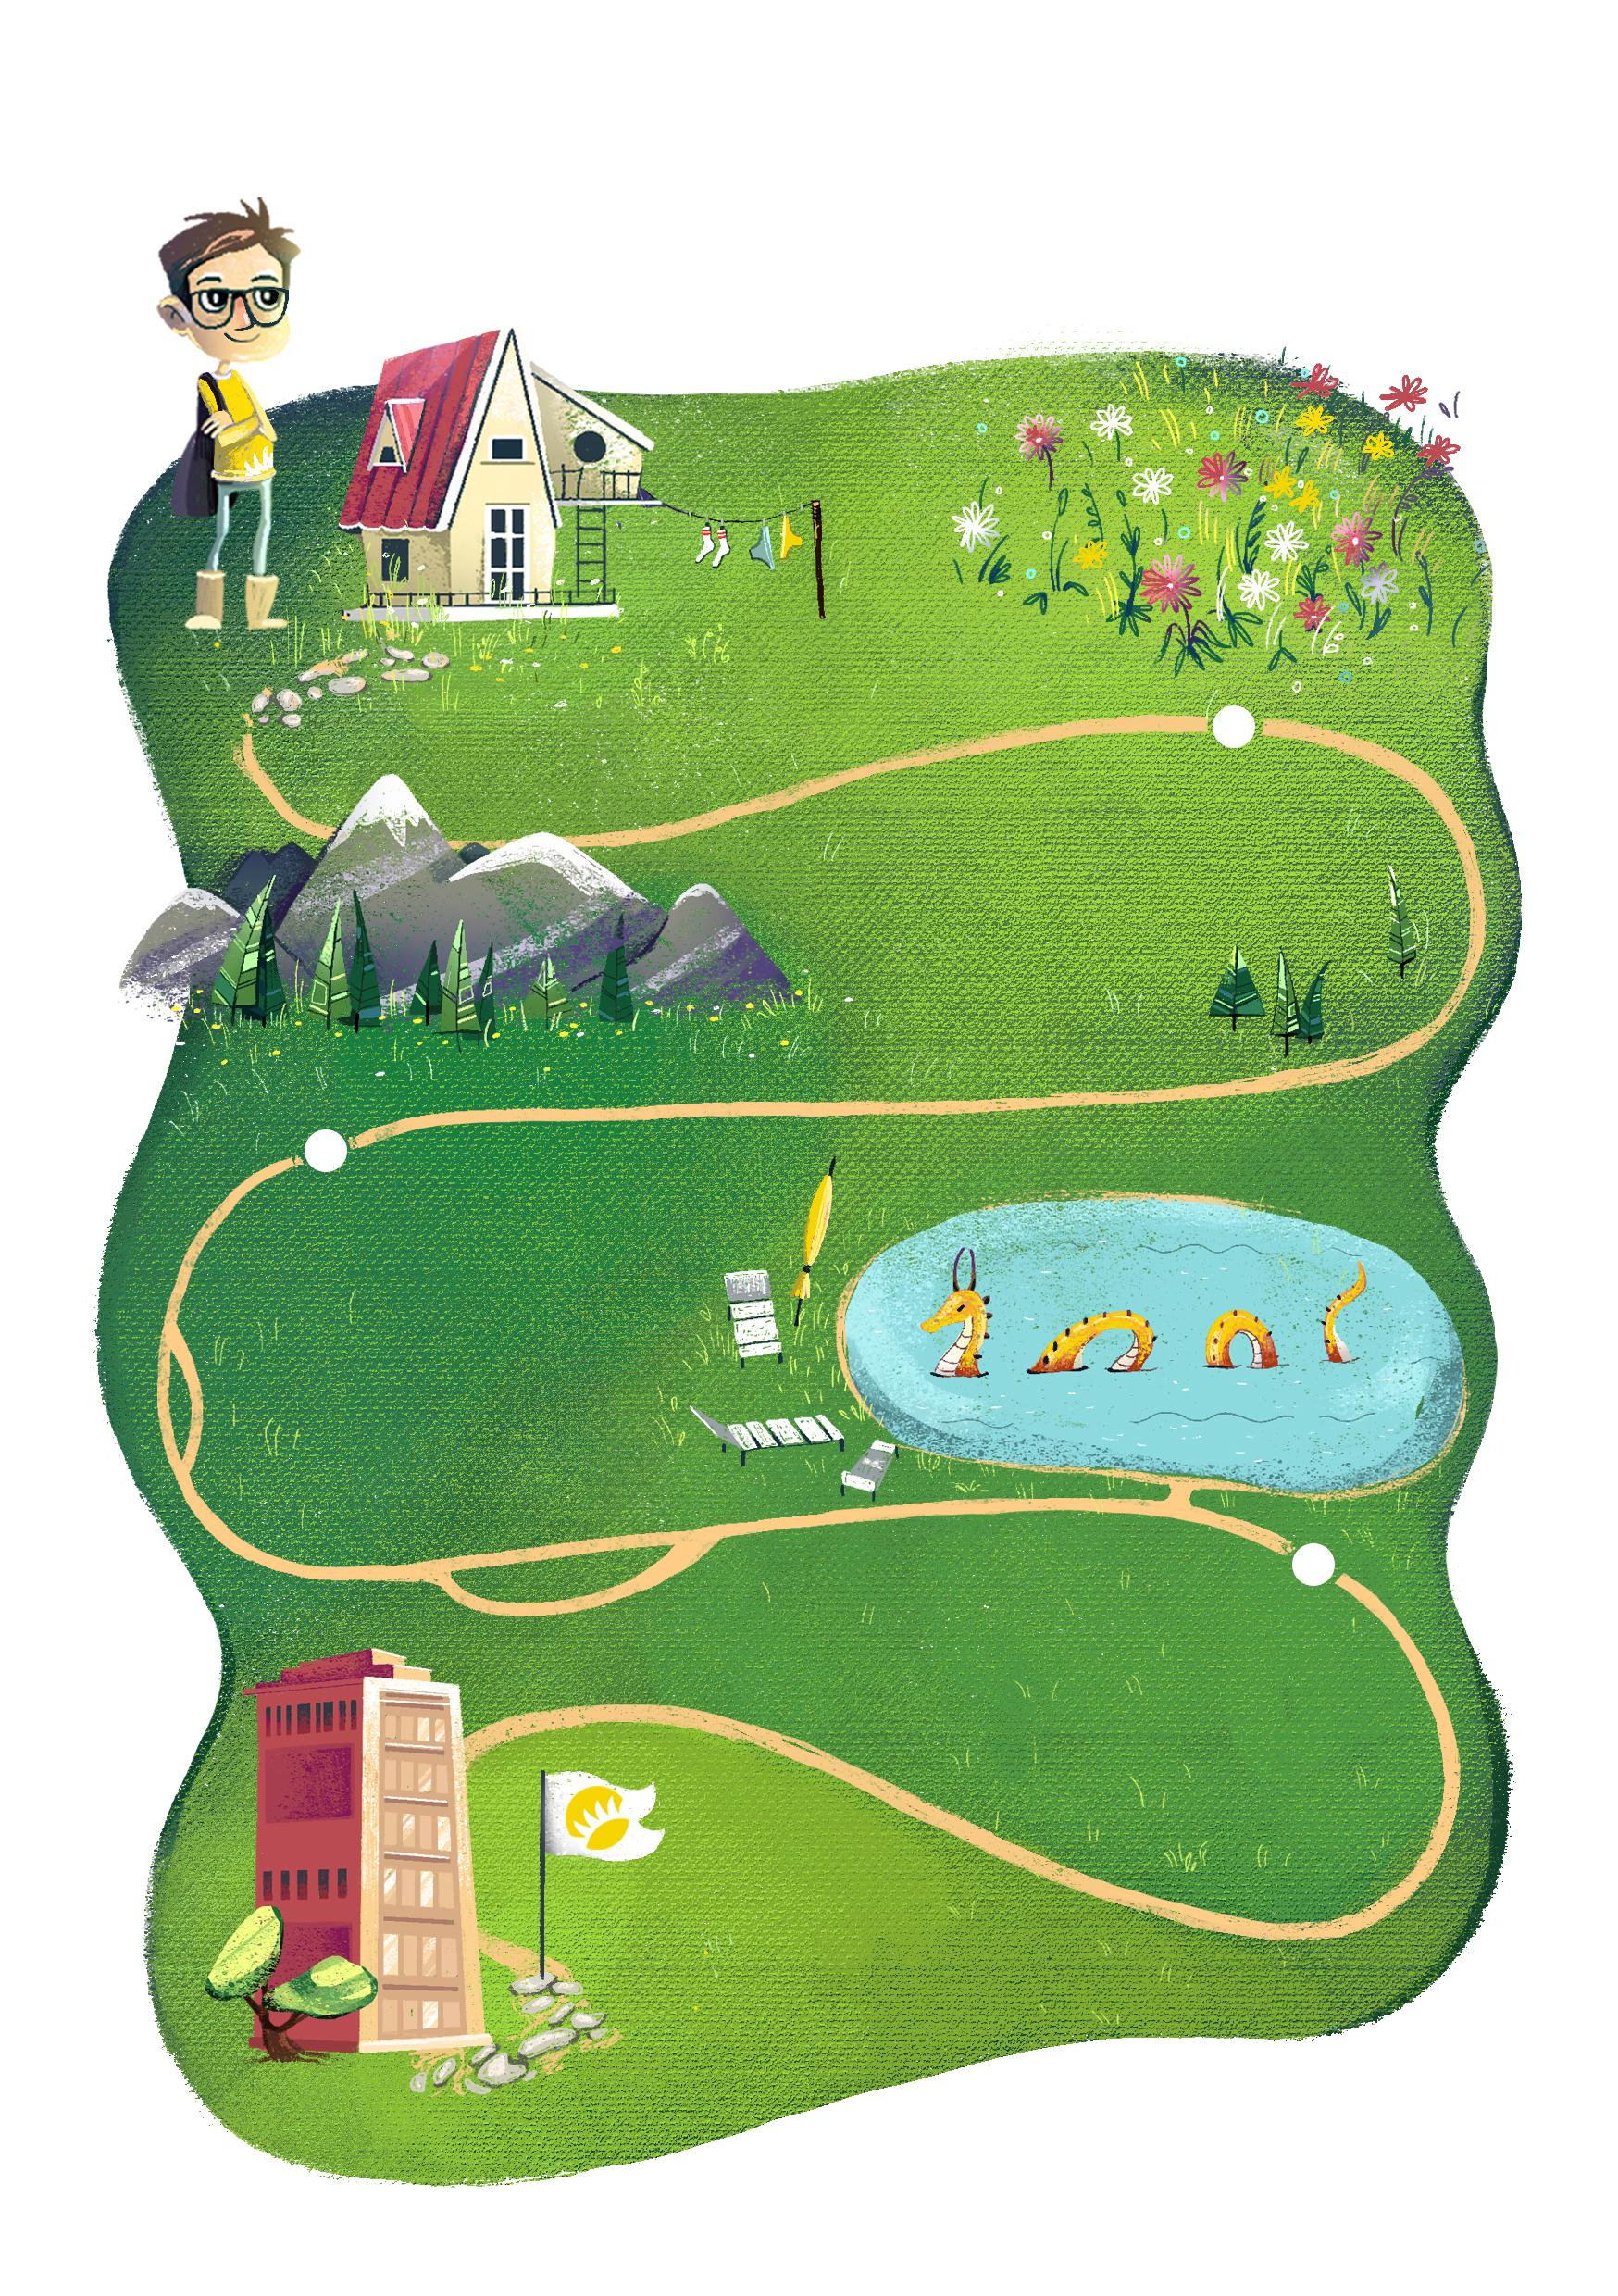
DEAR {name}!
ANDERSEN WISHES YOU:
bright
colors
through life
to achieve
great
hights
explore your
the deepest
depths
to be there,
where you are loved*
*ANDERSEN loves you

