Slide 1
It’s Technically Possible to Write R in Production
Matt Emery (@lstmemery)

Slide 2

A Disclaimer
This is not an invitation to start a language war!
Notes:
The guy in this picture is a French immortal, he is appointed by France to decide what is and isn’t part of the French language
He gets a cool sword

Slide 3
Why R?
R usually gets statistical packages first
The canonical version of several packages are here

Slide 4
What Makes for Smooth Deployment?
Reliability
Testability
Interopterability
Auditability
Notes:
This is a lot to cover in 5 minutes
Make sure you understand why you need to do something in R
There are Python versions of each of the things I’m talking about

Slide 5
Example: Poisson Regression
Trying to predict the number of times something will happen?
Use a Poisson Regression
There’s no Poisson regression in Sci-Kit Learn

Slide 6
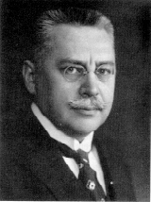
Example: Prussian Army Horse Kick Deaths
A classic Poisson distribution dataset is the number of Prussian soldiers killed by horses
Ladislaus Bortkiewicz
Notes:
Before you jump and use R ask your deployment team if they have any knowledge

Slide 7
A Look at the Data
library(readr) horse_kicks <- read_csv("data/VonBort.csv") tail(horse_kicks)
## # A tibble: 6 x 5 ## X1 deaths year corps fisher ## <dbl> <dbl> <dbl> <chr> <chr> ## 1 275 1 1894 VIII yes ## 2 276 0 1894 IX yes ## 3 277 1 1894 X yes ## 4 278 1 1894 XI no ## 5 279 0 1894 XIV yes ## 6 280 0 1894 XV yes
Notes:
We only care about deaths, year and corps

Slide 8
First Pass
library(dplyr) model <- glm(deaths ~ year + corps, data = horse_kicks, family = "poisson") predict_df <- tibble(year = c(1895), corps = c("I")) predict(model, predict_df)
## 1 ## -0.03196538
Notes:
Don’t worry if you are having difficulty reading this
First two lines are imports, then reading in data, building a model
Notice that the prediction here is negative!

Slide 9
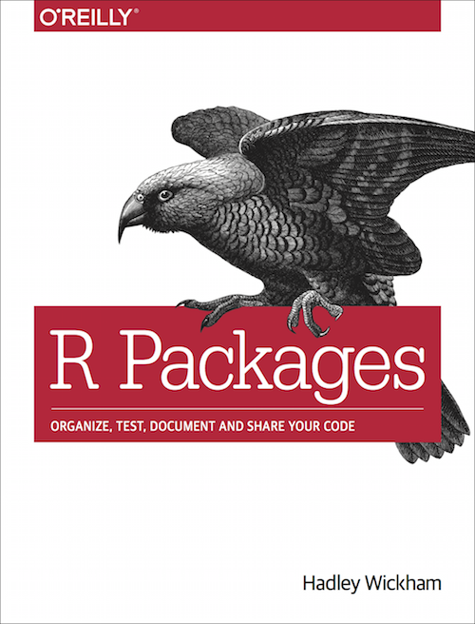
Turn Your Code Into a Package
Functions go in the R directory
Tests go in the tests directory
Gets you access to many builtin checks for code quality
R Packages by Hadley Wickham
Notes:
I highly recommend writing anything that will be used more than once as a R package

Slide 10
Reliability
What happens if instead of predicting the I corps, I predict the 1st corps?
One erroneous row breaks predictions for the whole data set
Strictly enforce checks on the data set
Notes:
We always make assumptions when we build models, you’ll need to write them out
A negative result for a Poisson regression may be acceptable when you are fiddling but not in production
A great way to enforce these assumptions are through unit tests

Slide 11
Checking Code
clean_horse_kicks <- function(horse_kick_df) { horse_kick_df %>% verify( has_all_names("year", "corps") , error_fun = error_stop) %>% assert( within_bounds(1701, 1919, allow.na = FALSE), .data$year, error_fun = warn_report) %>% select(.data$year, .data$corps) %>% filter(between(.data$year, 1701, 1919)) }
Notes:
If you haven’t seen tidyverse are before it looks very weird
The %>% means pipe, you can think of it as a “then” operator (i.e. verify THEN assert THEN select THE filter)
The important part is to sanitize your inputs

Slide 12

Testability
Most R starts it’s life as a one-off script
This code is rarely tested
Deploying untested code is a very bad idea
Notes:
Data science bugs are especially bad because so many of them don’t crash the system. Instead you get subtle shifts in behavior and your predictiveness goes down

Slide 13
Testthat
test_that("clean_horse_kicks removes bad entries", { test_df <- dplyr::tibble( year = c(1492, 1848, 2019, 1871), corps = c("I", "I", "I", "XXIII") ) reference_df <- dplyr::tibble(year = c(1848), corps = c("I")) expect_equal( expect_warning(clean_horse_kicks(test_df)), reference_df ) })
Notes:
This is roughly equivalent to the xUnit framework

Slide 14

Interopterability
The worst bugs of my life have been from trying to call Python from R and vice versa
Since our package is so small, why not turn the package into a microservice?
Notes:
A microservice is a small package separated from other packages
This can add complexity to your system

Slide 15
Defining a Plumber API
#* Predict the number of horse kick deaths a soldier suffered in a year #* #* @json #* @post /predict predict <- function(req) { horse_kick_df <- jsonlite::fromJSON(req$postBody) %>% as_tibble() results <- horse_kick_df %>% clean_horse_kicks() %>% predict_horse_kicks() jsonlite::toJSON(results, dataframe = "columns") }
Notes:
This is pretty similar to Flask

Slide 16
Calling the API
Notes:
If this needs to be faster you could also use protocol buffers
Even faster? Just rewrite the code in C++

Slide 17

Auditability
Someone asks you why a model from six months ago made a prediction, what would you tell them?
You need to have the exact model, package and dependencies available

Slide 18
Docker
FROM trestletech/plumber RUN R -e "install.packages(c('devtools', 'packrat'), repos = 'http://cran.us.r-project.org')" ADD ./horsekickeR /home/user/horsekickeR WORKDIR /home/user/horsekickeR RUN R -e 'devtools::install_deps(dependencies = TRUE, upgrade = "never")' RUN R -e 'devtools::install()' EXPOSE 8000 CMD ["Rscript", "exec/plumber.R"]
Notes:
I actually made this, you can check it out on GitHub and DockerHub

Slide 19
Questions?
https://github.com/lstmemery/r-in-production https://github.com/lstmemery/horsekickeR https://cloud.docker.com/u/lstmemery/repository/docker/lstmemery/horsekicker

