Slide 1
It’s Technically Possible to Write R in Production
Matt Emery (@lstmemery)
March 20, 2019

Slide 2

A Disclaimer
This is not an invitation to start a language war!
Notes:
The guy in this picture is a French immortal, he is appointed by France to decide what is and isn’t part of the French language
He gets a cool sword
<number>

Slide 3
Why R?
R usually gets statistical packages first
The canonical version of several packages are here

Slide 4
What Makes for Smooth Deployment?
Reliability
Testability
Interoperability
Auditability
Notes:
This is a lot to cover in 5 minutes
Make sure you understand why you need to do something in R
There are Python versions of each of the things I’m talking about
<number>

Slide 5
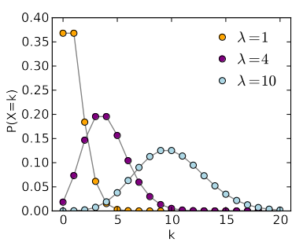
Example: Poisson Regression
Trying to predict the number of times something will happen?
Use a Poisson Regression
There’s no Poisson regression in Sci-Kit Learn

Slide 6
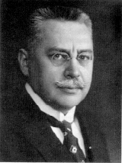
Example: Prussian Army Horse Kick Deaths
A classic Poisson distribution dataset is the number of Prussian soldiers killed by horses
Ladislaus Bortkiewicz
Notes:
Before you jump and use R ask your deployment team if they have any knowledge
<number>

Slide 7
A Look at the Data
library(readr) horse_kicks <- read_csv("data/VonBort.csv") tail(horse_kicks)
## # A tibble: 6 x 5
## X1 deaths year corps fisher
## <dbl> <dbl> <dbl> <chr> <chr>
## 1 275 1 1894 VIII yes
## 2 276 0 1894 IX yes
## 3 277 1 1894 X yes
## 4 278 1 1894 XI no
## 5 279 0 1894 XIV yes
## 6 280 0 1894 XV yes
Notes:
We only care about deaths, year and corps
<number>

Slide 8
First Pass
library(dplyr) model <- glm(deaths ~ year + corps, data = horse_kicks, family = "poisson") predict_df <- tibble(year = c(1895), corps = c("I")) predict(model, predict_df)
## 1
## -0.03196538
Notes:
Don’t worry if you are having difficulty reading this
First two lines are imports, then reading in data, building a model
Notice that the prediction here is negative!
<number>

Slide 9
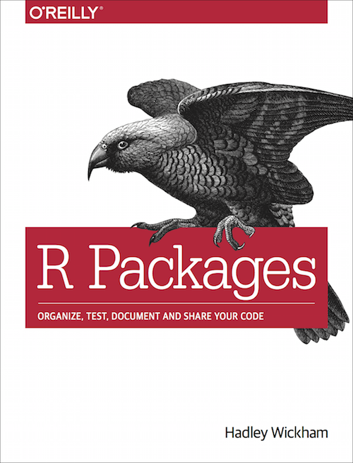
Turn Your Code Into a Package
Functions go in the R directory
Tests go in the tests directory
Gets you access to many builtin checks for code quality
R Packages by Hadley Wickham
Notes:
I highly recommend writing anything that will be used more than once as a R package
<number>

Slide 10
Reliability
What happens if instead of predicting the I corps, I predict the 1st corps?
One erroneous row breaks predictions for the whole data set
Strictly enforce checks on the data set
Notes:
We always make assumptions when we build models, you’ll need to write them out
A negative result for a Poisson regression may be acceptable when you are fiddling but not in production
A great way to enforce these assumptions are through unit tests
<number>

Slide 11
Checking Code
clean_horse_kicks <- function(horse_kick_df) { horse_kick_df %>% verify( has_all_names("year", "corps") , error_fun = error_stop) %>% assert( within_bounds(1701, 1919, allow.na = FALSE), .data$year, error_fun = warn_report) %>% select(.data$year, .data$corps) %>% filter(between(.data$year, 1701, 1919)) }
Notes:
If you haven’t seen tidyverse are before it looks very weird
The %>% means pipe, you can think of it as a “then” operator (i.e. verify THEN assert THEN select THE filter)
The important part is to sanitize your inputs
<number>

Slide 12

Testability
Most R starts it’s life as a one-off script
This code is rarely tested
Deploying untested code is a very bad idea
Notes:
Data science bugs are especially bad because so many of them don’t crash the system. Instead you get subtle shifts in behavior and your predictiveness goes down
<number>

Slide 13
Testthat
test_that("clean_horse_kicks removes bad entries", { test_df <- dplyr::tibble( year = c(1492, 1848, 2019, 1871), corps = c("I", "I", "I", "XXIII") ) reference_df <- dplyr::tibble(year = c(1848), corps = c("I")) expect_equal( expect_warning(clean_horse_kicks(test_df)), reference_df ) })
Notes:
This is roughly equivalent to the xUnit framework
<number>

Slide 14

Interoperability
The worst bugs of my life have been from trying to call Python from R and vice versa
Since our package is so small, why not turn the package into a microservice?
Notes:
A microservice is a small package separated from other packages
This can add complexity to your system
<number>

Slide 15
Calling the API
Notes:
If this needs to be faster you could also use protocol buffers
Even faster? Just rewrite the code in C++
<number>

Slide 16

Auditability
Someone asks you why a model from six months ago made a prediction, what would you tell them?
You need to have the exact model, package and dependencies available

Slide 17
Docker
FROM trestletech/plumber
RUN R -e "install.packages(c('devtools', 'packrat'), repos = 'http://cran.us.r-project.org')"
ADD ./horsekickeR /home/user/horsekickeR
WORKDIR /home/user/horsekickeR
RUN R -e 'devtools::install_deps(dependencies = TRUE, upgrade = "never")'
RUN R -e 'devtools::install()'
EXPOSE 8000
CMD ["Rscript", "exec/plumber.R"]
Notes:
I actually made this, you can check it out on GitHub and DockerHub
<number>

Slide 18
Questions?
https://github.com/lstmemery/r-in-production https://github.com/lstmemery/horsekickeR https://cloud.docker.com/u/lstmemery/repository/docker/lstmemery/horsekicker

