Slide 1
What is our goal of this project?
Build an actionable instructor-based dashboard for UBC edx instructor, so as to make an improvement compared to previous two dashboards : edX insight and VizIT .

Slide 2
How do instructors imagine using this dashboard?
Real-time monitoring (During the course run)
Fix content problems in time
Improve learner engagement on the fly
2. Redesign / refine the course content ( After at least one course run )
Source : Course VizIT Test Report by Letitia

Slide 3
Our dashboard is trying
solve 6 instructor pain points that we collected from previous usability testing feedback …...

Slide 4

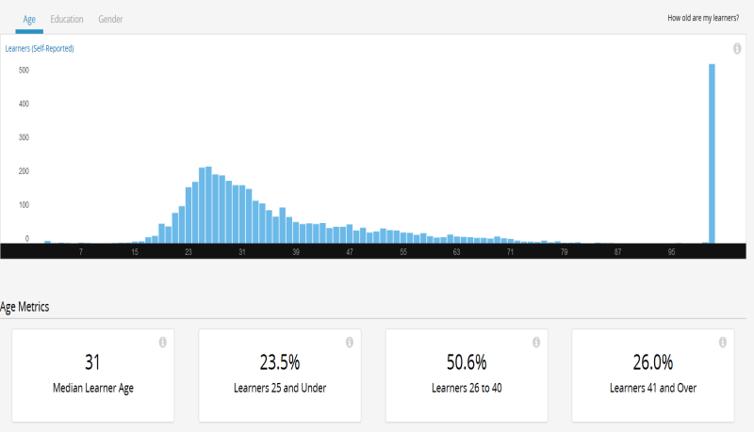
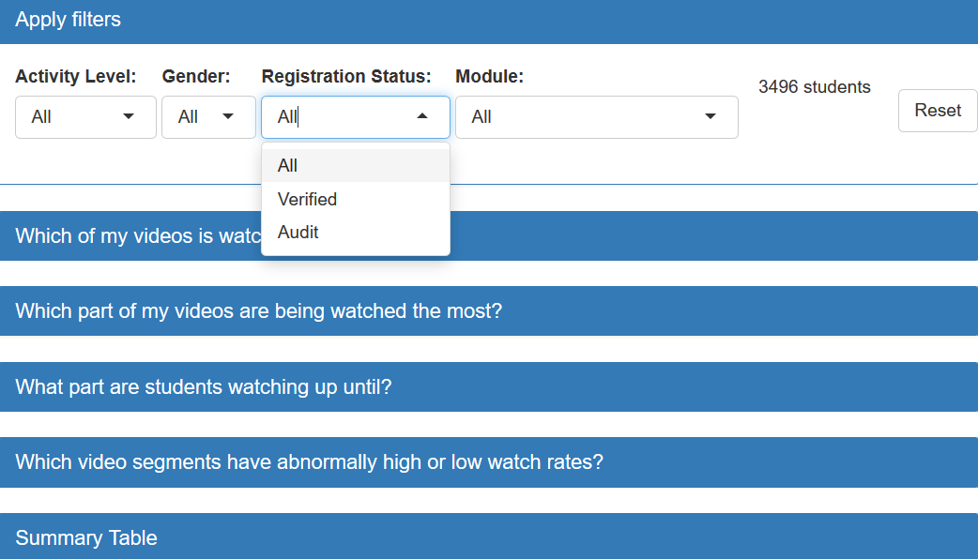
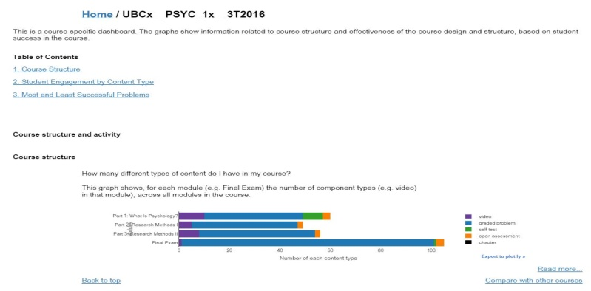
Instructor Pain Point 1 : Ask for interactivity to explore detail
It would be great to add demographic filters to explore engagement difference between verified / auditing student, so as to better serve student who paid
Previous Dashboards
MDS Dashboard
4 interactive filtering options for instructors to discover detailed patterns:
activity level
gender
registration status
course module
general view, static , useful demographics not included

Slide 5

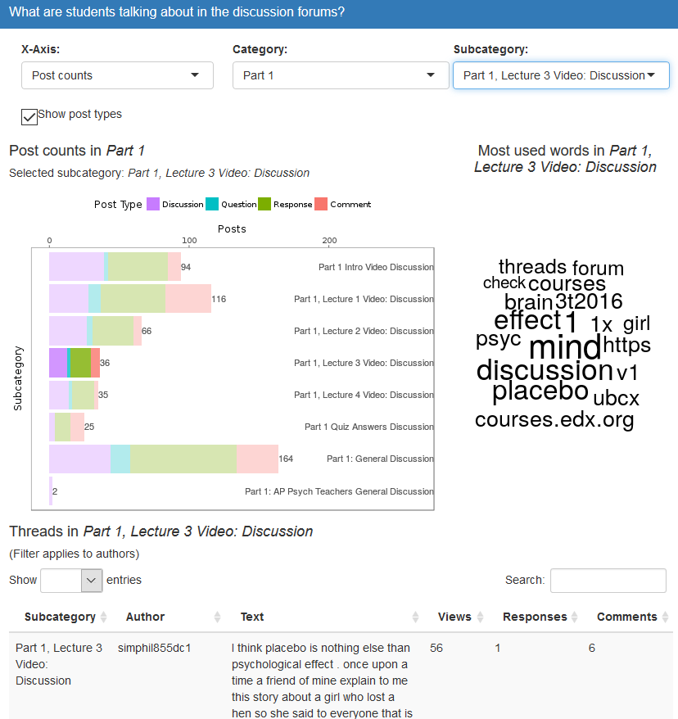
Instructor Pain Point 2 : No access to forum discussion data
I am curious about how many my students are active in participating forum discussion and what they are talking about.
Previous Dashboard
MDS Dashboard
Forum engagement was not
tracked and measured …

Slide 6

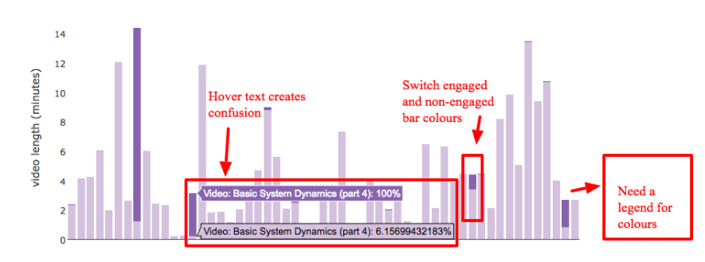
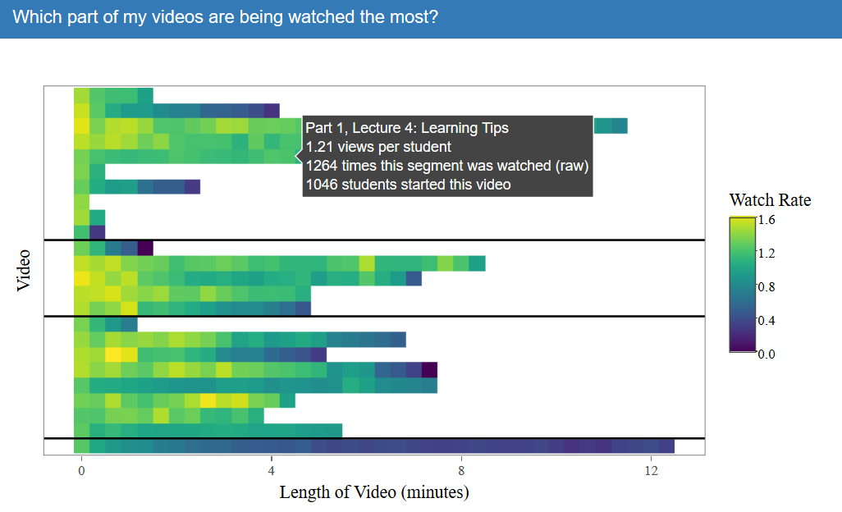
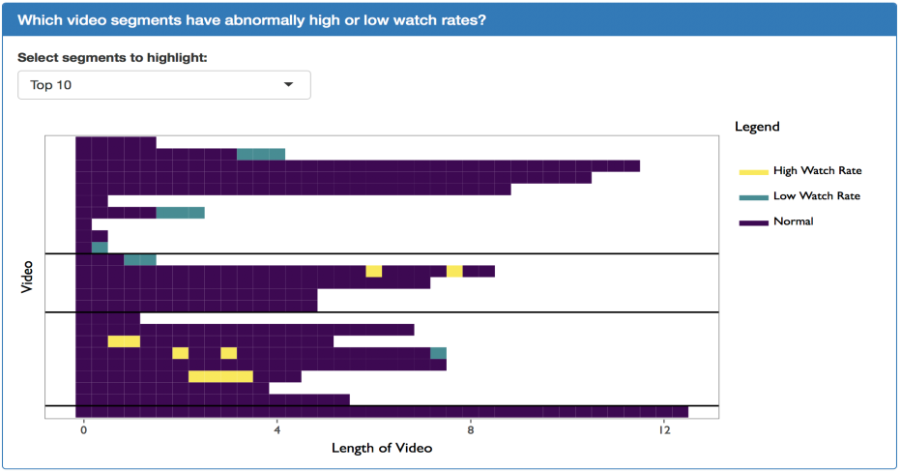
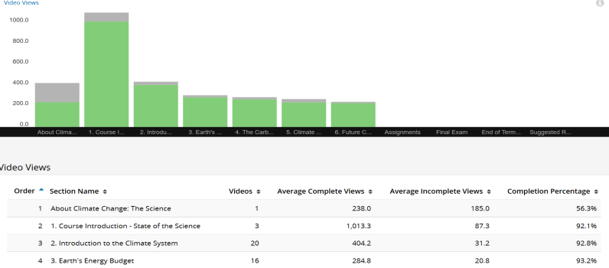
Instructor Pain Point 3: Lack of in-depth understanding on student video watching behaviour
I am interested in about which segment of my video were re-watched most so I can try figuring out what’s going on (too hard/or too interesting? )
Previous Dashboards
MDS Dashboard

Slide 7

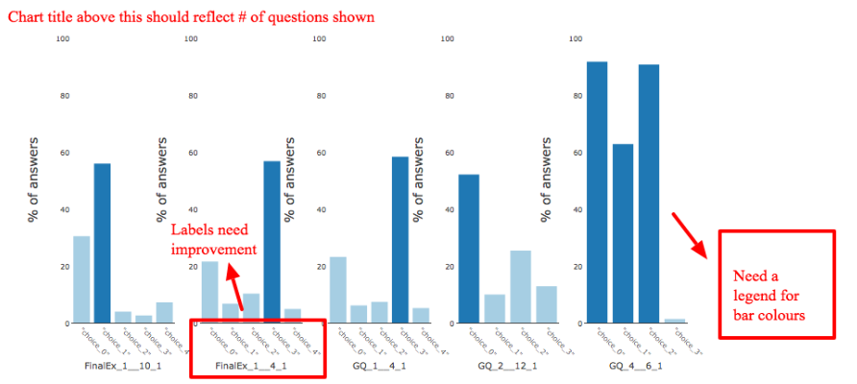
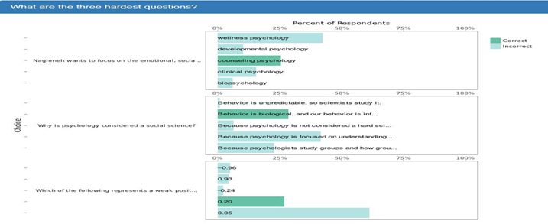
Instructor Pain Point 4 : Lack of granular analysis for student wrong choices
I want to know when most students got wrong to a question, which choices are most confusing to them. Maybe I can refine some wordy choices to them more straightforward.
Previous Dashboard
MDS Dashboard

Slide 8

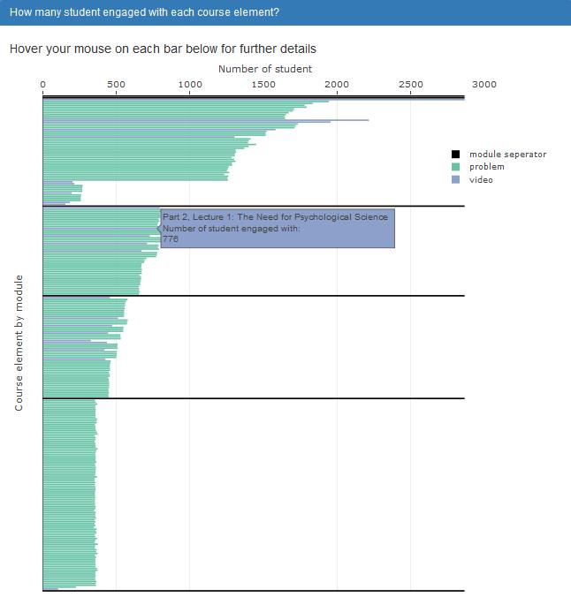
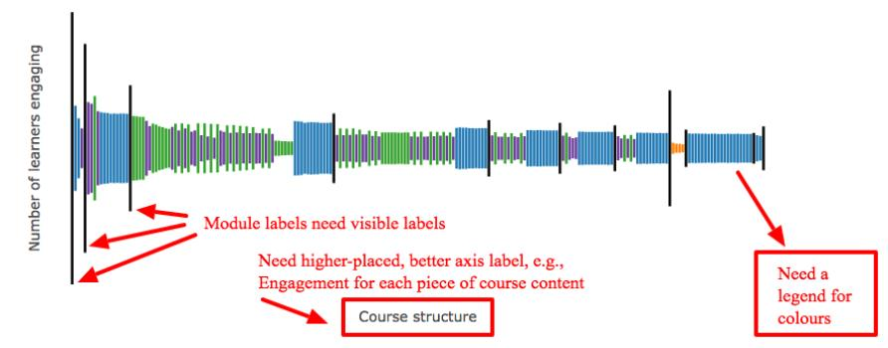
Instructor Pain Point 5 : Unclear display of overview engagement Eiffel Tower graph
I want to get more tooltip guidance about how to read and interpret this Eiffel Tower plot
Previous Dashboard
MDS Dashboard

Slide 9

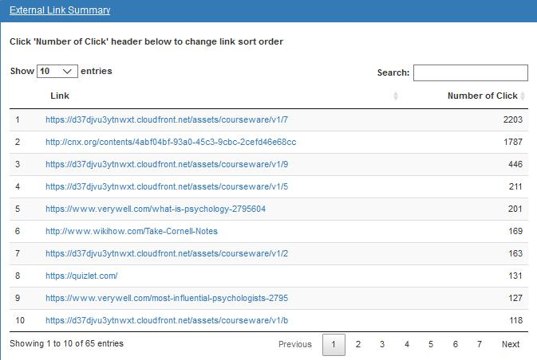
Instructor Pain Point 6 : Missing of student clicking record about external link
I am looking forward to knowing how many students actually clicked the reference material external links (to article, video, book etc.) that I put in the course.
Previous Dashboard
MDS Dashboard
External link clicking was not
tracked and measured …

Slide 10
Dashboard Presentation

Slide 11
What else did we do as professional data scientists?
Write automatic scripts for scalability and easier deployment
? all our efforts into an open-source R package with detailed documentation
Communicate with CTLT technical team for further maintenance
Protect personal sensitive data
Embed “other” as an option to student gender

Slide 12
Draft/refine protocol
Obtain feedback
Improve dashboards

Slide 13
Collect Instructor Feedback
Improve Dashboard
× 3
≈
a practical,
user-friendly
dashboard
Refine Testing Protocol
ELEMENT THREE

Slide 14
 | Course Name | Overview | Demographic | Link and Page | Forum Discussion | Problem | Video
Round 1 | Introduction to Marketing | - Add chapter separator | - Overlay bar would be better for identify actual numbers | - Loading time is slow. Need to optimize code speed | - “Wow, interesting!” - Add a reset button - Rename mode option | - Question display order is unclear - Add an export button | -“Scrolling is weird.” -Misinterpret x-axis
Round 2 | Software Programming Development | - Rename chapter to module | -“Pretty nice!” -Highlight verified students | - Error: replacement has one row when filtering other + verified | - Hard to find subsection - Red should be softer | - Hard to parse questions - Table is preferable | - Make a re-watch plot
Round 3 | Psychology | - Move x-axis label to the top | - Need to fix I Iframe height adjustment - Add a language filtering option | - Page Eiffel Tower plot might be more helpful | - Love search word table - Had trouble finding the number of comments | - Assessment need work | - New color palette is great! - Add video length unit

