Slide 1

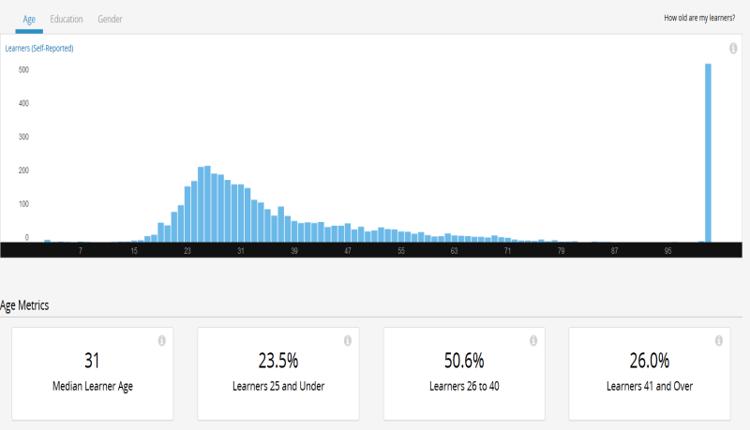
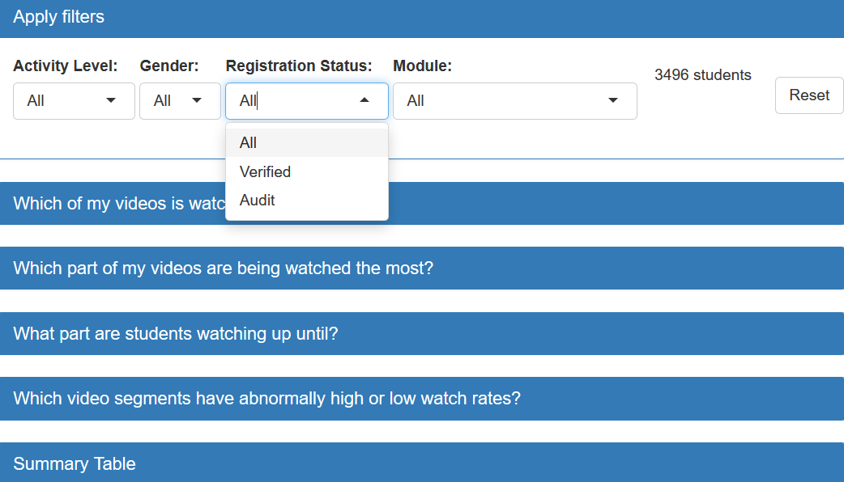
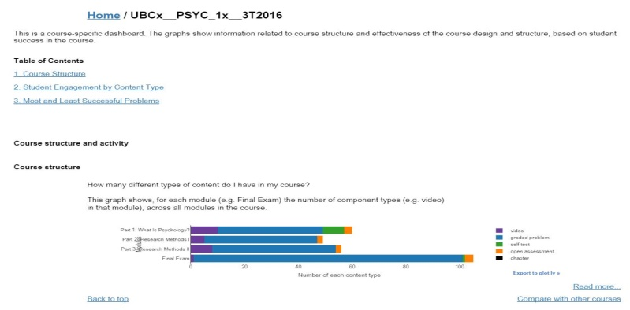
Instructor Pain Point #1: Not enough interactivity
It would be great to add demographic filters to explore engagement differences between verified/auditing students, to better serve students who paid
Previous Dashboards
MDS Dashboard
4 interactive filtering options for instructors to discover detailed patterns:
activity level
gender
registration status
course module
general view, static , useful demographics not included

Slide 2

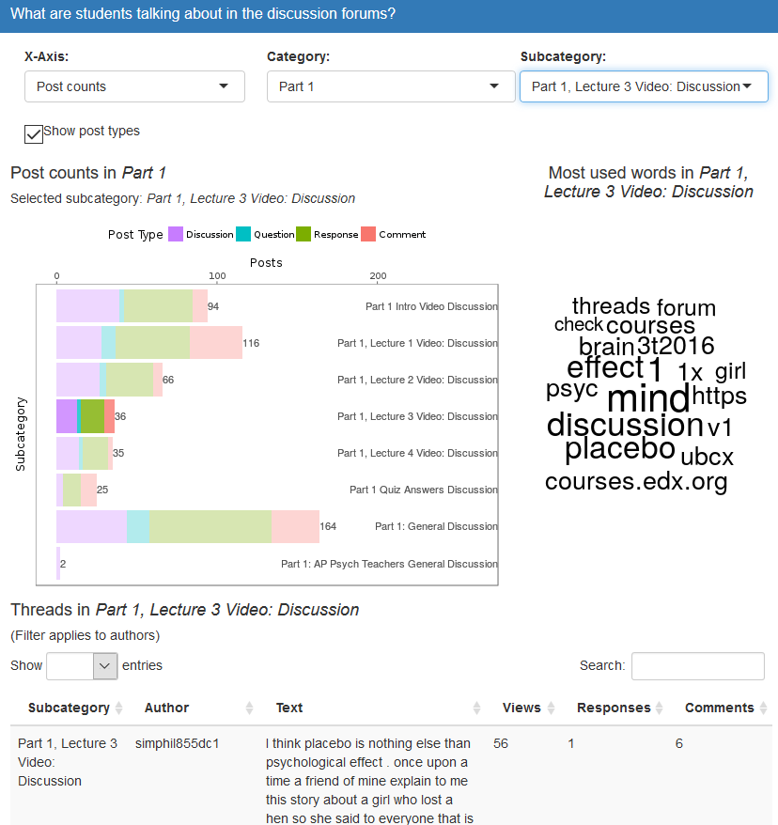
Instructor Pain Point #2: No access to discussion forum data
I am curious about how many of my students are active in forum discussions and what they are talking about.
Previous Dashboard
MDS Dashboard
Forum engagement was not
tracked or measured …

Slide 3

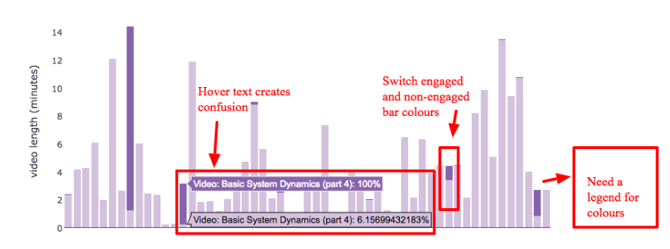
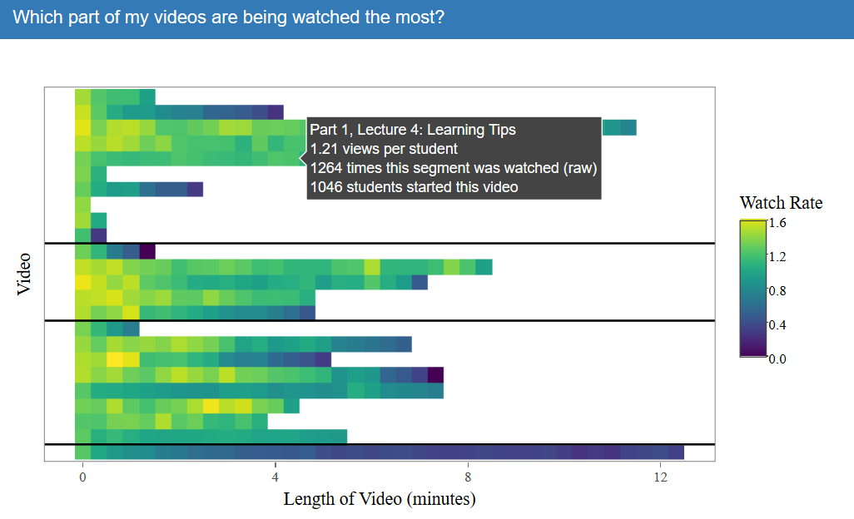
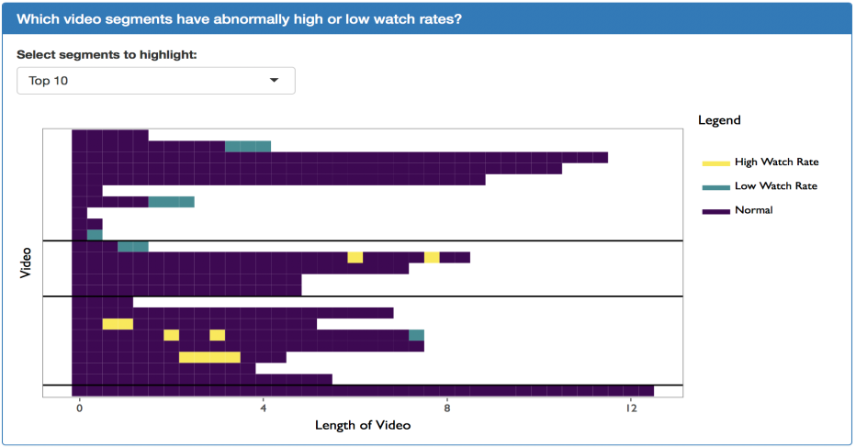
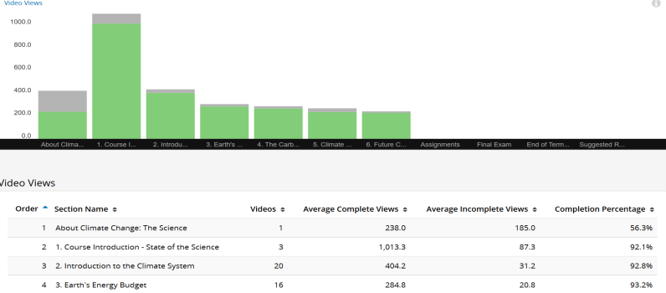
Instructor Pain Point #3: Lack of in-depth understanding of student video watching behaviour
I am interested in which segments of my videos were re-watched most so I can try to figure out what’s going on (too hard/confusing/interesting)
Previous Dashboards
MDS Dashboard

Slide 4

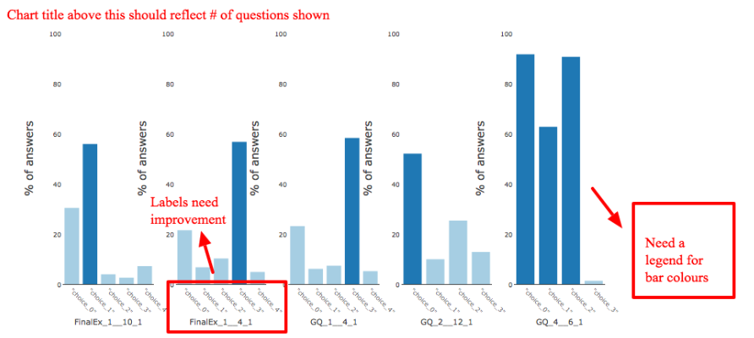
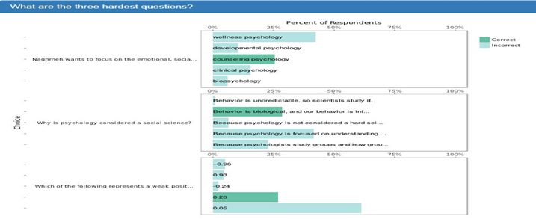
Instructor Pain Point #4: Lack of guidance for analytics of problem sets
I want to know which questions students are struggling with the most and which choices are most confusing. Perhaps I can reword my questions such that they are more straightforward.
Previous Dashboard
MDS Dashboard

Slide 5

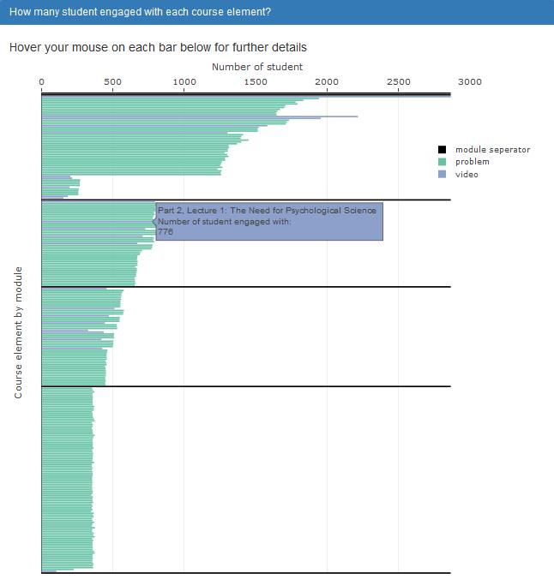
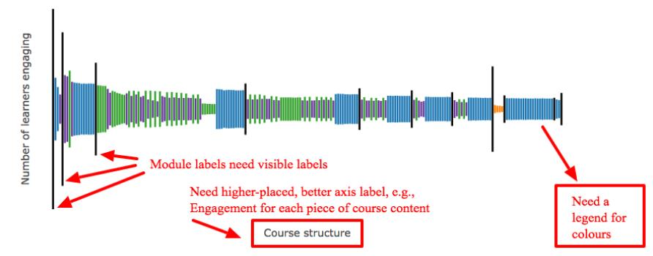
Instructor Pain Point #5: Unclear display of overview engagement Eiffel Tower graph
I want to get more tooltip guidance about how to read and interpret this Eiffel Tower plot
Previous Dashboard
MDS Dashboard

Slide 6

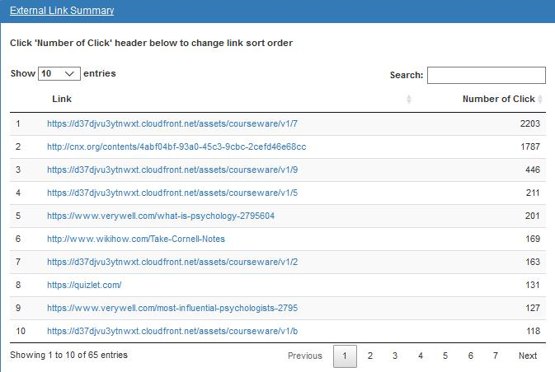
Instructor Pain Point 6: Lack of information about which URLs are clicked
I want to know how many students actually clicked the external links to reference materials, such as articles, books, or videos that I’ve put in the course.
Previous Dashboard
MDS Dashboard
External link clicking was not
tracked and measured …

Slide 7
Dashboard Presentation

Slide 8
Collect Instructor Feedback
Improve Dashboard
× 3
≈
a practical,
user-friendly
dashboard
Refine Testing Protocol
ELEMENT THREE

Slide 9
 | Course Name | Overview | Demographic | Link and Page | Forum Discussion | Problem | Video
Round 1 | Introduction to Marketing | - Add chapter separator | - Overlay bar would be better for identify actual numbers | - Loading time is slow. Need to optimize code speed | - “Wow, interesting!” - Add a reset button - Rename mode option | - Question display order is unclear - Add an export button | -“Scrolling is weird.” -Misinterpret x-axis
Round 2 | Software Programming Development | - Rename chapter to module | -“Pretty nice!” -Highlight verified students | - Error: replacement has one row when filtering other + verified | - Hard to find subsection - Red should be softer | - Hard to parse questions - Table is preferable | - Make a re-watch plot
Round 3 | Psychology | - Move x-axis label to the top | - Need to fix I Iframe height adjustment - Add a language filtering option | - Page Eiffel Tower plot might be more helpful | - Love search word table - Had trouble finding the number of comments | - Assessment need work | - New color palette is great! - Add video length unit

