Slide 1

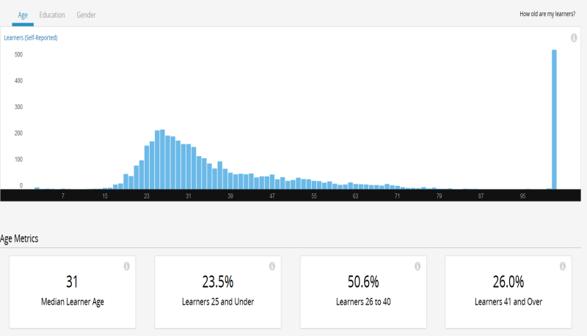
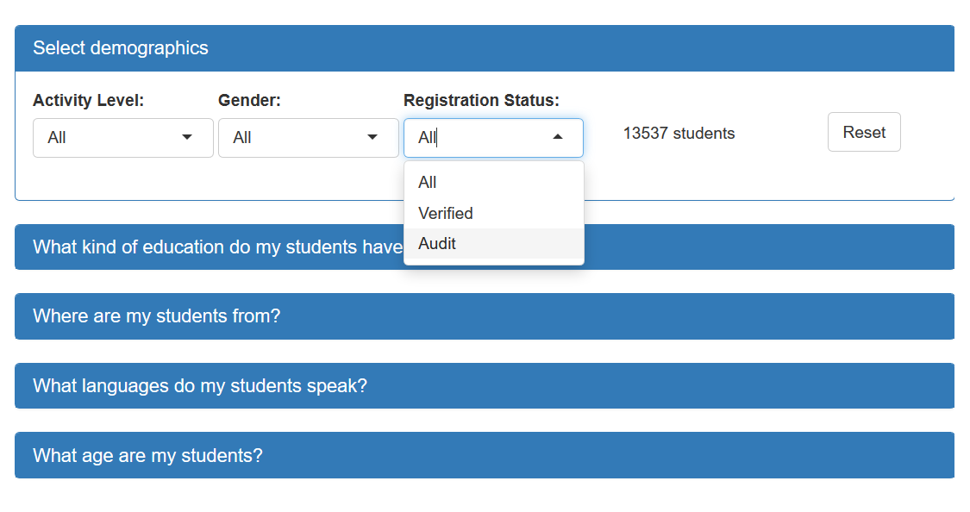
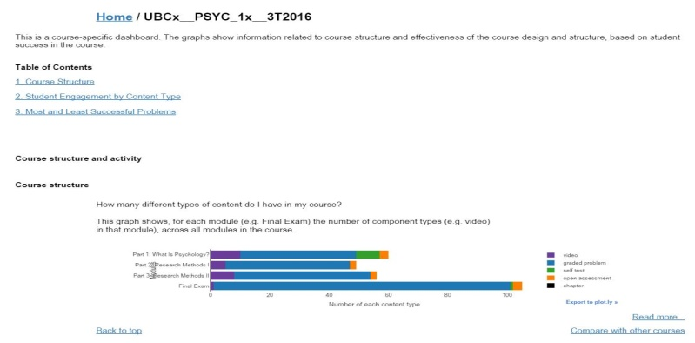
Instructor Pain Point 1 : More interactivity to cover detail
It would be great to add filters to all graphs to see the engagement difference between student demographic like various student types (verified/audit).
Previous Dashboards
MDS Dashboard
3 universal interactive filtering options for discovering detailed pattern based on instructor wish lists :
activity level
gender
registration status
general view, static , useful demographics not included

Slide 2

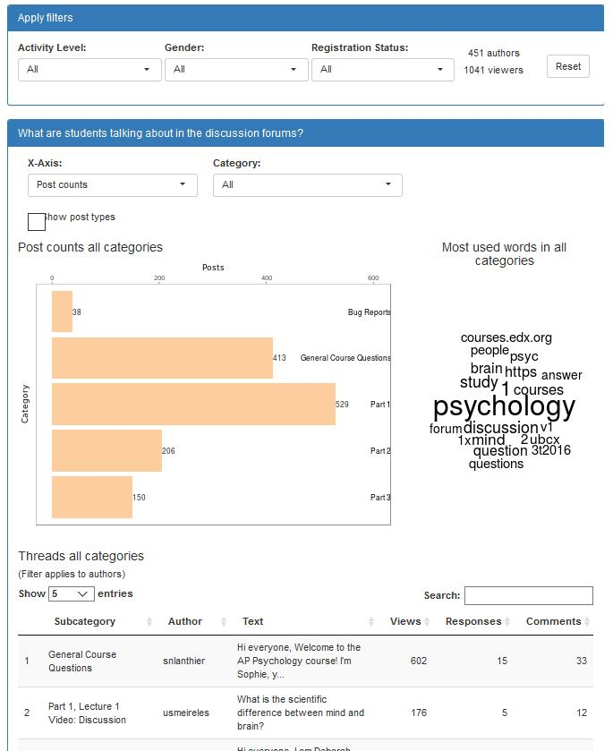
Instructor Pain Point 2 : Missing of forum discussion data
I am curious about how many my students are active in participating forum discussion and what they are talking about.
Previous Dashboard
MDS Dashboard
Forum engagement was not
tracked and measured …

Slide 3

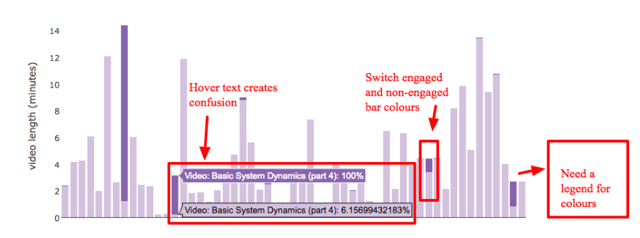
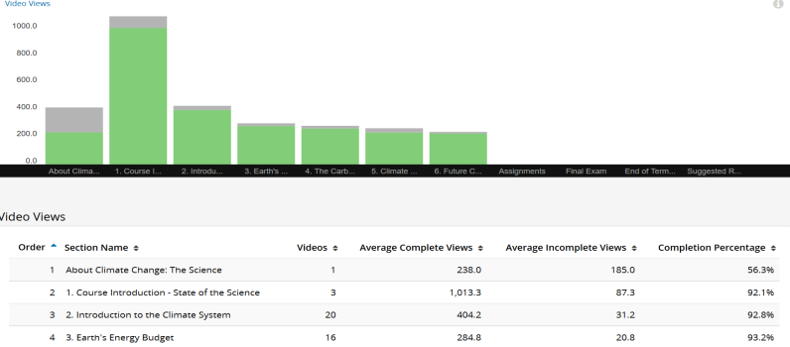
Instructor Pain Point 3: In-depth understanding on student video watching behaviour
I am interested in about which part of my video were re-watched most and when did my students usually stop playing.
Previous Dashboards
MDS Dashboard
meticulous viewer summary for each video segment , actionable for targeting abnormal segments
extensive viewer summary
for each video , non-actionable

Slide 4

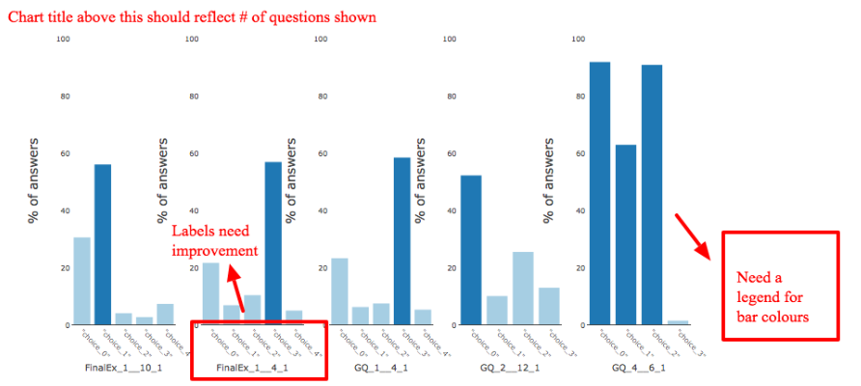
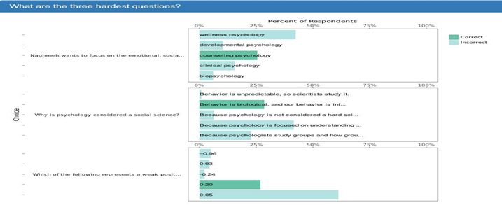
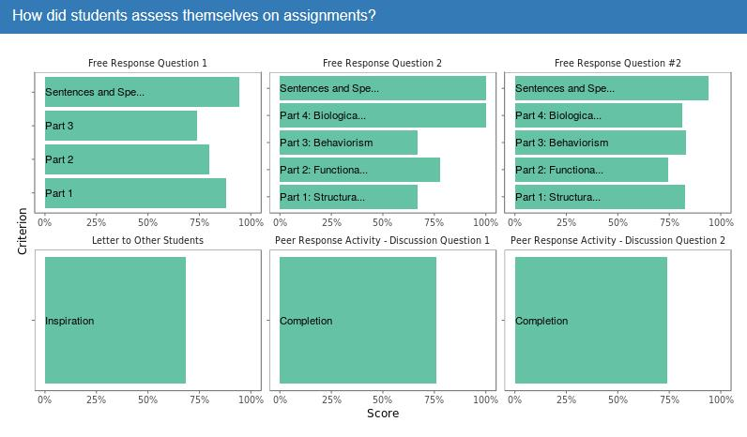
Instructor Pain Point 4 :Problem …..
I want to know when most students got wrong to a question, which choices are most confusing to them. Also, I am glad to see students performance on self-assessment problems.
Previous Dashboard
MDS Dashboard
edx insight problem viz could be put here…

Slide 5

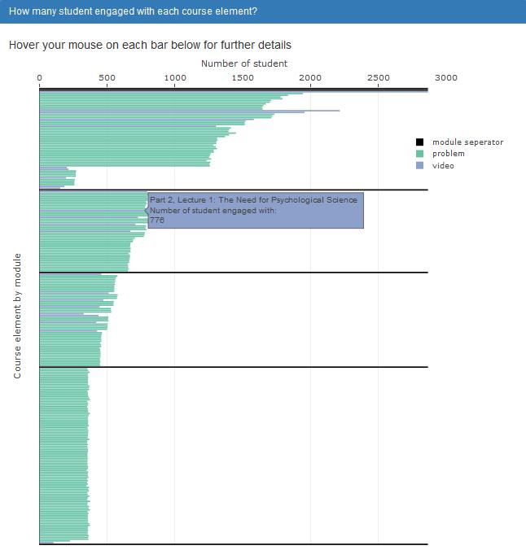
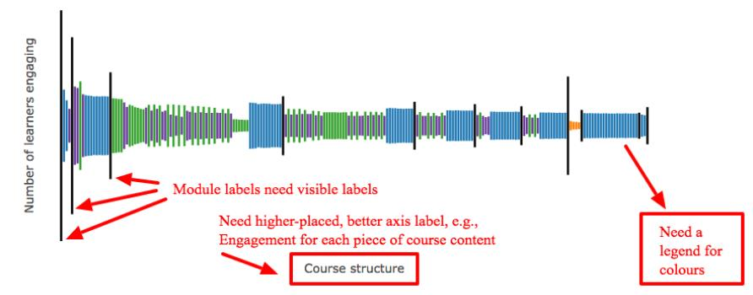
Instructor Pain Point 5 : Unclear display of overview engagement Eiffel Tower graph
I want get more tooltip guidance about how to read and interpret this Eiffel Tower plot
Previous Dashboard
MDS Dashboard

Slide 6

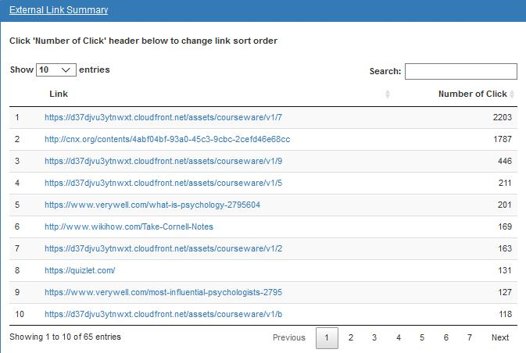
Instructor Pain Point 6 : Missing of student clicking record about external link
I am looking forward to know how many students actually clicked the reference material external links (to article,video,book etc.) that I put in the course.
Previous Dashboard
MDS Dashboard
External link clicking was not
tracked and measured …

