Slide 1
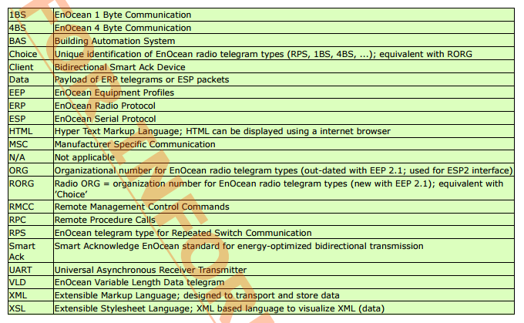
EnOcean

Slide 2

General
ERP specification defines the structure of a radio telegram
EEP (equipment profiles) defines the user data in the telegram
Each device defines 3 profile elements:
  RORG: telegram type
  FUNC: functionality of the data content
  TYPE: type of device

Slide 3
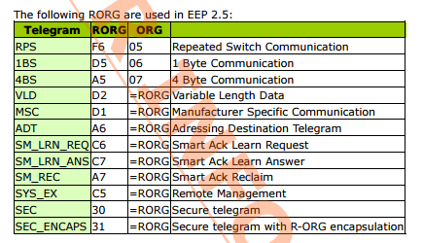
Telegram Types
Telegram types are grouped by CHOICE (RORG) number

Slide 4
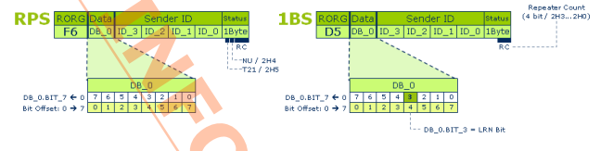

Telegram Types (RPS & 1BS)
1 byte payload
LRN bit is in position DB_0.BIT_3
T21 = 0 => PTM switch module type 1 (PTM1XX), T21 = 1 => PTM switch module type 2 (PTM2XX)
NU = 1 => N-message (N = normal)
NU = 0 => unassigned

Slide 5
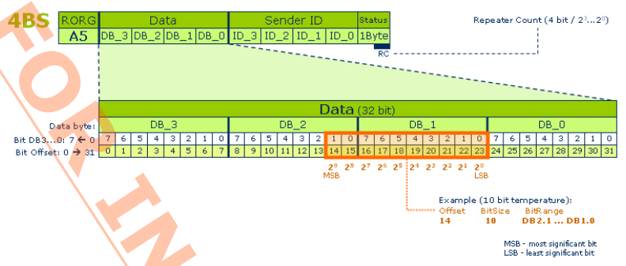
Telegram Types (4BS)
4 byte payload (bytes reversed)

Slide 6
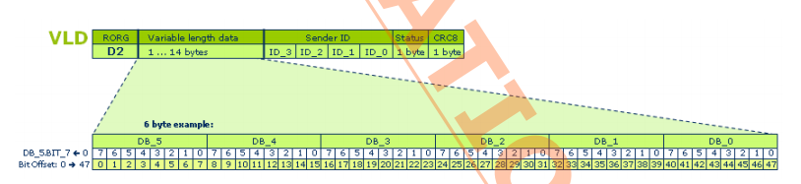
Telegram Types (VLD)
Variable data length

Slide 7
Teach-in
Defines the mutual connection between devices
  Defines to which transmitter a receiver listens to
The receiver detects if the device is already learned or unknown from the sender ID
Different for each telegram type
Procedure:
  Receiver into learning mode, each sender ID will then be stored by the receiver
  The transmitter sends a telegram
  The bits of the payload can have multiple functions

Slide 8
F6: RPS telegram

Slide 9
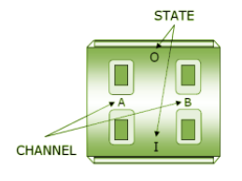
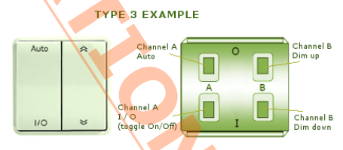

F6-02: Rocker Switch
2 message types (identified from the status field) N and U
Application style 2 also exists, but is typically used in the US and Canada

Slide 10
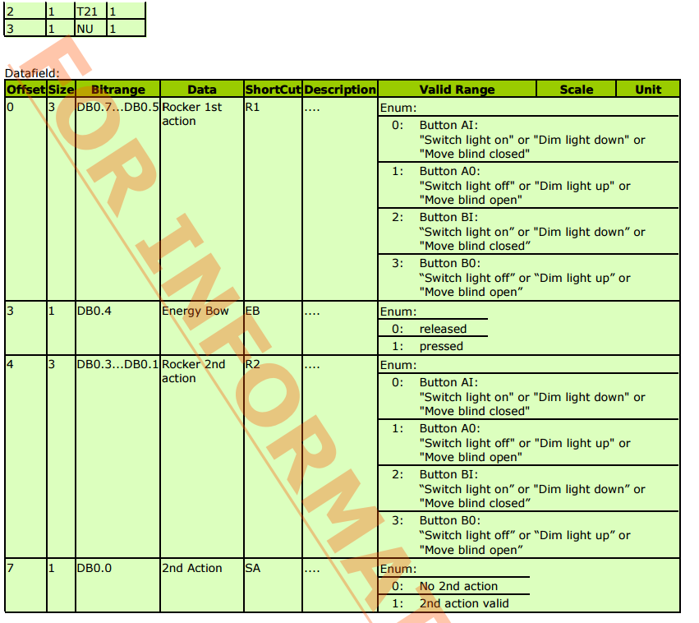
F6-02: Rocker Switch (NU = 1)

Slide 11
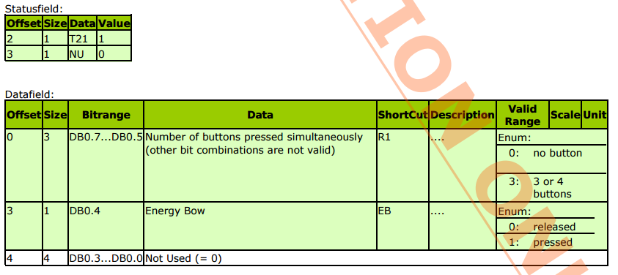
F6-02: Rocker Switch (NU = 0)

Slide 12
D2-01
Electronic switches and dimmers with energy measurement and local control

Slide 13
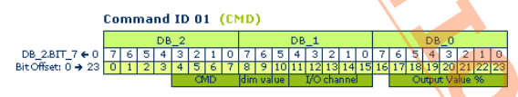
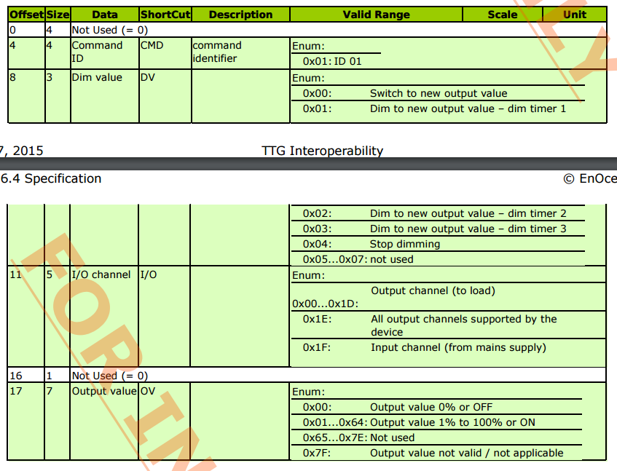
D2-01: Command 0x01
Actuator Set Ouput

Slide 14
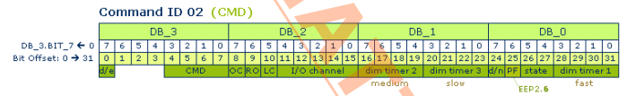
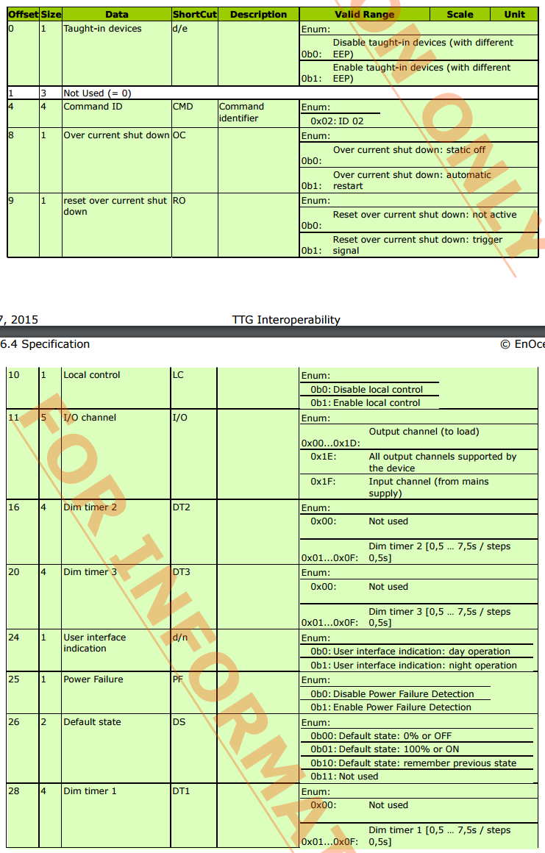
D2-01: Command 0x02
Actuator Set Local

Slide 15
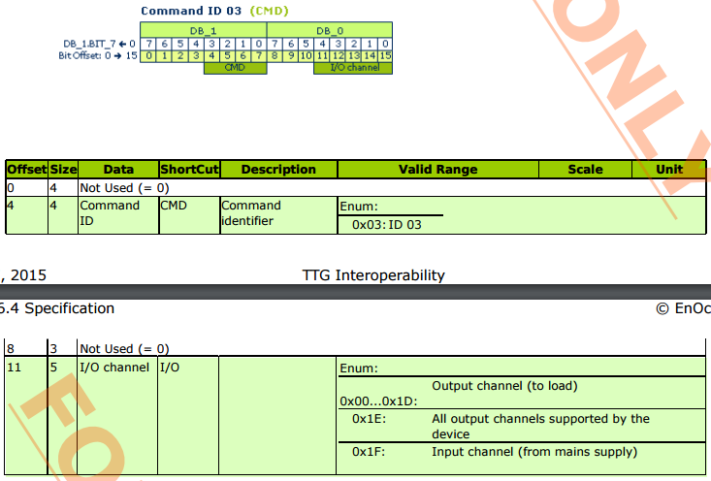
D2-01: Command 0x03
Actuator Status Query
Actuator responds with an Actuator Status Response
  Timeout 300ms

Slide 16
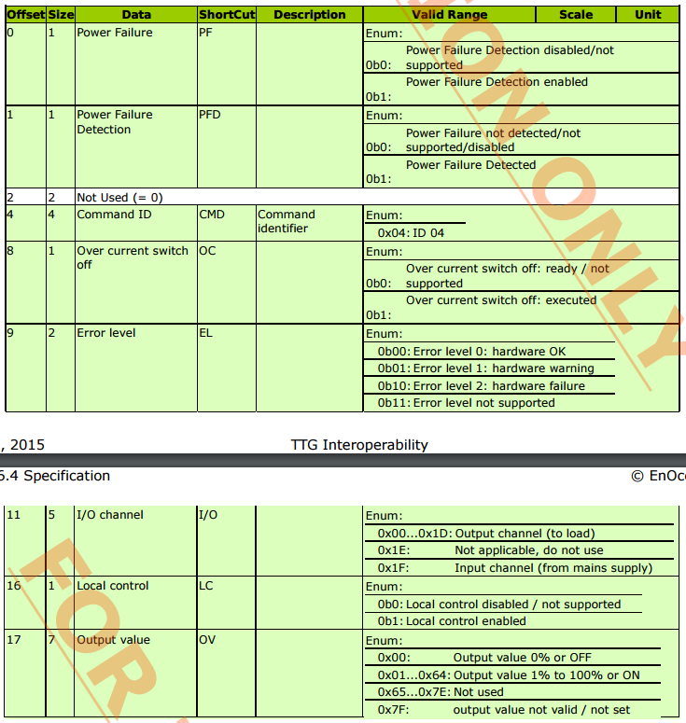
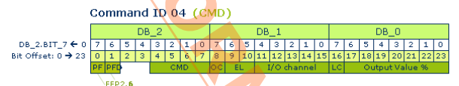
D2-01: Command 0x04
Actuator Status Response (actuator → gateway)
Sent if: (a) status of one of the channels changes locally or (b) Actuator Status Query is received
If all channels are requested, separate responses will be sent

Slide 17
NodOn In-Wall 2 Channel Module
Profile: D2-01-12

