Slide 1
410 Winter 2019
Sync # 1

Slide 2


Slide 3
Course Overview
Shell Code & Examples Python
Notes Python
Assignments Python/R
Software (Product Reviews? Bonus?)
Enthought – Canopy
YHAT-Rodeo
Anaconda with Spyder(3.6) See recording at Course: Recordings Anaconda Intro
Julia
Excel Pivot Tables
R
SAS
https://www.kaggle.com/t/f0a81ab5c1124f42a6a14c08ed0af604

Slide 4
Train vs Test Data
To assess the predictive accuracy of a model it is common practice to use a statistical methodology called cross-validation by splitting the sample data into two datasets called, respectively the train and test data. You will build your model on the train data set and you will use your model to predict on the test data.
Use Kaggle to see the accuracy (RMSE) of your model using the actual values (50%) for the test data.
You do not have the actual values for the testing data.

Slide 5
Anaconda Navigator
Spyder
Jupyter Notebook
Markdown

Slide 6
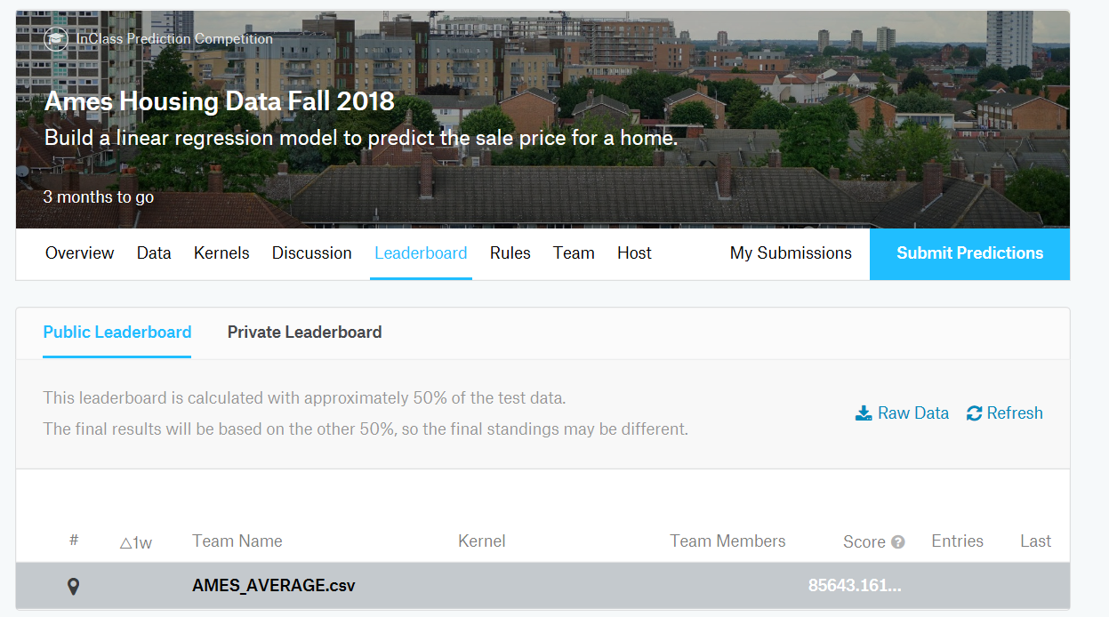
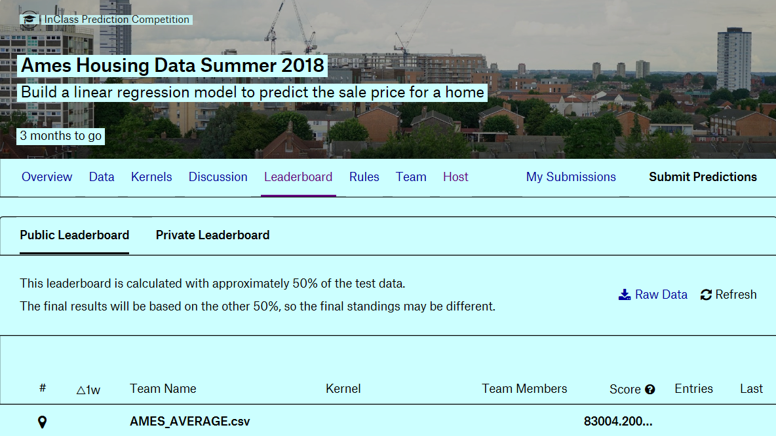

Slide 7
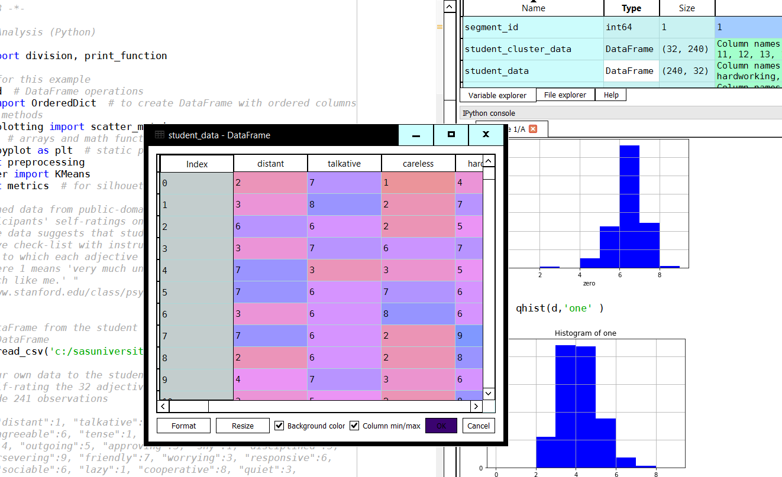

Slide 8
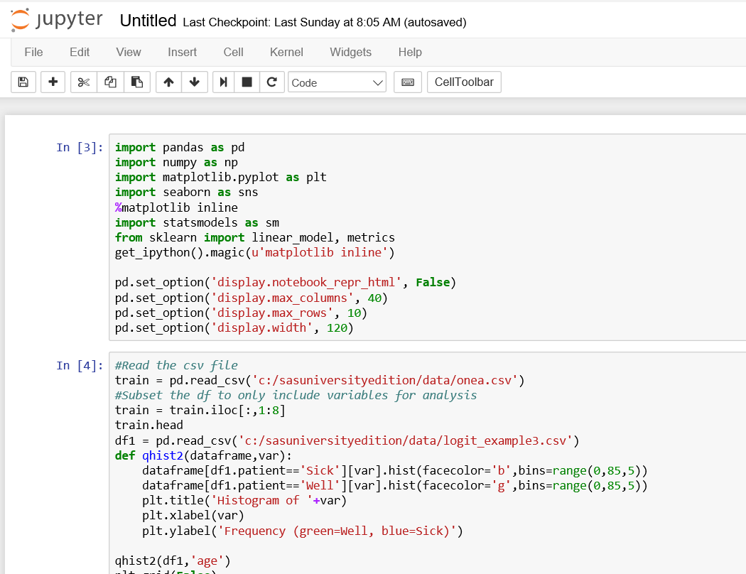

Slide 9
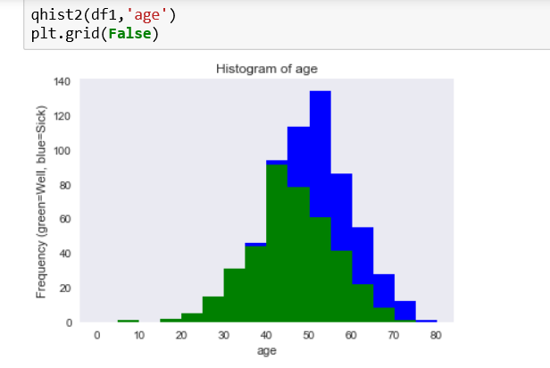

Slide 10
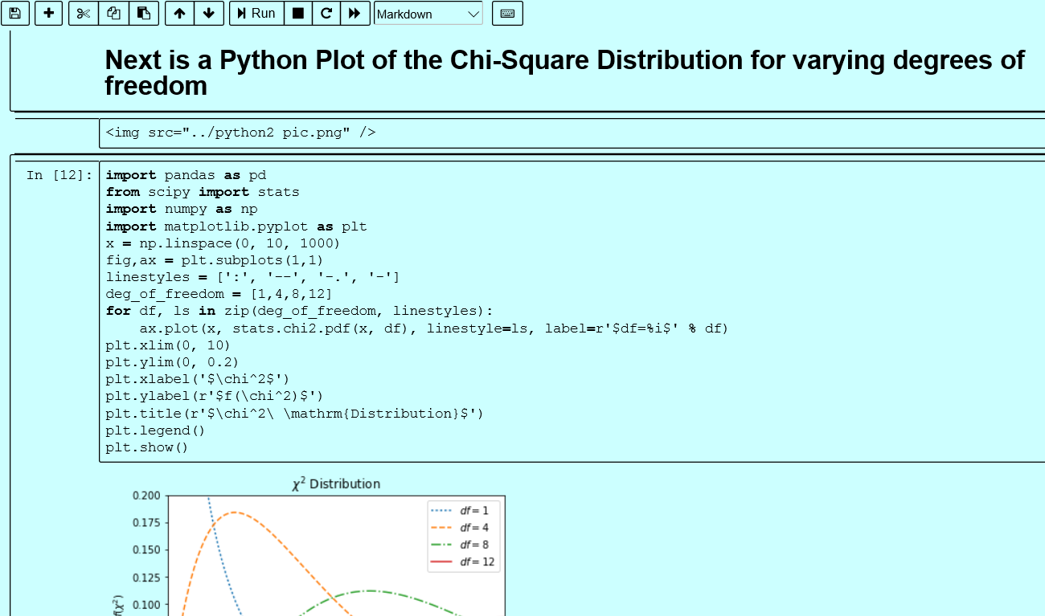

Slide 11
Canvas Overview
Syllabus
Python
Bonus Enter a prediction to Kaggle for small dataset 10 pts
Canvas go to Home then Course: Recordings
Sync Session Recordings
Recordings for assignment topics
Anything else I think of to put there that might be of help to you

Slide 12
Assignment #1
Targeted Reading
Unit 1 Linear Regression 300 pts
Quiz 36 pts
Bonus
Text Exercises 20 pts

Slide 13
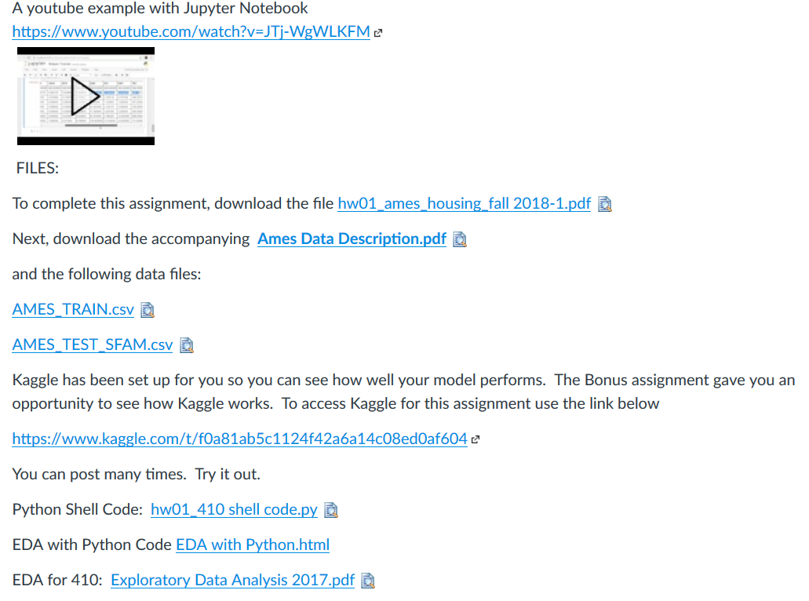

Slide 14
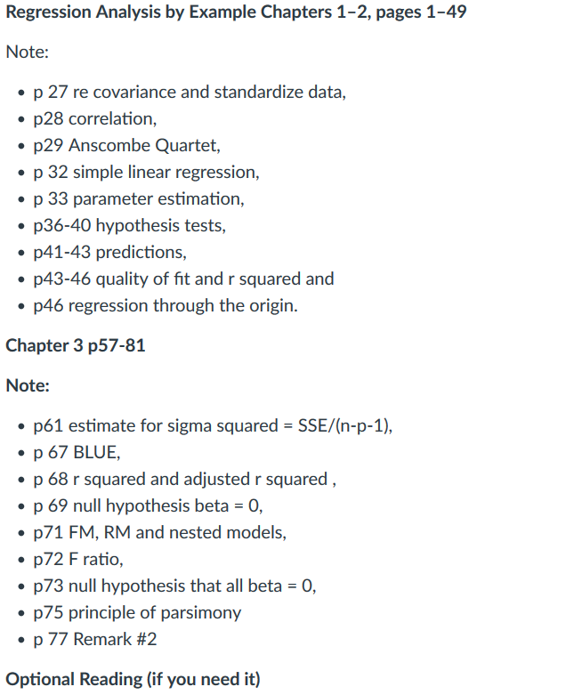

Slide 15
Canvas Detail
Targeted Reading
Unit 1 Linear Regression 300 pts
Quiz 36 pts
Bonus
Text Exercises 20 pts
Suggested Study Approach
Read Assignment
Text Skim Chapters 2-3
Start Assignment
Reread Text in detail as needed for Assignment
Take Quiz when feel ready
Focus on Assignment to completion
Select Bonus work as time allows
Manage your time to allow for completion

Slide 16
Assignments #1 & #2
Targeted Reading
Unit 1 Linear Regression 300 pts
Quiz 36 pts
Bonus
Text Exercises 20 pts
Targeted Reading
Unit 2 Validation, Transformation & More 300 pts
Quiz 52 pts
Bonus Text Exercises 30 pts

Slide 17
Assignments #1 #2 #3
Targeted Reading
Unit 1 Linear Regression 300 pts
Quiz 36 pts
Bonus
Text Exercises 20 pts
Targeted Reading
Unit 2 Validation, Transformation & More 300 pts
Quiz 52 pts
Bonus Text Exercises 30 pts
Unit 3 Tutorial - Collinearity, Principal Components and Factor Analysis 100 pts
Quiz 30 pts
Bonus 20 pts

Slide 18
Assignments
Unit 1 Linear Regression 300 pts
Quiz 36 pts
Bonus
Bonus Text Exercises 20 pts
Unit 2 Validation, Transformation & More 300 pts
Quiz 52 pts
Bonus Text Exercises 30 pts
Unit 3 Tutorial - Collinearity, Principal Components and Factor Analysis 100 pts
Quiz 30 pts
Bonus Write Up 20 pts
Unit 4 Tutorial - Cluster & Multivariate Analysis 100 pts
Assignment 4A 100 pts
Total Points Assignment + Quizzes 1018
Bonus 70
Final Exam 30

Slide 19
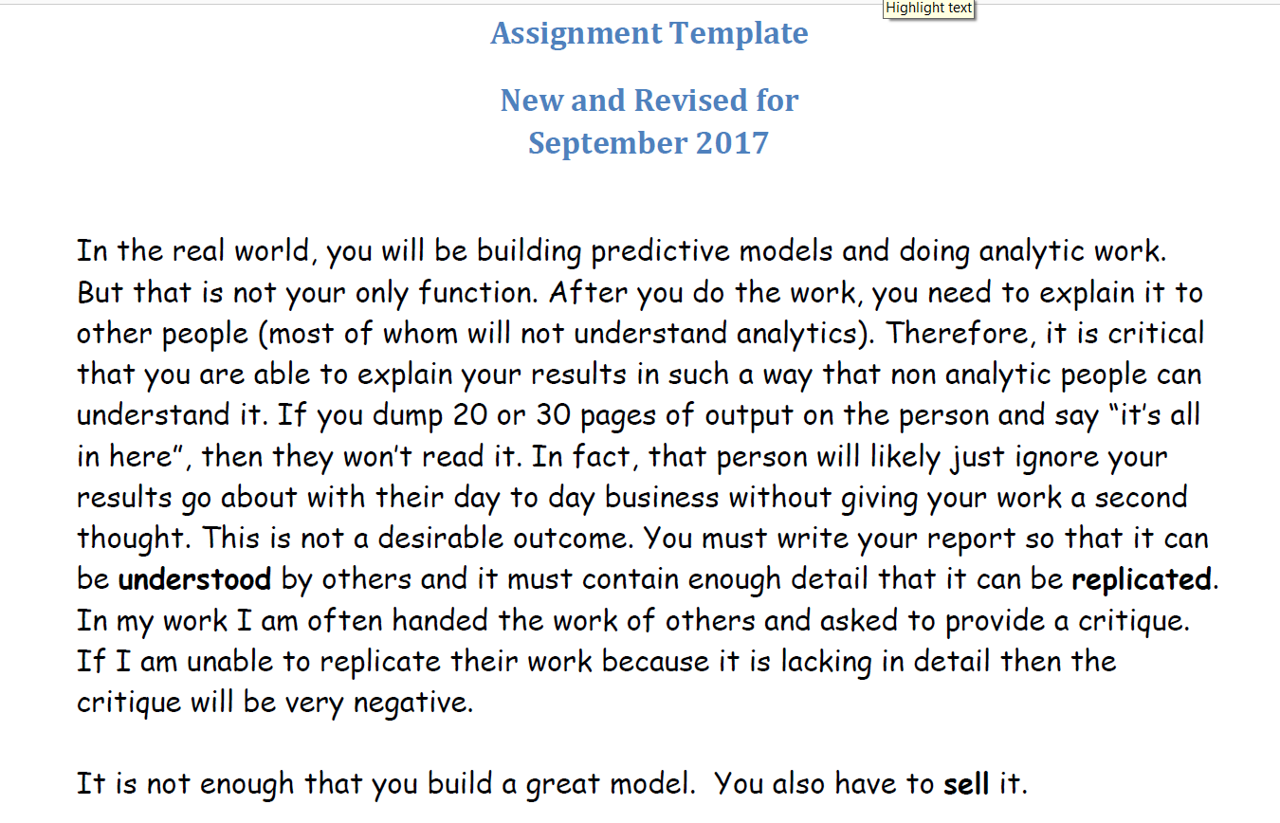

Slide 20
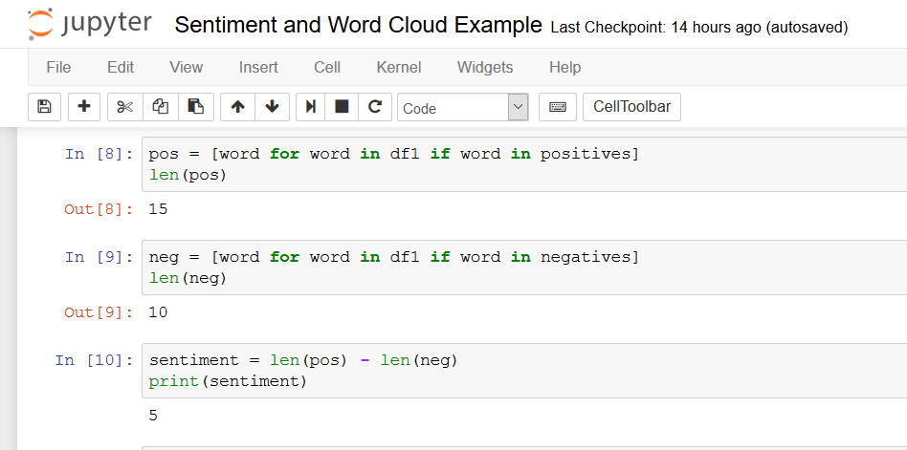
Sentiment Analysis for Assignment Template

Slide 21
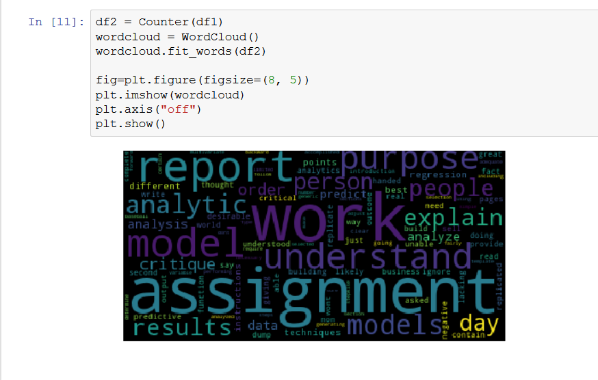

Slide 22
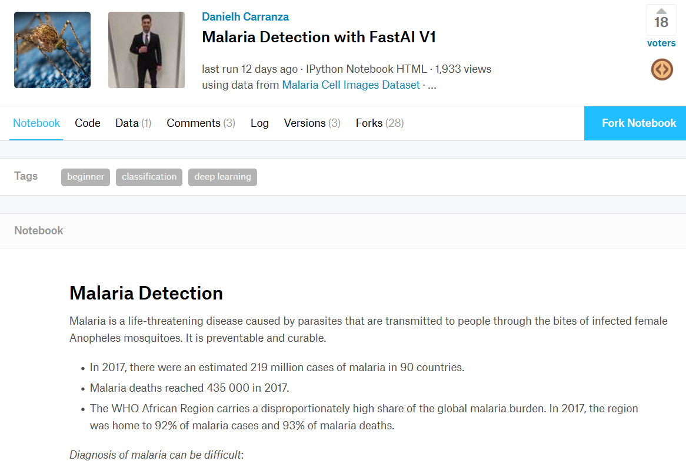

Slide 23
Comments for your Data Future
Other people have opinions, but you have data.
Engineers have a rule of thumb, but you have data.
Economists have theory, but you have data.
Be patient in expressing your results. Start by telling a story. This is where we have been, show the data. This is where we are going if we make no change, show data. This is where the predictive model suggests we can go if we follow the steps indicated by the data and the model.
Just because you have data, don’t be arrogant. Be nice.

Slide 24
Questions

