Slide 1
달려간다
탕탕
우당
시작하기
종료하기
1
1
8,888,888
8,888,888
8,888,888
2
2
8,888,888
8,888,888
8,888,888
창모드
전체화면
3
3
8,888,888
8,888,888
8,888,888

Slide 2
달려간다
우당’탕탕’
시작하기
종료하기
혼자서!
둘이서!
Easy
Normal
Hard
안할래!

Slide 3
Player 1
00,000,000,000
Boss

Slide 4
Player 1
00,000,000,000
Boss
Clear!
Player 1
00,000,000,000
X 100,000
Total Score
재시도
X 10,000
00,000,000,000
88.8%
88.8%
88.8%
타이틀
X 100,000
X 1,000,000
X 10,000,000

Slide 5
Player 1
00,000,000,000
Boss
Defeat…
재시도
타이틀

Slide 6
Player 1
00,000,000,000
Boss
Player 2
00,000,000,000

Slide 7
Player 1
00,000,000,000
Clear!
Boss
Player 1
00,000,000,000
X 100,000
Total Score
X 10,000
00,000,000,000
88.8%
88.8%
88.8%
X 100,000
X 1,000,000
X 10,000,000
Player 2
00,000,000,000
X 100,000
Total Score
X 10,000
00,000,000,000
재시도
88.8%
88.8%
88.8%
X 100,000
X 1,000,000
X 10,000,000
타이틀
Player 2
00,000,000,000

Slide 8
Player 1
00,000,000,000
Boss
Defeat…
재시도
타이틀
Player 2
00,000,000,000

Slide 9
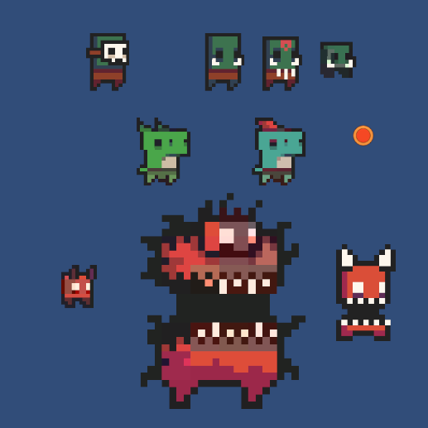
사용할 스프라이트 목록

