Slide 1
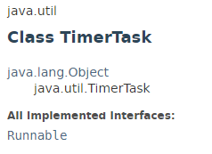
TimerTask
The java.util.TimerTask class represents a task that can be scheduled for one-time or repeated execution by a Timer.

Slide 2
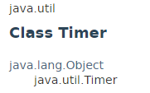
Timer
The java.util.Timer class provides a facility for threads to schedule tasks for future execution in a background thread.
Tasks may be scheduled for one-time execution, or for repeated execution at regular intervals.
This class is thread-safe: multiple threads can share a single Timer object without the need for external synchronization.

Slide 3
TimerTask
TimerTask is the task to perform and Timer is the scheduler.
Using Timer we can schedule
TimerTask to run at a particular time
Timer
TimerTask

Slide 4
TimerTask
https://docs.oracle.com/javase/8/docs/api/index.html?java/util/TimerTask.html
https://docs.oracle.com/javase/8/docs/api/index.html?java/util/Timer.html

