Slide 1
こんにちは、ロンドン！

Slide 2
Konnichiwa, rondon!

Slide 3
Hello, London!

Slide 4
こんにちは、ロンドン！
↓
Konnichiwa, rondon!
↓
Hello, London!
Notes:
This is a simple example of a rewrite system.
A rewrite system is something that takes an input and systematically transforms it into something else.
In this case, from Japanese characters to alphabet, to English.

Slide 5
Cracking the code: Translating Japanese numbers with rewrite systems

Slide 6
Overview
Issues with translating Japanese numbers
Rewrite systems and applications to arithmetic
Using rewrite systems to rewrite Japanese and English text

Slide 7
So, why am I talking about this?
Bsc Maths with Japanese
2014-2021: Japanese translator
2021: Transitioned to software engineering
Frustrations with translation software

Slide 8
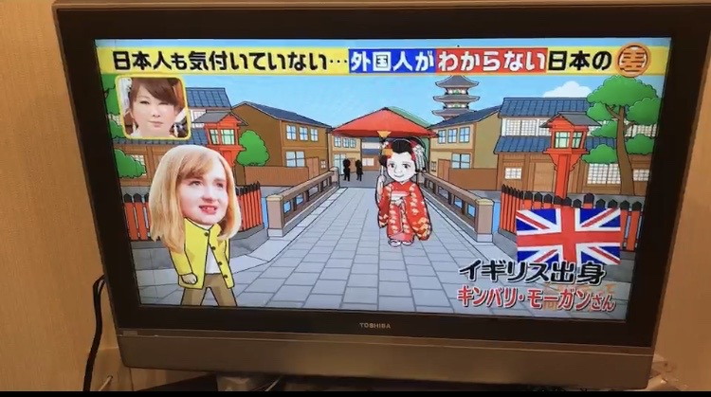

Slide 9
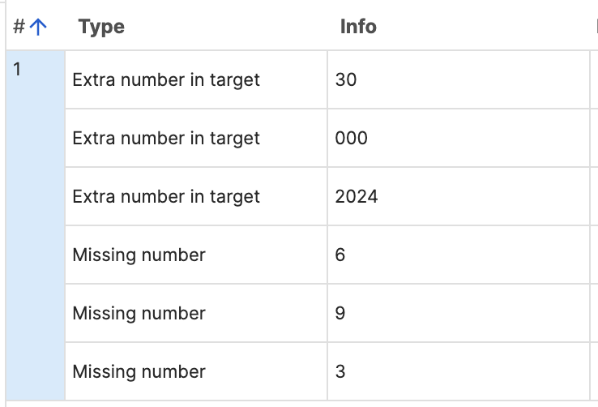
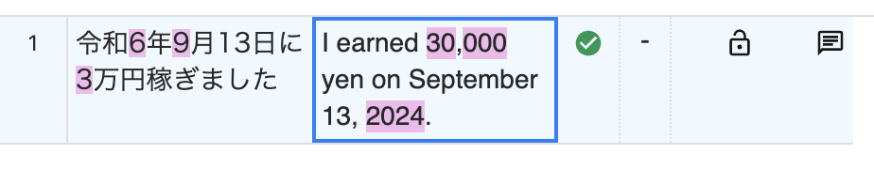
Issues with translation tools
Computer Assisted Translation (CAT) tools
Quality checks before client submission
Below is a perfectly translated sentence. Why so many errors?

Slide 10
Difficulties comparing Japanese and English numbers
Months
Number + 月
1 月 = January, 2 月 = February
CAT tool will complain of missing number!

Slide 11
Difficulties comparing Japanese and English numbers
Years
Japanese imperial year system
E.g., Reiwa started in 2019
2024 = Reiwa 6
Missing “6” in the source and extra “2024” in the translation!

Slide 12
Difficulties comparing Japanese and English numbers
Numbers
Arabic numerals: 1, 2, 3
Kanji characters: 一、二、三
Combination: 3千 (3,000)
Different units to English: 万 (10,000), 億 (100 million)
10 万 = 100 thousand
CAT: missing numbers from source and extra in translation!

Slide 13
Parsing Japanese words difficult
No spaces used in Japanese
昨日はビールを百杯飲んでしまった
昨日はビールを百杯飲んでしまった

Slide 14

My struggle
CAT tool number checks useless
Very easy to make a careless mistake
Checking numbers VERY important in financial translation
Hours spent clicking through false errors

Slide 15
Transformation to a common format
令和6年9月13日に3万円稼ぎました
↓
List(Year(2024), Month(9), Number(13), Number(30,000))
List(Year(2024), Month(9), Number(13), Number(30,000))
↑
On September 13, 2024, I earned 30,000 yen

Slide 16
Rewrite systems
Introduction

Slide 17
What is a rewrite system?
Set of rules that transforms one term into another
Process described in a series of rewrite steps
LHS → RHS
x + 0 → x
Notes:
In TRS, the process is often described as a series of rewrite steps, where one term is transformed into another by applying rewrite rules.
A rule generally looks like:
where LHS is a pattern to match, and RHS is the result of applying the rewrite.
For instance, a rewrite rule could be something like: indicating that any term of the form x + 0 can be rewritten to just x. The process of applying this rule to a term is called rewriting.
A term rewriting system consists of a set of rules that transform terms (expressions) into other terms. Each term is made of function symbols and variables, and rules specify how specific patterns in a term should be rewritten. This process of applying rules to transform terms is very similar to the way functions are applied in functional programming to reduce expressions.

Slide 18

Symbolic differentiation
$$\frac{d}{dx}x^{2}=2x$$

Slide 19
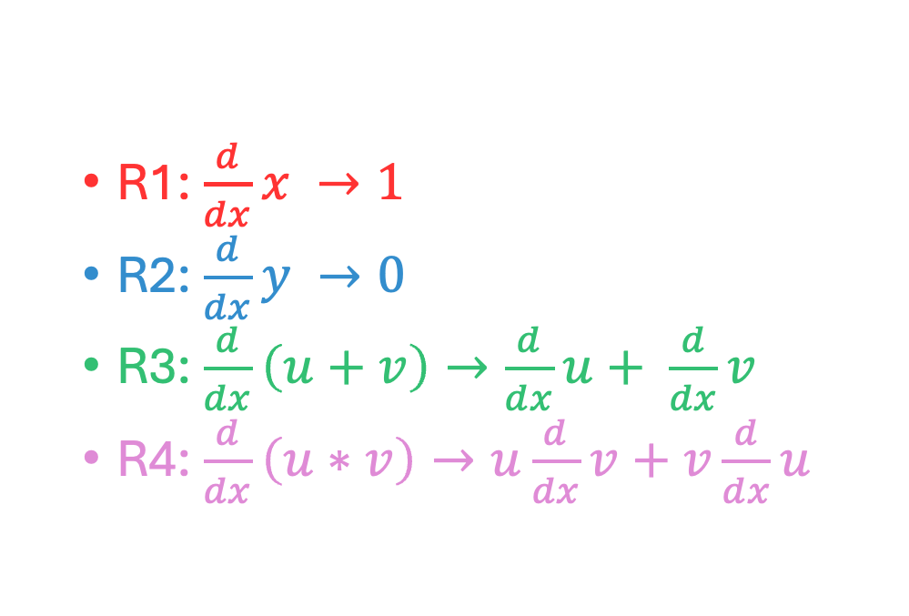
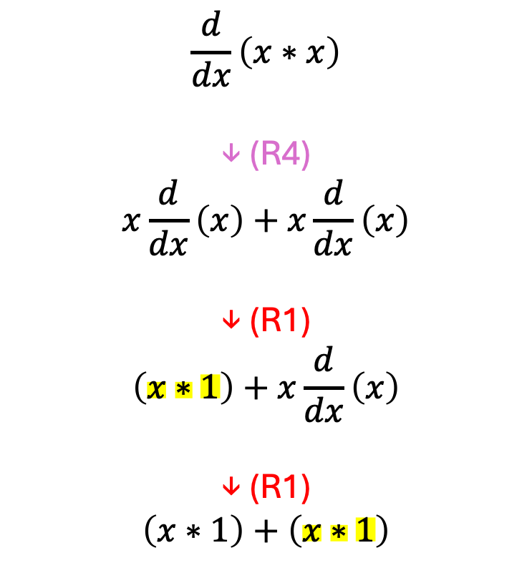
Symbolic differentiation
R1: $\frac{d}{dx}x →1$
R2: $\frac{d}{dx}y →0$
R3: $\frac{d}{dx}\left(u+v\right)→\frac{d}{dx}u+ \frac{d}{dx}v$
R4: $\frac{d}{dx}\left(u∗v\right)→u\frac{d}{dx}v+v\frac{d}{dx}u$
$$\frac{d}{dx}\left(x∗x\right)$$
↓ (R4)
$$x\frac{d}{dx}\left(x\right)+x\frac{d}{dx}\left(x\right)$$
↓ (R1)
$$\left(x∗1\right)+x\frac{d}{dx}\left(x\right)$$
↓ (R1)
$$\left(x∗1\right)+\left(x∗1\right)$$
Notes:
add animation

Slide 20
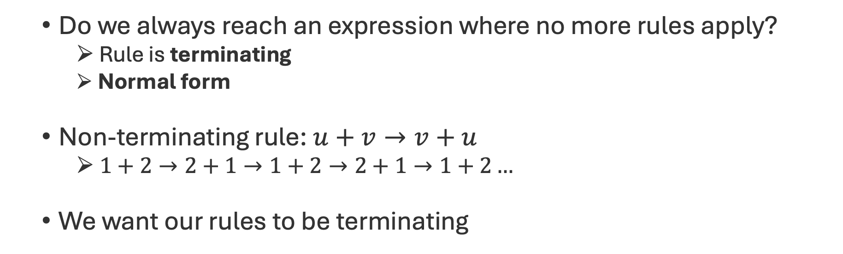
Termination
Do we always reach an expression where no more rules apply?
Rule is terminating
Normal form
Non-terminating rule: $u+v→v+u$
$1+2→2+1→1+2→2+1→1+2…$
We want our rules to be terminating
Notes:
animation

Slide 21


Confluence
If there are different ways of applying the rule, does it always lead to the same output?
$$\frac{d}{dx}\left(x∗x\right)$$
↓ (R4)
$$x\frac{d}{dx}\left(x\right)+x\frac{d}{dx}\left(x\right)$$
↓ (R1)
$$\left(x∗1\right)+x\frac{d}{dx}\left(x\right)$$
↓ (R1)
$$\left(x∗1\right)+\left(x∗1\right)$$
$$\frac{d}{dx}\left(x∗x\right)$$
↓ (R4)
$$x\frac{d}{dx}\left(x\right)+x\frac{d}{dx}\left(x\right)$$
↓ (R1)
$$x\frac{d}{dx}(x)+(x ∗1)$$
↓ (R1)
$$\left(x∗1\right)+\left(x∗1\right)$$

Slide 22
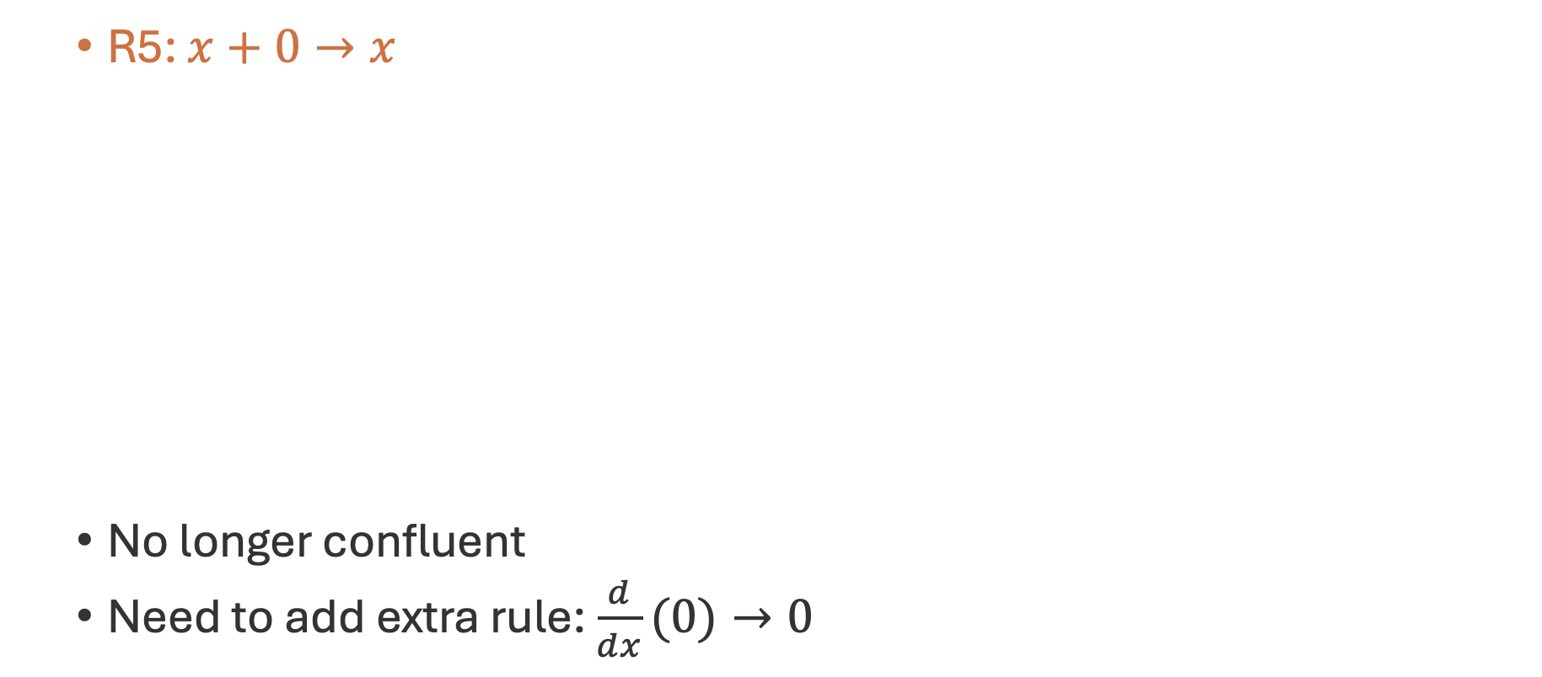


Confluence
R5: $x+0→x$
No longer confluent
Need to add extra rule: $\frac{d}{dx}(0)→0$
$$\frac{d}{dx}\left(x+0\right)$$
↓ (R5)
$$\frac{d}{dx}\left(x\right)$$
↓ (R1)
$$1$$
$$\frac{d}{dx}\left(x+0\right)$$
↓ (R3)
$$\frac{d}{dx}\left(x\right)+\frac{d}{dx}(0)$$
↓ (R1)
$$1+\frac{d}{dx}(0)$$

Slide 23
Summary
System of rules for transforming input to output
Termination: Converges to normal form in finite number of steps
Confluence: Result is same regardless of evaluation strategy

Slide 24
Rewrite systems
Solving the Japanese number issue

Slide 25
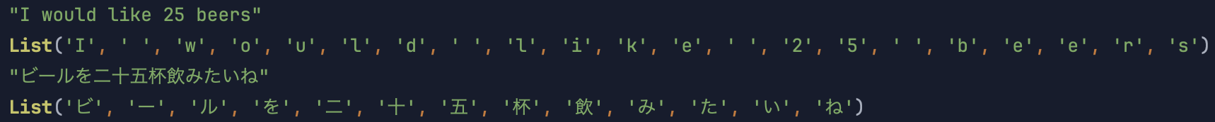
Rewrite rules in Scala
Named entity recognition
Input a rule matches
Output produced upon match
Notes:
animation
named entity recognition ensure termination by not expanding
In this section we'll use rewrite systems to perform [named entity
// recognition](https://en.wikipedia.org/wiki/Named-entity_recognition). This is
// a natural language processing task where we attempt to extract particular
// items (entities) of interest from text. In our case we're interested in
// extracting numeric entities, such as number and dates.
// How would we implement this as code? Conceptually there are two parts to a
// rewrite:
//
// 1. the *pattern* it matches, which is the left hand side of the rule; and
// 2. the output it produces, if it successfully matches.
//
// The input and output are of the same type in the example above, but this is
// not always the case. So in Scala we can write.

Slide 26
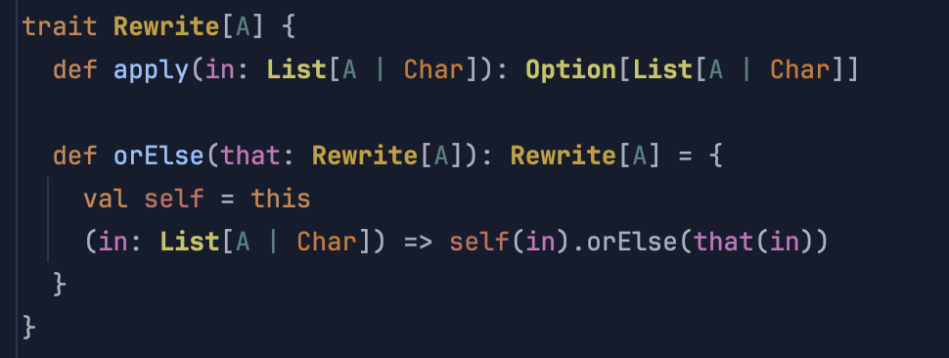
Rewrite rules in Scala
Notes:
apply Method:
This method takes a list of elements, where each element is either of type A or Char, and returns an Option[List[A | Char]].If the rewrite operation succeeds, it returns Some(rewrittenList). If it fails (i.e., no rewrite is possible), it returns None.
orElse:
This method defines an orElse mechanism, which allows chaining two Rewrite[A] instances.
If the current rewrite (self) does not succeed (i.e., returns None), it tries the alternative rewrite (that).
In other words, it combines two rewrite strategies so that if the first one (self) fails to rewrite the input, the second one (that) is tried.

Slide 27
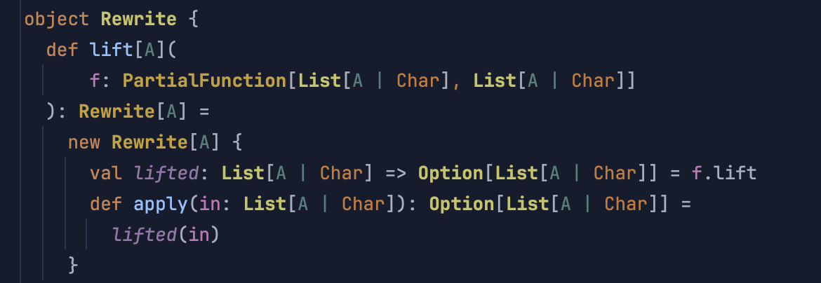
Rewrite rules in Scala
Notes:
Lift method: This method takes a PartialFunction[List[A | Char], List[A | Char]] and converts it into a Rewrite[A]. (A PartialFunction is a function that is not necessarily defined for all possible inputs. It may be defined only for certain cases.)
The partial function represents the pattern we are matching in our rewrite rule
The .lift method converts this PartialFunction into a total function that returns an Option. If the input matches the cases defined in the PartialFunction, it returns Some(output). If not, it returns None.It creates a new instance of Rewrite[A] and assigns the lifted version of the function to the apply method.

Slide 28
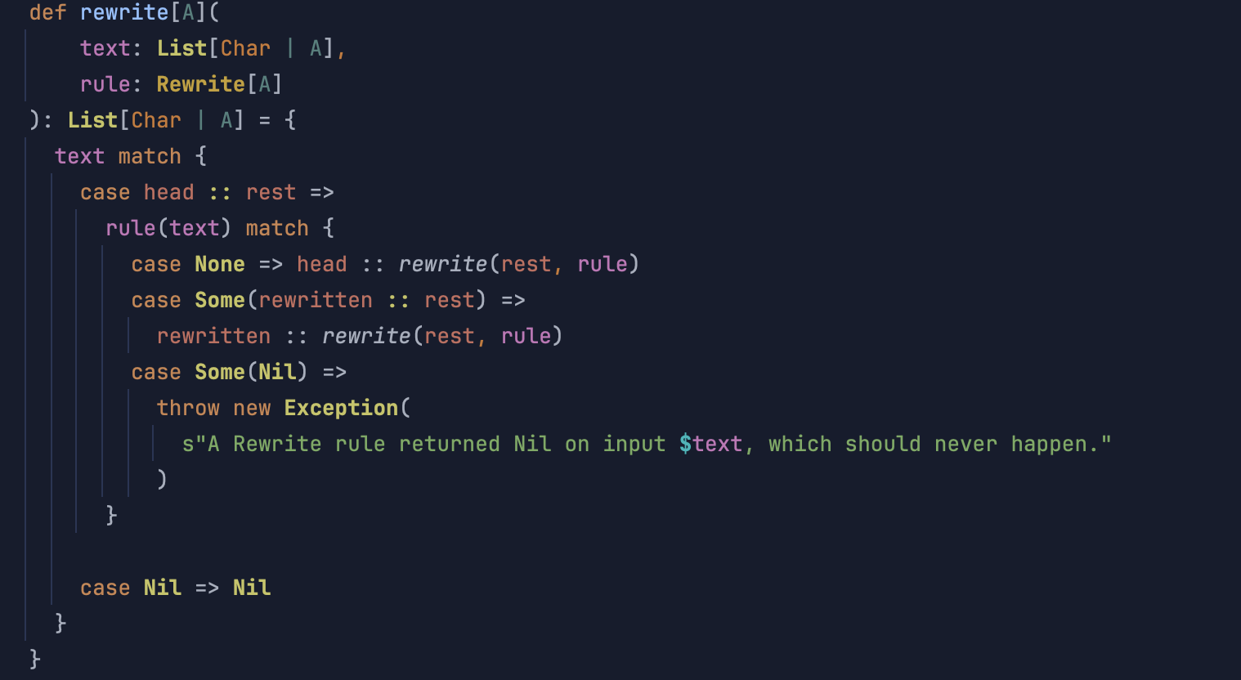
Rewrite rules in Scala
Notes:
So now we need a method for applying a rewrite The function attempts to apply the rewrite rule rule(text) to the list text. This call returns an Option[List[Char | A]], which can be Some(list) if the rule was successfully applied, or None if the rule didn't match.
Case None: If the rewrite rule returns None, the rule was not applicable, so the function keeps the first element head unchanged and recursively processes the rest of the list rest.
Case Some(head :: rest): If the rule succeeds and returns Some(head :: rest), it replaces the first part of the list with this new head :: rest and recursively applies the rewrite to the rest of the list.
Case Some(Nil): If the rule returns Some(Nil), it indicates that the rewrite rule unexpectedly erased the entire list. This is considered an error, and the function throws an exception.

Slide 29
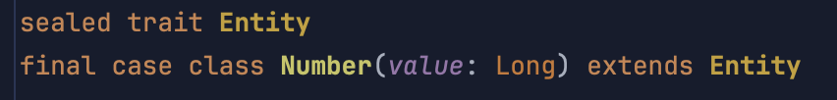
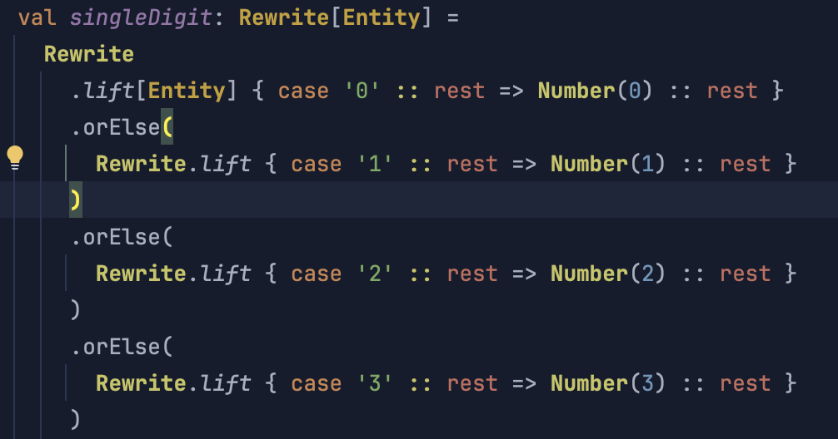
Rewrite rules in Scala

Slide 30

Rewrite rules in Scala

Slide 31
Rewrite rules in Scala
Notes:
make a shorter sample

Slide 32
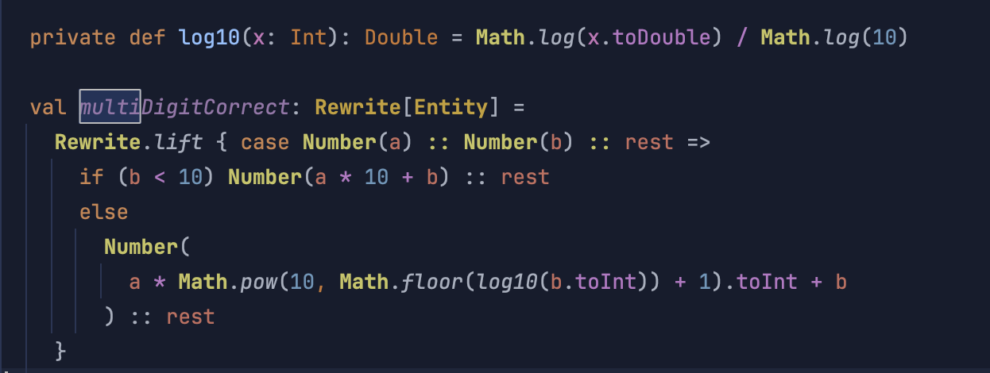
Rewrite rules in Scala

Slide 33
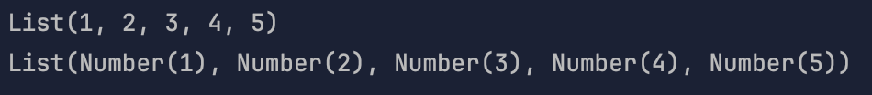
Rewrite rules in Scala

Slide 34
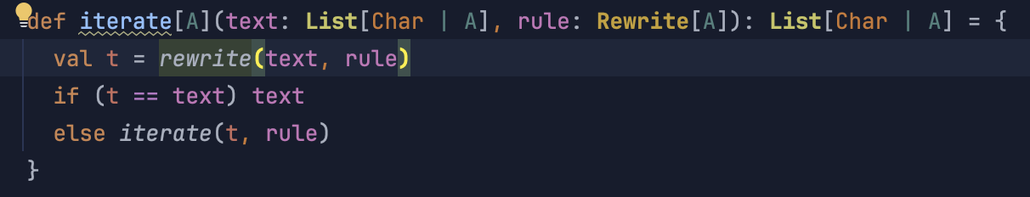
Rewrite rules in Scala
Notes:
The final piece of our puzzle is the iterate function, which builds on the previous rewrite function, introducing a looping mechanism to repeatedly apply a rewrite rule until the list no longer changes.
(The iterate function repeatedly applies a rewrite rule (Rewrite[A]) until no further changes occur, meaning the rule can no longer alter the list. This process is often called "normalization" or "fixpoint iteration" because the goal is to reach a "fixed point" where further applications of the rule do not change the input.)
This is useful in cases where applying the rule once is not enough and multiple passes are required to fully transform the list.

Slide 35
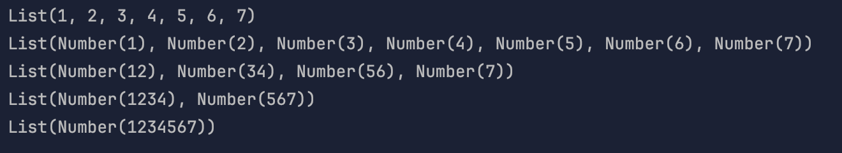
Rewrite rules in Scala

Slide 36
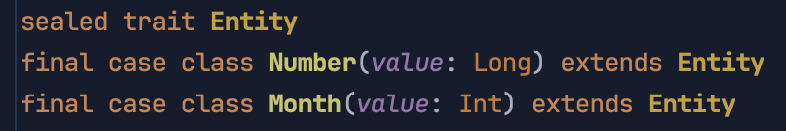
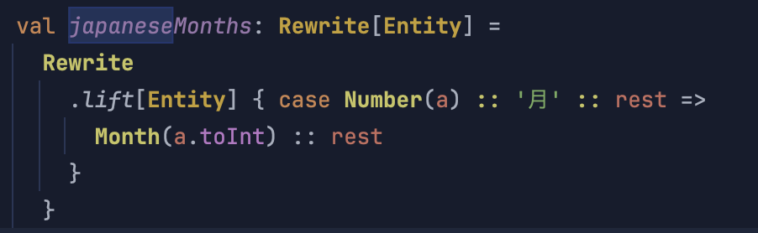
Rewrite rules in Scala

Slide 37
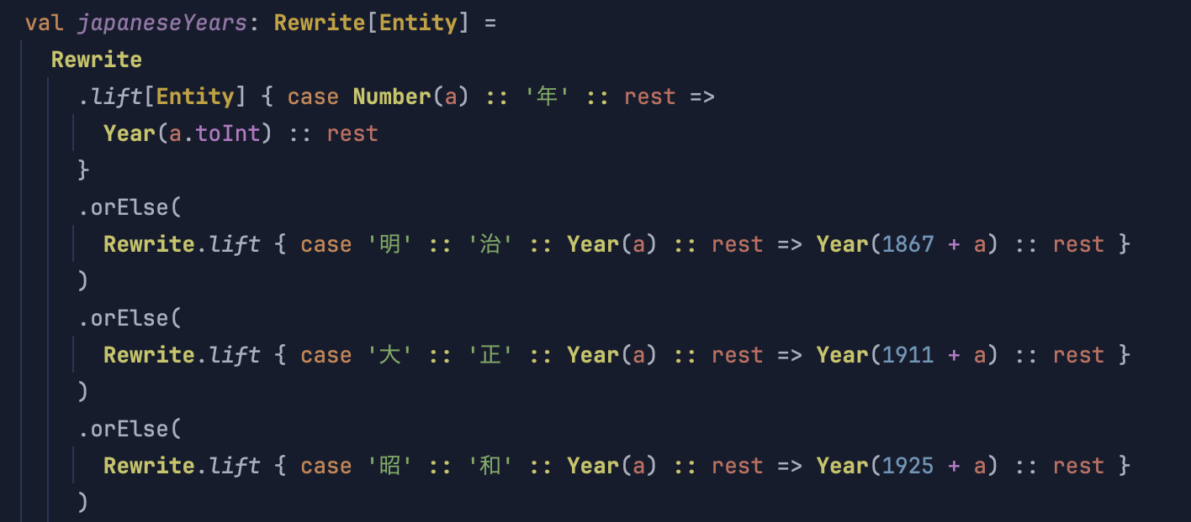
Rewrite rules in Scala

Slide 38
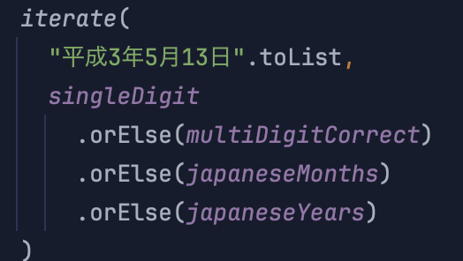
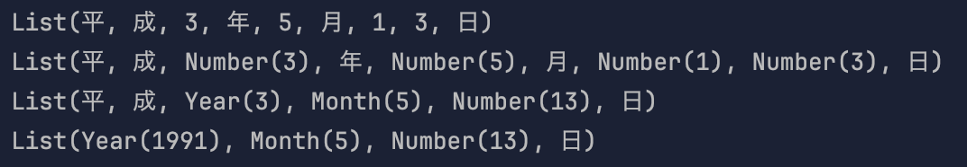
Rewrite rules in Scala

Slide 39
Rewrite rules in Scala
一
one
（一、二、三、四…）
Notes:
animation

Slide 40
Rewrite rules in Scala
千
三
百
二
十
一
3
10
１
2
1000
100
1321
321
21
11

Slide 41
Rewrite rules in Scala
三
千
二
百
万
二
千
3
2
2
1000
100
10000
1000
32,002,000
32,000,000
3,200

Slide 42
Rewrite rules in Scala
三千二百三十一万二千三百二十二
3千2百3十1万2千3百2十2
3千2百31万2千3百22
3千231万2千322
3,231 万2,322
32,312,322

Slide 43
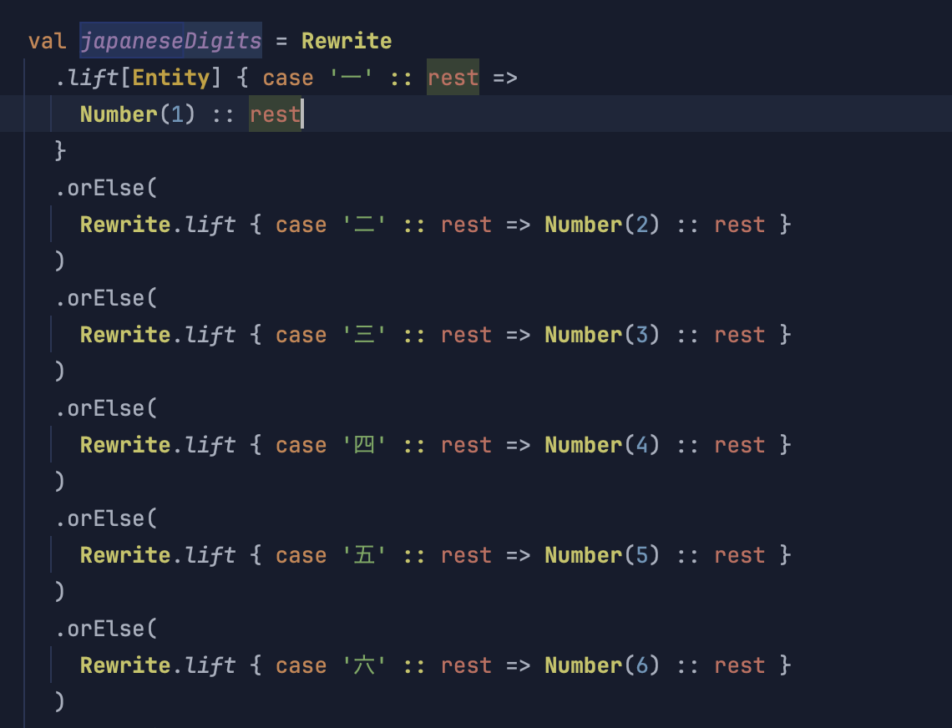
Rewrite rules in Scala

Slide 44
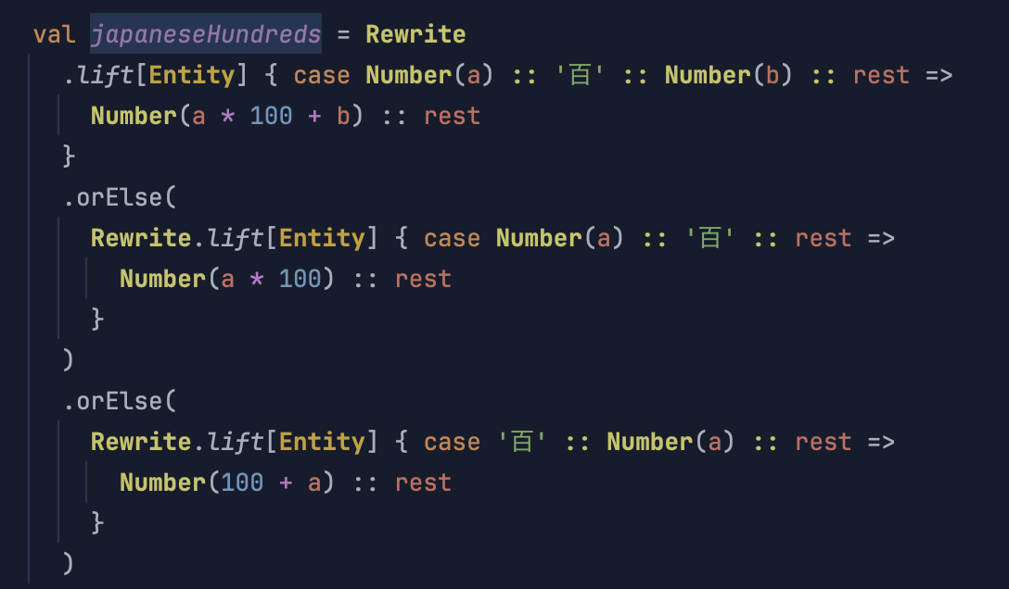
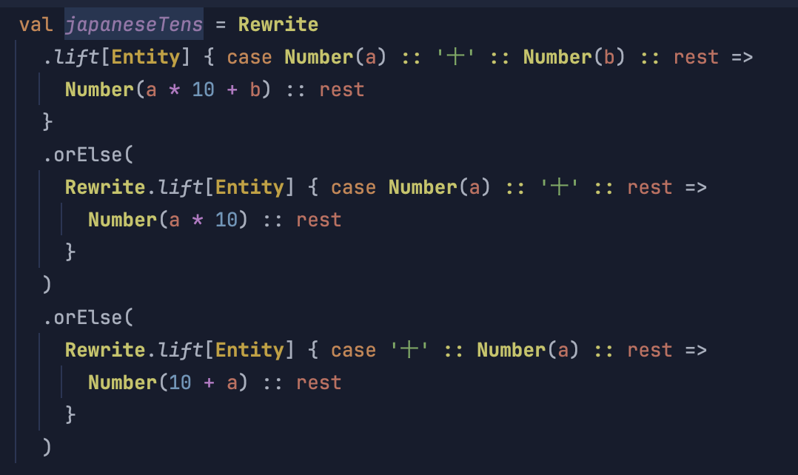
Rewrite rules in Scala

Slide 45
Rewrite rules in Scala
and so on…

Slide 46
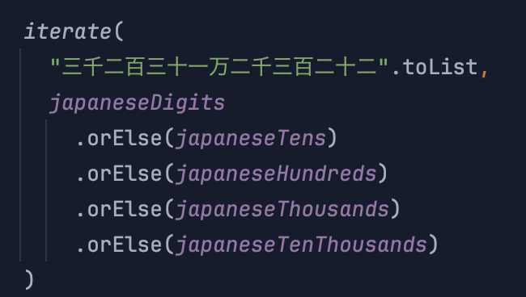
Rewrite rules in Scala

Slide 47
Rewrite rules in Scala
三千二百三十一万二千三百二十二
3千2百3十1万2千3百2十2
3,002, 103, 11, 10,002, 1,003, 102, 12
Not confluent
3,002

Slide 48
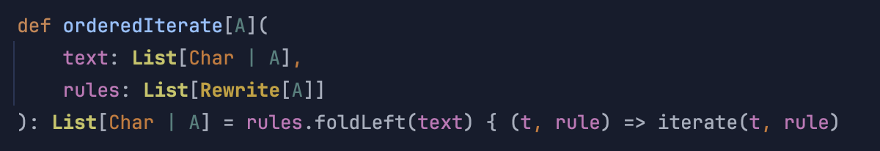
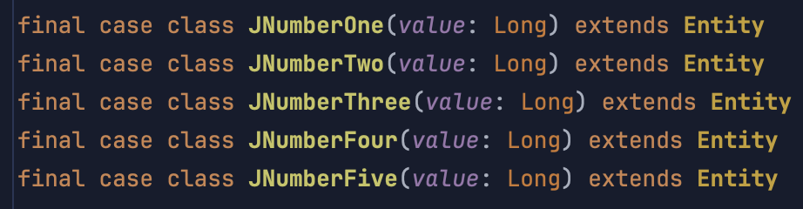
Rewrite rules in Scala
Change the implementation of the system to strictly apply one rule at a time
Make non-confluent rules confluent by embedding additional info into our case classes

Slide 49
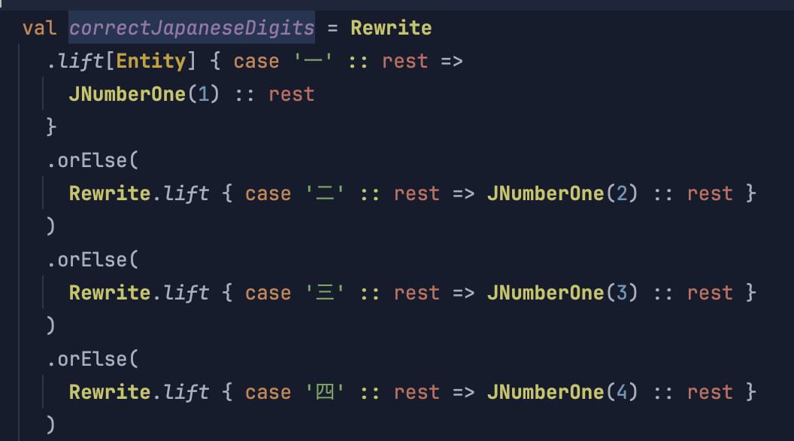
Rewrite rules in Scala

Slide 50
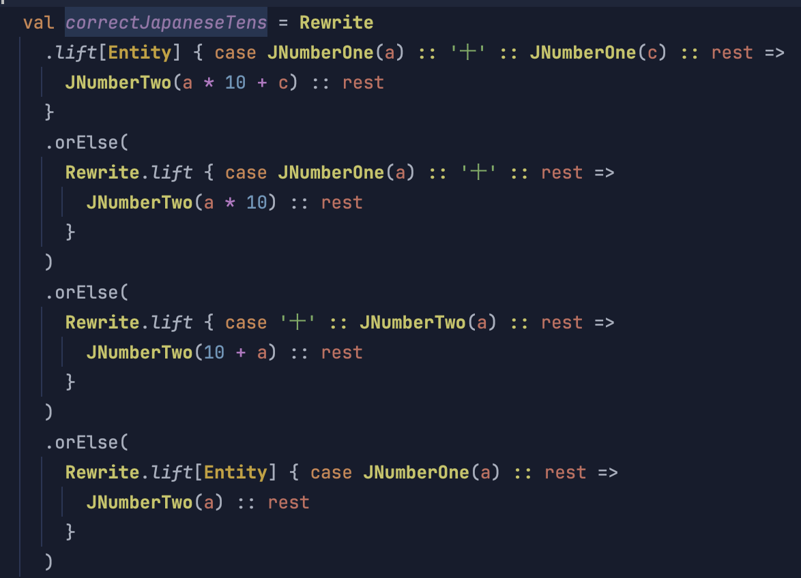
Rewrite rules in Scala

Slide 51
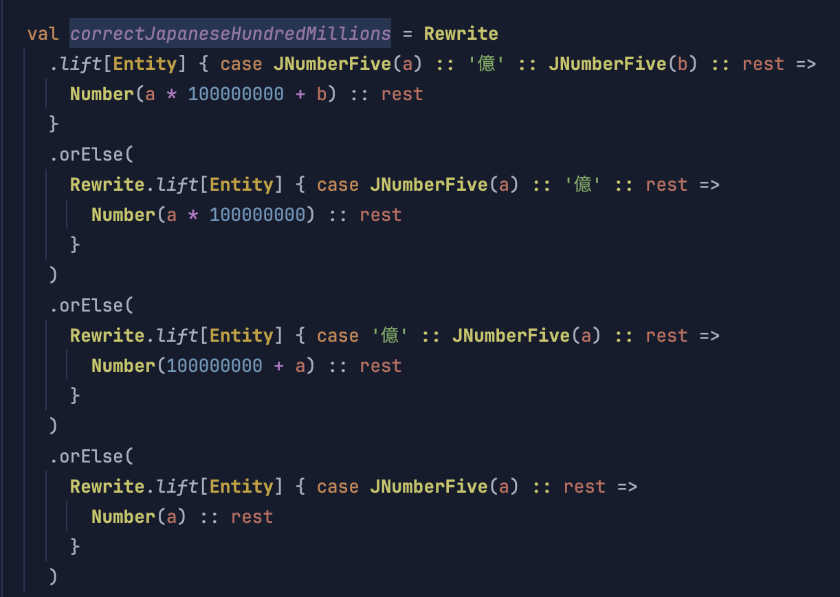
Rewrite rules in Scala

Slide 52
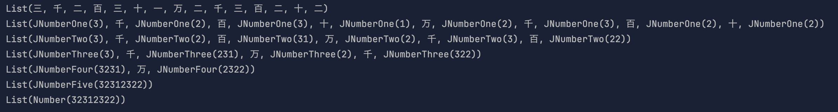
Rewrite rules in Scala

Slide 53
Rewrite rules in Scala
English word numbers: One hundred and twenty-one
Similar approach to kanji numbers
Mixed Arabic & kanji numbers: 12万
Similar approach to kanji numbers
English months: January
Trivial

Slide 54
Rewrite rules in Scala
On September 13, 2024, I earned 30,000 yen
令和6年9月13日に3万円を稼ぎました

Slide 55
Summary and next steps
Rewrite system applied to named entity recognition
Exploring other solutions: parser combinators?
Create an add on for CAT tools
In any case, in less than an hour we have already written a better system!

