Slide 1
Lecture 3.1 – History of Convolutional Networks

Slide 2

The GPU Teaching Kit is licensed by NVIDIA and New York University under the
Creative Commons Attribution-NonCommercial 4.0 International License.
Deck credit: Y. LeCun, Facebook

Slide 3
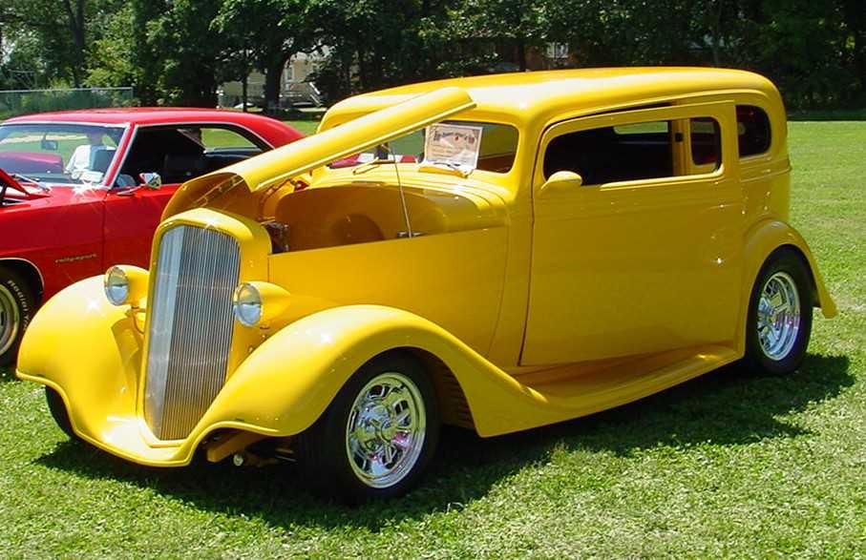
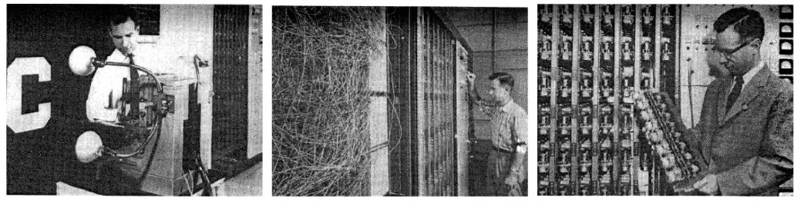
55 years of hand-crafted features
The traditional model of pattern recognition (since the late 50's)
Fixed/engineered features (or fixed kernel) + trainable classifier
Perceptron
Hand-crafted Feature Extractor
“Simple” Trainable Classifier

Slide 4
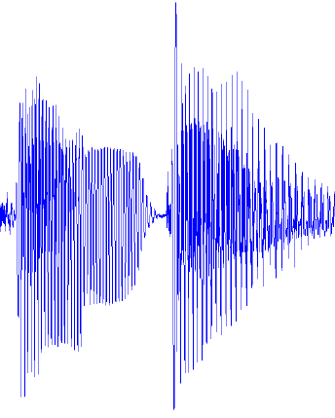
Architecture of “classical” recognition systems
“Classic” architecture for pattern recognition
Speech recognition: 1990-2011
Object Recognition: 2005-2012
Handwriting recognition (long ago)
Graphical model has latent variables (locations of parts)
fixed
unsupervised
fixed
supervised
fixed
MFCC SIFT, HoG
Cuboids
Gaussians K-Means
Sparse Coding
Pooling
(linear) Classifier
Graphical Model
Low-level Features
Mid-level Features
parts, phones, characters
Object, Utterance, word

Slide 5
Architecture of deep learning-based recognition systems
“Deep” architecture for pattern recognition
Speech, and Object recognition: since 2011/2012
Handwriting recognition: since the early 1990s
Convolutional Net with optional Graphical Model on top
Trained purely supervised
Graphical model has latent variables (locations of parts)
supervised
fixed
supervised
fixed
supervised
fixed
Filters + ReLU
Pooling
Filters + ReLU
Pooling
Filters + ReLU
Graphical Model
Low-level Features
Mid-level Features
parts, phones, characters
Object, Utterance, word

Slide 6
Future Systems: deep learning + structured prediction
Globally-trained deep architecture
Handwriting recognition: since the mid 1990s
Speech Recognition: since 2011
All the modules are trained with a combination of unsupervised and supervised learning
End-to-end training == deep structured prediction
Unsup + supervised
Unsup + supervised
Unsup + supervised
Unsup + supervised
fixed
fixed
Filters + ReLU
Pooling
Filters + ReLU
Pooling
Filters + ReLU
Graphical Model
Low-level Features
Mid-level Features
parts, phones, characters
Object, Utterance, word

Slide 7
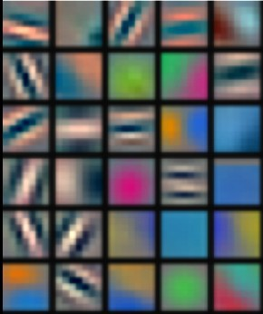
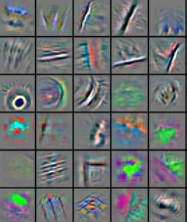
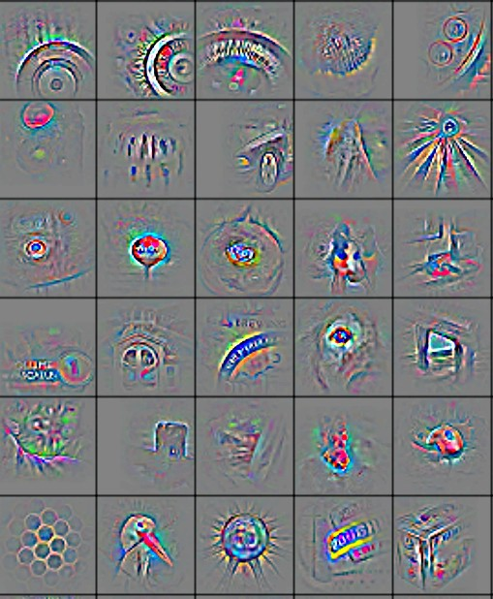
Deep learning = learning hierarchical representations
It's deep if it has more than one stage of non-linear feature transformation
Low-level feature
Mid-level feature
High-level feature
Trainable classifier
Feature visualization of convolutional net trained on ImageNet from [Zeiler & Fergus 2013]

Slide 8
Trainable feature hierarchy
Hierarchy of representations with increasing level of abstraction Each stage is a kind of trainable feature transform
Image recognition
Pixel → edge → texton → motif → part → object
Text
Character → word → word group → clause → sentence → story
Speech
Sample → spectral band → sound → … → phone → phoneme → word
Trainable feature transform
Trainable feature transform
Trainable feature transform
Trainable feature transform

Slide 9
Learning representations: a challenge for ML, CV, AI, neuroscience, cognitive science...
How do we learn representations of the perceptual world?
How can a perceptual system build itself by looking at the world?
How much prior structure is necessary
ML/AI: how do we learn features or feature hierarchies?
What is the fundamental principle? What is the learning algorithm? What is the architecture?
Neuroscience: how does the cortex learn perception?
Does the cortex “run” a single, general learning algorithm? (or a small number of them)
CogSci: how does the mind learn abstract concepts on top of less abstract ones?
Deep Learning addresses the problem of learning hierarchical representations with a single algorithm
Or perhaps with a few algorithms
Trainable feature transform
Trainable feature transform
Trainable feature transform
Trainable feature transform

Slide 10
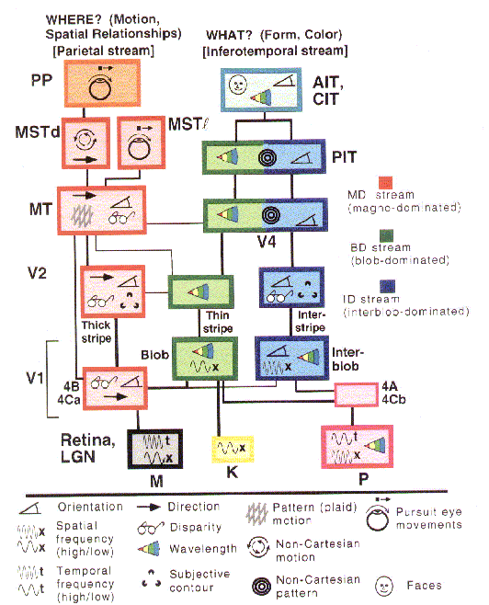
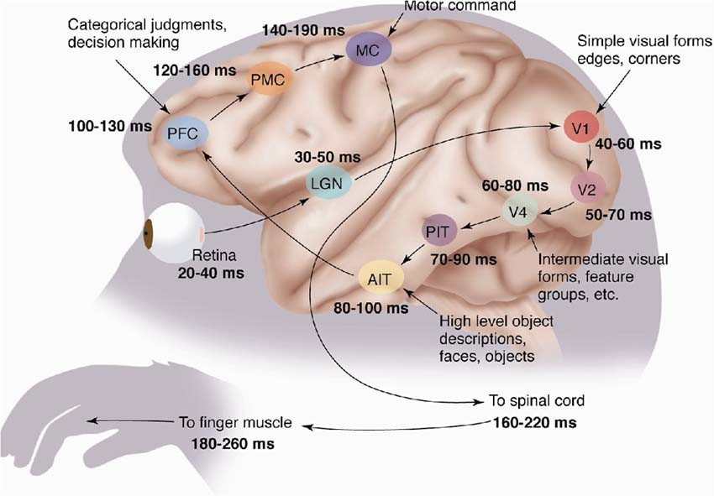
The mammalian visual cortex is hierarchical
The ventral (recognition) pathway in the visual cortex has multiple stages Retina - LGN - V1 - V2 - V4 - PIT - AIT ....
Lots of intermediate representations
[picture from Simon Thorpe]
[Gallant & Van Essen]

Slide 11
Architecture of the mammalian visual cortex
Y LeCun
Ventral pathway = “what”
dorsal pathway = “where”
It's hierarchical
There is feedback
There is motion processing
Learning is mostly unsupervised
It does recognition, localization, navigation, grasping.....
[Gallant & Van Essen]

Slide 12
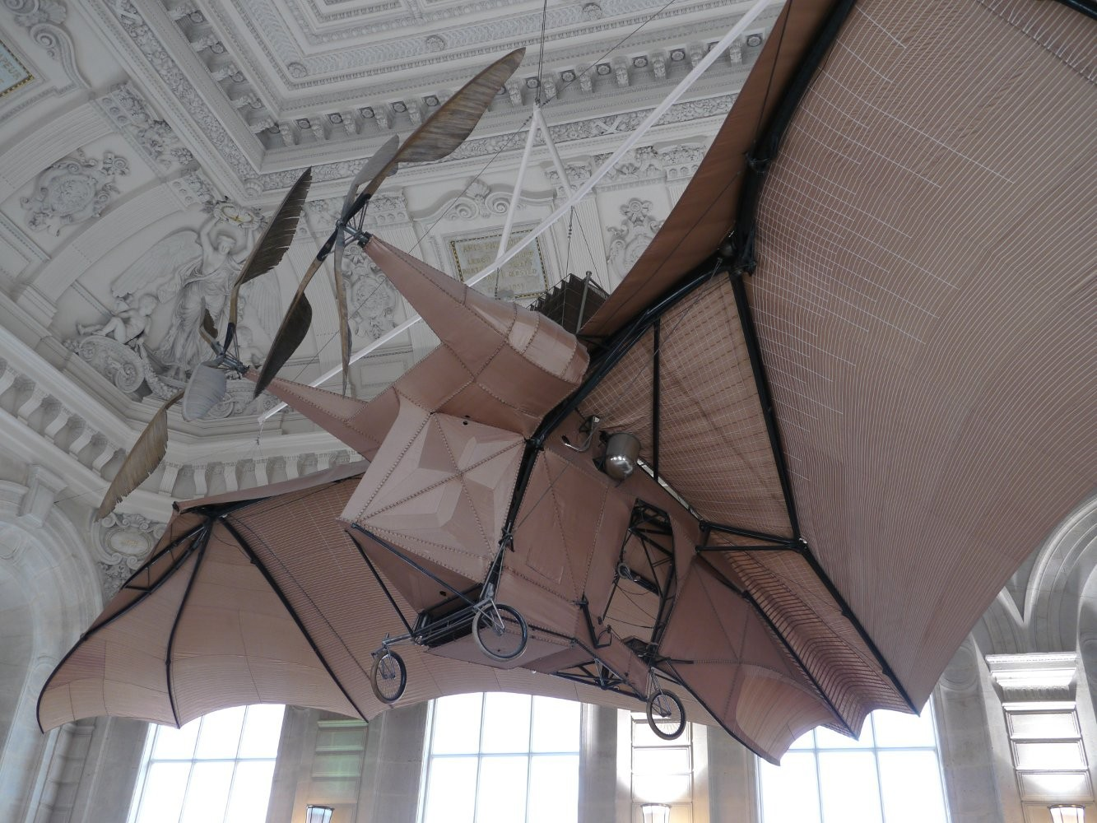
Let's be inspired by nature, but not too much
It's nice imitate Nature,
But we also need to understand
How do we know which details are important?
Which details are merely the result of evolution, and the constraints of biochemistry?
For airplanes, we developed aerodynamics and compressible fluid dynamics.
We figured that feathers and wing flapping weren't crucial
QUESTION: What is the equivalent of aerodynamics for understanding intelligence?
L'Avion III de Clément Ader, 1897
(Musée du CNAM, Paris)
His Eole took off from the ground in 1890, 13 years before the Wright Brothers, but you probably never heard of it.

Slide 13
Shallow vs Deep == lookup table vs multi-step algorithm
“Shallow & wide” vs “deep and narrow” == “more memory” vs “more time”
Look-up table vs algorithm
Few functions can be computed in two steps without an exponentially large lookup table
Using more than 2 steps can reduce the “memory” by an exponential factor.
Step 4
Step 3
Step 2
Step 2
Step 1 (look up table/templates)
Step 1

Slide 14
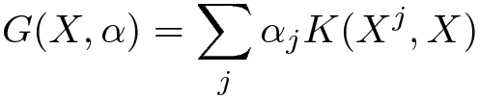




Which models are deep?
2-layer models are not deep (even if you train the first layer)
Because there is no feature hierarchy
Neural nets with 1 hidden layer are not deep
SVMs and Kernel methods are not deep
Layer1: kernels; layer2: linear
The first layer is “trained” in with the simplest unsupervised method ever devised: using the samples as templates for the kernel functions.
“glorified template matching”
Classification trees are not deep
No hierarchy of features. All decisions are made in the input space

Slide 15
What are good features?

Slide 16
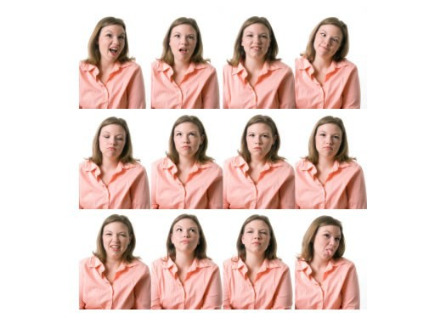
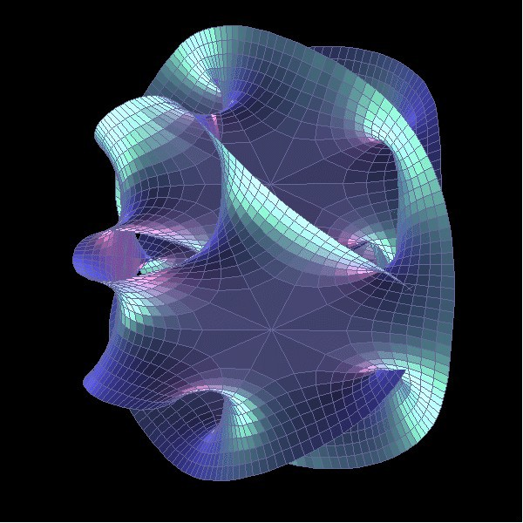
Discovering the hidden structure in high-dimensional data the manifold hypothesis
Learning representations of data:
Discovering & disentangling the independent explanatory factors
The manifold hypothesis:
Natural data lives in a low-dimensional (non-linear) manifold
Because variables in natural data are mutually dependent

Slide 17
Basic idea for invariant feature learning
Embed the input non-linearly into a high(er) dimensional space
In the new space, things that were non separable may become separable
Pool regions of the new space together
Bringing together things that are semantically similar. Like pooling.
Pooling or
Aggregation
Non-linear function
Input
Stable/invariant features
high-dim Unstable/non-smooth
features

Slide 18
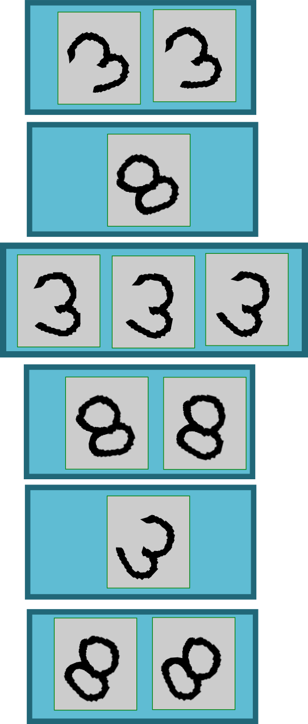
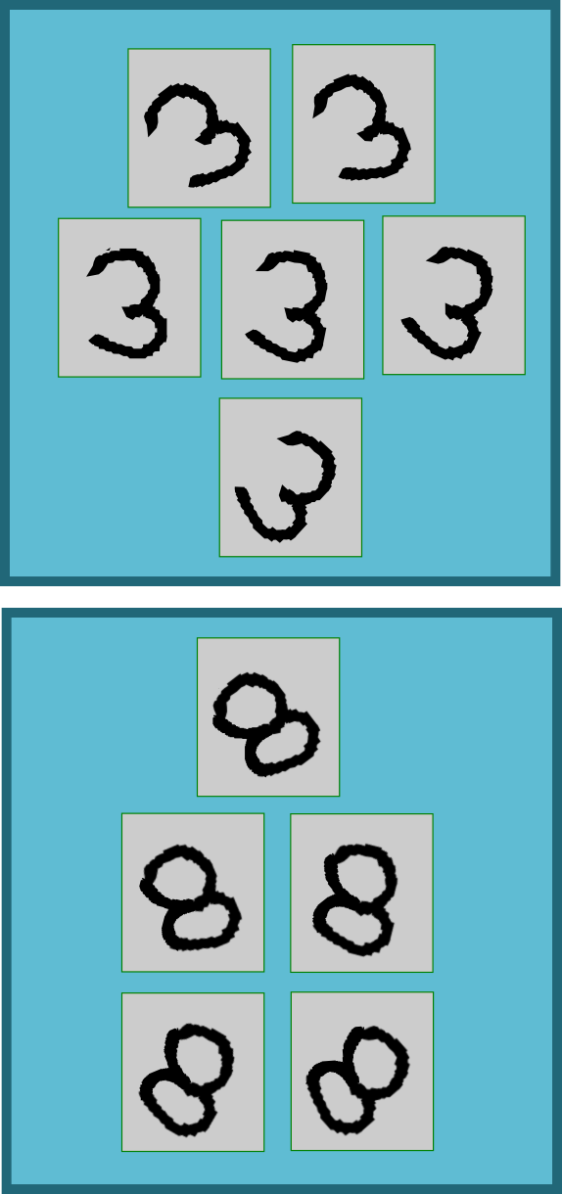
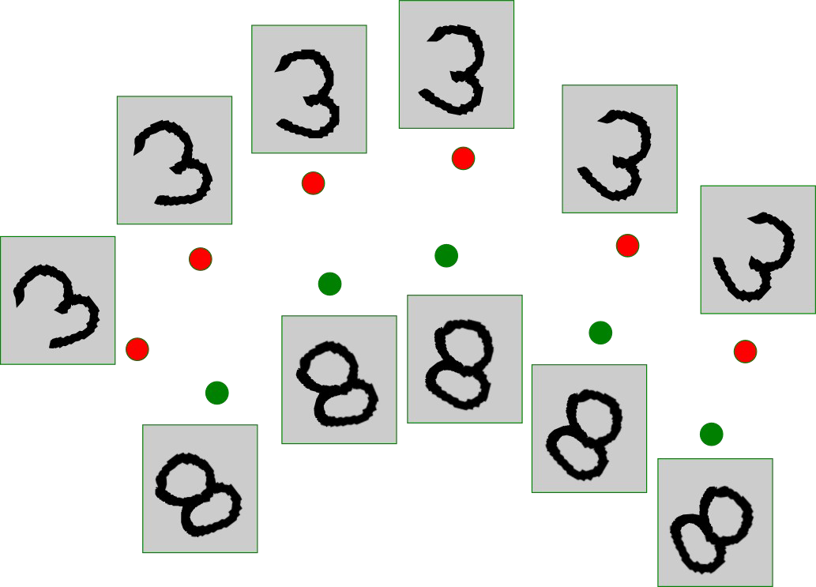
Sparse non-linear expansion → pooling
Use clustering to break things apart, pool together similar things
Clustering, quantization, sparse coding
Pooling
aggregation

Slide 19
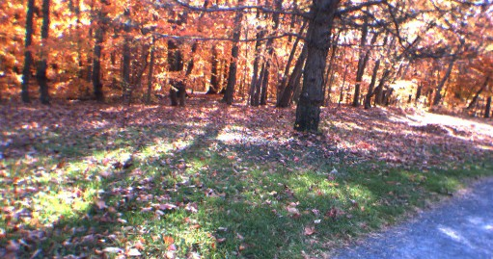
Overall architecture: multiple stages of
Normalization → filter bank → non-linearity → pooling
Filter Bank
Non- Linear
feature Pooling
Filter Bank
Non- Linear
feature Pooling
Norm
Norm
Classifier
Normalization: variations on whitening
Subtractive: average removal, high pass filtering
Divisive: local contrast normalization, variance normalization
Filter bank: dimension expansion, projection on overcomplete basis
Non-linearity: sparsification, saturation, lateral inhibition....
Rectification (relu), component-wise shrinkage, tanh,..
ReLU (x )=max (x , 0)
Pooling: aggregation over space or feature type
Max, Lp norm, log prob.

Slide 20
Deep nets with ReLUs and max pooling
Y LeCun
Stack of linear transforms interspersed with Max operators
Point-wise ReLUs:
Max Pooling
“switches” from one layer to the next
31
ReLU ( x )=max ( x ,0)
W31,22
22
W22,14
14
W14,3
3
Z3

Slide 21
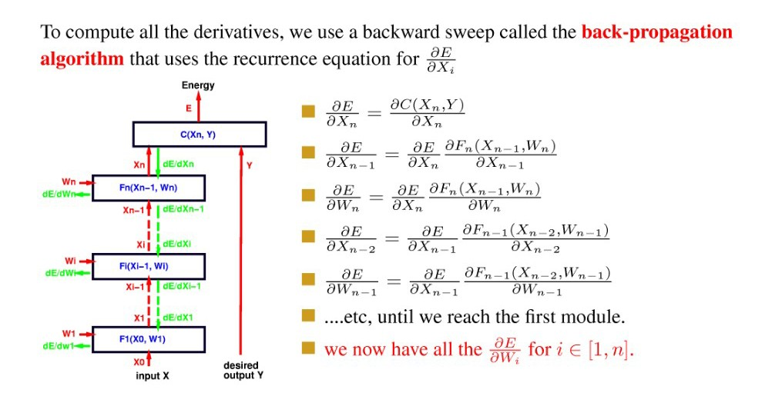
Supervised training: stochastic (sub) gradient optimization
To compute all the derivatives, we use a backward sweep called the back-propogation algorithm that uses the recurrence equation for

Slide 22
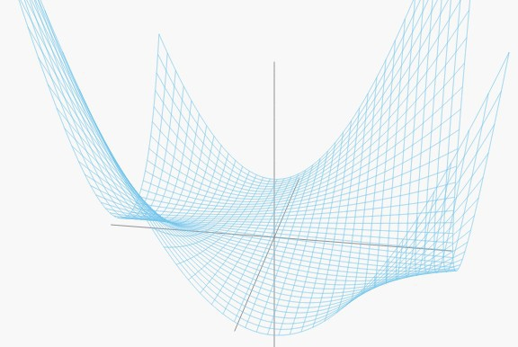
Loss function for a simple network
Y LeCun
1-1-1 network - Y = W1*W2*X
trained to compute the identity function with quadratic loss Single sample X=1, Y=1 L(W) = (1-W1*W2)^2
Y
W2
X
W1
X
Solution
Saddle point
Solution

Slide 23
Deep nets with ReLUs
Single output:
Wij: weight from j to i
P: path in network from input to output
P=(3,(14,3),(22,14),(31,22))
di: 1 if ReLU i is linear, 0 if saturated.
Xpstart: input unit for path P.
Dp(W,X): 1 if path P is “active”, 0 if inactive
Input-output function is piece-wise linear
Polynomial in W with random coefficients
31
W31,22
22
W22,14
14
W14,3
3
Z3

Slide 24
Deep convolutional nets (and other deep neural nets)
Training sample: (Xi,Yi) k=1 to K
Objective function (with margin-type loss = ReLU)
Polynomial in W of degree l (number of adaptive layers)
Continuous, piece-wise polynomial with “switched” and partially random coefficients
Coefficients are switched in an out depending on W

Slide 25
Deep nets with ReLUs:
Objective function is piecewise polynomial
If we use a hinge loss, delta now depends on label Yk:
Piecewise polynomial in W with random coefficients
A lot is known about the distribution of critical points of polynomials on the sphere with random (Gaussian) coefficients [Ben Arous et al.]
High-order spherical spin glasses
Random matrix theory
31
W31,22
22
W22,14
14
W14,3
Histogram of minima
3
Z3
L(W)

Slide 26
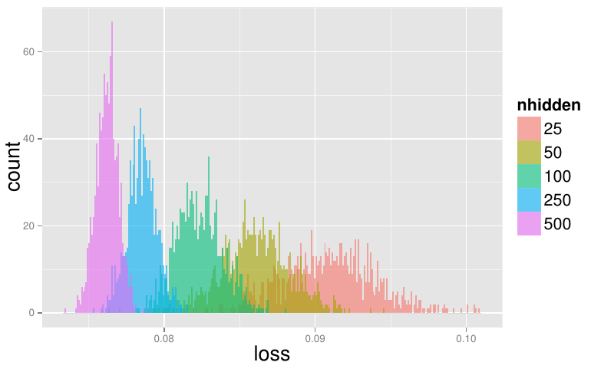
Deep nets with ReLUs: objective function is piecewise polynomial
Y LeCun
Train 2-layer nets on scaled-down MNIST (10x10) from multiple initial conditions. Measure loss on test set.
[Choromanska, Henaff, Mathieu, Ben Arous, LeCun 2015]

Slide 27
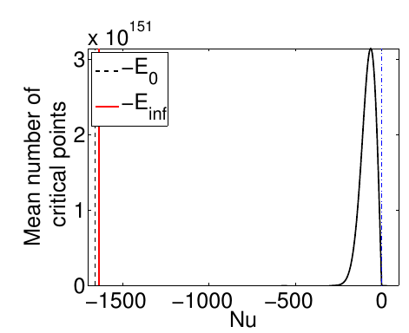
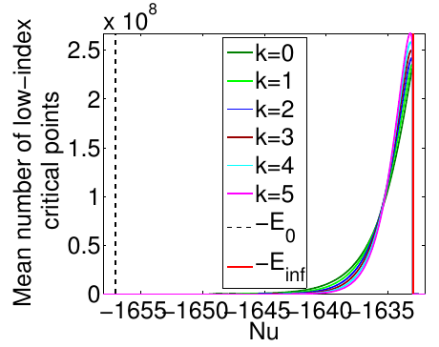
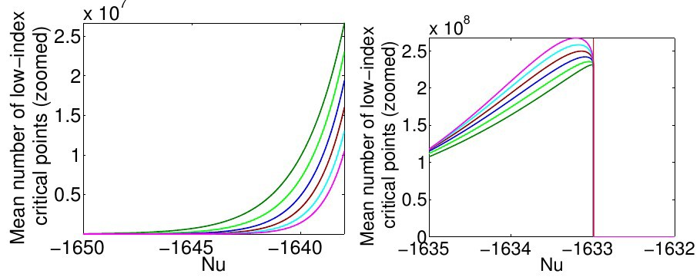
Spherical spin glass theory
Distribution of critical points (saddle points, minima, maxima)
K=number of negative eigenvalues of Hessian (K=0 → minimum)
Critical Points
Zoomed:

Slide 28
Thank you

