Slide 1
Lecture 3.3 - Structural Prediction and Natural Language Processing

Slide 2

The GPU Teaching Kit is licensed by NVIDIA and New York University under the
Creative Commons Attribution-NonCommercial 4.0 International License.
Deck credit: Y. LeCun, Facebook

Slide 3
End-to-end learning – Word-level discriminative training
Energy
Making every single module in the system trainable.
Every module is trained simultaneously so as to optimize a global loss function.
Includes the feature extractor, the recognizer, and the contextual post-processor (graphical model)
Problem: back-propagating gradients through the graphical model.
(factor graph)
Language model
Word hypothesis
(factor graph)
Word geometry
Character hypothesis
ConvNet or other deep architecture
Segmentation
Word
Word image
(latent)
(output)
(input)

Slide 4
Integrating Deep Learning and structured prediction
Deep Learning systems can be assembled into factor graphs (graphical models)
Energy function measures the “compatibility” between variables.
X: inputs (observed variables)
Z: latent variables (never observed)
Y: outputs (observed on training set)
Inference is energy minimization (MAP) or free energy minimization (marginalization) over Z and Y given an X
Y* = Argmin E(X,Y,Z)
Energy function can embed whole deep learning systems (e.g. ConvNets).
E(X,Y,Z)
Energy Model (factor graph)
Z
Latent vars. (unobserved)
X
input (observed)
Y
output (observed on training set)

Slide 5

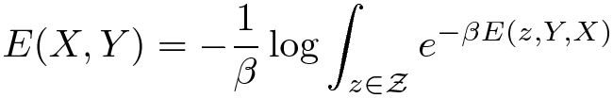
Latent variable models
Y LeCun
The energy includes “hidden” variables Z whose value is never given to us
We can minimize the energy over those latent variables
We can also “marginalize” the energy over the latent variables
Minimization over latent variables:
Marginalization over latent variables:
Estimating this integral may require some approximations (sampling, variational methods, maximum a posteriori....)
E(X,Y,Z)
E(Z,Y,X)
Z
X
Y

Slide 6
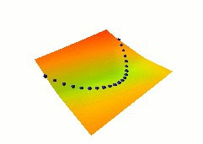
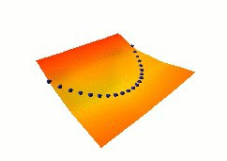
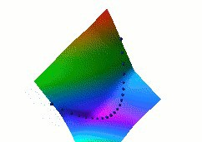
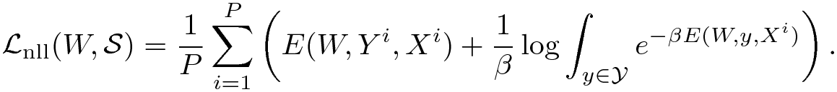
Loss functions for EBM
Y LeCun
Loss functions
Energy Loss (pull down on the data points)
Square-Square Loss
Negative Log Likelihood

Slide 7
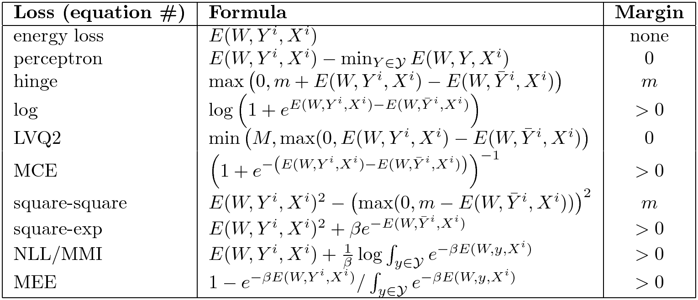
Loss Function to train energy-based models
Good and bad loss functions
A tutorial on Energy-Based Learning [LeCun et al 2006]

Slide 8
“Shallow” structured prediction
Energy function is linear in the parameters
with the NLL Loss :
Conditional Random Field [Lafferty, McCallum, Pereira 2001]
with Hinge Loss:
Max Margin Markov Nets and Latent SVM [Taskar, Altun, Hofmann...]
with Perceptron Loss
Structured Perceptron [Collins...]
∑
E(X,Y,Z)
E ( X ,Y , Z )=
T
W h_{i} ( X ,Y , Z )
i
i
+
Params
W1
W3
W2
Features
h(X,Y,Z)
h(X,Y,Z)
h(X,Y,Z)
Y1
Y2
Y3
Y4
Outputs:
Latent Vars:
Input:
Z1
Z2
Z3
X

Slide 9
“Shallow” structured prediction
Energy function is linear in the parameters
Graph Transformer Networks:
[LeCun, Bottou, Bengio, Haffner 97, 98]
NLL loss
Perception loss
∑
E(X,Y,Z)
E ( X ,Y , Z )=
g _{i} ( X , Y , Z , W_{i} )
i
+
g(X,Y,Z,W)
g(X,Y,Z,W)
g(X,Y,Z,W)
ConvNet
Y1
Y2
Y3
Y4
Outputs:
Latent Vars:
Input:
Z1
Z2
Z3
X

Slide 10
Integrating Deep Learning and structured prediction
F(X,Y) = MIN_z E(X,Y,Z)
Deep Net + Graphical Model = Factor Graph
Energy function is a sum of factors
Factors can embed deep architectures X: observed variables (inputs)
Z: never observed (latent variables)
Y: observed on training set (output variables)
Inference is energy minimization (MAP) or free energy minimization (marginalization) over Z and Y given an X
F(X,Y) = MIN_z E(X,Y,Z)
F(X,Y) = -log[ SUM_z exp(-E(X,Y,Z) ) ]
E(X,Y,Z)
Energy model (factor graph)
Z (unobserved)
X (observed)
Y (observed on training set)

Slide 11
End-to-end learning – Word-level training
Energy
Making every single module in the system trainable.
Every module is trained simultaneously so as to optimize a global loss function.
Includes the feature extractor, the recognizer, and the contextual post-processor (graphical model)
Problem: back-propagating gradients through the graphical model.
Energy-based module
ConvNet or other deep architecture
Latent Variables
Input
Output

Slide 12
Deep structured prediction for speech recognition (1991)
Spoken word recognition with trainable elastic templates and trainable feature extraction [Driancourt&Bottou 1991, Bottou 1991, Driancourt 1994]
Word models (elastic template)
Energies
Switch
Sequence of
feature vectors
LVQ2 Loss
Trainable feature
Extractor (ConvNet)
Warping Function (latent var)
Input Sequence (acoustic vectors)
Category (output)

Slide 13
Alignment through dynamic time warping
Spoken word recognition with trainable elastic templates and trainable feature extraction
[Driancourt&Bottou 1991, Bottou 1991, Driancourt 1994]
Elastic matching using dynamic time warping (Viterbi algorithm on a trellis).
Object models
(elastic template)
Energy
Trellis
Warping/Path (latent var)
Sequence of feature vectors

Slide 14
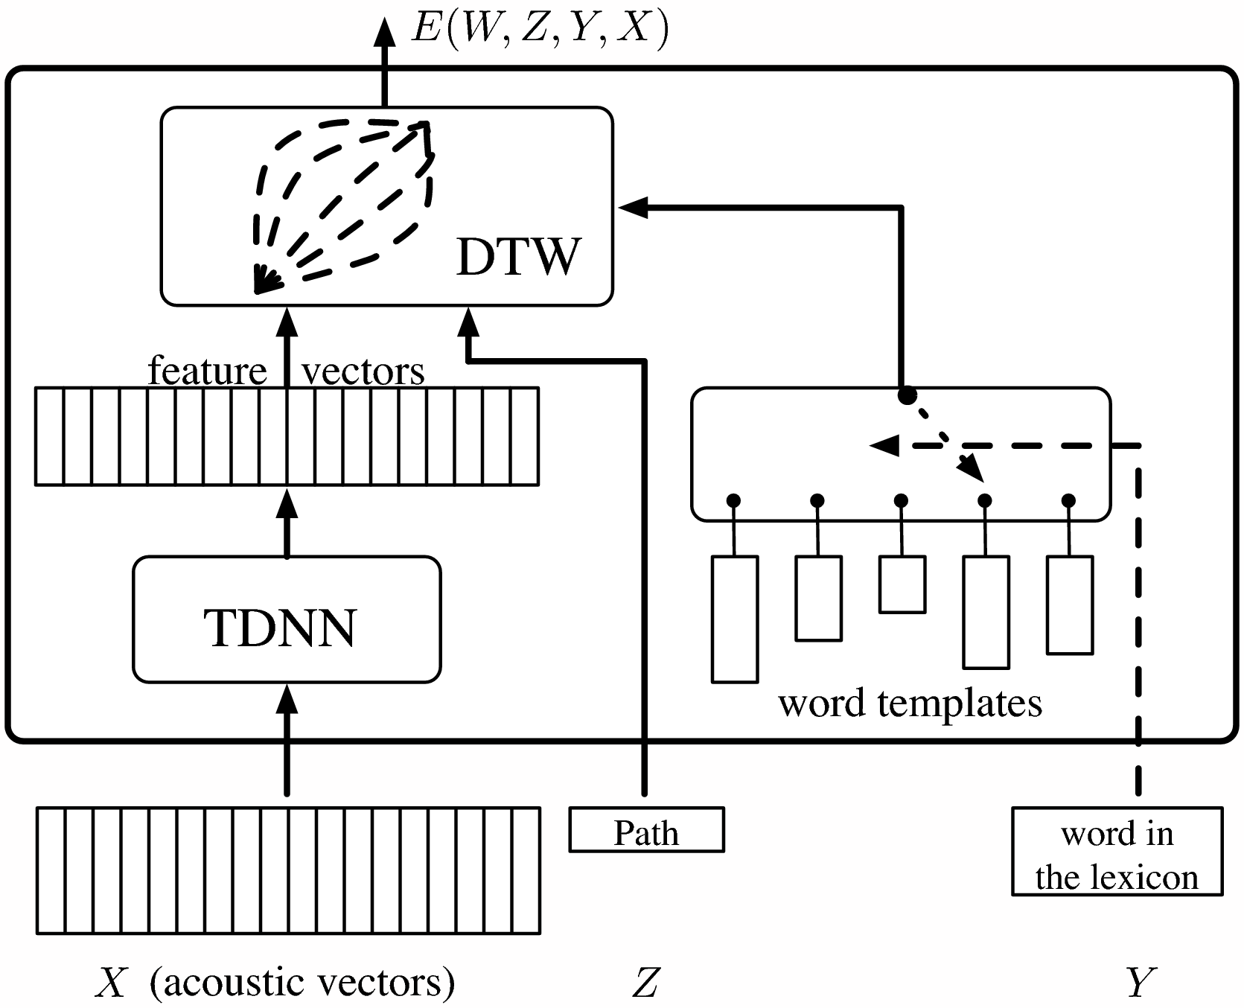
Deep factors / deep graph: ASR with TDNN/DTW
Trainable Automatic Speech Recognition system with convolutional nets (TDNN) and dynamic time warping (DTW)
Training the feature extractor as part of the whole process.
with the LVQ2 Loss :
Driancourt and Bottou's speech recognizer (1991)
with NLL:
Bengio's speech recognizer (1992)
Haffner's speech recognizer (1993)

Slide 15
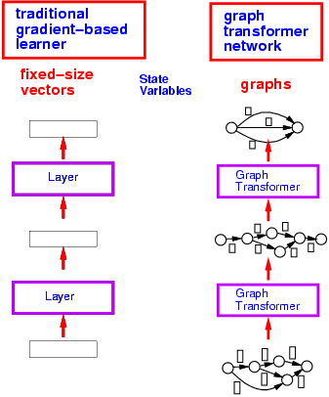
Using graphs instead of vectors or arrays
Whereas traditional learning machines manipulate fixed-size vectors, Graph Transformer Networks manipulate graphs.

Slide 16
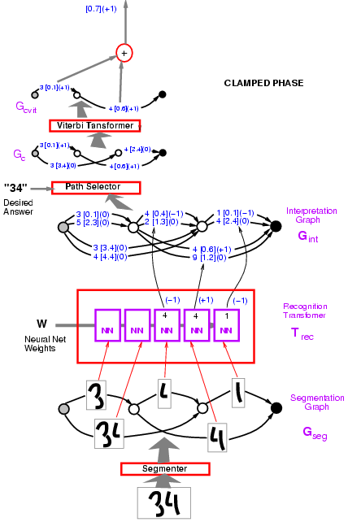
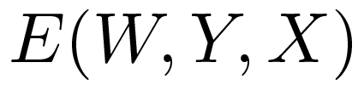
Graph transformer networks
Y LeCun
Variables:
X: input image
Z: path in the interpretation graph/segmentation
Y: sequence of labels on a path
Loss function: computing the energy of the desired answer:

Slide 17
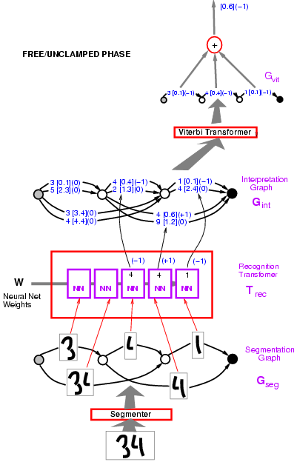
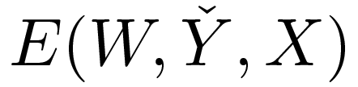
Graph transformer networks
Y LeCun
Variables:
X: input image
Z: path in the interpretation graph/segmentation
Y: sequence of labels on a path
Loss function: computing the constrastive term:

Slide 18
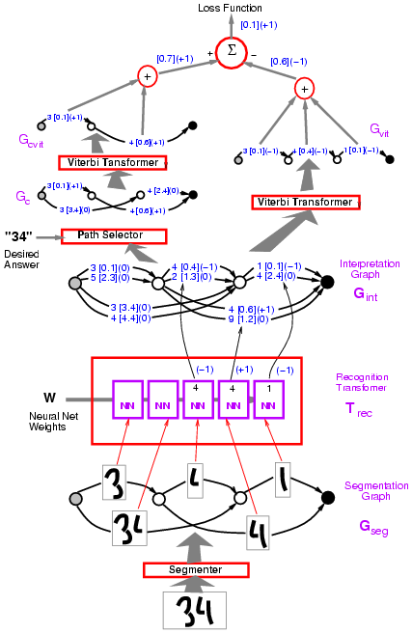
Graph transformer networks
Y LeCun
Example: Perceptron loss
Loss = Energy of desired answer - Energy of best answer.
(no margin)

Slide 19

Integrating deep learning and structured prediction
Structured prediction: when the output is structured: string, graph.....
Integrating deep learning and structured prediction is an old idea
In fact, it predates structured prediction [LeCun, Bottou, Bengio, Haffner 1998]
Globally-trained convolutional-net + graphical models for handwriting recognition
Trained discriminatively at the word level
Loss identical to CRF and structured perceptron
Compositional movable parts model

Slide 20
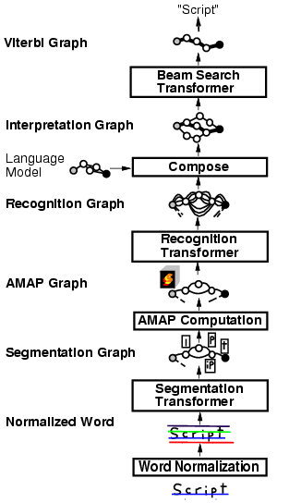
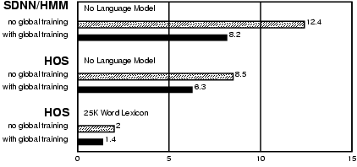
Global (word-level) training helps
Y LeCun
Pen-based handwriting recognition (for tablet computer)
[Bengio&LeCun 1995]

Slide 21
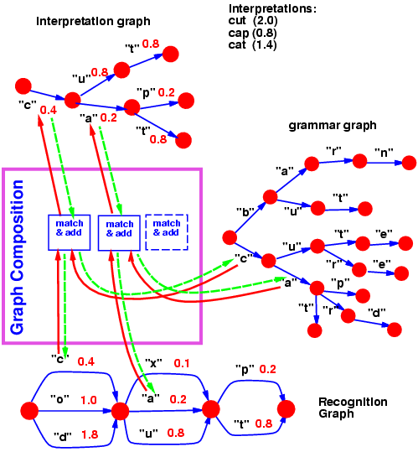
Graph composition, transducers.
Y LeCun
The composition of two graphs can be computed, the same way the dot product between two vectors can be computed.
General theory: semi-ring algebra on weighted finite-state transducers and acceptors.

Slide 22
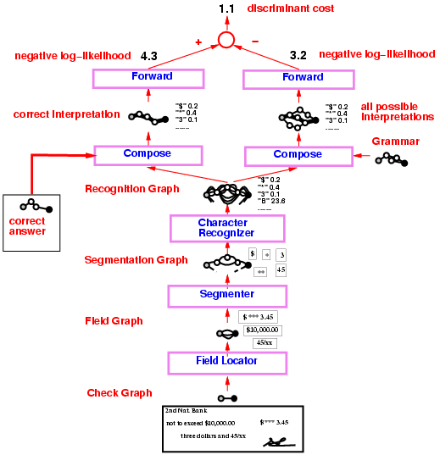
Check reader
Y LeCun
Graph transformer network trained to read check amounts.
Trained globally with Negative-Log-Likelihood loss.
50% percent correct, 49% reject, 1% error (detectable later in the process.
Fielded in 1996, used in many banks in the US and Europe.
Processes an estimated 10% to 20% of all the checks written in the US.

Slide 23
Deep structured predictions for speech and handwriting
Trainable Speech/Handwriting Recognition systems that integrate Neural Nets (or other “deep” classifiers) with dynamic time warping, Hidden Markov Models, or other graph-based hypothesis representations
Word-level global discriminative training with GMM:
With Minimum Empirical Error loss
Ljolje and Rabiner (1990)
With MCE
Juang et al. (1997)
Word-level global discriminative training with ConvNets:
with the LVQ2 Loss:
Driancourt and Bottou's speech recognizer (1991)
with Neg Log Likelihood (aka MMI):
Bengio (1992), Haffner (1993), Bourlard (1994)
CRF-like Late normalization
un-normalized HMM
Bottou pointed out the label bias problem (1991)
Denker and Burges proposed a solution (1995)
Implemented in (LeCun et al 1998)

Slide 24
Deep learning in natural language processing research at Facebook

Slide 25
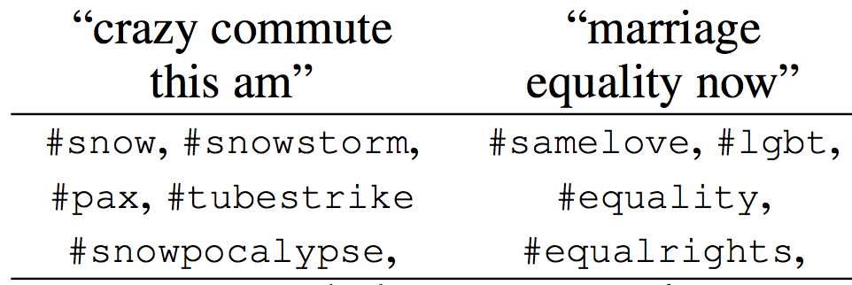
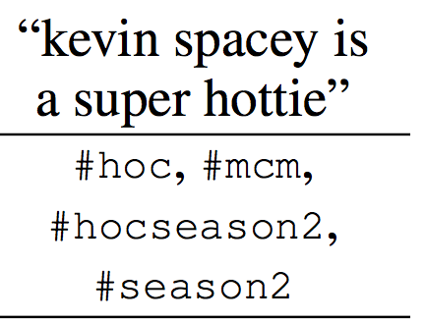
TagSpace: hash tag prediction [Adams et al. 2014]
Y LeCun
We want to learn semantic features for post content.
Hashtags are a cheap, plentiful labeling of text provided by authors, similar to classical NLP task labels:
disambiguation (chips #futurism vs. chips #junkfood); identification of named entities (#sf49ers); sentiment (#dislike); and topic annotation (#yoga).
We train a neural network using hashtags as supervisor training on 5.5 billion words and 100,000 possible hashtags.
The learned features are useful for other tasks e.g. food
n,

Slide 26
Predicting posts and comments with recurrent nets
Y LeCun

Slide 27
Question-answering system

Slide 28
Question-answering system
Y LeCun

Slide 29
Question-answering system

Slide 30
Memory network [Weston, Chopra, Bordes 2014]
Add a short-term memory to a network
Joe went to the garden then Fred picked up the milk; Joe moved to the bathroom and Fred dropped the milk, and then Dan moved to the living room.
Where is Dan? A: living room I believe
Where is Joe? A: the bathroom
Fred moved to the bedroom and Joe went to the kitchen then Joe took the milk there and Dan journeyed to the bedroom; Joe discarded the milk.
Where is the milk now? A: the milk is in the kitchen
Where is Dan now? A: I think he is in the bedroom
Joe took the milk there, after that Mike travelled to the office, then Joe went to the living room, next Dan went back to the kitchen and Joe travelled to the office.
Where is Joe now? A: I think Joe is in the office
http://arxiv.org/abs/1410.3916

Slide 31
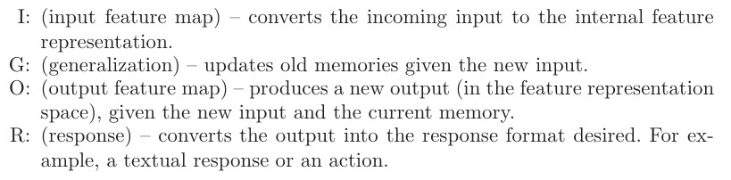
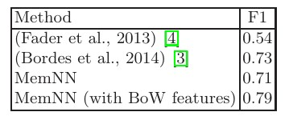
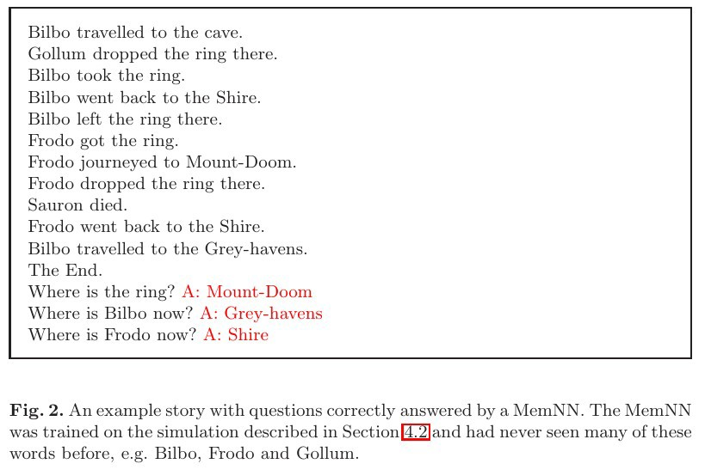
Memory network [Weston, Chopra, Bordes 2014]
Add a short-term memory to a network
http://arxiv.org/abs/1410.3916
Results on question answering task

Slide 32
Thank you

