Slide 1
Lecture 2.1 - Introduction to Deep Learning

Slide 2

The GPU Teaching Kit is licensed by NVIDIA and New York University under the
Creative Commons Attribution-NonCommercial 4.0 International License.
Deck credit: Y. LeCun
MA Ranzato

Slide 3
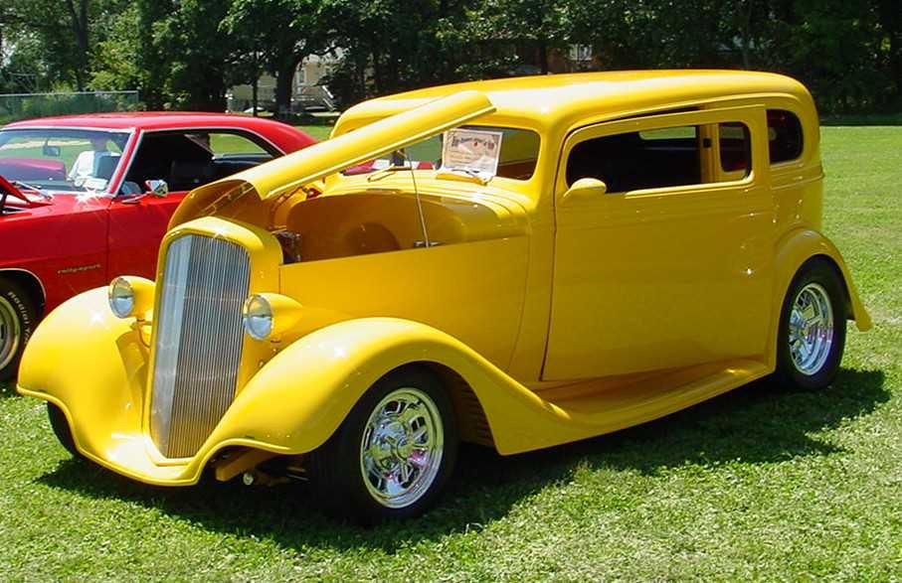
Deep learning =
Learning representations/features
The traditional model of pattern recognition (since the late 50's)
Fixed/engineered features (or fixed kernel) + trainable classifier
End-to-end learning / Feature learning / Deep learning
Trainable features (or kernel) + trainable classifier
Hand-crafted Feature Extractor
“Simple” Trainable Classifier
Trainable Feature Extractor
Trainable Classifier

Slide 4
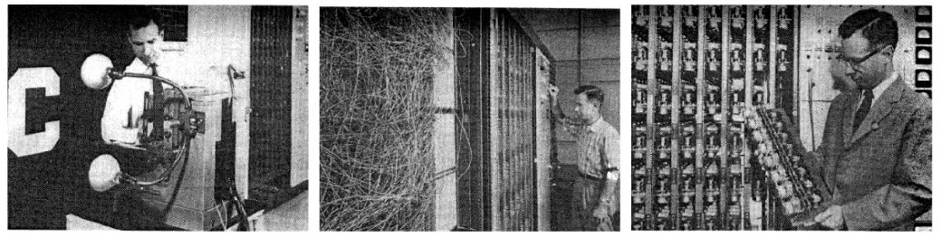
This basic model has not evolved much since the 50's
The first learning machine: the Perceptron
Built at Cornell in 1960
The Perceptron was a linear classifier on top of a simple feature extractor
The vast majority of practical applications of ML today use glorified linear classifiers or glorified template matching.
Designing a feature extractor requires considerable efforts by experts.
Feature Extractor
A
Wi
)
N
)
y=sign
∑
W _{i} F_{i} ( X ) +b
i=1

Slide 5
Linear machines and their limitations

Slide 6
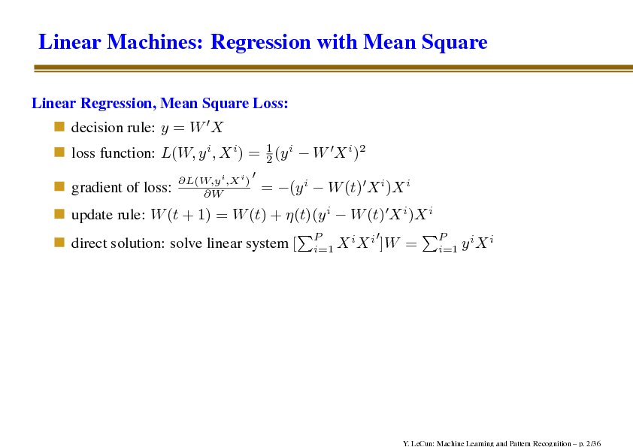
Linear machines: regression with mean square
Linear regression, mean square loss:
Decision rule:
Loss function:
Gradient of loss:
Update rule:
Direct solution: solve linear system

Slide 7
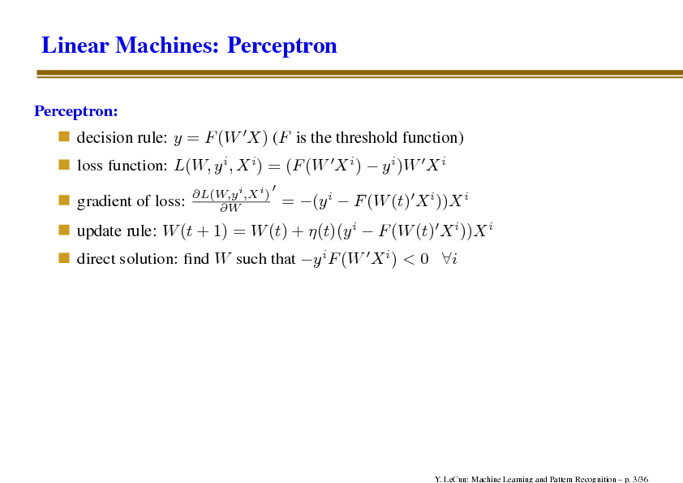
Linear machines
Perception
Decision rule: (F is the threshold function)
Loss function:
Gradient of loss:
Update rule:
Direct solution: fine W such that

Slide 8
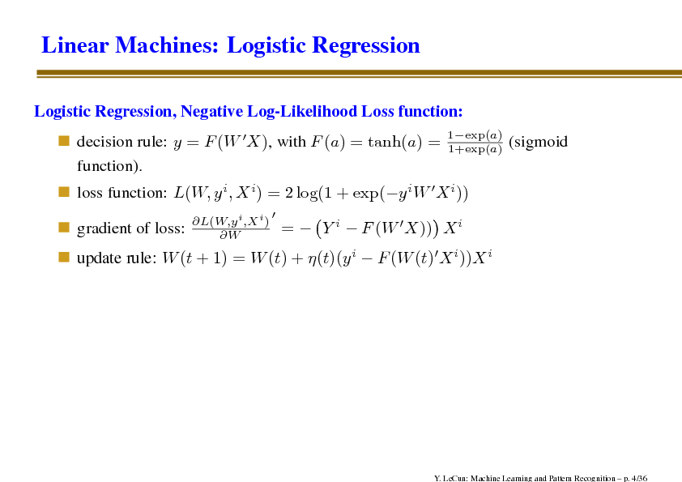
Linear machines: logistic regression
Logistic regression, negative log-likelihood loss function:
Decision rule:
Loss function:
Gradient of loss:
Update rule:

Slide 9
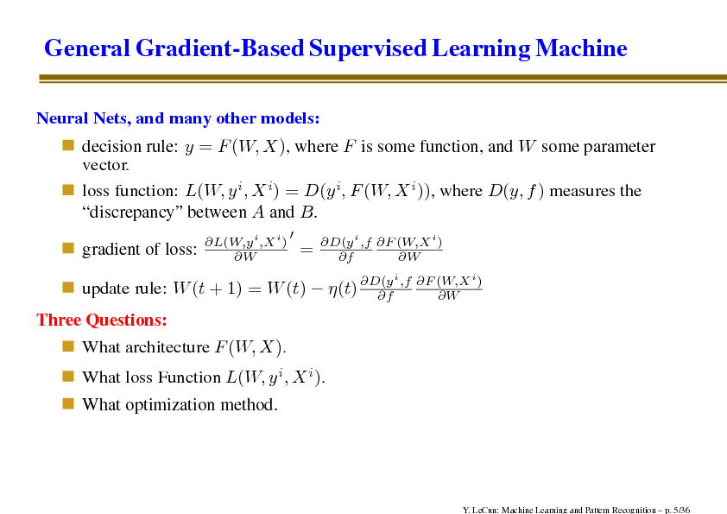
General gradient-based supervised learning machine
Neural nets, and many other models:
Decision rule: y = F(W,X), where F is some function, and W some parameter vector.
Loss function: where D(y, f) measures the “discrepancy” between A and B.
Gradient loss:
Update rule:
Three questions:
What architecture F(W,X).
What loss function L(W, y^{i}, X^{i}).
What optimization method.

Slide 10
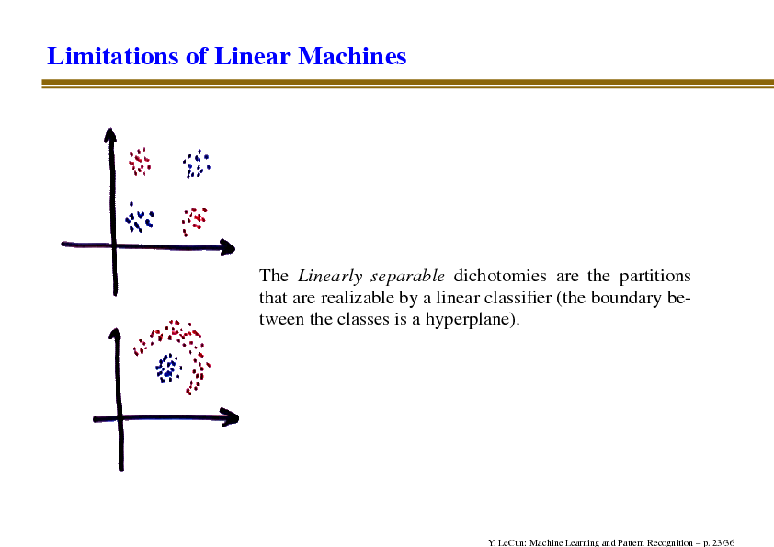
Limitations of linear machines
The linearly separable dichotomies are the partitions that are realizable by a linear classifier (the boundary between the classes is a hyperplane).

Slide 11
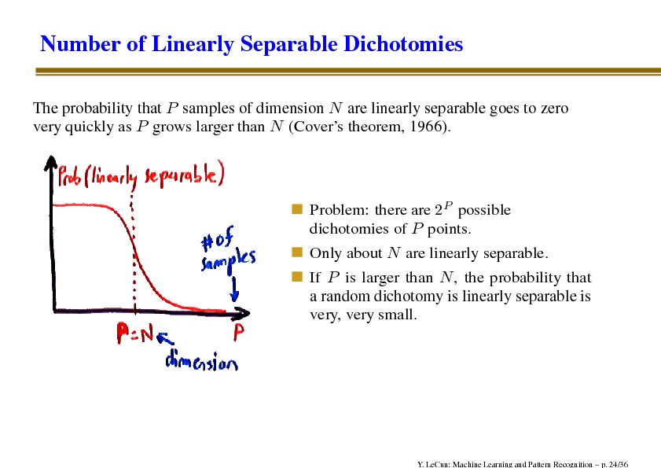
Number of linearly separable dichotomies
The probability that P samples of dimension N are linearly separable goes to zero very quickly as P grows larger than N (Cover’s theorem, 1966).
Problem: there are 2^{P} possible dichotomies of P points
Only about N are linearly separable
If P is larger than N, the probability that a random dichotomy linearly separable is very, very small

Slide 12
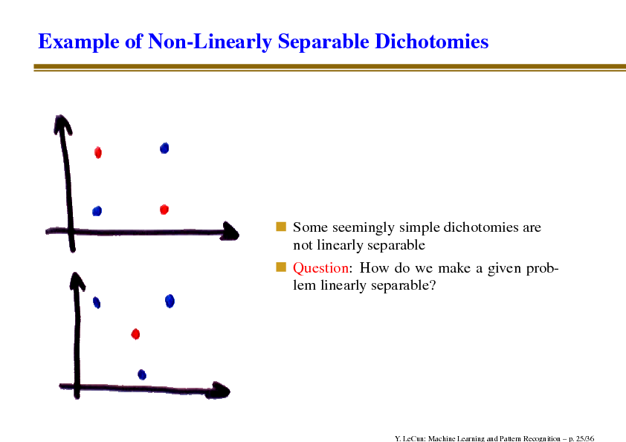
Example of non-linearly separable dichotomies
Some seemingly simple dichotomies are not linearly separable
Question: how do we make a given problem linearly separable?

Slide 13
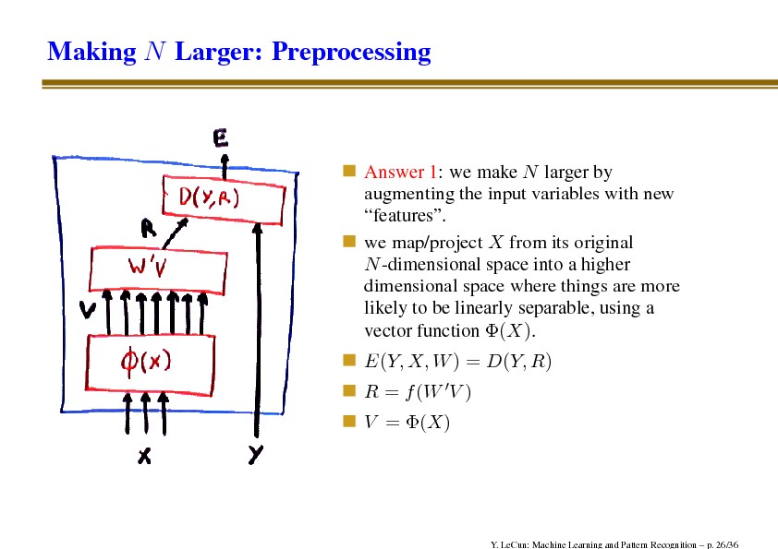
Making N larger: preprocessing
Answer 1: we make N larger by augmenting the input variables with new “features”.
We map/project X from its original N-dimensional space into a higher dimensional space where things are more likely to be linearly separable, using a vector function

Slide 14
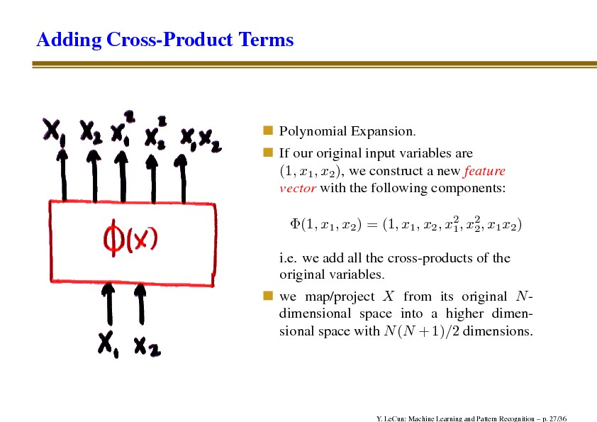
Adding cross-product terms
Polynomial expansion
If our original input variables are (1, x1, x2), we construct a new feature vector with the following components:
i.e. we add all the cross-products of the original variables
We map/project X from its original N-dimensional space into a higher dimensional space with N (N+1)/2 dimensions

Slide 15
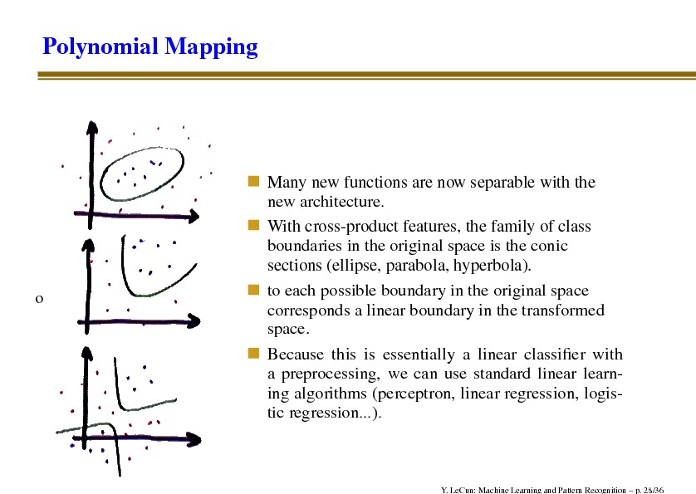
Polynomial mapping
Many new functions are now separable with the new architecture
With cross-product features, the family of class boundaries in the original space is the conic sections (ellipse, parabola, hyperbola)
To each possible boundary in the original space corresponds a linear boundary in the transformed space
Because this is essentially a linear classifier with a preprocessing, we can use standard linear learning algorithms (perception, linear regression, logistic regression…)

Slide 16
Problems with polynomial mapping
We can generalize this idea to higher degree polynomials, adding cross-product terms with 3, 4 or more variables
Unfortunately, the number of terms is the number of combinations d choose N, which grows like N^{d}, where d is the degree, and N the number of original variables
In particular, the number of free parameters that must be learned is also of order N^{d}.
This is impractical for large N and for d > 2
Example: handwritten digit recognition (16x16 pixel images). Number of variables: 256. degree 2: 32,896 variables. Degree 3: 2,796,160. degree 4: 247,460,160…

Slide 17
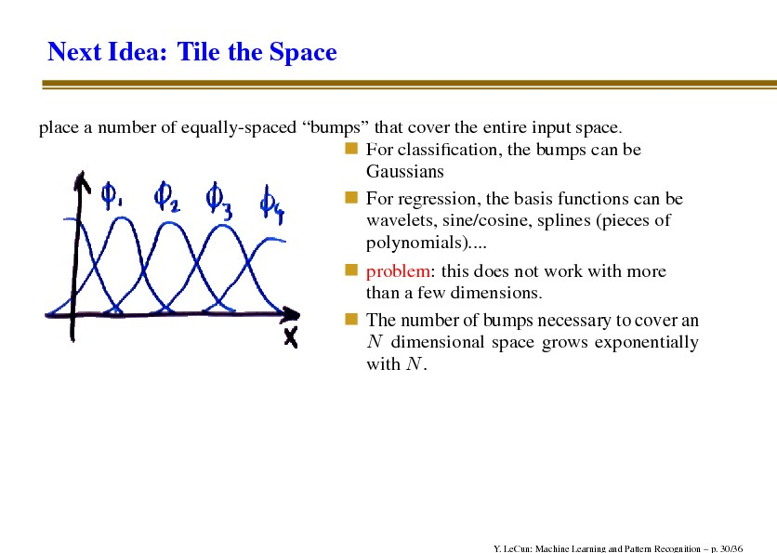
Next idea: tile the space
Place a number of equally-spaced “bumps” that cover the entire input space
For classification, the bumps can be Gaussians
For regression, the basis functions can be wavelets, sine/cosine, splines (pieces of polynomials)…
Problem: this does not work with more than a few dimensions
The number of bumps necessary to cover an N dimensional space grows exponentially with N.

Slide 18
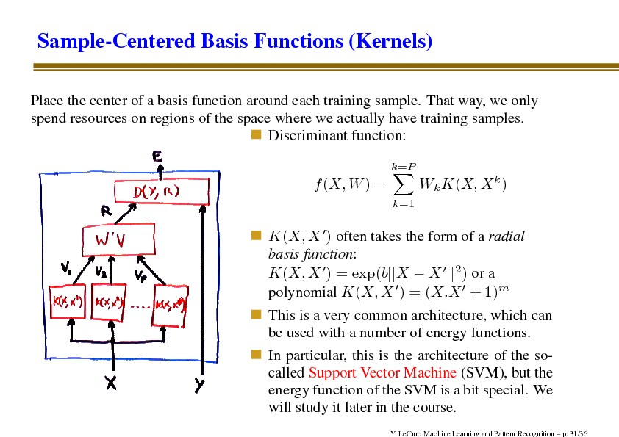
Sample-centered basis functions (kernels)
Place the center of a basis function around each training sample. That way, we only spend resources on regions of the space where we actually have training samples.
Discriminant function:
K(X,X’) often takes the form of a radial basis function:
This is a very common architecture, which can be used with a number of energy functions.
In particular, this is the architecture of the so-called Support Vector Machine (SVM), but the energy function of the SVM is a bit special. We will study it later in the course.

Slide 19
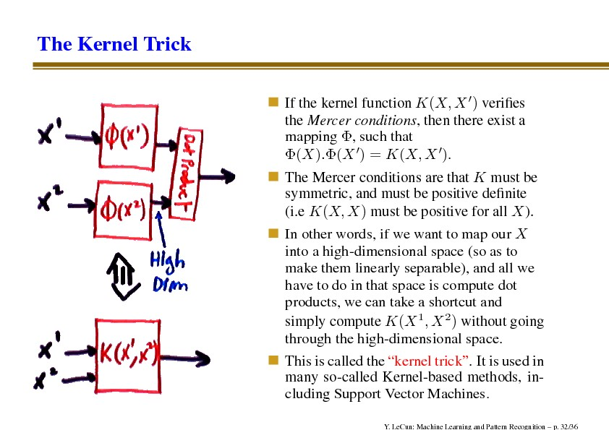
The kernel trick
If the kernel function K(X,X’) verifies the Mercer conditions, then there exist a mapping , such that
The Mercer conditions are that K must be symmetric, and must be positive definite (i.e. K(X,X) must be positive for all X)
In other words, if we want to map our X into a high-dimensional space (so as to make them linearly separable), and all we have to do in that space is compute dot products, we can take a shortcut and simply compute K(X¹,X²) without going through the high-dimensional space
This is called the “kernel trick”. It is used in many so-called Kernel-based methods, including Support Vector Machines.

Slide 20
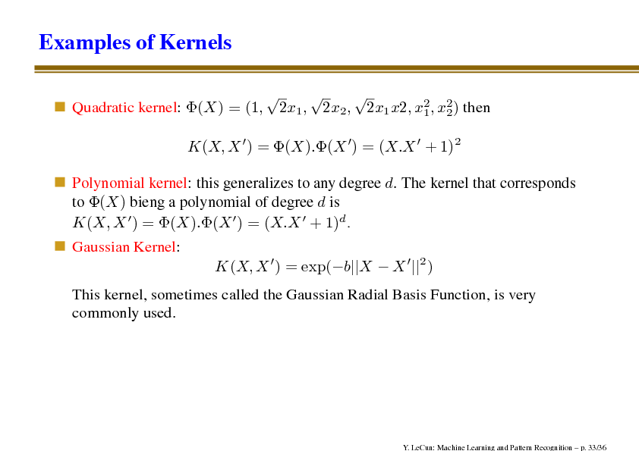
Examples of Kernels
Quadratic kernel:
Polynomial kernel: this generalizes to any degree d. the kernel that corresponds to (X) being a polynomial of degree d is
Gaussian Kernel:
This kernel, sometimes called the Gaussian Radial Basis Function, is very commonly used

Slide 21
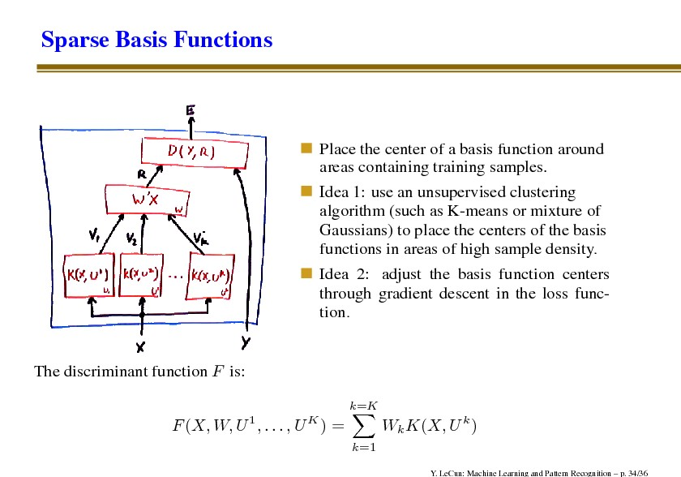
Sparse basis functions
Place the center of a basis function around areas containing training samples
Idea 1: use an unsupervised clustering algorithm (such as K-means or mixture of Gaussians) to place the centers of the basis functions in areas of high sample density
Idea 2: adjust the basis functions centers through gradient descent in the loss function

Slide 22
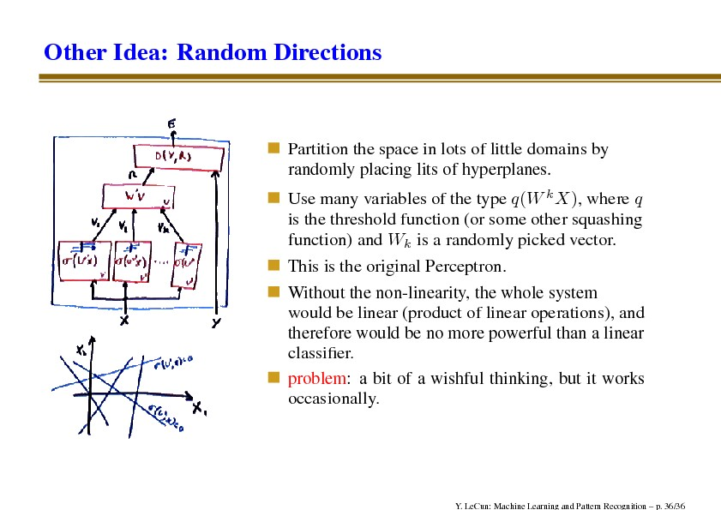
Other idea: random directions
Partition the space in lots of little domains by randomly placing lits of hyperplanes
Use many variables of the type q(W^{k}X), where q is the threshold function (or some other squashing function) and W^{k} is a randomly picked vector
This is the original Perceptron
Without the non-linearity, the whole system would be linear (product of linear operations), and therefore would be no more powerful than a linear classifier
Problem: a bit of wishful thinking, but it works occasionally

Slide 23
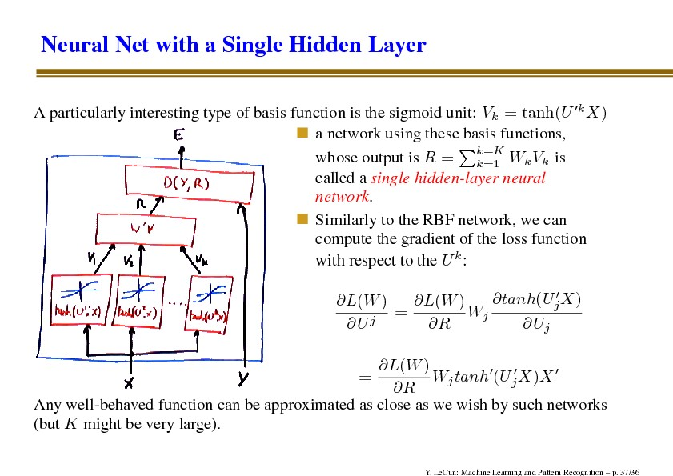
Neural net with a single hidden layer
A particularly interesting type of basis function is the sigmoid unit: V_{k} = tanh(U^{’k}X)
A network using these basis functions, whose output is is called a single hidden-layer neural network
Similarly to the RBF network, we can compute the gradient of the loss function with respect to the U^{k}.
Any well-behaved function can be approximated as close as we wish by such networks (but K might be very large).

Slide 24
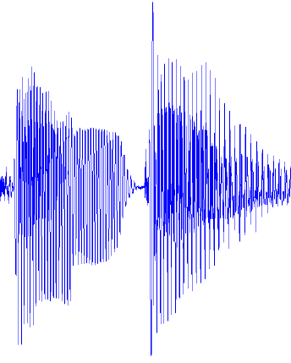
Architecture of “mainstream” pattern recognition systems
Modern architecture for pattern recognition
Speech recognition: early 90's – 2011
Object Recognition: 2006 - 2012
MFCC
Mix of Gaussians
Classifier
fixed
unsupervised
supervised
SIFT HoG
K-means Sparse Coding
Pooling
Classifier
fixed
unsupervised
supervised
Low-level Features
Mid-level Features

Slide 25
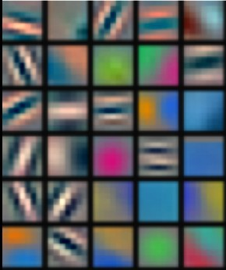
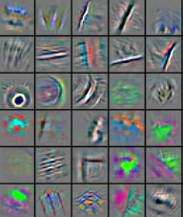
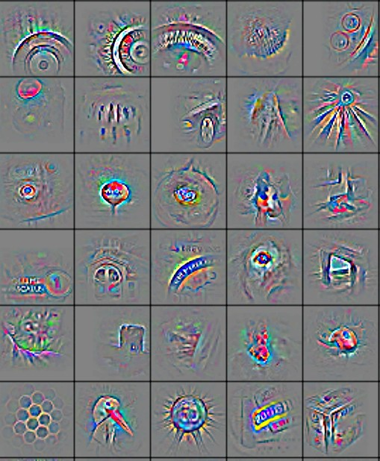
Deep learning = learning hierarchical representations
It's deep if it has more than one stage of non-linear feature transformation
Low-level feature
Mid-level feature
High-level feature
Trainable classifier
Feature visualization of convolutional net trained on ImageNet from [Zeiler & Fergus 2013]

Slide 26
Trainable feature hierarchy
Hierarchy of representations with increasing level of abstraction Each stage is a kind of trainable feature transform
Image recognition
Pixel → edge → texton → motif → part → object
Text
Character → word → word group → clause → sentence → story
Speech
Sample → spectral band → sound → … → phone → phoneme → word
Trainable feature transform
Trainable feature transform
Trainable feature transform
Trainable feature transform

Slide 27
Learning representations: a challenge for ML, CV, AI, neuroscience, cognitive science...
How do we learn representations of the perceptual world?
How can a perceptual system build itself by looking at the world?
How much prior structure is necessary
ML/AI: how do we learn features or feature hierarchies?
What is the fundamental principle? What is the learning algorithm? What is the architecture?
Neuroscience: how does the cortex learn perception?
Does the cortex “run” a single, general learning algorithm? (or a small number of them)
CogSci: how does the mind learn abstract concepts on top of less abstract ones?
Deep Learning addresses the problem of learning hierarchical representations with a single algorithm
Or perhaps with a few algorithms
Trainable feature transform
Trainable feature transform
Trainable feature transform
Trainable feature transform

Slide 28
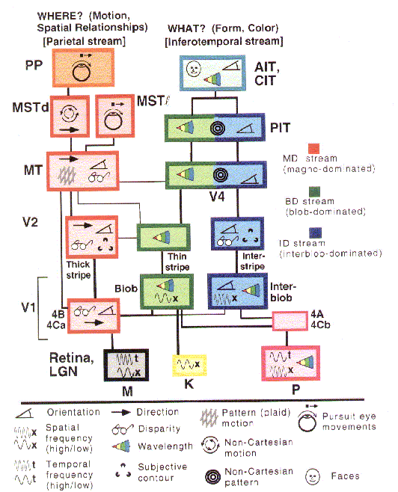
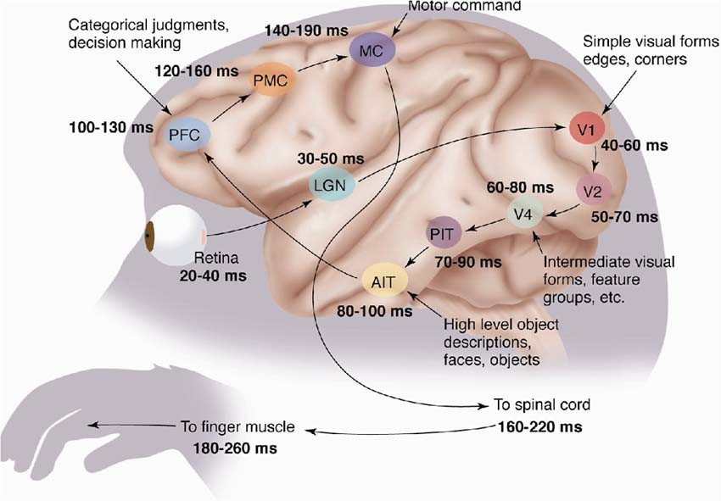
The mammalian visual cortex is hierarchical
The ventral (recognition) pathway in the visual cortex has multiple stages Retina - LGN - V1 - V2 - V4 - PIT - AIT ....
Lots of intermediate representations
[picture from Simon Thorpe]
[Gallant & Van Essen]

Slide 29
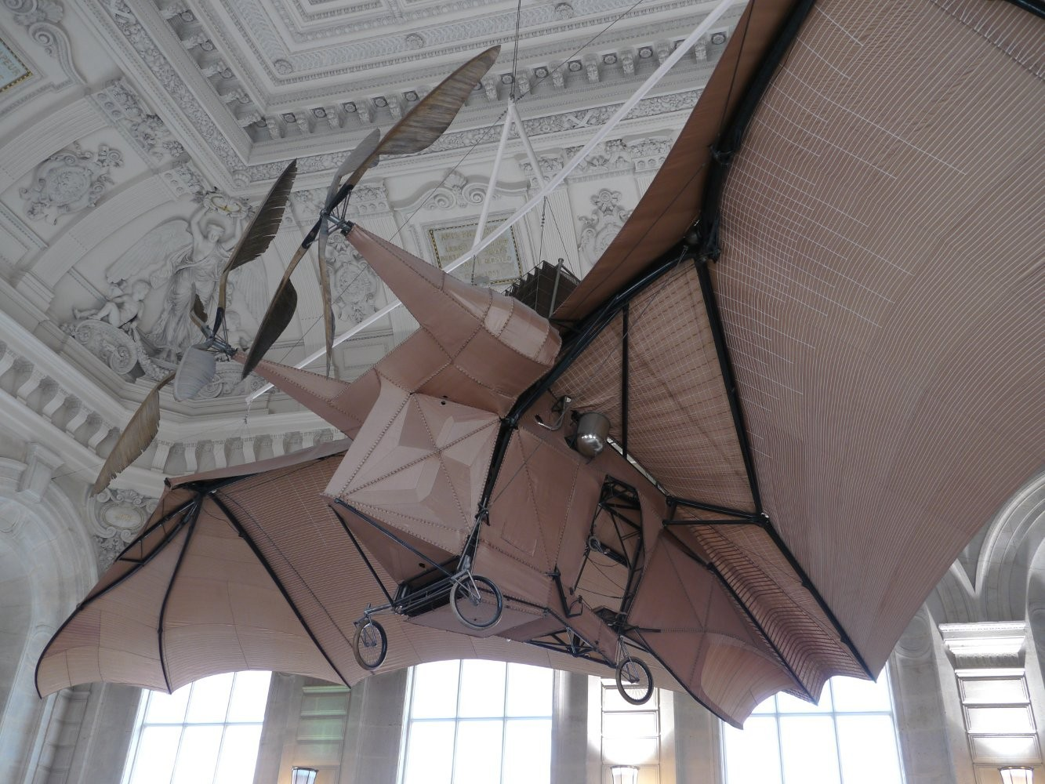
Let's be inspired by nature, but not too much
It's nice imitate Nature,
But we also need to understand
How do we know which details are important?
Which details are merely the result of evolution, and the constraints of biochemistry?
For airplanes, we developed aerodynamics and compressible fluid dynamics.
We figured that feathers and wing flapping weren't crucial
QUESTION: What is the equivalent of aerodynamics for understanding intelligence?
L'Avion III de Clément Ader, 1897
(Musée du CNAM, Paris)
His Eole took off from the ground in 1890, 13 years before the Wright Brothers, but you probably never heard of it.

Slide 30
Trainable feature hierarchies: end-to-end learning
A hierarchy of trainable feature transforms
Each module transforms its input representation into a higher-level one.
High-level features are more global and more invariant
Low-level features are shared among categories
How can we make all the modules trainable and get them to learn appropriate representations?
Trainable feature transform
Trainable feature transform
Trainable feature transform
Learned internal representations

Slide 31
Three types of deep architectures
Feed-forward: multilayer neural nets, convolutional nets
Feed-back: stacked sparse coding, deconvolutional nets
Bi-directional: Deep Boltzmann Machines, stacked auto-encoders

Slide 32
Three types of training protocols
Purely Supervised
Initialize parameters randomly Train in supervised mode
Typically with SGD, using backprop to compute gradients
Used in most practical systems for speech and image recognition
Unsupervised, layerwise + supervised classifier on top
Train each layer unsupervised, one after the other
Train a supervised classifier on top, keeping the other layers fixed
Good when very few labeled samples are available
Unsupervised, layerwise + global supervised fine-tuning
Train each layer unsupervised, one after the other
Add a classifier layer, and retrain the whole thing supervised
Good when label set is poor (e.g. pedestrian detection)
Unsupervised pre-training often uses regularized auto-encoders

Slide 33
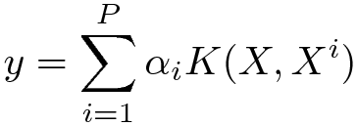

Do we really need deep architectures?
Theoretician's dilemma: “We can approximate any function as close as we want with shallow architecture. Why would we need deep ones?”
kernel machines (and 2-layer neural nets) are “universal”.
Deep learning machines
Deep machines are more efficient for representing certain classes of functions, particularly those involved in visual recognition
They can represent more complex functions with less “hardware”
We need an efficient parameterization of the class of functions that are useful for “AI” tasks (vision, audition, NLP...)

Slide 34
Why would deep architectures be more efficient?
[Bengio & LeCun 2007 “Scaling Learning Algorithms Towards AI”]
A deep architecture trades space for time (or breadth for depth)
More layers (more sequential computation),
But less hardware (less parallel computation).
Example1: N-bit parity
requires N-1 XOR gates in a tree of depth log(N).
Even easier if we use threshold gates
requires an exponential number of gates of we restrict ourselves to 2 layers (DNF formula with exponential number of minterms).
Example2: circuit for addition of 2 N-bit binary numbers
Requires O(N) gates, and O(N) layers using N one-bit adders with ripple carry propagation.
Requires lots of gates (some polynomial in N) if we restrict ourselves to two layers (e.g. Disjunctive Normal Form).
Bad news: almost all boolean functions have a DNF formula with an exponential number of minterms O(2^N).....

Slide 35
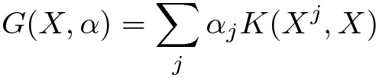




Which models are deep?
2-layer models are not deep (even if you train the first layer)
Because there is no feature hierarchy
Neural nets with 1 hidden layer are not deep
SVMs and Kernel methods are not deep
Layer1: kernels; layer2: linear
The first layer is “trained” in with the simplest unsupervised method ever devised: using the samples as templates for the kernel functions.
Classification trees are not deep
No hierarchy of features. All decisions are made in the input space

Slide 36
Are graphical models deep?
There is no opposition between graphical models and deep learning.
Many deep learning models are formulated as factor graphs
Some graphical models use deep architectures inside their factors
Graphical models can be deep (but most are not). Factor graph: sum of energy functions
Over inputs X, outputs Y and latent variables Z. Trainable parameters: W
Each energy function can contain a deep network
The whole factor graph can be seen as a deep network

Slide 37
Deep learning: A theoretician's nightmare?
Deep Learning involves non-convex loss functions
With non-convex losses, all bets are off
Then again, every speech recognition system ever deployed has used non-convex optimization (GMMs are non convex).
But to some of us all “interesting” learning is non convex
Convex learning is invariant to the order in which sample are presented (only depends on asymptotic sample frequencies).
Human learning isn't like that: we learn simple concepts before complex ones. The order in which we learn things matter.

Slide 38
Deep learning: A theoretician's nightmare?
No generalization bounds?
Actually, the usual VC bounds apply: most deep learning systems have a finite VC dimension
We don't have tighter bounds than that.
But then again, how many bounds are tight enough to be useful for model selection?
It's hard to prove anything about deep learning systems
Then again, if we only study models for which we can prove things, we wouldn't have speech, handwriting, and visual object recognition systems today.

Slide 39
Deep learning: A theoretician's paradise?
Deep learning is about representing high-dimensional data
There has to be interesting theoretical questions there what is the geometry of natural signals?
Is there an equivalent of statistical learning theory for unsupervised learning?
What are good criteria on which to base unsupervised learning?
Deep learning systems are a form of latent variable factor graph
Internal representations can be viewed as latent variables to be inferred, and deep belief networks are a particular type of latent variable models.
The most interesting deep belief nets have intractable loss functions: how do we get around that problem?
Lots of theory at the 2012 IPAM summer school on deep learning
Wright's parallel SGD methods, Mallat's “scattering transform”, Osher's “split Bregman” methods for sparse modeling, Morton's “algebraic geometry of DBN”,....

Slide 40
Deep learning and feature learning today
Deep learning has been the hottest topic in speech recognition in the last 2 years
A few long-standing performance records were broken with deep learning methods
Microsoft and google have both deployed dl-based speech recognition system in their products
Microsoft, google, IBM, nuance, AT&T, and all the major academic and industrial players in speech recognition have projects on deep learning
Deep learning is the hottest topic in computer vision
Feature engineering is the bread-and-butter of a large portion of the CV community, which creates some resistance to feature learning
But the record holders on ImageNet and semantic segmentation are convolutional nets
Deep learning is becoming hot in natural language processing
Deep learning/feature learning in applied mathematics
The connection with applied math is through sparse coding, non-convex optimization, stochastic gradient algorithms, etc...

Slide 41
In many fields, feature learning has caused a revolution (methods used in commercially deployed systems)
Speech Recognition I (late 1980s)
Trained mid-level features with Gaussian mixtures (2-layer classifier)
Handwriting Recognition and OCR (late 1980s to mid 1990s)
Supervised convolutional nets operating on pixels
Face & People Detection (early 1990s to mid 2000s)
Supervised convolutional nets operating on pixels (YLC 1994, 2004, Garcia 2004)
Haar features generation/selection (Viola-Jones 2001)
Object Recognition I (mid-to-late 2000s: Ponce, Schmid, Yu, YLC....)
Trainable mid-level features (K-means or sparse coding)
Low-Res Object Recognition: road signs, house numbers (early 2010's)
Supervised convolutional net operating on pixels
Speech Recognition II (circa 2011)
Deep neural nets for acoustic modeling
Object Recognition III, Semantic Labeling (2012, Hinton, YLC,...)
Supervised convolutional nets operating on pixels

Slide 42

Shallow
Deep
Boosting
Neural net
RNN
Conv. Net
Perceptron
Ae
D-AE
SVM
RBM
DBN
DBM
Sparse GMM coding
BayesNP
ϵπ
DecisionTree

Slide 43
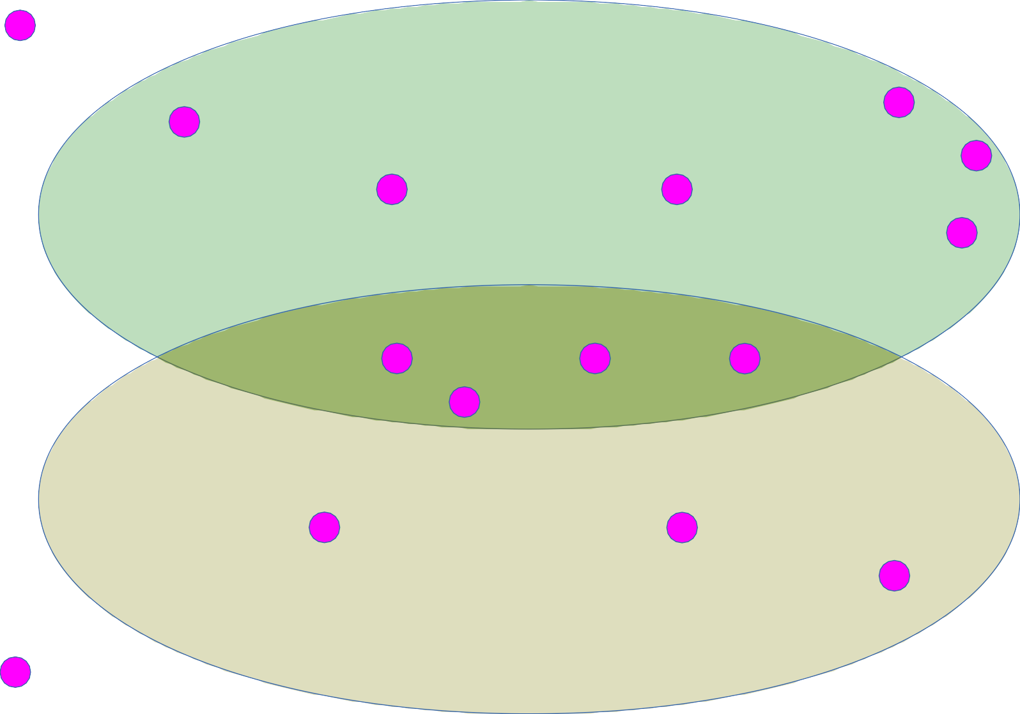
Shallow
Deep
Boosting
Neural networks
Neural net
RNN
Conv. Net
Perceptron
Ae
D-AE
SVM
RBM
DBN
DBM
Sparse GMM coding
BayesNP
ϵπ
Probabilistic models
DecisionTree

Slide 44
Shallow
Deep
Boosting
Neural networks
Neural net
RNN
Conv. Net
Perceptron
Ae
D-AE
SVM
RBM
DBN
DBM
Sparse GMM coding
BayesNP
ϵπ
Probabilistic models
DecisionTree
Supervised
Supervised

Slide 45
Shallow
Deep
Boosting
Neural net
RNN
Conv. Net
Perceptron
Ae
D-AE
SVM
RBM
DBN
DBM
Sparse GMM coding
BayesNP
ϵπ
In this talk, we’ll focus on the simplest and typically most effective methods
DecisionTree

Slide 46
What are good features?

Slide 47
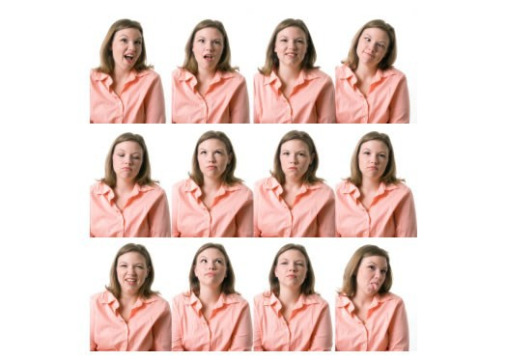
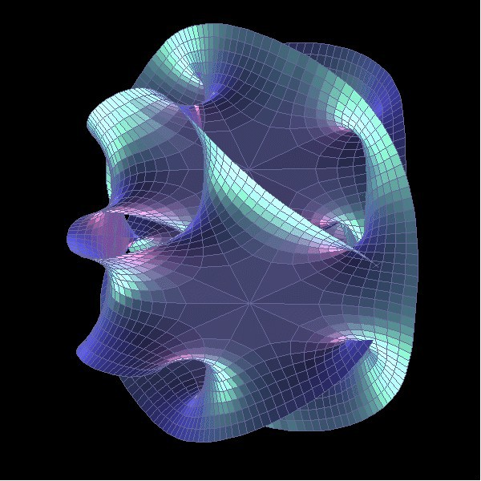
Discovering the hidden structure in high-dimensional data the manifold hypothesis
Learning representations of data:
Discovering & disentangling the independent explanatory factors
The manifold hypothesis:
Natural data lives in a low-dimensional (non-linear) manifold
Because variables in natural data are mutually dependent

Slide 48

Discovering the hidden structure in high-dimensional data
Example: all face images of a person
1000x1000 pixels = 1,000,000 dimensions
But the face has 3 Cartesian coordinates and 3 Euler angles and humans have less than about 50 muscles in the face
Hence the manifold of face images for a person has <56 dimensions
The perfect representations of a face image:
Its coordinates on the face manifold
Its coordinates away from the manifold
We do not have good and general methods to learn functions that turns an image into this kind of representation
1.2 | Face/not face
-3 | Pose
0.2 | Lighting
-2… | Expression
Ideal feature extractor

Slide 49
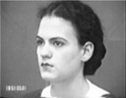
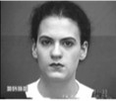

Disentangling factors of variation
The ideal disentangling feature extractor
View
Pixel n
Ideal feature extractor
Pixel 2
Expression
Pixel 1

Slide 50



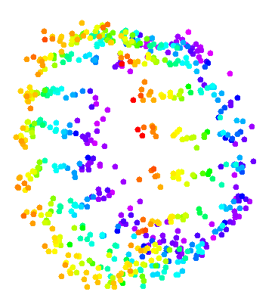

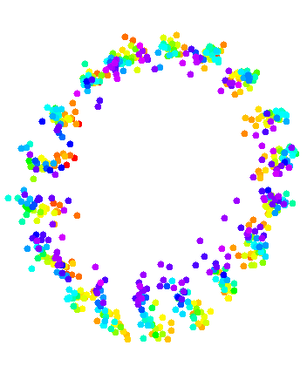
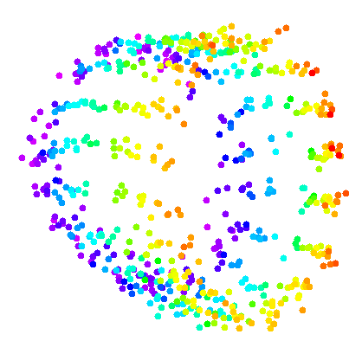







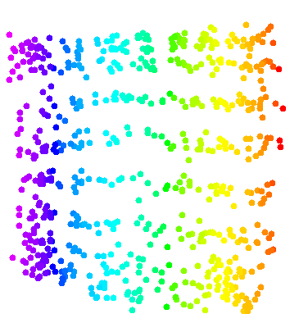
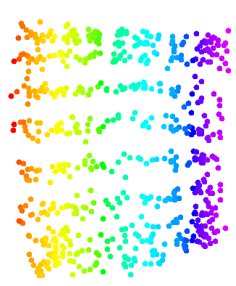









Data manifold & invariance: Some variations must be eliminated
Azimuth-Elevation manifold. Ignores lighting. [Hadsell et al. CVPR 2006]

Slide 51
Basic idea for invariant feature learning
Embed the input non-linearly into a high(er) dimensional space
In the new space, things that were non separable may become separable
Pool regions of the new space together
Bringing together things that are semantically similar. Like pooling.
Pooling or
Aggregation
Non-linear function
Input
Stable/invariant features
high-dim Unstable/non-smooth
features

Slide 52
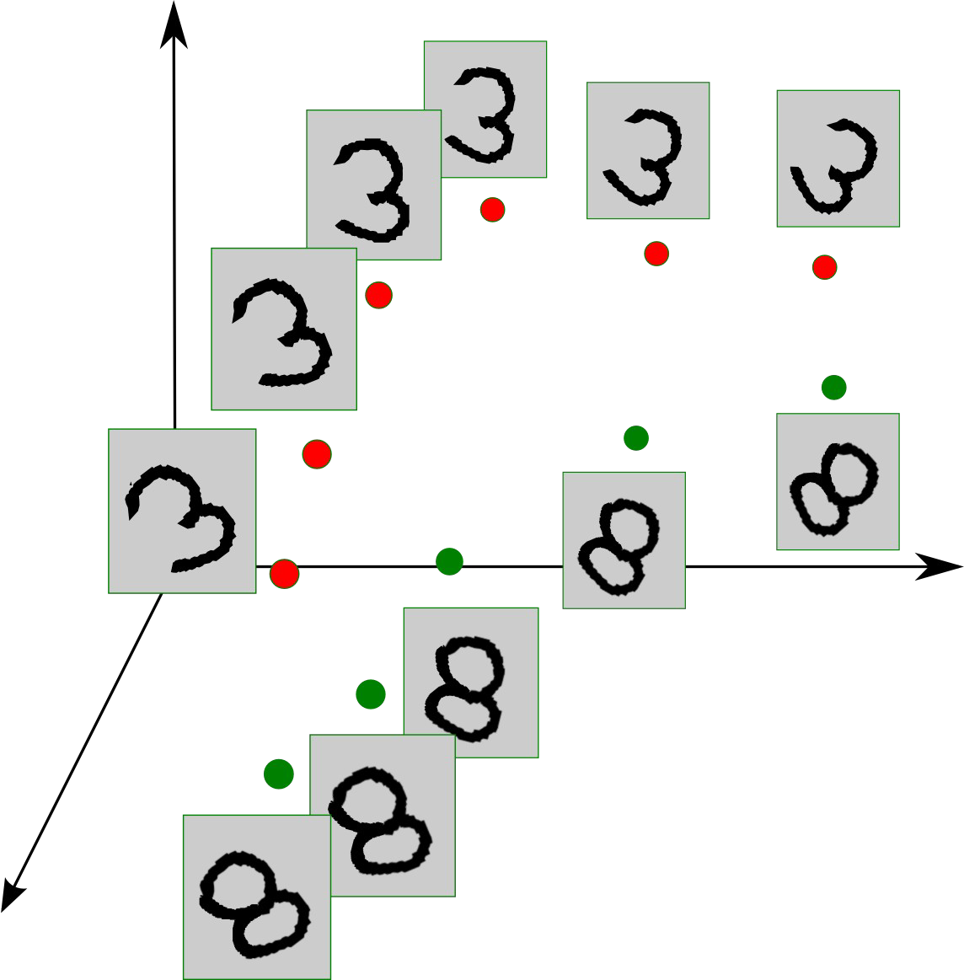
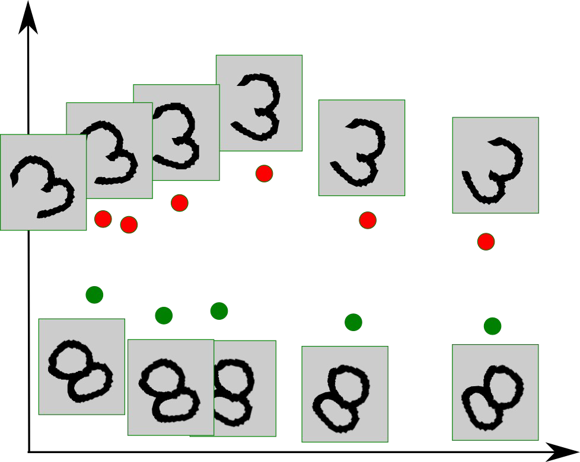
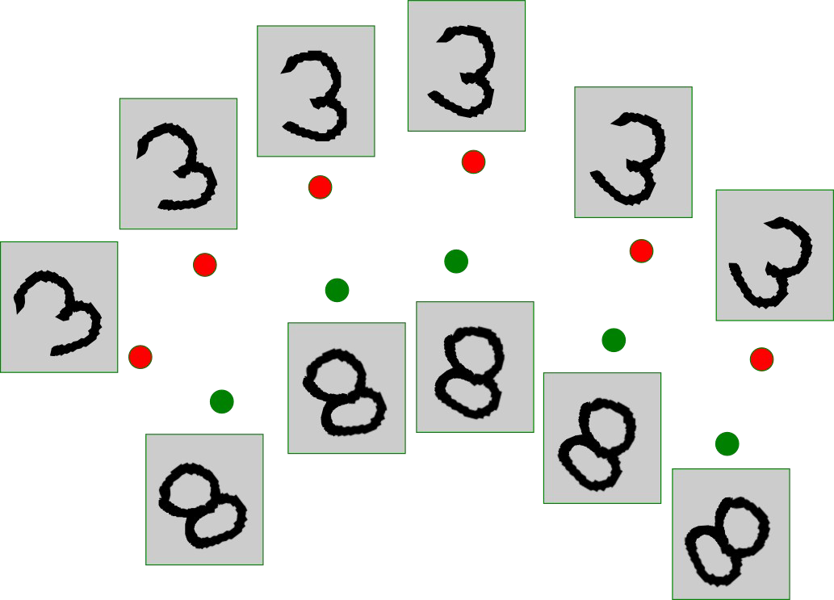
Non-linear expansion → pooling
Entangled data manifolds
Non-linear dim expansion, disentangling
Pooling
aggregation

Slide 53
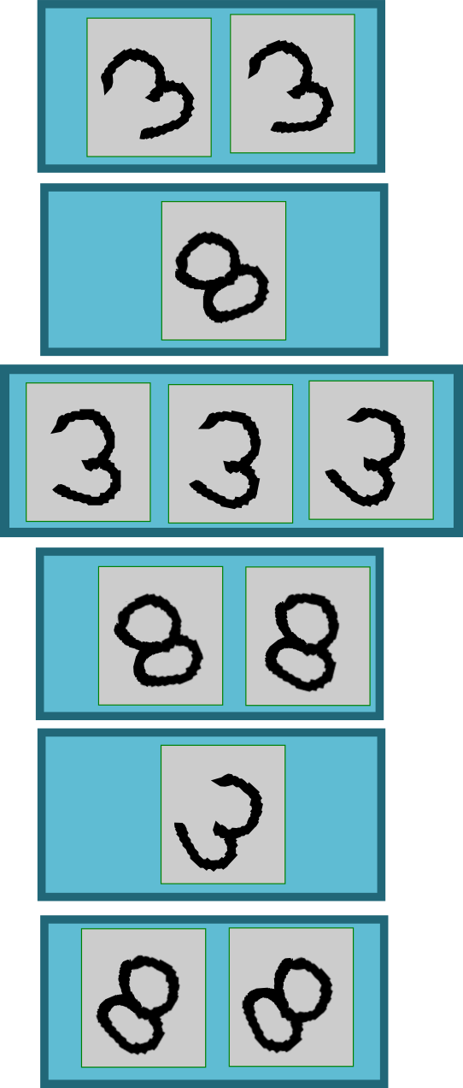
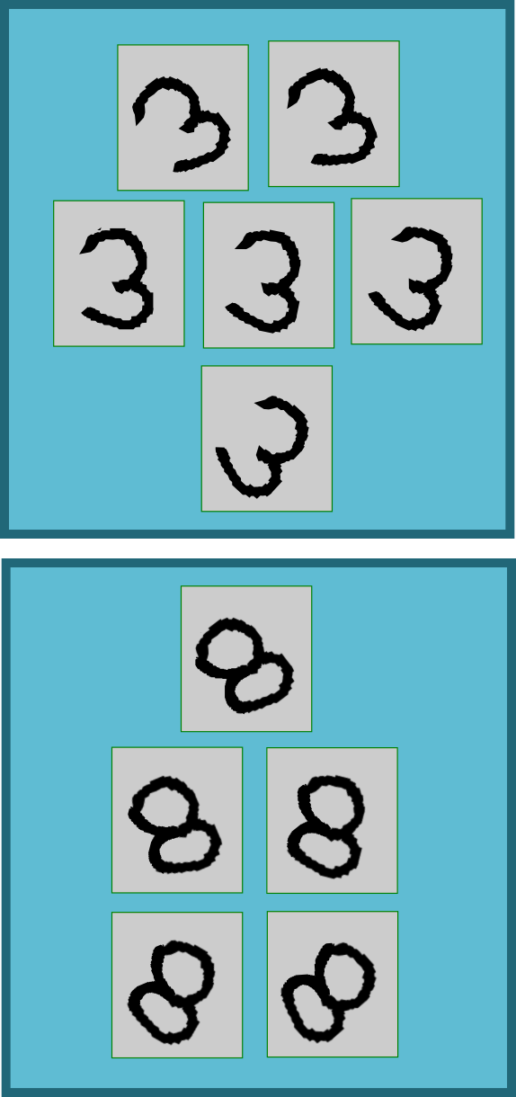
Sparse non-linear expansion → pooling
Use clustering to break things apart, pool together similar things
Clustering, quantization, sparse coding
Pooling
aggregation

Slide 54
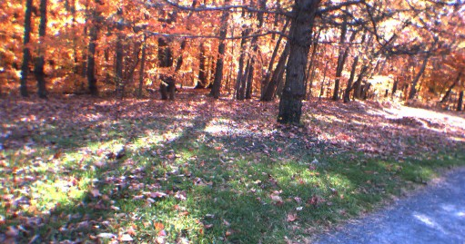
Overall architecture:
Normalization → filter bank → non-linearity → pooling
Filter Bank
Non- Linear
feature Pooling
Filter Bank
Non- Linear
feature Pooling
Norm
Norm
Classifier
Stacking multiple stages of
[Normalization → filter bank → non-linearity → pooling].
Normalization: variations on whitening
Subtractive: average removal, high pass filtering
Divisive: local contrast normalization, variance normalization
Filter bank: dimension expansion, projection on overcomplete basis
Non-linearity: sparsification, saturation, lateral inhibition....
Rectification (relu), component-wise shrinkage, tanh, winner-takes-all
Pooling: aggregation over space or feature type

Slide 55
Software
Torch7: learning library that supports neural net training
http://www.torch.ch
http://code.cogbits.com/wiki/doku.php (tutorial with demos by C. Farabet)
http://eblearn.sf.net (C++ Library with convent support by P. Sermanet)
Python-based learning library (U. Montreal)
http://deeplearning.net/software/theano/ (does automatic differentiation)
RNN
www.fit.vutbr.cz/~imikolov/rnnlm (language modeling)
http://sourceforge.net/apps/mediawiki/index.php (LSTM)
CUDAMat & GNumpy
code.google.com/p/cudamat
www.cs.toronto.edu/~tijmen/gnumpy.htm
Misc
www.deeplearning.net//software_links

Slide 56
References
Convolutional nets
LeCun, Bottou, Bengio and Haffner: Gradient-Based Learning Applied to Document Recognition, Proceedings of the IEEE, 86(11):2278-2324, November 1998
Krizhevsky, Sutskever, Hinton “ImageNet Classification with deep convolutional neural networks” NIPS 2012
Jarrett, Kavukcuoglu, Ranzato, LeCun: What is the Best Multi-Stage Architecture for
Object Recognition?, Proc. International Conference on Computer Vision (ICCV'09), IEEE, 2009
Kavukcuoglu, Sermanet, Boureau, Gregor, Mathieu, LeCun: Learning Convolutional Feature Hierarchies for Visual Recognition, Advances in Neural Information Processing Systems (NIPS 2010), 23, 2010
see yann.lecun.com/exdb/publis for references on many different kinds of convnets.
see http://www.cmap.polytechnique.fr/scattering/ for scattering networks (similar to convnets but with less learning and stronger mathematical foundations)

Slide 57
References
Applications of RNNs
Mikolov “Statistical language models based on neural networks” PhD thesis 2012
Boden “A guide to RNNs and backpropagation” Tech Report 2002
Hochreiter, Schmidhuber “Long short term memory” Neural Computation 1997
Graves “Offline arabic handwrting recognition with multidimensional neural networks” Springer 2012
Graves “Speech recognition with deep recurrent neural networks” ICASSP 2013

Slide 58
References
Applications of convolutional nets
Farabet, Couprie, Najman, LeCun, “Scene Parsing with Multiscale Feature Learning, Purity Trees, and Optimal Covers”, ICML 2012
Pierre Sermanet, Koray Kavukcuoglu, Soumith Chintala and Yann LeCun: Pedestrian Detection with Unsupervised Multi-Stage Feature Learning, CVPR 2013
D. Ciresan, A. Giusti, L. Gambardella, J. Schmidhuber. Deep Neural Networks Segment Neuronal Membranes in Electron Microscopy Images. NIPS 2012
Raia Hadsell, Pierre Sermanet, Marco Scoffier, Ayse Erkan, Koray Kavackuoglu, Urs Muller and Yann LeCun: Learning Long-Range Vision for Autonomous Off-Road Driving, Journal of Field Robotics, 26(2):120-144, February 2009
Burger, Schuler, Harmeling: Image Denoising: Can Plain Neural Networks Compete with BM3D?, Computer Vision and Pattern Recognition, CVPR 2012,

Slide 59
References
Deep learning & energy-based models
Deep learning & energy-based models
Y. Bengio, Learning Deep Architectures for AI, Foundations and Trends in Machine Learning, 2(1), pp.1-127, 2009.
LeCun, Chopra, Hadsell, Ranzato, Huang: A Tutorial on Energy-Based Learning, in Bakir, G. and Hofman, T. and Schölkopf, B. and Smola, A. and Taskar, B. (Eds), Predicting Structured Data, MIT Press, 2006
M. Ranzato Ph.D. Thesis “Unsupervised Learning of Feature Hierarchies” NYU 2009
Practical guide
Y. LeCun et al. Efficient BackProp, Neural Networks: Tricks of the Trade, 1998
L. Bottou, Stochastic gradient descent tricks, Neural Networks, Tricks of the Trade Reloaded, LNCS 2012.
Y. Bengio, Practical recommendations for gradient-based training of deep architectures, ArXiv 2012

Slide 60
Thank you

