Slide 1
Lecture 2.2 - Deep Supervised Learning (modular approach)

Slide 2

The GPU Teaching Kit is licensed by NVIDIA and New York University under the
Creative Commons Attribution-NonCommercial 4.0 International License.
Deck credit: Y. LeCun
MA Ranzato

Slide 3
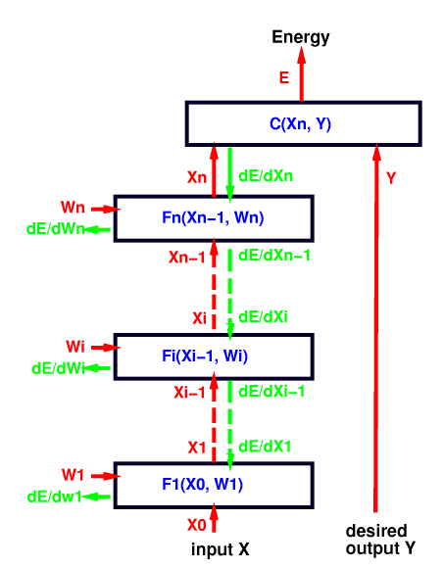
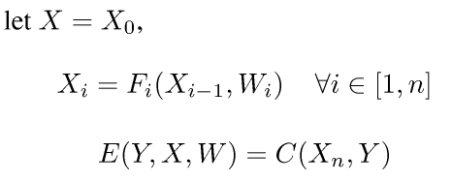
Multimodule systems: Cascade
Complex learning machines can be built by assembling modules into networks
Simple example: sequential/ layered feed-forward architecture (cascade)
Forward Propagation:

Slide 4
Multimodule systems: Implementation
Each module is an object
Contains trainable parameters
Inputs are arguments Output is returned, but also stored internally
Example: 2 modules m1, m2
Torch7 (by hand)
hid = m1:forward(in)
out = m2:forward(hid)
Torch7 (using the nn.Sequential class)
model = nn.Sequential()
model:add(m1)
model:add(m2)
out = model:forward(in)

Slide 5
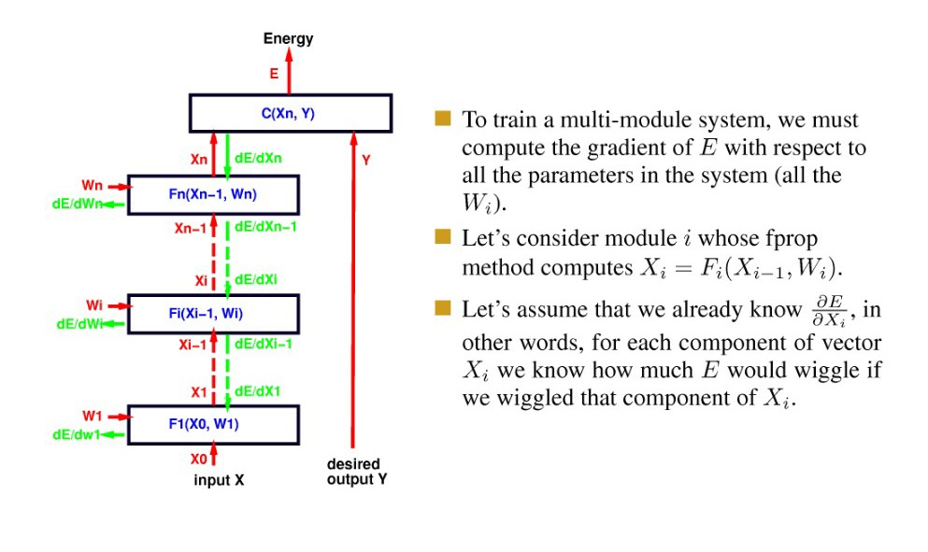
Computing the gradient in multi-layer systems
To train a multi-module system, we must compute the gradient of E with respect to all the parameters in the system (all the W_{i}).
Let’s consider module I whose fprop method computes X_{i} = F_{i}(X_{i-1}, W_{i}).
Let’s assume that we already know , in other words, for each component of vector X_{i}, we know how much E would wiggle if we wiggled that component of X_{i}.

Slide 6
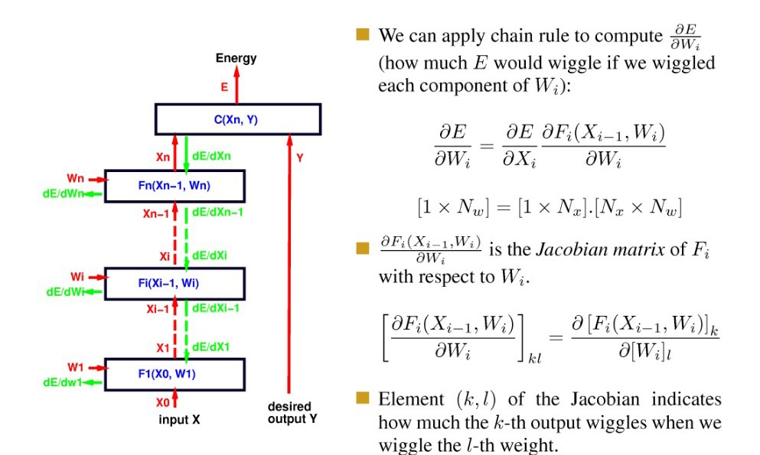
Computing the gradient in multi-layer systems
We can apply chain rule to compute (how much E would wiggle if we wiggles each component of W_{i}):
is the Jacobian matrix of F_{i} with respect to W_{i}
Element (k,l) of the Jacobian indicates how much the k-th output wiggles when we wiggle the l-th weight.

Slide 7
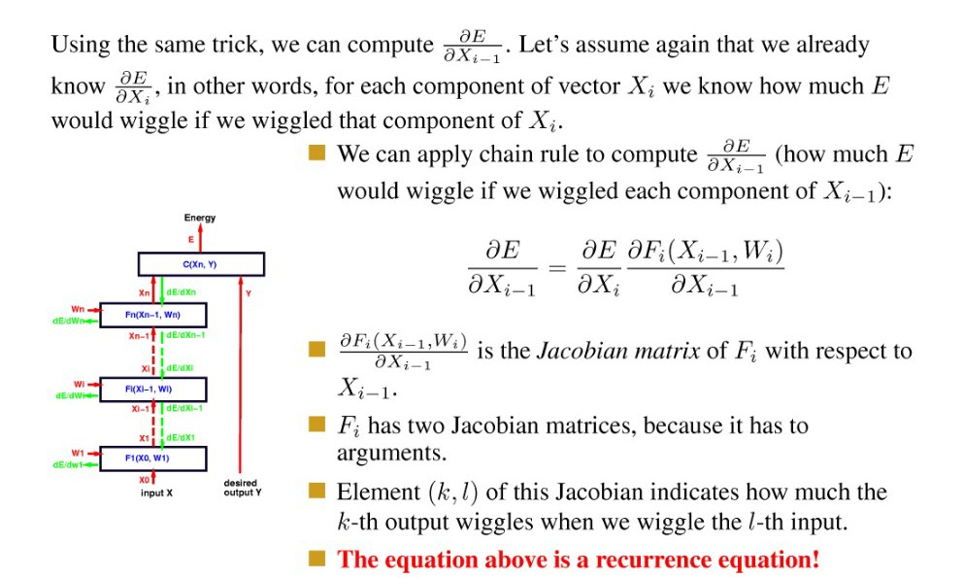
Computing the gradient in multi-layer systems
Using the same trick, we can compute . Let’s assume again that we already know , in other words, for each component of vector X_{i} we know how much E would wiggle if we wiggled that component of X_{i}.
We can apply chain rule to compute (how much E would wiggle if we wiggles each component of X_{i-1}):
is the Jacobian matrix of F_{i} with respect to X_{i-1}
Fi has two Jacobian matrices, because it has two arguments
Element (k,l) of this Jacobian indicates how much the k-th output wiggles when we wiggle the l-th input.
The equation above is a recurrence equation!

Slide 8
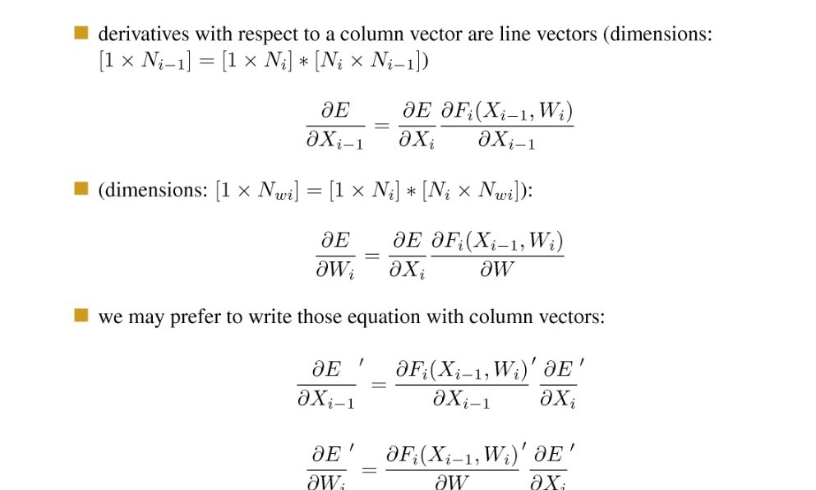
Jacobians and dimensions
Derivatives with respect to a column vector are line vectors (dimensions):
(dimensions:
We may prefer to write those equation with column vectors:

Slide 9
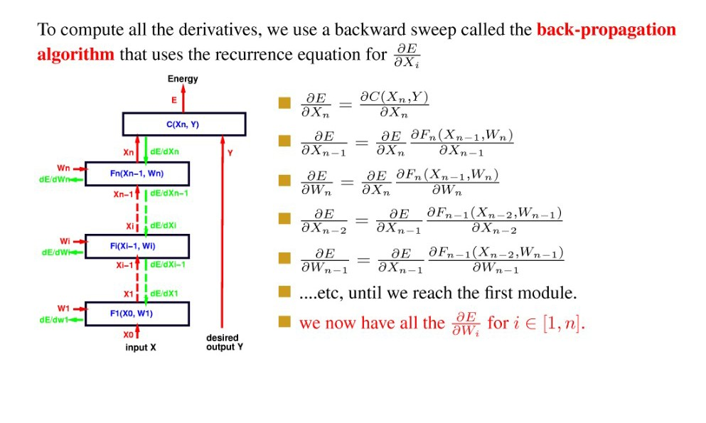
Back propagation
To compute all the derivatives, we use a backward sweep called the back-propagation algorithm that uses the recurrence equation for
…etc, until we reach the first module.
We now have all the

Slide 10
Multimodule systems: Implementation
Backpropagation through a module
Contains trainable parameters
Inputs are arguments Gradient with respect to input is returned.
Arguments are input and gradient with respect to output
Torch7 (by hand)
hidg = m2:backward(hid,outg)
ing = m1:backward(in,hidg)
Torch7 (using the nn.Sequential class)
ing = model:backward(in,outg)

Slide 11
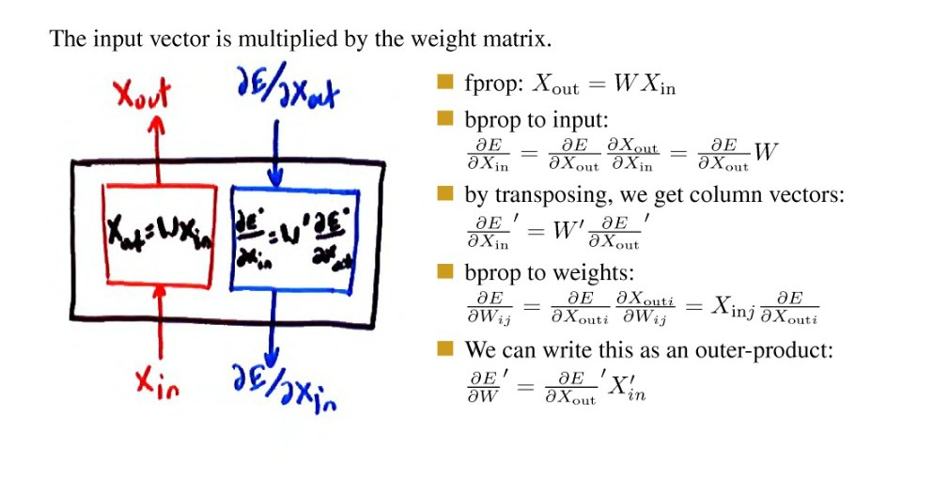
Linear module
The input vector is multiplied by the weight matrix.
fprop: X_{out} = W X_{in}
bprop to input:
by transposing, we get column vectors:
Bprop to weights:
We can write this as an outer-product:

Slide 12
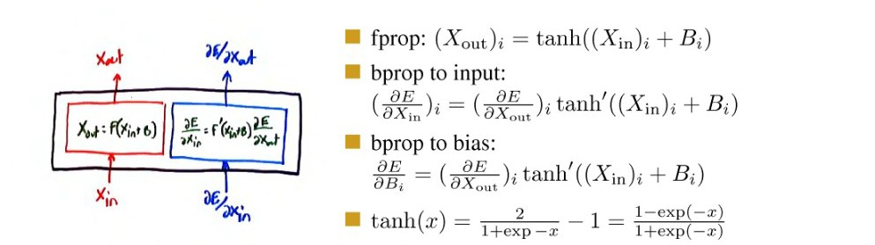
Tanh module (or any other pointwise function)
fprop: X_{out} = tanh ((X_{in})_{i} + B_{i})
bprop to input:
bprop to bias:

Slide 13
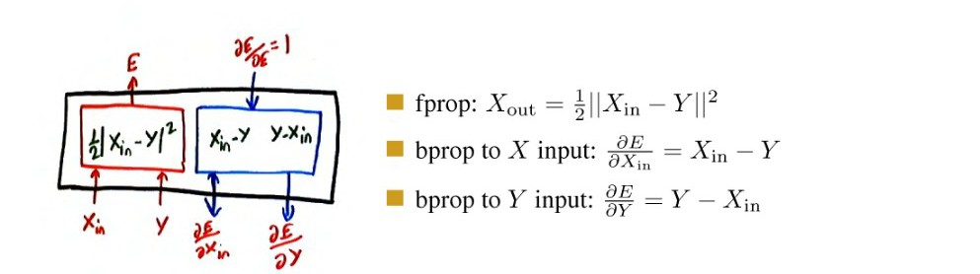
Euclidean distance module
fprop:
bprop to X input:
bprop to Y input:

Slide 14
Any architecture works
Any connection is permissible
Networks with loops must be “unfolded in time”.
Any module is permissible
As long as it is continuous and differentiable almost everywhere with respect to the parameters, and with respect to non-terminal inputs.

Slide 15
Module-based deep learning with Torch7
Torch7 is based on the Lua language
Simple and lightweight scripting language, dominant in the game industry
Has a native just-in-time compiler (fast!)
Has a simple foreign function interface to call C/C++ functions from Lua
Torch7 is an extension of Lua with
A multidimensional array engine with CUDA and OpenMP backends A machine learning library that implements multilayer nets, convolutional nets, unsupervised pre-training, etc
Various libraries for data/image manipulation and computer vision
A quickly growing community of users
Single-line installation on Ubuntu and Mac OSX:
curl -s https://raw.github.com/clementfarabet/torchinstall/master/install | bash
Torch7 Machine Learning Tutorial (neural net, convnet, sparse auto-encoder):
http://code.cogbits.com/wiki/doku.php

Slide 16
Example: building a neural net in Torch7
Net for SVHN digit recognition
10 categories
Input is 32x32 RGB (3 channels)
1500 hidden units
Creating a 2-layer net
Make a cascade module
Reshape input to vector
Add Linear module
Add tanh module
Add Linear Module
Add log softmax layer
Create loss function module
Noutputs
= 10;
3; Width = 32; height = 32
nfeats = ninputs
= nfeats*width*height
= 1500
nhiddens
­­-- Simple 2­layer neural network
model = nn.Sequential()
model:add(nn.Reshape(ninputs)) model:add(nn.Linear(ninputs,nhiddens)) model:add(nn.Tanh()) model:add(nn.Linear(nhiddens,noutputs)) model:add(nn.LogSoftMax())
criterion
= nn.ClassNLLCriterion()
See Torch7 example at http://bit.ly/16tyLAx

Slide 17
Example: training a neural net in torch7
for t = 1,trainData:size(),batchSize do inputs,outputs = getNextBatch() local feval = function(x)
parameters:copy(x) gradParameters:zero()
one epoch over training set
Get next batch of samples
Create a “closure” feval(x) that takes the parameter vector as argument and returns the loss and its gradient on the batch.
Run model on batch
Backprop
Normalize by size of batch
Return loss and gradient
call the stochastic gradient optimizer
local f for i = local local f = f local
= 0
1,#inputs do
output = model:forward(inputs[i])
err = criterion:forward(output,targets[i])
+ err
df_do = criterion:backward(output,targets[i])
model:backward(inputs[i], df_do) end
gradParameters:div(#inputs) f = f/#inputs
return f,gradParameters end – of feval
optim.sgd(feval,parameters,optimState) end

Slide 18
Toy code (matlab): neural net trainer
% F-PROP
for i = 1: nr_layers - 1
[h{i} jac{i}] = nonlinearity(W{i} * h{i-1} + b{i}); end
h{nr_layers-1} = W{nr_layers-1} * h{nr_layers-2} + b{nr_layers-1}; prediction = softmax(h{l-1});
% CROSS ENTROPY LOSS
Loss = - sum(sum(log(prediction).* target)) / batch_size
% B-PROP
dh{l-1} = prediction – target;
for i = nr_layers – 1 : -1 : 1
Wgrad{i} = dh{i} * h{i-1}';
bgrad{i} = sum(dh{i}, 2);
dh{i-1} = (W{i}' * dh{i}).* jac{i-1};
end
% UPDATE
for i = 1 : nr_layers – 1
W{i} = W{i} - (lr / batch_size) * Wgrad{i};
b{i} = b{i} - (lr / batch_size) * bgrad{i};
end

Slide 19
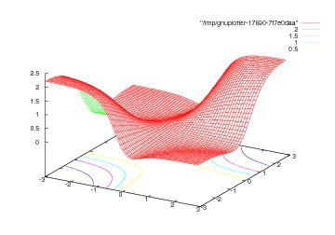
Deep supervised learning is non-convex
Example: what is the loss function for the simplest 2-layer neural net ever
Function: 1-1-1 neural net. Map 0.5 to 0.5 and -0.5 to -0.5 (identity function) with quadratic cost:

Slide 20
Backprop in practice
Use ReLU non-linearities (tanh and logistic are falling out of favor) Use cross-entropy loss for classification
Use Stochastic Gradient Descent on minibatches Shuffle the training samples
Normalize the input variables (zero mean, unit variance) Schedule to decrease the learning rate
Use a bit of L1 or L2 regularization on the weights (or a combination)
But it's best to turn it on after a couple of epochs
Use “dropout” for regularization
Hinton et al 2012 http://arxiv.org/abs/1207.0580
Lots more in [LeCun et al. “Efficient Backprop” 1998]
Lots, lots more in “Neural Networks, Tricks of the Trade” (2012 edition) edited by G. Montavon, G. B. Orr, and K-R Müller (Springer)

Slide 21
Software
Torch7:learning library that supports neural net training
http://www.torch.ch
http://code.cogbits.com/wiki/doku/php (tutorial with demos by C. Farabet)
http://eblearn.sf.net (C++ Library with convent support by P. Sermanet)
Python-based learning library (U. Montreal)
http://deeplearning.net/software/theano/ (does automatic differentiation)
RNN
www.fit.vutbr.cz/~imikolov/rnnlm (language modeling)
http://sourceforge.net/apps/mediawiki/rnnl/index.php (LSTM)
CUDAMat & GNumpy
code.google.com/p/cudamat
www.cs.Toronto.edu/~tijmen/gnumpy.html
Misc
www.deeplearning.net//software_links

Slide 22
References
Convolutional nets
LeCun, Bottou, Bengio and Haffner: Gradient-Based Learning Applied to Document Recognition, Proceedings of the IEEE, 86(11):2278-2324, November 1998
Krizhevsky, Sutskever, Hinton “ImageNet Classification with deep convolutional neural networks” NIPS 2012
Jarrett, Kavukcuoglu, Ranzato, LeCun: What is the Best Multi-Stage Architecture for Object Recognition?, Proc. International Conference on Computer Vision (ICCV'09), IEEE, 2009
Kavukcuoglu, Sermanet, Boureau, Gregor, Mathieu, LeCun: Learning Convolutional Feature Hierachies for Visual Recognition, Advances in Neural Information Processing Systems (NIPS 2010), 23, 2010
see yann.lecun.com/exdb/publis for references on many different kinds of convnets.
see http://www.cmap.polytechnique.fr/scattering/ for scattering networks (similar to convnets but with less learning and stronger mathematical foundations)

Slide 23
References
Applications of convolutional nets
Farabet, Couprie, Najman, LeCun, “Scene Parsing with Multiscale Feature Learning, Purity Trees, and Optimal Covers”, ICML 2012
Pierre Sermanet, Koray Kavukcuoglu, Soumith Chintala and Yann LeCun: Pedestrian Detection with Unsupervised Multi-Stage Feature Learning, CVPR 2013
D. Ciresan, A. Giusti, L. Gambardella, J. Schmidhuber. Deep Neural Networks Segment Neuronal Membranes in Electron Microscopy Images. NIPS 2012
Raia Hadsell, Pierre Sermanet, Marco Scoffier, Ayse Erkan, Koray Kavackuoglu, Urs Muller and Yann LeCun: Learning Long-Range Vision for Autonomous Off-Road Driving, Journal of Field Robotics, 26(2):120-144, February 2009
Burger, Schuler, Harmeling: Image Denoisng: Can Plain Neural Networks Compete with BM3D?, Computer Vision and Pattern Recognition, CVPR 2012,

Slide 24
References
Applications of RNNs
Mikolov “Statistical language models based on neural networks” PhD thesis 2012
Boden “A guide to RNNs and backpropagation” Tech Report 2002
Hochreiter, Schmidhuber “Long short term memory” Neural Computation 1997
Graves “Offline arabic handwrting recognition with multidimensional neural networks” Springer 2012
Graves “Speech recognition with deep recurrent neural networks” ICASSP 2013

Slide 25
References
Deep Learning & Energy-Based Models
Y. Bengio, Learning Deep Architectures for AI, Foundations and Trends in Machine Learning, 2(1), pp.1-127, 2009.
LeCun, Chopra, Hadsell, Ranzato, Huang: A Tutorial on Energy-Based Learning, in Bakir, G. and Hofman, T. and Schölkopf, B. and Smola, A. and Taskar, B. (Eds), Predicting Structured Data, MIT Press, 2006
M. Ranzato Ph.D. Thesis “Unsupervised Learning of Feature Hierarchies” NYU 2009
Practical guide
Y. LeCun et al. Efficient BackProp, Neural Networks: Tricks of the Trade, 1998
L. Bottou, Stochastic gradient descent tricks, Neural Networks, Tricks of the Trade Reloaded, LNCS 2012.
Y. Bengio, Practical recommendations for gradient-based training of deep architectures, ArXiv 2012

Slide 26
Thank you

