Slide 1
Lecture 2.3 - Deep Supervised Learning (modular approach) – Part 2

Slide 2

The GPU Teaching Kit is licensed by NVIDIA and New York University under the
Creative Commons Attribution-NonCommercial 4.0 International License.
Deck credit: Y. LeCun
MA Ranzato

Slide 3
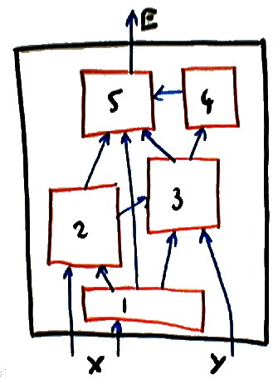
Other topologies
The back-propagation procedure is not limited to feed-forward cascades.
It can be applied to networks of module with any topology, as long as the connection graph is acyclic.
If the graph is acyclic (no loops) then, we can easily find a suitable order in which to call the fprop method of each module.
The bprop methods are called in the reverse order.
if the graph has cycles (loops) we have a so-called recurrent network. This will be studied in a subsequent lecture.

Slide 4
More modules
A rich repertoire of learning machines can be constructed with just a few module types in addition to the linear, sigmoid, and euclidean modules we have already seen.
We will review a few important modules:
The branch/plus module
The switch module
The Softmax module
The logsum module

Slide 5
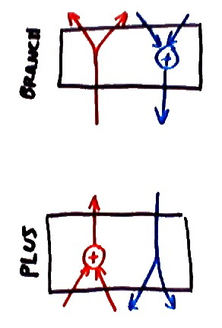
The branch/plus module
The PLUS module: a module with K inputs X₁, . . . , X_{K} (of any type) that computes the sum of its inputs:
back-prop:
The BRANCH module: a module with one input and K outputs X₁, . . . , X_{K} (of any type) that simply copies its input on its outputs:
back-prop:

Slide 6
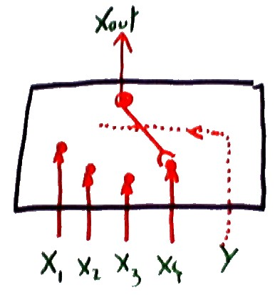
The switch module
A module with K inputs X₁, . . . , X_{K} (of any type) and one additional discrete-valued input Y .
The value of the discrete input determines which of the N inputs is copied to the output.
The gradient with respect to the output is copied to the gradient with respect to the switched-in input. The gradients of all other inputs are zero.

Slide 7
The logsum module
fprop:
bprop:
or
with

Slide 8
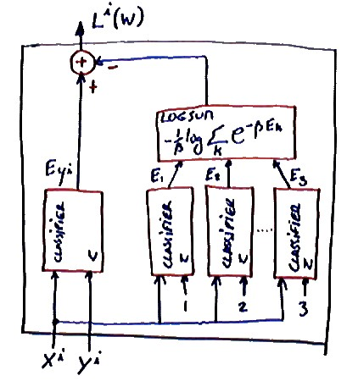
Log-likelihood loss function and logsum modules
A classifier trained with the Log-Likelihood loss can be transformed into an equivalent machine trained with the energy loss.
The transformed machine contains multiple “replicas” of the classifier, one replica for the desired output, and K replicas for each possible value of Y .

Slide 9
Softmax module
A single vector as input, and a “normalized” vector as output:
Exercise: find the bprop

Slide 10
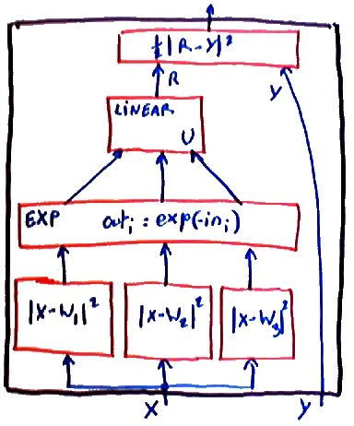
Radial Basis Function Network (RBF Net)
Linearly combined Gaussian bumps.
The centers of the bumps can be initialized with the K-means algorithm (see below), and subsequently adjusted with gradient descent.
This is a good architecture for re- gression and function approxi- mation.

Slide 11
MAP/MLE loss and cross-entropy
Classification (y is scalar and discrete). Let’s denote
MAP/MLE loss function:
This loss can be written as

Slide 12
Cross-entropy and KL-divergence
Let’s denote then
with D_{k}(y^{i}) = 1 iff k = y^{i}, and 0 otherwise.
example1: D = (0, 0, 1, 0) and P (.|X_{i}, W ) = (0.1, 0.1, 0.7, 0.1). with β = 1,
L^{i}(W ) = log(1/0.7) = 0.3567
example2: D = (0, 0, 1, 0) and P (.|X_{i}, W ) = (0, 0, 1, 0). with β = 1,
L^{i}(W ) = log(1/1) = 0

Slide 13
Cross-entropy and KL-divergence
L(W) is proportional to the cross-entropy between the conditional distribution of y given by the machine P (k|X^{i}, W ) and the desired distribution over classes for sample i, D_{k}(y^{i}) (equal to 1 for the desired class, and 0 for the other classes).
The cross-entropy also called Kullback-Leibler divergence between two distributions Q(k) and P (k) is defined as:
It measures a sort of dissimilarity between two distributions.
The KL-divergence is not a distance, because it is not symmetric, and it does not satisfy the triangular inequality.

Slide 14
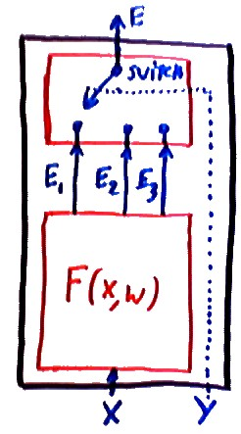
Multiclass classification and KL-divergence
Assume that our discriminant module F (X, W ) produces a vector of energies, with one energy E_{k}(X, W ) for each class.
A switch module selects the smallest E_{k} to perform the classification.
As shown above, the MAP/MLE loss below be seen as a KL-divergence between the desired distribution for y, and the distribution produced by the machine.

Slide 15
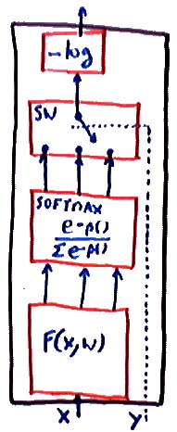
Multiclass classification and softmax
The previous machine: discriminant function with one output per class + switch, with MAP/MLE loss
It is equivalent to the following machine: discriminant function with one output per class + softmax + switch + log loss
with (softmax of the
Machines can be transformed into various equivalent forms to factorize the computation in advantageous ways.

Slide 16
Multiclass classification with a junk category
Sometimes, one of the categories is “none of the above”, how can we handle that?
We add an extra energy wire E₀ for the “junk” category which does not depend on the input. E₀ can be a hand-chosen constant or can be equal to a trainable parameter (let’s call it w₀).
Everything else is the same.

Slide 17
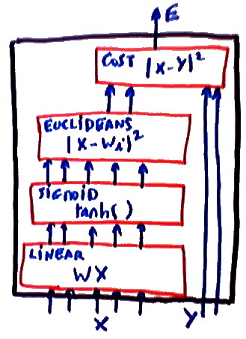
NN-RBF hybrids
Sigmoid units are generally more appropriate for low-level feature extraction.
Euclidean/RBF units are generally more appropriate for final classifications, particularly if there are many classes.
Hybrid architecture for multiclass classification: sigmoids below, RBFs on top + soft-max + log loss.

Slide 18
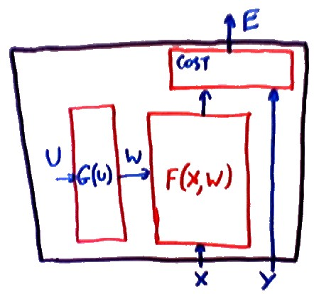
Parameter-space transforms
Reparameterizing the function by transforming the space
Gradient descent in U space:
Equivalent to the following algorithm in W space:
Dimensions:

Slide 19
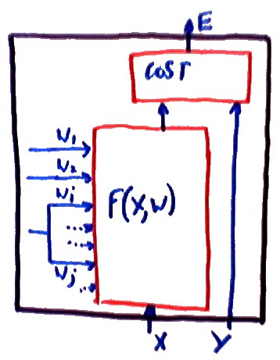
Parameter-space transforms: weight sharing
A single parameter is replicated multiple times in a machine
E(Y, X, w₁, . . . , w_{i}, . . . , w_{j}, . . .) →
E(Y, X, w₁, . . . , u_{k}, . . . , u_{k}, . . .)
Gradient:
w_{i} and w_{j} are tied, or equivalently, u_{k} is shared between two locations.

Slide 20
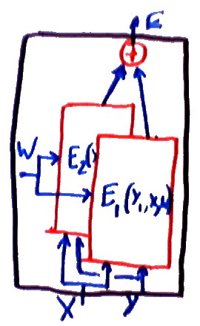
Parameter sharing between replicas
We have seen this before: a parameter controls several replicas of a machine.
E(Y₁, Y₂, X, W ) = E₁(Y₁, X, W )+E₁(Y₂, X, W )
Gradient:
W is shared between two (or more) instances of the machine: just sum up the gradient contributions from each instance.

Slide 21
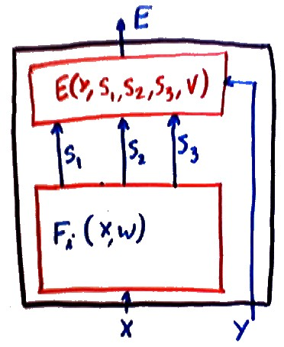
Path summation (path integral)
One variable influences the output through several others
E(Y, X, W ) = E(Y, F₁(X, W ), F₂(X, W ), F₃(X, W ), V )
Gradient:
Gradient:
There is no need to implement these rules explicitly. They come out naturally of the object-oriented implementation.

Slide 22
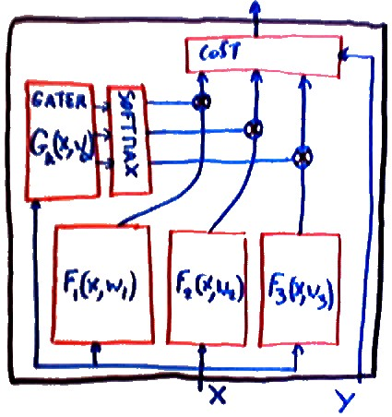
Mixtures of experts
Sometimes, the function to be learned is consistent in restricted domains of the input space, but globally inconsistent. Example: piecewise linearly separable function.
Solution: a machine composed of several “experts” that are specialized on subdomains of the input space.
The output is a weighted combination of the outputs of each expert. The weights are produced by a “gater” network that identifies which subdomain the input vector is in.
The expert weights u_{k} are obtained by softmaxing the outputs of the gater.
Example: the two experts are linear regressors, the gater is a logistic regressor.

Slide 23
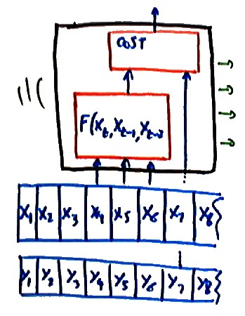
Sequence processing: time-delayed inputs
The input is a sequence of vectors X_{t}.
Simple idea: the machine takes a time window as input
R = F (X_{t}, X_{t−1}, X_{t−2}, W )
Examples of use:
Predict the next sample in a time series (e.g. stock market, water consumption)
Predict the next character or word in a text
Classify an intron/exon transition in a DNA sequence

Slide 24
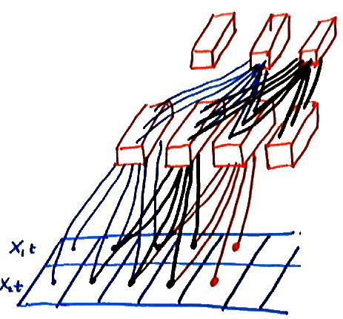
Sequence processing: time-delayed networks
One layer produces a sequence for the next layer: stacked time-delayed layers.
layer1
layer2
cost
Examples:
Predict the next sample in a time series with long-term memory (e.g. stock market, water consumption)
Recognize spoken words
Recognize gestures and handwritten characters on a pen computer.
How do we train?

Slide 25
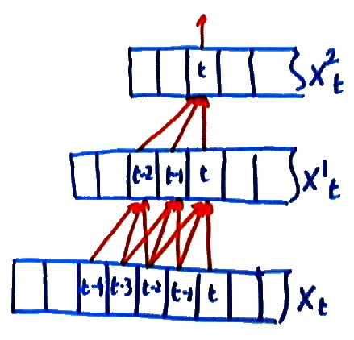
Training a TDNN
Idea: isolate the minimal network that influences the energy at one particular time step t.
In our example, this is influenced by 5 time steps on the input.
Train this network in isolation, taking those 5 time steps as the input.
Surprise: we have three identical replicas of the first layer units that share the same weights.
We know how to deal with that.
Do the regular backprop, and add up the contributions to the gradient from the 3 replicas

Slide 26
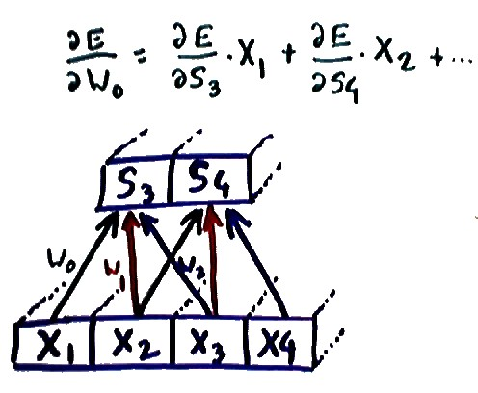
Convolutional module
If the first layer is a set of linear units with sigmoids, we can view it as performing a sort of multiple discrete convolutions of the input sequence.
1D convolution operation:
is a conventional kernel
Sigmoid
Derivative:

Slide 27
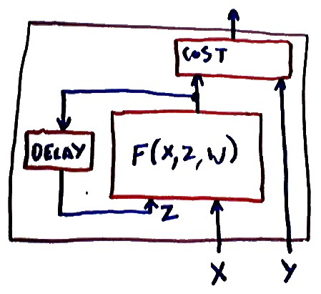
Simple recurrent machines
The output of a machine is fed back to some of its inputs Z. Z_{t+1} = F (X_{t}, Z_{t}, W ), where t is a time index. The input X is not just a vector but a sequence of vectors X_{t}.
This machine is a dynamical system with an internal state Z_{t}.
Hidden Markov Models are a special case of recurrent machines where F is linear.

Slide 28
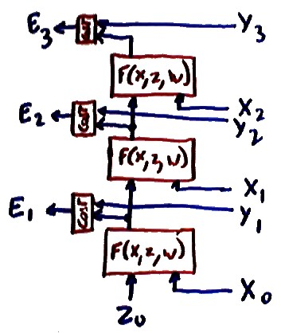
Unfolded recurrent nets and backprop through time
To train a recurrent net: “unfold” it in time and turn it into a feed-forward net with as many layers as there are time steps in the input sequence.
An unfolded recurrent net is a very “deep” machine where all the layers are identical and share the same weights.
This method is called back-propagation through time.
examples of use: process control (steel mill, chemical plant, pollution control....), robot control, dynamical system modelling...

Slide 29
Thank you

