Slide 1
Lecture 6.1 - Recurrent Neural Network Basics

Slide 2

The GPU Teaching Kit is licensed by NVIDIA and New York University under the
Creative Commons Attribution-NonCommercial 4.0 International License.
Deck credit: T. Mikolov

Slide 3
Contents
Introduction
Architecture of simple recurrent nets
Training: Backpropagation through time
Application to language modeling
Research directions
Resources

Slide 4
Introduction
Building models of sequential data is important: automatic speech recognition, machine translation, natural language, …
Recurrent nets (RNN) are a simple and general framework for this type of tasks

Slide 5
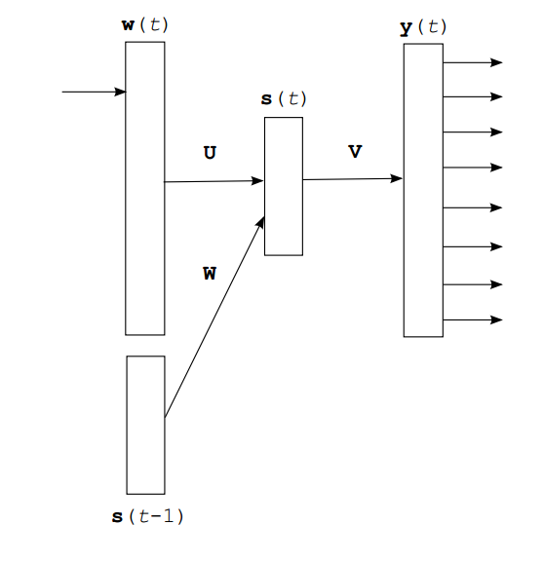
Architecture: simple RNN
Input layer, hidden layer with recurrent connections, and the output layer
In theory, the hidden layer can learn to represent unlimited memory
Also called Elman network (Finding structure in time, Elman 1990)

Slide 6
Architecture: simple RNN
s(t) = f(Uw(t) + Ws(t-1))
y(t) = g(Vs(t))
f() is often sigmoid activation function:
g() is often the softmax function:

Slide 7
Training: Backpropagation through time (BPTT)
How to train the recurrent nets?
The output value does depend on the state of the hidden layer, which depends on all previous states of the hidden layer (and thus, all previous inputs)
Recurrent net can be seen as a (very deep) feedforward net with shared weights

Slide 8
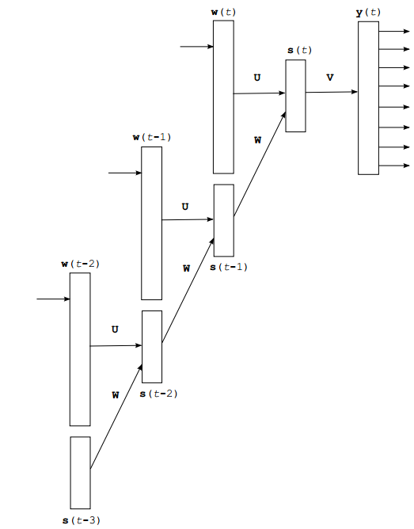
Backpropagation through time
The intuition is that we unfold the RNN in time
We obtain deep neural network with shared weights U and W
Unfolding for several steps is often enough
(called Truncated BPTT)

Slide 9
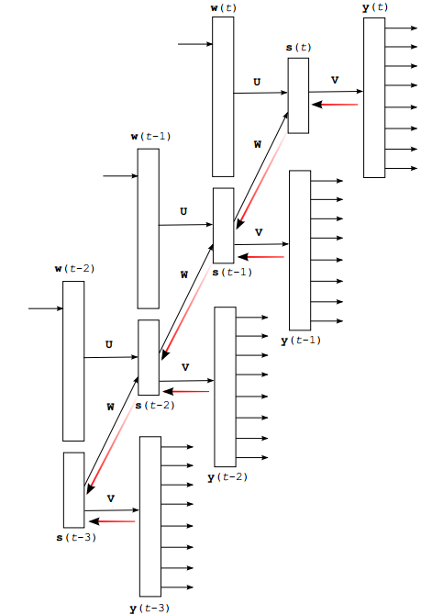
Backpropagation through time
We train the unfolded RNN using normal backpropagation + SGD
In practice, we limit the number of unfolding steps to 5 – 10
It is computationally more efficient to propagate gradients after few training examples (batch training)

Slide 10
Vanishing gradients
As we propagate the gradients back in time, usually their magnitude quickly decreases: this is called “vanishing gradient problem”
In practice this means that learning long term dependencies in data is difficult for simple RNN architecture
Special RNN architectures address this problem:
Exponential trace memory (Jordan 1987, Mozer 1989)
Long Short-term Memory (Hochreiter & Schmidhuber, 1997))
will be described in the second part of this lecture

Slide 11
Exploding gradients
Sometimes, the gradients start to increase exponentially during backpropagation through the recurrent weights
Happens rarely, but the effect can be catastrophic: huge gradients will lead to big change of weights, and thus destroy what has been learned so far
One of the main reasons why RNNs were supposed to be unstable
Simple solution (first published in RNNLM toolkit in 2010): clip or normalize values of the gradients to avoid huge changes of weights

Slide 12
Application of RNNs: Language modeling
Statistical language modeling is one of the oldest and most important NLP tasks
The language models are core of machine translation, speech recognition and many other applications
Historically, it was amazingly difficult to convincingly beat N-grams, especially on larger than tiny datasets

Slide 13
Language modeling: example
A B C A B C A B _
What symbol comes next?
What is its probability?
Yesterday it was Sunday, so today it must be _
How to predict the next word?
What is this good for?

Slide 14
N-grams
Task: compute probability of a sentence W
Often simplified to trigrams:
The probabilities are computed using counting on training data

Slide 15
Language modeling with neural networks
Main deficiency of N-grams is the exponential growth of number of parameters with the length of the context
Neural networks address this problem by performing dimensionality reduction and parameter sharing

Slide 16
Language modeling with neural networks
Neural network language models are today state of the art, often applied to systems participating in competitions (ASR, MT)
There are two main types of neural network architectures for language modeling: feedforward and recurrent

Slide 17
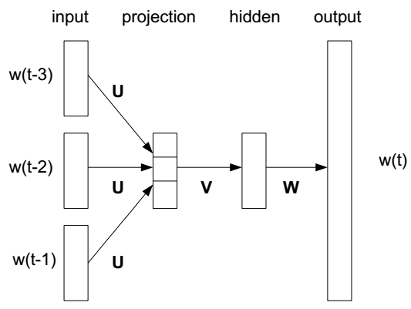
Feedforward neural network LM
Proposed by Bengio et al, 2003
The projection layer is linear
The hidden layer is non-linear
Softmax at the output computes probability distribution over the whole vocabulary
The basic architecture is computationally very expensive

Slide 18
RNN language model
s(t) = f(Uw(t) + Ws(t-1))
y(t) = g(Vs(t))
f() is often sigmoid activation function:
g() is often the softmax function:

Slide 19
Comparison of performance on small data:
Penn Treebank
Small, standard dataset, ~1M words
Perplexity: lower is better (exp of average entropy per symbol)
RNN outperforms FNN by about 10%
Model | Perplexity
Kneser-Ney 5-gram | 141
Maxent 5-gram | 142
Random forest | 132
Feedforward NNLM | 140
Recurrent NNLM | 125

Slide 20
Scaling up to large datasets
While neural network LMs have been around for a while, their computational complexity complicated their use in real-world systems
Main computational bottlenecks:
Computation of probability distribution in the output layer
Dense matrix multiplication (FNN: projection -> hidden layer, RNN: recurrent matrix)
Further, one can train RNNs on GPUs

Slide 21
Softmax
Softmax at the output layer computes probability distribution over the whole vocabulary:
Sums to 1, all output values are non-negative

Slide 22
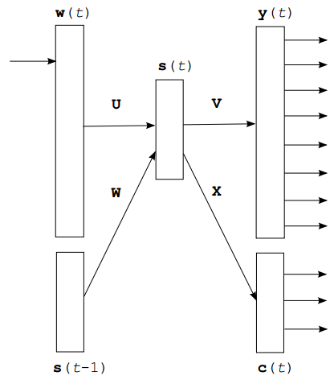
Scaling up: class based softmax
Instead of normalizing probability over all words, we:
Assign each word to a single class
Normalize over the class layer
Normalize over words from within the current class
Reduces complexity from |V| to about
sqrt(|V|)

Slide 23
How to assign words to classes?
Frequency binning:
Simple, computationally efficient
Slightly degrades accuracy
Brown classes:
good accuracy
has to be pre-computed, less efficient
Other clustering techniques work too (for example K-means on pre-trained word vectors, or combination of frequency + Brown).

Slide 24
Joint training of RNN with Maxent model
Logistic regression and neural networks are closely related
Maximum entropy model is how logistic regression is called in NLP
Logistic regression: fast, scales to very large datasets
Neural networks: more compact and robust, generalize better
Why not combine both?

Slide 25
Joint training of RNN with Maxent model
Just another matrix of weights in the RNN
This corresponds to RNN with bigram ME:
We can use n-gram features for ME
Strategies for training large scale neural network language models (Mikolov et al, 2011)
ME

Slide 26
Joint training of RNN with Maxent model
Joint training allows:
To use the fast, big sparse model (direct weights between inputs and outputs)
The slow, dense part (hidden layer) can be much smaller

Slide 27
Joint training of RNN with Maxent model
Why not train models separately and combine their predictions?
If neural network is trained jointly with the maxent model, it can learn just the complementary information.
By using the direct connections, we can reduce the hidden layer size greatly and still achieve good performance.

Slide 28
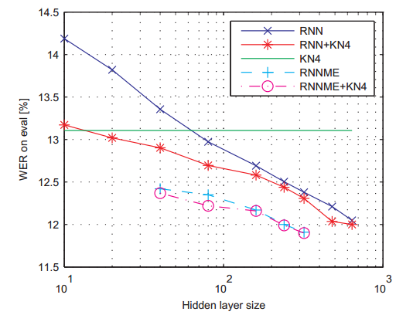
IBM RT04 speech recognition system
Model | WER(%)
KN4 (baseline) | 13.11
model M | 12.49
3xRNN | 11.70
Strong ASR system from IBM, “model M“ was the previous state-of-art LM
Bigger models = better results, RNNME works the best

Slide 29
Multi-threaded training of RNNME
Another speedup ~10x, scales training to billions of words
One Billion Word Benchmark for Measuring Progress in Statistical Language Modeling (Chelba et al, 2014)
Model | Training time |  | Perplexity
 | Hours | CPUs
Interpolated KN 5-gram, 1.1B n-grams (KN) | 3 | 100 | 67.6
Recurrent NN-256 + MaxEnt 9=gram | 60 | 24 | 58.3
Recurrent NN-512 + MaxEnt 9=gram | 120 | 24 | 54.5
Recurrent NN-1024 + MaxEnt 9=gram | 240 | 24 | 51.3

Slide 30
GPU training of RNNLM
Allows to use even larger models:
Scaling Recurrent Neural Network Language Models (Williams et al, 2015)
Model | # Params (millions) | Training time | Perplexity
KN 5-gram | 1,740 | 30m | 66.9
RNN-128 | 16.4 | 6h | 60.8
RNN-256 | 32.8 | 16h | 57.3
RNN-512 | 65.8 | 1d2h | 53.2
RNN-1024 | 132 | 2d2h | 48.9
RNN-2048 | 266 | 4d7h | 45.2
RNN-4096 | 541 | 14d5h | 42.4

Slide 31
Language modeling summary
RNN outperforms FNN on language modeling tasks, both are better than n-grams
The question “are neural nets better than n-grams” is incomplete: the best solution is to use both
Joint training of RNN and maxent with n-gram features works great on large datasets

Slide 32
Extensions of RNNLM and application to MT
RNN conditioned on extra features
Simple solution to deal with the vanishing gradients
Recent applications in MT

Slide 33
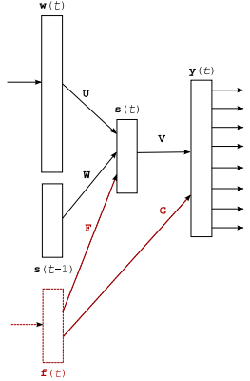
Recurrent neural network with additional
features
We can use extra features (POS, external information, long context information, …) represented as additional inputs
Context dependent recurrent neural network language model (Mikolov & Zweig, 2012)

Slide 34
Recurrent neural network with slow features
We can define the extra features f(t) as exponentially decaying sum of word vectors w(t):
This will give the model longer term memory
Performance in language modeling similar to Long Short-Term Memory (LSTM) RNN – about 10% reduction of perplexity over simple RNN
LSTM-based LM will be described in the second talk today

Slide 35
Recurrent neural network with slow features
2 hidden layers
One usual, fully connected
The other constrained (diagonal)
The values in diagonal can be fixed (close to 1)
Learns longer term patterns

Slide 36
Application to machine translation
Machine translation: input is a sequence of words in one language, output is the translated sentence in another language
Example: Google Translate

Slide 37
Application to machine translation
Straightforward: N-best list rescoring with NNLMs on top of existing system
Search space in MT is huge, integration into decoding is a better idea
Decoding with Large-Scale Neural Language Models Improves Translation (Vaswani et al, 2013)
Setting | Dev | 2004 | 2005 | 2006
Baseline | 38.2 | 38.4 | 37.7 | 34.3
Reranking | 38.5 | 38.6 | 37.8 | 34.7
Decoding | 39.1 | 39.5 | 38.8 | 34.9

Slide 38
Application to machine translation
Instead of conditioning the prediction of word just on the previous words within target sentence, we can use also the source sentence words
We can use whole source sentence representation as additional input features
Modeling both translation and language model probability with NNLMs: Joint Language and Translation Modeling with Recurrent Neural Networks (Auli et al, 2013)

Slide 39
Application to machine translation
BOLT test
 | Ar-En
 | BLEU | Gain
“Simple Hier.” baseline | 33.8 | -
Standard NNJM | 40.2 | +6.4
Self-Norm NNJM | 40.1 | +6.3
Pre-Computed NNJM | 39.9 | +6.1
Decoding with Joint NN models; BLEU metric = higher is better
Additional inputs represent words in the source sentence around position that is currently decoded
Fast and Robust Neural Network Joint Models for Statistical Machine Translation (Devlin et al, 2014)

Slide 40
Summary: Neural net language models
NNLMs are currently the state-of-the-art in language modeling
Considerable improvements in ASR, MT
Significant ongoing efforts to scale training to very large datasets

Slide 41
Summary: Neural net language models
Much of the recent success is based on basic principles: big data, big models, algorithmic efficiency, neural nets from the 80’s
Neural network models incrementally extend existing paradigms: there is no single (important) task that RNNs can do that other models completely fail at
So far there is no big success story of deep learning in NLP: maybe we will have to do something novel to make it work?

Slide 42
Promising future research directions
We should pick challenging problems that are really important by themselves
Examples:
Language understanding by machines
What computational models can represent human languages
Learning language from increasingly complex examples, and through communication

Slide 43
Future of AI research
Language understanding:
Should aim to allow machines do what people can do
Learn language through communication: intelligence is not about knowing answers to everything, but about ability to learn new concepts quickly
We need to revisit basic concepts in machine learning / NLP. Instead of doing just big data statistics, we need to develop new paradigms.
Towards AI-Complete Question Answering: A Set of Prerequisite Toy Tasks (Weston et al, 2015)

Slide 44
Resources
RNNLM toolkit
Links to large text corpora
Benchmark datasets for advancing the state of the art

Slide 45
RNNLM toolkit
Available at rnnlm.org
Allows training of RNN and RNNME language models
Extensions are actively developed, for example multi-threaded version with hierarchical softmax: http://svn.code.sf.net/p/kaldi/code/trunk/tools/rnnlm-hs-0.1b/

Slide 46
CSLM: Feedforward NNLM code
Continuous Space Language Model toolkit: http://www-lium.univ-lemans.fr/cslm/
Implementation of feedforward neural network language model by Holger Schwenk

Slide 47
Other neural net SW
List available at http://deeplearning.net/software_links/
Mostly focuses on general machine learning tools

Slide 48
Large text corpora
Short list available at the word2vec project: https://code.google.com/p/word2vec/#Where_to_obtain_the_training_data
Sources: Wikipedia dump, statmt.org, UMBC webbase corpus
Altogether around 8 billion words can be downloaded for free

Slide 49
Benchmark datasets for language modeling
The Penn Treebank setup including the usual text normalization is part of the example archive at rnnlm.org
WSJ setup (simple ASR experiments, includes N-best list rescoring): http://www.fit.vutbr.cz/~imikolov/rnnlm/kaldi-wsj.tgz

Slide 50
Thank you

