Slide 1
Lecture 6.2 - Advanced Recurrent Neural Networks

Slide 2

The GPU Teaching Kit is licensed by NVIDIA and New York University under the
Creative Commons Attribution-NonCommercial 4.0 International License.
Deck credit: S. Chopra
Y. LeCun
MA Ranzato

Slide 3
Recap
Standard RNNs
Training: Backpropagation Through Time (BPTT) Application to sequence modeling
Language modeling
Applications: Automatic speech recognition, Machine translation
Main problems in training

Slide 4
Major shortcomings
Handling of complex non-linear interactions
Difficulties using BPTT to capture long-term dependencies exploding gradients
Vanishing gradients

Slide 5
Handling non-linear interactions

Slide 6
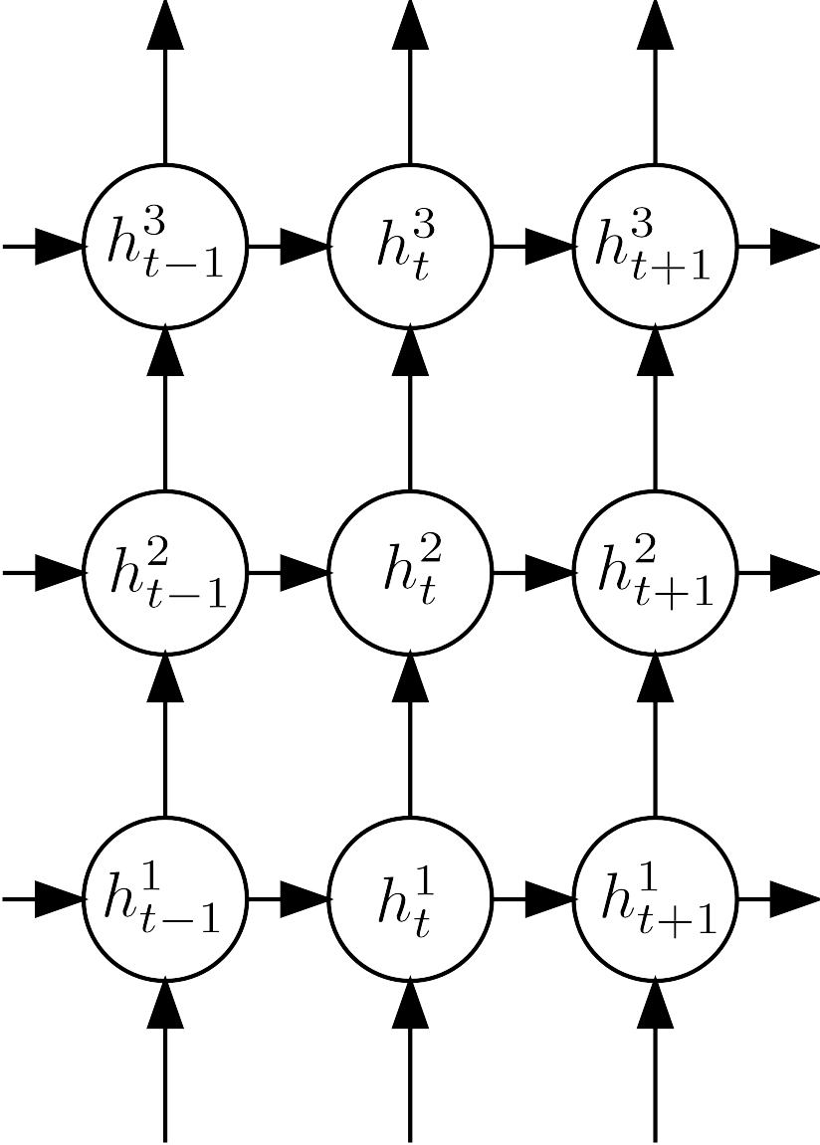
Handling non-linear interactions
Have depth not only in temporal dimension
But also in space (at each time step)
Empirically shown to provide significant improvement in tasks like ASR, un-supervised training using videos

Slide 7
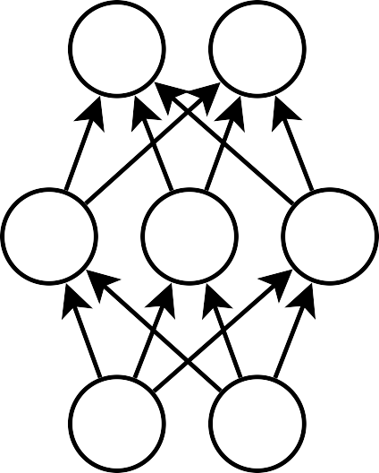
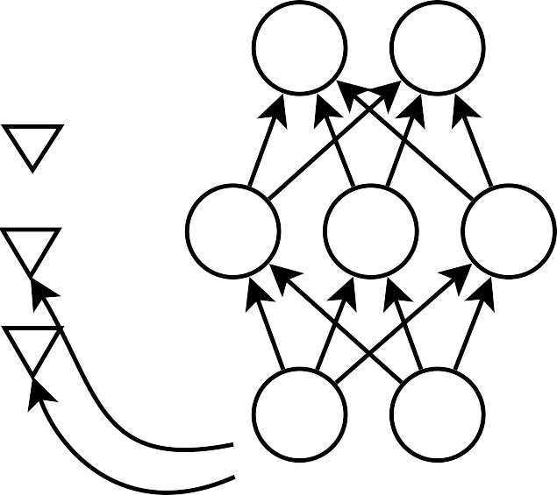
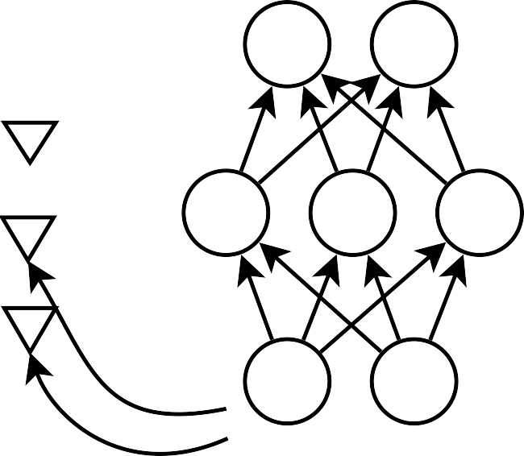
Handling non-linear interactions
Gated RNNs
Shown to work on character based language modeling
Sutskever et.al., 2011:Generating Test with Recurrent Networks

Slide 8
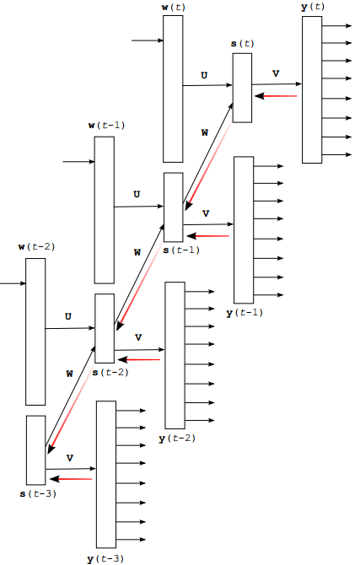
Training: Exploding gradients
Gradient clipping during BPTT

Slide 9



Training: Exploding gradients
Gradient clipping during BPTT

Slide 10
Training: Vanishing gradients
Multiple schools of thought
better initialization of the recurrent matrix and using momentum during training
Sutskever et.al.,: On The Importance of Initialization and Momentum in Deep Learning
modifying the architecture

Slide 11




Structurally constrained RNNs
y_{t}
U
R
h_{t}
A
x_{t}
Mikolov et.al., 2015: Learning Longer Memory in Recurrent Neural Networks

Slide 12




Structurally constrained RNNs
y_{t}
y_{t}
U
V
U
R
h_{t}
R
h_{t}
P
s_{t}
A
x_{t}
A
B
x_{t}

Slide 13
Structurally constrained RNNs
Language modeling on penntree bank corpus
Model | #hidden | #context
Ngram | - | -
Ngram + cache | - | -
SRN | 50 | -
SRN | 100 | -
SRN | 300 | -
Test perplexity
141
125
144
129
129
SCRN | 100 | 40
SCRN | 300 | 40
115
115

Slide 14
Structurally constrained RNNS
Language modeling on text8 corpus
Model | #hidden | #context
SCRN | 100 | 245
SCRN | 300 | 202
SCRN | 500 | 184
Context = 40 | Context = 80
189 | 184
165 | 164
162 | 161

Slide 15
Long Short-Term Memory (LSTM)
Recently gained a lot of popularity
Have explicit memory “cells” to store short-term activations the presence of additional gates partly alleviates the vanishing gradient problem
Multi-layer versions shown to work quite well on tasks which have “medium term” dependencies
Hochreiter et.al.,1997: Long Short-Term Memory

Slide 16
Long Short-Term Memory (LSTM)
y_{t}
U
R
h_{t}
A
x_{t}
Hochreiter et.al.,1997: Long Short-Term Memory

Slide 17



Long Short-Term Memory (LSTM)
h_{t} = c_{t} · o_{t}
o_{t}
x_{t}
y_{t}
U
h_{t}
1
1.0
Cell
c_{t} = c_{t-1} + g_{t} · i_{t}
R
h_{t}
A
x_{t}
i_{t}
x_{t}
g_{t}
h_{t}
1
h_{t}
x_{t}
1
Hochreiter et.al.,1997: Long Short-Term Memory

Slide 18
Long Short-Term Memory (LSTM)
h_{t} = c_{t} · o_{t}
o_{t}
x_{t}
h_{t}
1
f_{t}
c_{t} = f_{t} · c_{t-1} + g_{t} · i_{t}
x_{t}
Cell
h_{t}
1
i_{t}
x_{t}
g_{t}
h_{t}
1
h_{t}
x_{t}
1
Hochreiter et.al.,1997: Long Short-Term Memory

Slide 19
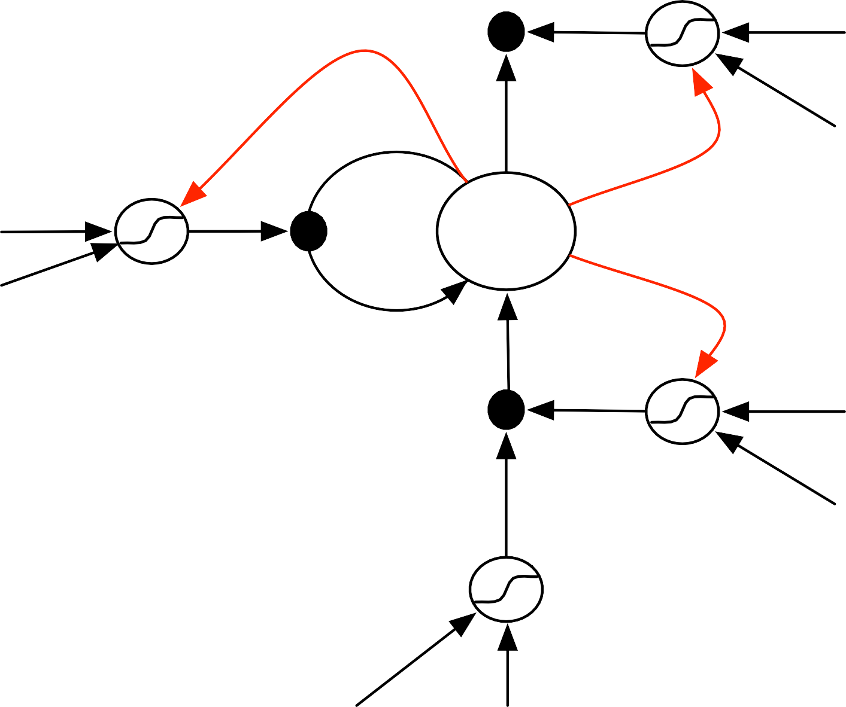
Long Short-Term Memory (LSTM)
h_{t} = c_{t} · o_{t}
o_{t}
x_{t}
h_{t}
1
f_{t}
c_{t} = f_{t} · c_{t-1} + g_{t} · i_{t}
x_{t}
1
Cell
h_{t}
i_{t}
x_{t}
h_{t}
g_{t}
1
Peep-hole connections
h_{t}
x_{t}
1
Hochreiter et.al.,1997: Long Short-Term Memory

Slide 20
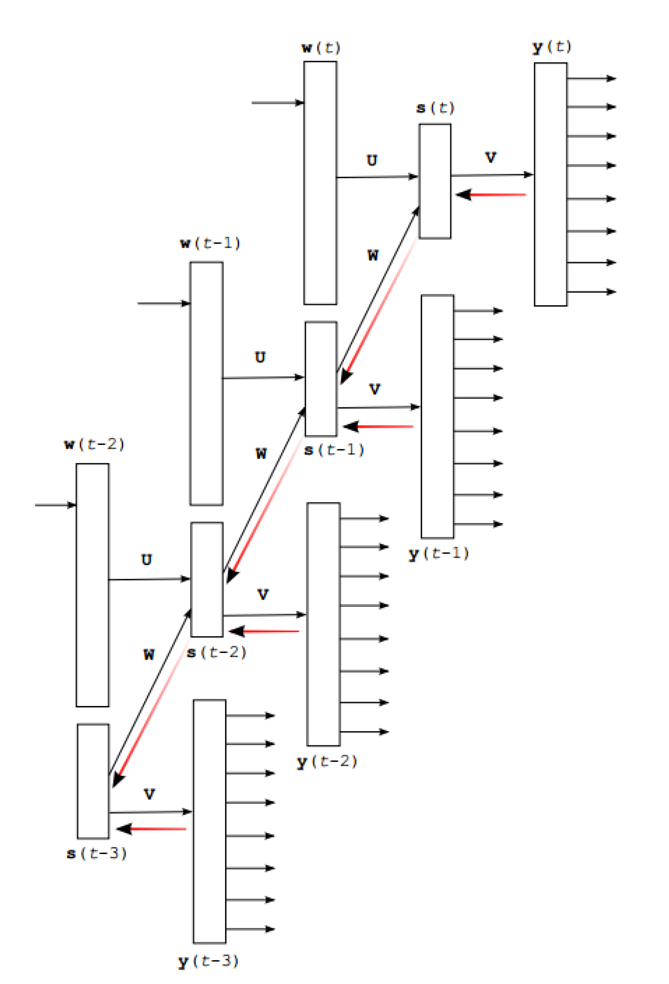
LSTM training
Backpropagation through time: BPTT

Slide 21

Deep LSTMs
…
…
…
…

Slide 22
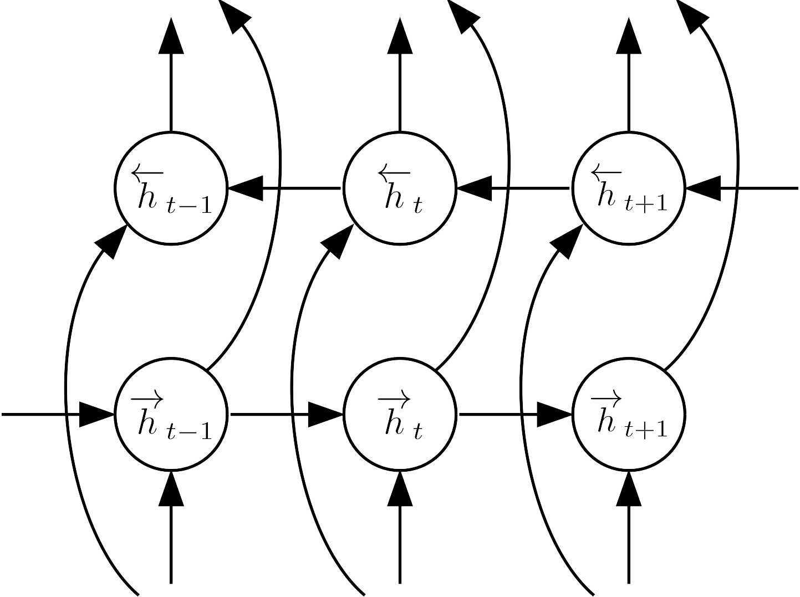


Bi-directional LSTMs

Slide 23
Applications of LSTMs

Slide 24


Automatic speech recognition
Use bi-directional LSTMs to represent the audio sequence
Plug a classifier on top of the representation to directly predict phone classes
Graves et. al., 2014: Speech Recognition with Deep Recurrent Neural Networks

Slide 25
Automatic speech recognition
Table 1. TIMIT Phoneme Recognition Results. ‘Epochs’ is the number of passes through the training set before convergence. ‘PER’ is the phoneme error rate on the core test set.
Network | Weights | Epochs | PER
Ctc-3l-500h-tanh | 3.7m | 107 | 37.6%
Ctc-1l-250h | 0.8m | 82 | 23.9%
Ctc-1l-622h | 3.8m | 87 | 23.0%
Ctc-2l-250h | 2.3m | 55 | 21.0%
Ctc-3l-421h-uni | 3.8m | 115 | 19.6%
Ctc-3l-250h | 3.8m | 124 | 18.6%
Ctc-5l-250h | 6.8m | 150 | 18.4%
Trans-3l-250h | 4.3m | 112 | 18.3%
Pretrans-3l-250h | 4.3m | 144 | 17.7%
Graves et. al., 2014: Speech Recognition with Deep Recurrent Neural Networks

Slide 26
Sequence to sequence learning
A B C → W X Y Z
Machine translation
Short text response generation sentence summarization
Sutskever at. al., 2014: Sequence to Sequence Learning with Neural Network

Slide 27
Sequence to sequence learning
Method | test BLEU score (ntst14)
Bahdanau et al. [2] | 28.45
Baseline System [29] | 33.30
Single forward LSTM, beam size 12 | 26.17
Single reversed LSTM, beam size 12 | 30.59
Ensemble of 5 reversed LSTMs, beam size 1 | 33.00
Ensemble of 2 reversed LSTMs, beam size 12 | 33.27
Ensemble of 5 reversed LSTMs, beam size 2 | 34.50
Ensemble of 5 reversed LSTMs, beam size 12 | 34.81
State-of-the-art WMT’14 result: 37.0
Sutskever at. al., 2014: Sequence to Sequence Learning with Neural Network

Slide 28
Unsupervised training on video
Auto-encoder model
Learned Representation
vˆ₃
vˆ₂
vˆ₁
W₁
W₁
copy
W₂
W₂
v₁
v₂
v₃
v₃
v₂
Srivastav et. al., 2014: Unsupervised Learning of Video Representation using LSTMs

Slide 29
Unsupervised training on video
Future frame predictor model
Learned Representation
vˆ₄
vˆ₅
vˆ₆
W₁
W₁
copy
W₂
W₂
v₁
v₂
v₃
v₄
v₅
Srivastav et. al., 2014: Unsupervised Learning of Video Representation using LSTMs

Slide 30
Unsupervised training on video
Composite model
Input Reconstruction
vˆ₃
vˆ₂
vˆ₁
W₂
W₂
Learned Representation
copy
v₃
v₂
W₁
W₁
copy
vˆ₄
vˆ₅
vˆ₆
v₁
v₂
v₃
W₃
W₃
Sequence of Input Frames
Future Prediction
v₄
v₅
Srivastav et. al., 2014: Unsupervised Learning of Video Representation using LSTMs

Slide 31
Gated recurrent units
z
h
~
h
IN
r
OUT
_{z}j
Update gate:
Reset gate:
Candidate activation:
j
t
= a- (W_{z} x_{t} + U_{z} h_{t-1}) .
_{r}j
j
t
= J (W_{r} x_{t} + U_{r} h_{t-1}) .
˜
j t
h
= tanh (W x
t
+ U (r 8 h ₁))^{j} ,
t
t
_{h}j
j j
t-1
˜
= (1 - z )h
+ z h
j j
,
t
t
t t

Slide 32
Implementation
Torch code available (soon!)
Standard RNN
LSTMs SCRNN
and other models..
GPU compatible

Slide 33
Open problems
Encoding long-term memory into RNNs
Speed-up the RNN training
Control problems
Language understanding

Slide 34
Thank you

