Slide 1
Lecture 6.4 - Embedding Methods for NLP
Part 2: Embeddings for Multi-relational Data

Slide 2

The GPU Teaching Kit is licensed by NVIDIA and New York University under the
Creative Commons Attribution-NonCommercial 4.0 International License.
Deck credit: A.Bordes

Slide 3
Menu – Part 2
Embeddings for multi-relational data
Multi-relational data
Link Prediction in KBs
Embeddings for information extraction
Question Answering
Pros and cons of embedding models
Future of embedding models
Resources

Slide 4
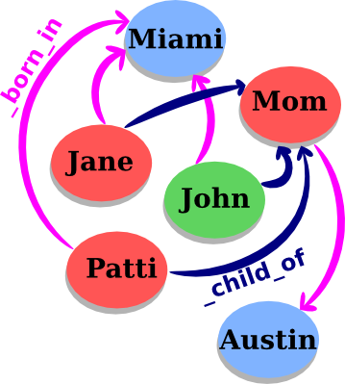
Multi-relational data
Data is structured as a graph
Each node = an entity
Each edge = a relation/fact
A relation = (sub, rel, obj):
sub =subject,
rel = relation type,
obj = object.
Nodes w/o features.
In this talk, we focus on Knowledge Bases (KBs).

Slide 5
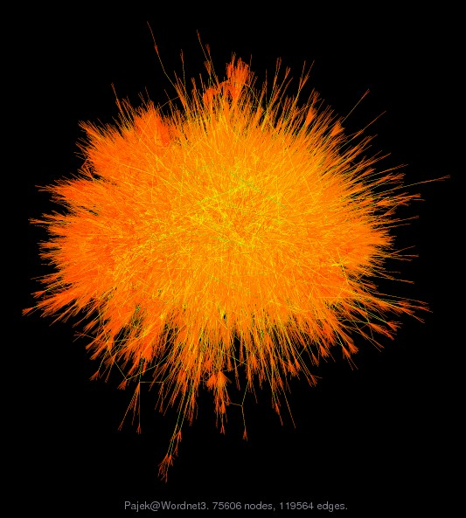
Example of KB: WordNet
WordNet: dictionary where each entity is a sense (synset).
Popular in NLP.
Statistics:
117k entities;
20 relation types;
500k facts.
Examples:
(car_NN_1, _has_part, _wheel_NN_1) (score_NN_1, _is_a, _rating_NN_1) (score_NN_2, _is_a, _sheet_music_NN_1)

Slide 6

Example of KB: Freebase
Freebase: huge collaborative (hence noisy) KB.
Part of the Google Knowledge Graph.
Statistics:
80M of entities;
20k relation types;
1.2B facts.
Examples:
(Barack Obama, place of birth, Hawaii)
(Albert Einstein, follows diet, Veganism)
(San Francisco, contains, Telegraph Hill)

Slide 7
Modeling Knowledge Bases
Why KBs?
KBs: Semantic search, connect people and things
KBs ← Text: Information extraction
KBs → Text: Text interpretation, summary, Q&A
Main issue: KBs are hard to manipulate
Large dimensions: 105/108 entities, 104/106 rel. types
Sparse: few valid links
Noisy/incomplete: missing/wrong relations/entities
How?
Encode KBs into low-dimensional vector spaces
Use these representations:
to complete/visualize KBs
as KB data in text applications

Slide 8
Menu – Part 2
Embeddings for multi-relational data
Multi-relational data
Link Prediction in KBs
Embeddings for information extraction
Question Answering
Pros and cons of embedding models
Future of embedding models
Resources

Slide 9
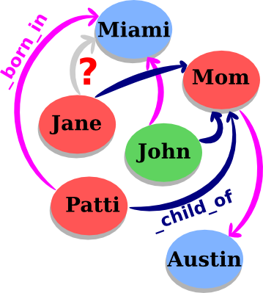
Link prediction
Add new facts without requiring extra knowledge
From known information, assess the validity of an unknown fact

Slide 10
Link prediction
Add new facts without requiring extra knowledge
From known information, assess the validity of an unknown fact
→ collective classification
→ reasoning in embedding spaces

Slide 11
Statistical relational learning
Framework:
n_{s} subjects {subi}_{i∈[1;ns]}
n_{r} relation types {relk}_{k∈[1;nr]}
n_{o} objects {objj}_{j∈[1;no]}
→ For us, n_{s} = n_{o} = n_{e} and ∀i∈ [1;n_{e}], subi = obji.
A fact exists for (sub_{i}, rel_{k}, obj_{j} ) if rel_{k} (sub_{i}, obj_{j} )= 1
Goal: We want to model, from data,
P[rel_{k} (sub_{i}, obj_{j} ) = 1]
(eq. to approximate the binary tensor X ∈ {0,1}^{ns ×no ×nr})

Slide 12
Previous work
Embeddings for multi-relational data
Tensor factorization (Harshman et al., ’94)
Probabilistic Relational Learning (Friedman et al., ’99)
Relational Markov Networks (Taskar et al., ’02)
Markov-logic Networks (Kok et al., ’07)
Extension of SBMs (Kemp et al., ’06) (Sutskever et al., ’10)
Spectral clustering (undirected graphs) (Dong et al., ’12)
Ranking of random walks (Lao et al., ’11)
Collective matrix factorization (Nickel et al., ’11)
Embedding models (Bordes et al., ’11, ’13) (Jenatton et al., ’12) (Socher et al., ’13) (Wang et al., ’14) (Garc´ıa-Dur´an et al., ’14)

Slide 13
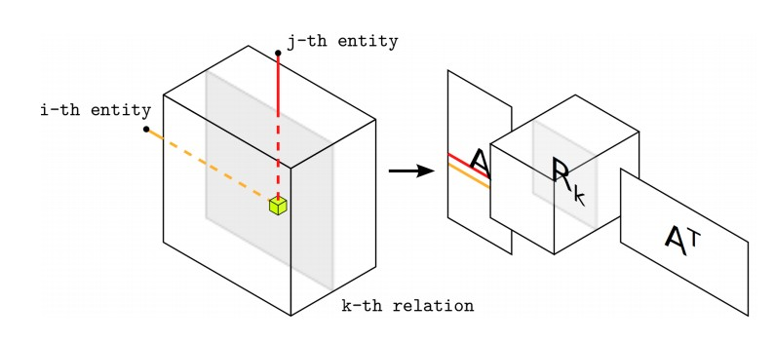
Collective matrix factorization (Nickel et al., ’11)
RESCAL:
(close from DEDICOM (Harshman, ’78)).
A & R learned by reconstruction (alternating least-squares):

Slide 14
Scalability
Embeddings for multi-relational data
RESCAL involves many parameters.
Bad scalability w.r.t. n_{r} .
Reconstruction criterion does not ﬁt well for binary data..

Slide 15
Embedding models
Two main ideas:
Models based on low-dimensional continuous vector embeddings for entities and relation types, directly trained to define a similarity criterion.
Stochastic training based on ranking loss with sub-sampling of unknown relations.

Slide 16
Embedding models for KBs
Subjects and objects are represented by vectors in
Rel. types = similarity operators between subj/obj
Learning similarities depending on rel → d (sub, rel , obj ), parameterized by s, R and o.

Slide 17
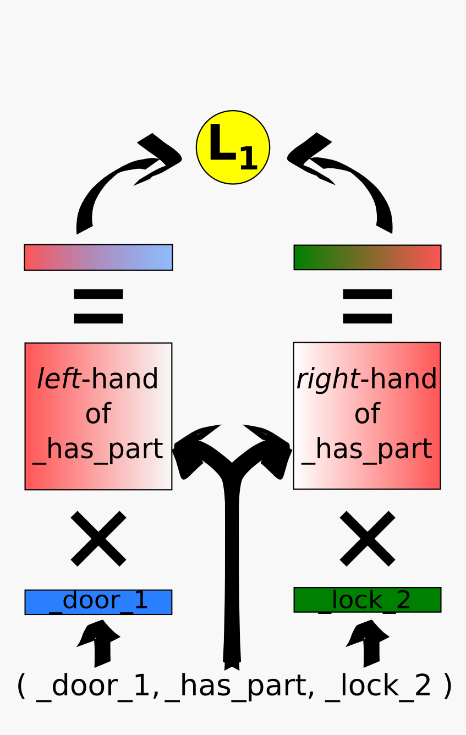
Structured embeddings (Bordes et al., ’11)
Intuition: sub and obj are projected using rel
in a space where they are similar
d (sub, rel , obj ) = −||R^{left} s^{T} − R^{right} o^{T}||₁
Entities: s and o ∈ R^{d}
Projection: R^{left} and R^{right} ∈ R^{d×d}
R^{left} /= R^{right} because of asymmetry
Similarity: L1 distance

Slide 18
Stochastic training
Learning by stochastic gradient descent: one training fact after the other
For each relation from the training set:
sub-sample unobserved facts (false?)
check if the similarity of the true fact is lower
if not, update parameters of the considered facts
Stopping criterion: performance on a validation set

Slide 19
Scalability
Freebase15k: n_{e} = 15k , n_{r} = 1.3k .
SE also involves many parameters.
Bad scalability w.r.t. n_{r} .
Potential training problems for SE (overfitting).

Slide 20
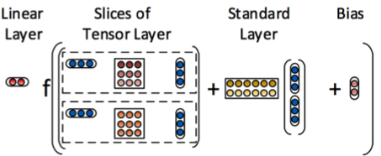
Neural tensor networks (Socher et al., ’13)
In NTN, a relationship is represented by a tensor, 2 matrices and 2 vectors + a non-linearity (tanh).
Neural Tensor layer:
Very powerful model with high capacity for each relation.

Slide 21
Scalability
Embeddings for multi-relational data
Freebase15k: n_{e} = 15k , n_{r} = 1.3k .
Very high modeling capacity.
Involves many parameters.
Bad scalability w.r.t. n_{r} (overfitting if few triples).

Slide 22
Modeling relations as translations (Bordes et al. ’13)
Intuition: we want s + r ≈ o.

Slide 23
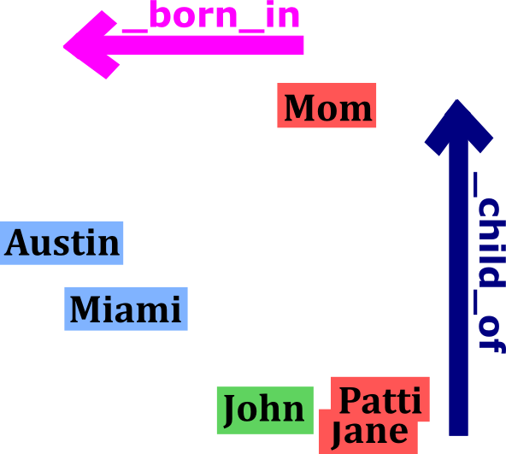
Modeling relations as translations (NIPS13)
Intuition: we would like that s + r ≈ o.

Slide 24
Modeling relations as translations (Bordes et al. ’13)
Intuition: we want s + r ≈ o.
The similarity measure is defined as:
d (sub, rel , obj ) = ||s + r − o||₂
s,r and o are learned to verify that.

Slide 25
Learning TransE
Embeddings for multi-relational data
For training, a margin ranking criterion is minimized:
where [x ]₊ is the positive part of x , γ > 0 is a margin, and:

Slide 26
Learning TransE
Embeddings for multi-relational data

Slide 27
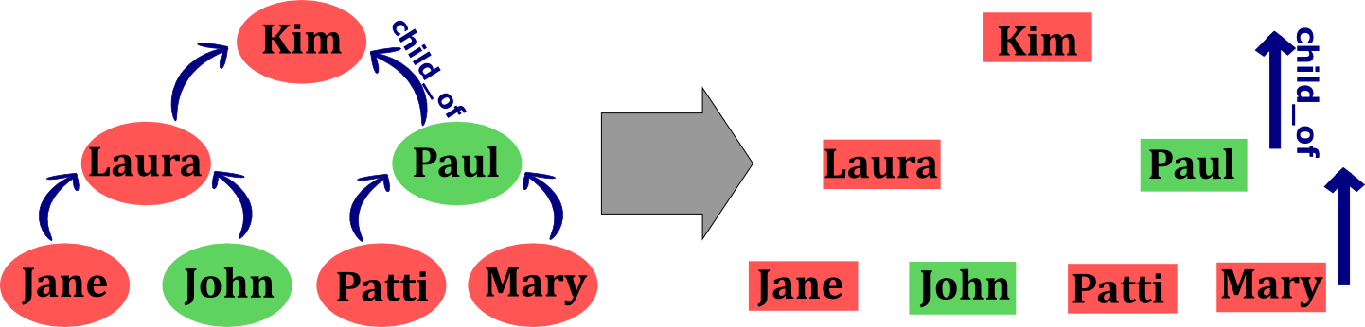
Motivations of a translation-based model
Natural representation for hierarchical relationships.
Recent work on word embeddings (Mikolov et al., ’13): there may exist embedding spaces in which relationships among concepts are represented by translations.

Slide 28
Scalability
Embeddings for multi-relational data
Freebase15k: n_{e} = 15k , n_{r} = 1.3k .
TransE is a special case of SE and NTN.
TransE obtains better training errors: less overfitting. Much better scalability.

Slide 29
Chunks of freebase
Data statistics:
Training times for TransE:
Embedding dimension: 50.
Training time:
on Freebase15k: ≈2h (on 1 core),
on Freebase1M: ≈1d (on 16 cores).

Slide 30
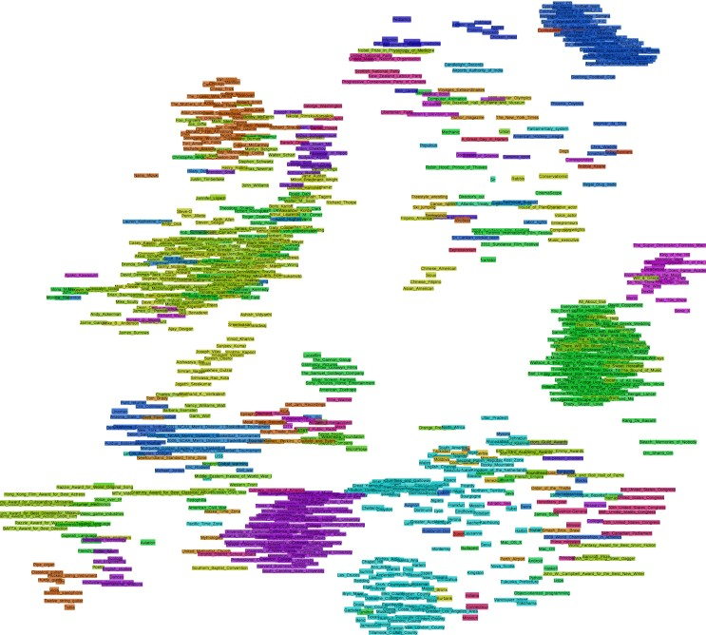
Visualization of 1,000 entities

Slide 31
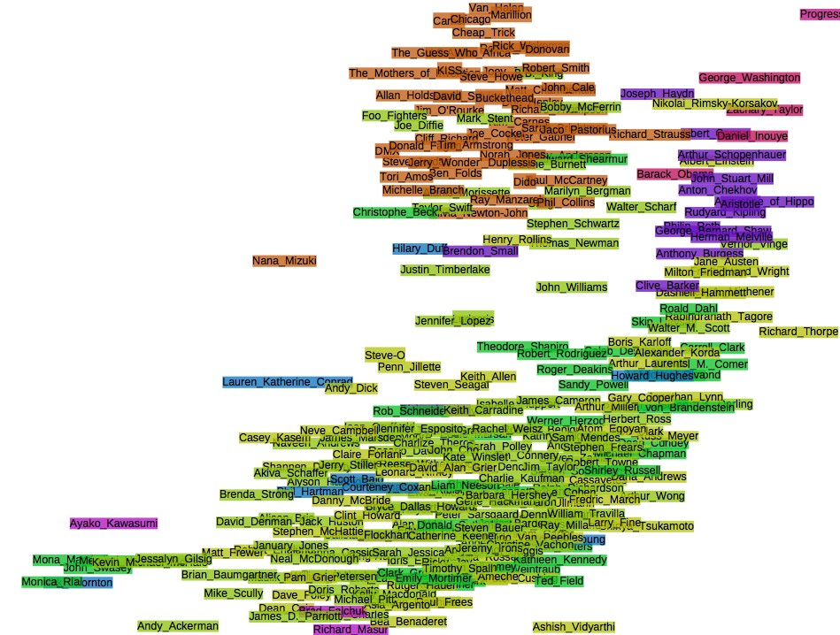
Visualization of 1,000 entities – Zoom 1

Slide 32
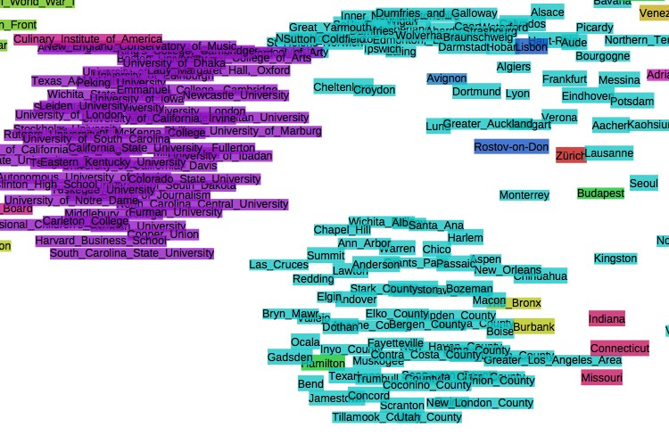
Visualization of 1,000 entities – Zoom 2

Slide 33
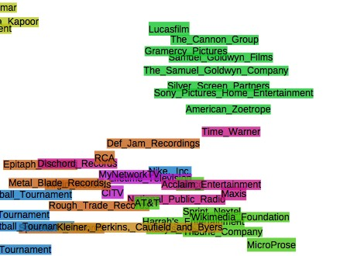
Visualization of 1,000 entities – Zoom 3

Slide 34

Example
Embeddings for multi-relational data
“Who influenced J.K. Rowling?”
J. K. Rowling _influenced_by ?

Slide 35
Example
Embeddings for multi-relational data
“Who influenced J.K. Rowling?”
J. K. Rowling _influenced_by ?
G. K. Chesterton
J. R. R. Tolkien
C. S. Lewis
Lloyd Alexander
Terry Pratchett
Roald Dahl
Jorge Luis Borges Stephen King
Ian Fleming

Slide 36

Example
Embeddings for multi-relational data
“Which genre is the movie WALL-E?”
WALL-E _has_genre?

Slide 37
Example
Embeddings for multi-relational data
“Which genre is the movie WALL-E?”
WALL-E _has_genre?
Animation
Computer animation Comedy film
Adventure film
Science Fiction
Fantasy
Stop motion
Satire
Drama

Slide 38
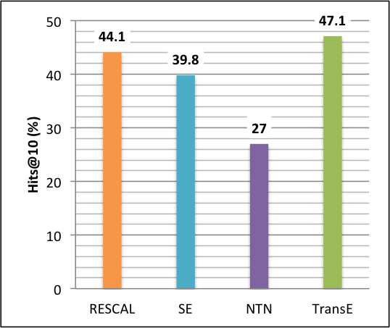
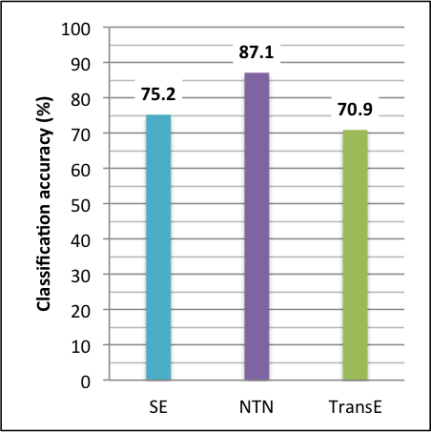
Benchmarking
Embeddings for multi-relational data
Ranking on FB15k
Classification on FB13
On FB1M, TransE predicts 34% in the Top-10 (SE only 17.5%).
Results extracted from (Bordes et al., ’13) and (Wang et al., ’14)

Slide 39
Refining TransE
TATEC (Garc´ıa-Duran´ et al., ’14) supplements TransE with a trigram term for encoding complex relationships:
TransH (Wang et al., ’14) adds an orthogonal projection to the translation of TransE:

Slide 40
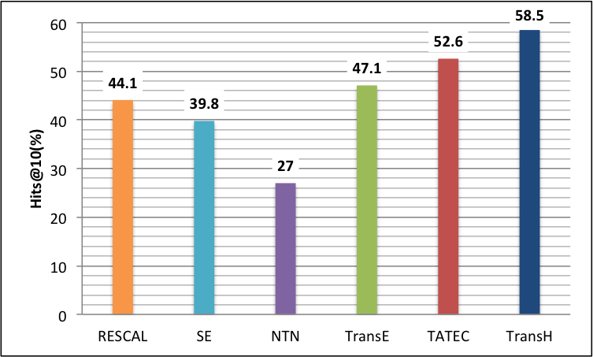
Benchmarking
Embeddings for multi-relational data
Ranking on FB15k
Results extracted from (Garc´ıa-Dur´an et al., ’14) and (Wang et al., ’14)

Slide 41
Menu – Part 2
Embeddings for multi-relational data
Multi-relational data
Link Prediction in KBs
Embeddings for information extraction
Question Answering
Pros and cons of embedding models
Future of embedding models
Resources

Slide 42
Information extraction
Information extraction: populate KBs with new facts using text
Usually two steps:
Entity linking: identify mentions of entities in text
Relation extraction: extract facts about them
Previous works include rule-based models, classifiers with features from parsers, graphical models, etc.
Embedding models exist for both steps.

Slide 43
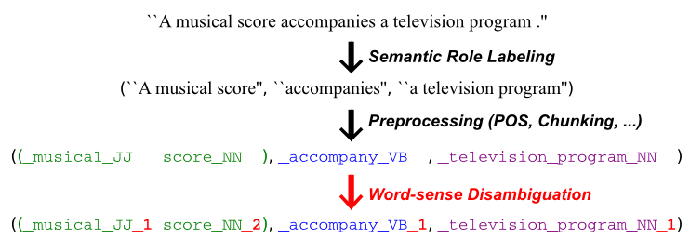
Entity linking as WSD
Word Sense Disambiguation ↔ WordNet entity linking
Towards open-text semantic parsing:

Slide 44
Embeddings of text and WordNet (Bordes et al., ’12)
Text is converted into relations (sub,rel,obj ).
Joint learning of embeddings for all symbols: words, entities and relation types from WordNet.
This system can label 37,141 words with 40,943 synsets.

Slide 45
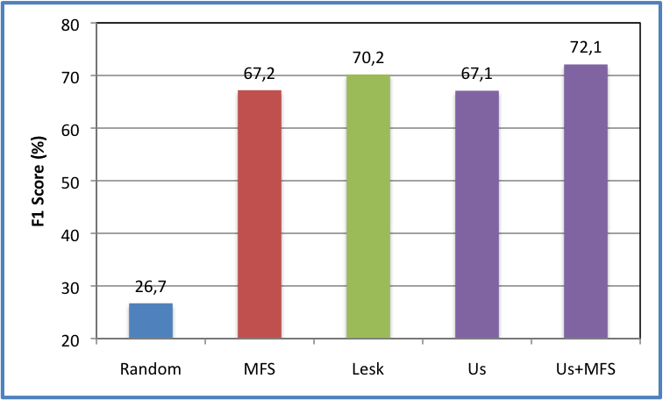
Benchmarking on extended WordNet
F1-score on 5,000 test sentences to disambiguate
Results extracted from (Bordes et al., ’12)

Slide 46
WordNet is enriched through text
Similarities among senses beyond WordNet
“what does an army attack?”
army_NN_1 attack_VB_1 ?

Slide 47
WordNet is enriched through text
Similarities among senses original WordNet data
“what does an army attack?”
army_NN_1 attack_VB_1
troop_NN_4
armed_service_NN_1
ship_NN_1
territory_NN_1
military_unit_NN_1

Slide 48
WordNet is enriched through text
Similarities among senses beyond WordNet
“Who or what earns money?”
? earn_VB_1 money _NN_1

Slide 49
WordNet is enriched through text
Similarities among senses beyond original WordNet data
“Who or what earns money?”
? earn_VB_1 money _NN_1
person_NN_1
business_ﬁrm_NN_1 family_NN_1
payoﬀ_NN_3
card_game_NN_1

Slide 50
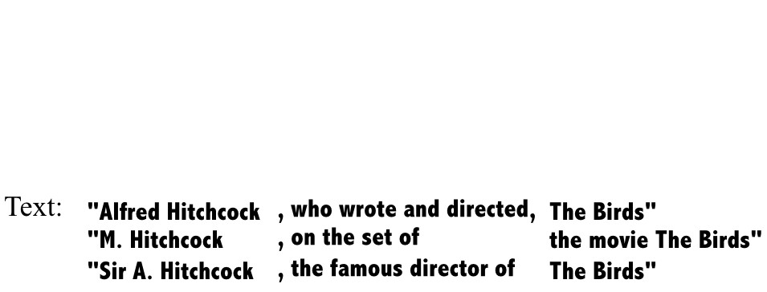
Relation extraction
Given a bunch of sentences.

Slide 51
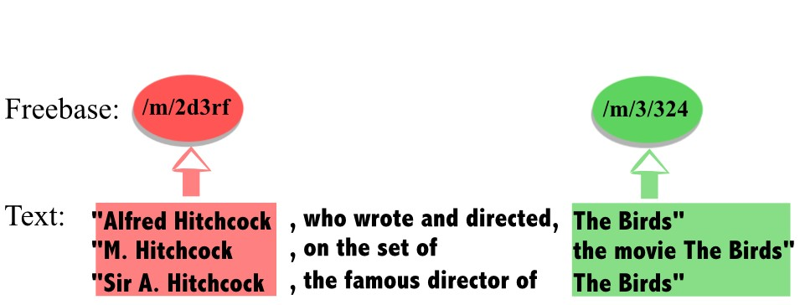
Relation extraction
Given a bunch of sentences concerning the same pair of entities.

Slide 52
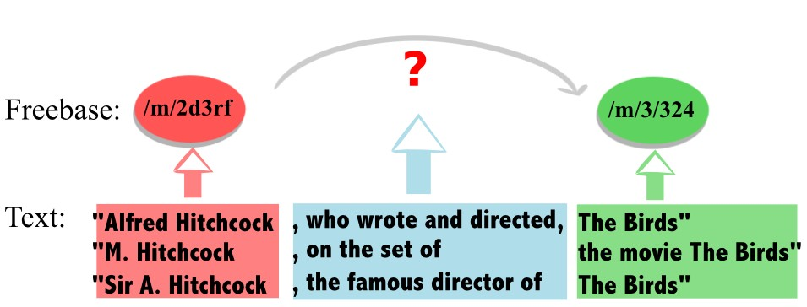
Relation extraction
Goal: identify if there is a relation between them to add to the KB.

Slide 53
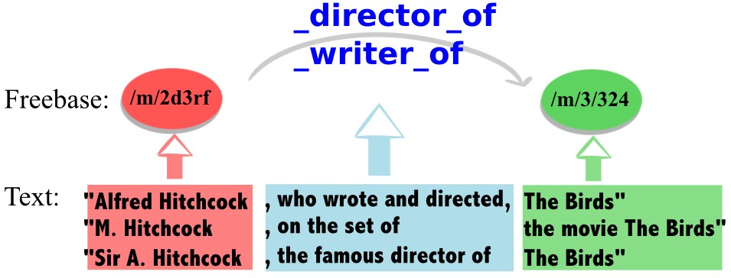
Relation extraction
And from which type, to enrich an existing KB.

Slide 54
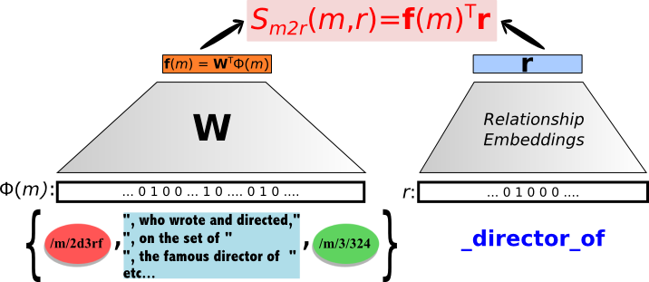
Embeddings of text and freebase (Weston et al., ’13)
Standard Method: an embedding-based classifier is trained to predict the relation type, given text mentions M and (sub, obj ):
Classifier based on WSABIE (Weston et al., ’11).

Slide 55
Embeddings of text and freebase (Weston et al., ’13)
Idea: improve extraction by using both text + available knowledge (= current KB).
A model of the KB is used in a re-ranking setting to force extracted relations to agree with it:

Slide 56
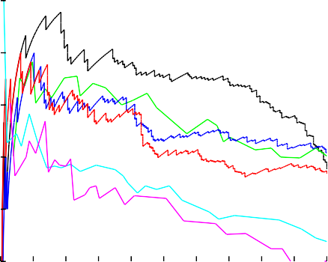
Benchmarking on NYT+Freebase
Exp. on NY Times papers linked with Freebase (Riedel et al., ’10)
0.9
Wsabie M2R+FB MIMLRE
Hoffmann Wsabie M2R Riedel
Mintz
0.8
precision
0.7
0.6
0.5
0.4₀
0.01 0.02 0.03 0.04 0.05 0.06 0.07 0.08 0.09 0.1
recall
Precision/recall curve for predicting relations
Results extracted from (Weston et al., ’13)

Slide 57
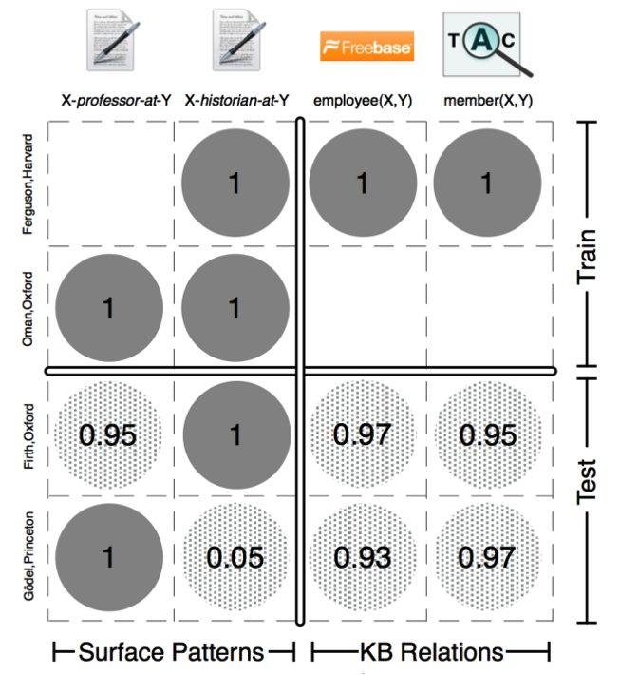
Universal Schemas (Riedel et al., ’13)
Join in a single learning problem:
relation extraction
link prediction
The same model score triples:
made of text mentions
from a KB

Slide 58
Universal Schemas (Riedel et al., ’13)
Relation prediction using the score:
All scores are defined using embeddings:
Training by ranking observed facts versus other and updating using SGD.

Slide 59
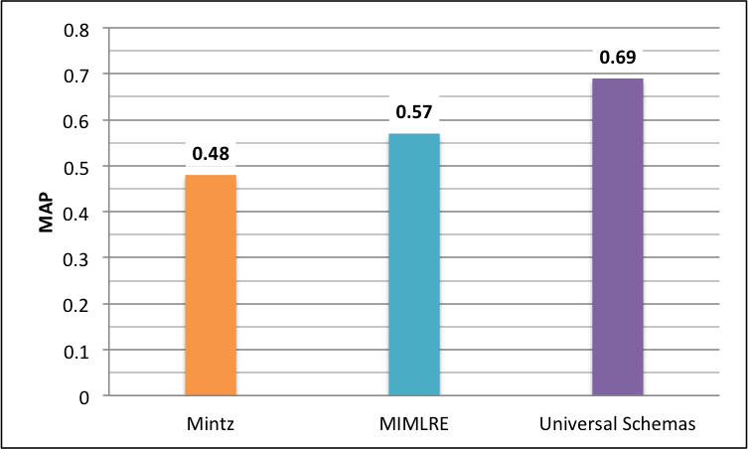
Benchmarking on NYT+Freebase
Exp. on NY Times papers linked with Freebase (Riedel et al., ’10)
Mean Averaged Precision for predicting relations
Results extracted from (Riedel et al., ’13)

Slide 60
Menu – Part 2
Embeddings for multi-relational data
Multi-relational data
Link Prediction in KBs
Embeddings for information extraction
Question Answering
Pros and cons of embedding models
Future of embedding models
Resources

Slide 61
Link prediction as Q&A
“Who influenced J.K. Rowling?”
J. K. Rowling _influenced_by ?
G. K. Chesterton
J. R. R. Tolkien
C. S. Lewis
Lloyd Alexander
Terry Pratchett
Roald Dahl
Jorge Luis Borges
Can we go beyond such rigid structure?

Slide 62
Open-domain question answering
Open-domain Q&A: answer question on any topic
→ query a KB with natural language
Recent effort with semantic parsing (Kwiatkowski et al. ’13) (Berant et al. ’13, ’14) (Fader et al., ’13, ’14) (Reddy et al., ’14)
Models with embeddings as well (Bordes et al., ’14)
Examples
“What is cher’s son’s name ?” | elijah_blue_allman
“What are dollars called in spain ?” | Peseta
“What is henry_clay known for? | Lawyer
“Who did georges_clooney marry in 1987 ?” | kelly_preston

Slide 63

















































Subgraph Embeddings (Bordes et al., ’14)
Model learns embeddings of questions and (candidate) answers
Answers are represented by entity and its neighboring subgraph
Score
How the candidate answer ﬁts the ques6on
Embedding model
Embedding of the ques6on
Embedding of the subgraph
Word embedding lookup table
Dot product
Freebase embedding lookup table
Binary encoding of the ques6on
Binary encoding of the subgraph
Freebase subgraph
1987
Ques%on
K. Preston
Honolulu
“Who did
Clooney
marry in 1987?”
G. Clooney
Subgraph of a candidate answer (here K. Preston)
Model
Detec6on of Freebase en6ty in the ques6on
J. Travolta

Slide 64
Training data
Embeddings for multi-relational data
Freebase is automatically converted into Q&A pairs
Closer to expected language structure than triples
Examples of Freebase data
(sikkim, location.in_state.judicial_capital, gangtok) what is the judicial capital of the in state sikkim ? – gangtok
(brighouse, location.location.people_born_here, Edward_barber) who is born in the location brighouse ? – edward_barber
(sepsis, medicine.disease.symptoms, skin_discoloration) what are the symptoms of the disease sepsis ? – skin _discoloration

Slide 65
Training data
Embeddings for multi-relational data
All Freebase questions have rigid and similar structures
Supplemented by pairs from clusters of paraphrase questions
Multitask training: similar questions ↔ similar embeddings
Examples of paraphrase clusters
what are two reason to get a 404 ? what is error 404 ? how do you correct error 404 ?
what is the term for a teacher of islamic law ? what is the name of the religious book islam use ? who is chief of islamic religious authority ?
what country is bueno aire in ? what countrie is buenos aires in ? what country is bueno are in ?

Slide 66
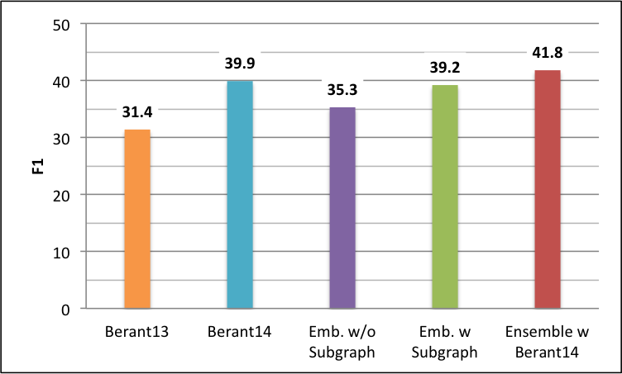
Benchmarking on WebQuestions
Experiments on WebQuestions (Berant et al., ’13)
F1-score for answering test questions
Results extracted from (Berant et al., ’14) and (Bordes et al., ’14)

Slide 67
Menu – Part 2
Embeddings for multi-relational data
Multi-relational data
Link Prediction in KBs
Embeddings for information extraction
Question Answering
Pros and cons of embedding models
Future of embedding models
Resources

Slide 68
Advantages
Efficient features for many tasks in practice
Training with SGD scales & parallelizable (Niu et al., ’11)
Flexible to various tasks: multi-task learning of embeddings
Supervised or unsupervised training
Allow to use extra-knowledge in other applications

Slide 69
Issues
Must train all embeddings together (no parallel 1-vs-rest)
Low-dimensional vector → compression, blurring
Sequential models suffer from long-term memory
Embeddings need quite some updates to be good – not 1-shot
Negative example sampling can be inefficient

Slide 70
Menu – Part 2
Embeddings for multi-relational data
Multi-relational data
Link Prediction in KBs
Embeddings for information extraction
Question Answering
Pros and cons of embedding models
Future of embedding models
Resources

Slide 71
Fix current limitations
Compression: improve the memory capacity of embeddings and allows for one-shot learning of new symbols
Long-term memory: encode longer dependencies in sequential models like RNNs
Training: faster and better sampling of examples
Beyond linear: most supervised labeling problems are well tackled by simple linear models. Non-linearity should help more.

Slide 72
Explore new directions
Compositionality (Baroni et al. ’10) (Grefenstette, 13)
Multimodality (Bruni et al., 12) (Kiros et al., ’14)
Grounding language into actions (Bordes et al., 10)

Slide 73
At EMNLP
Modeling Interestingness with Deep Neural Networks Jianfeng Gao, Patrick Pantel, Michael Gamon, Xiaodong He and Li Deng
Translation Modeling with Bidirectional Recurrent Neural Networks Martin Sundermeyer, Tamer Alkhouli, Joern Wuebker and Hermann Ney
Learning Image Embeddings using Convolutional Neural Networks for Improved Multi-Modal Semantics Douwe Kiela and L´eon Bottou
Learning Abstract Concept Embeddings from Multi-Modal Data: Since You Probably Can’t See What I Mean Felix Hill and Anna Korhonen
Incorporating Vector Space Similarity in Random Walk Inference over Knowledge Bases Matt Gardner, Partha Talukdar, Jayant Krishnamurthy and Tom Mitchell
Composition of Word Representations Improves Semantic Role Labelling Michael Roth and Kristian Woodsend

Slide 74
At EMNLP
A Neural Network for Factoid Question Answering over Paragraphs Mohit Iyyer, Jordan Boyd-Graber, Leonardo Claudino, Richard Socher and Hal Daum´e III
Joint Relational Embeddings for Knowledge-based Question Answering Min-Chul Yang, Nan Duan, Ming Zhou and Hae-Chang Rim
Evaluating Neural Word Representations in Tensor-Based Compositional Settings Dmitrijs Milajevs, Dimitri Kartsaklis, Mehrnoosh Sadrzadeh and Matthew Purver
Opinion Mining with Deep Recurrent Neural Networks Ozan Irsoy and Claire Cardie
The Inside-Outside Recursive Neural Network model for Dependency Parsing Phong Le and Willem Zuidema
A Fast and Accurate Dependency Parser using Neural Networks Danqi Chen and Christopher Manning

Slide 75
At EMNLP
Reducing Dimensions of Tensors in Type-Driven Distributional Semantics Tamara Polajnar, Luana Fagarasan and Stephen Clark
Word Semantic Representations using Bayesian Probabilistic Tensor Factorization Jingwei Zhang, Jeremy Salwen, Michael Glass and Alfio Gliozzo
Glove: Global Vectors for Word Representation Jeffrey Pennington, Richard Socher and Christopher Manning
Jointly Learning Word Representations and Composition Functions Using Predicate-Argument Structures Kazuma Hashimoto, Pontus Stenetorp, Makoto Miwa and Yoshimasa Tsuruoka
Typed Tensor Decomposition of Knowledge Bases for Relation Extraction Kai-Wei Chang, Wen-tau Yih, Bishan Yang and Christopher Meek
Knowledge Graph and Text Jointly Embedding Zhen Wang, Jianwen Zhang, Jianlin Feng and Zheng Chen

Slide 76
At EMNLP
Question Answering with Subgraph Embeddings Antoine Bordes, Sumit Chopra and Jason Weston
Word Translation Prediction for Morphologically Rich Languages with Bilingual Neural Networks Ke M. Tran, Arianna Bisazza and Christof Monz
Learning Phrase Representations using RNN Encoder–Decoder for Statistical Machine Translation Kyunghyun Cho, Bart van Merrienboer, Caglar Gulcehre, Dzmitry Bahdanau, Fethi Bougares, Holger Schwenk and Yoshua Bengio
Convolutional Neural Networks for Sentence Classification Yoon Kim
#TagSpace: Semantic Embeddings from Hashtags Jason Weston, Sumit Chopra and Keith Adams

Slide 77
Focus on (Kiros et al., 14)
Multimodal Neural Language Models Ryan Kiros, Ruslan Salakhutdinov, Richard Zemel. ICML, 2014.

Slide 78
Menu – Part 2
Embeddings for multi-relational data
Multi-relational data
Link Prediction in KBs
Embeddings for information extraction
Question Answering
Pros and cons of embedding models
Future of embedding models
Resources

Slide 79
Code
Torch: www.torch.ch
SENNA: ronan.collobert.com/senna
RNNLM: www.fit.vutbr.cz/~imikolov/rnnlm
Word2vec: code.google.com/p/word2vec
Recursive NN: nlp.stanford.edu/sentiment
SME (multi-relational data): github.com/glorotxa/sme

Slide 80
References
Semantic Parsing on Freebase from Question-Answer Pairs J. Berant, A. Chou, R. Frostig & P. Liang. EMNLP, 2013
Semantic Parsing via Paraphrasing J. Berant & P. Liang. ACL, 2013
Learning Structured Embeddings of Knowledge Bases A. Bordes, J. Weston, R. Collobert & Y. Bengio. AAAI, 2011
Joint Learning of Words and Meaning Rep. for Open-Text Semantic Parsing A. Bordes, X. Glorot, J. Weston & Y. Bengio. AISTATS, 2012
A Semantic Matching Energy Function for Learning with Multi-relational Data A. Bordes, X. Glorot, J. Weston & Y. Bengio. MLJ, 2013
Translating Embeddings for Modeling Multi-relational Data A. Bordes, N. Usunier, A. Garc´ıa-Dur´an, J. Weston & O. Yakhnenko. NIPS, 2013

Slide 81
References
Question Answering with Subgrap Embeddings A. Bordes, S. Chopra & J. Weston. EMNLP, 2014
Clustering with Multi-Layer Graphs: A Spectral Perspective X. Dong, P. Frossard, P. Vandergheynst & N. Nefedov. IEEE TSP, 2013
Paraphrase-Driven Learning for Open Question Answering A. Fader, L. Zettlemoyer & O. Etzioni. ACL, 2013
Open Question Answering Over Curated and Extracted Knowledge Bases A. Fader, L. Zettlemoyer & O. Etzioni. KDD, 2014
Learning Probabilistic Relational Models N. Friedman, L. Getoor, D. Koller & A. Pfeffer. IJCAI, 1999
Effective Blending of Two and Three-way Interactions for Modeling Multi-relational Data A. Garcıa-Duran, A. Bordes & N. Usunier. ECML-PKDD, 2014

Slide 82
References
Models for the Analysis of Asymmetrical Relationships among n Objects or Stimuli R. Harshman. Joint Symposium of Psych. and Mathematical Societies, 1978.
PARAFAC: Parallel factor analysis R. Harshman & M. Lundy. Comp. Statistics and Data Analysis, 1994
A Latent Factor Model for Highly Multi-relational Data R. Jenatton, N. Le Roux, A. Bordes & G. Obozinski. NIPS, 2012.
Learning Systems of Concepts with an Infinite Relational Model C. Kemp, J. Tenenbaum, T. Griffiths, T. Yamada & N. Ueda. AAAI, 2006.
Statistical Predicate Invention S. Kok, P. Domingos. ICML, 2007
Scaling Semantic Parsers with On-the-fly Ontology Matching T. Kwiatkowski, E. Choi, Y. Artzi & L. Zettlemoyer. EMNLP, 2013

Slide 83
References
Random Walk Inference and Learning in A Large Scale Knowledge Base N. Lao, T. Mitchell & W. Cohen. EMNLP, 2011.
Distributed Representations of Words and Phrases and their Compositionality T. Mikolov, I. Sutskever, K. Chen, G. Corrado & J. Dean. NIPS, 2013.
A Three-Way Model for Collective Learning on Multi-Relational Data M. Nickel, V. Tresp & H.-P. Kriegel. ICML, 2011.
Large-scale Semantic Parsing without Question-Answer Pairs S. Reddy, M. Lapata & M. Steedman. TACL, 2014.
Modeling Relations and Their Mentions without Labeled Text S. Riedel, L. Yao and A. McCallum. ECML-PKDD, 2010
Relation Extraction with Matrix Factorization and Universal Schemas S. Riedel, L. Yao, B. Marlin and A. McCallum. HLT-NAACl, 2013

Slide 84
References
Reasoning With Neural Tensor Networks for Knowledge Base Completion R. Socher, D. Chen, C. Manning & A. Ng NIPS, 2013.
Modelling Relational Data using Bayesian Clustered Tensor Factorization I. Sutskever, R. Salakhutdinov & J. Tenenbaum. NIPS, 2009.
Discriminative Probabilistic Models for Relational Data B. Taskar, P. Abbeel & D. Koller. UAI, 2002.
Knowledge Graph Embedding by Translating on Hyperplanes Z. Wang, J. Zhang, J. Feng & Z. Chen. AAAI, 2014.
Wsabie: Scaling Up To Large Vocabulary Image Annotation J. Weston, S. Bengio & N. Usunier. IJCAI, 2011
Connecting Language and Knowledge Bases with Embedding Models for Relation Extraction. J. Weston, A. Bordes, O. Yakhnenko & N. Usunier. EMNLP, 2013

Slide 85
Thank you

