Slide 1
Lecture 1.3 - Introduction to Neural Networks

Slide 2

The GPU Teaching Kit is licensed by NVIDIA and New York University under the
Creative Commons Attribution-NonCommercial 4.0 International License.
Deck credit: J. Seng

Slide 3
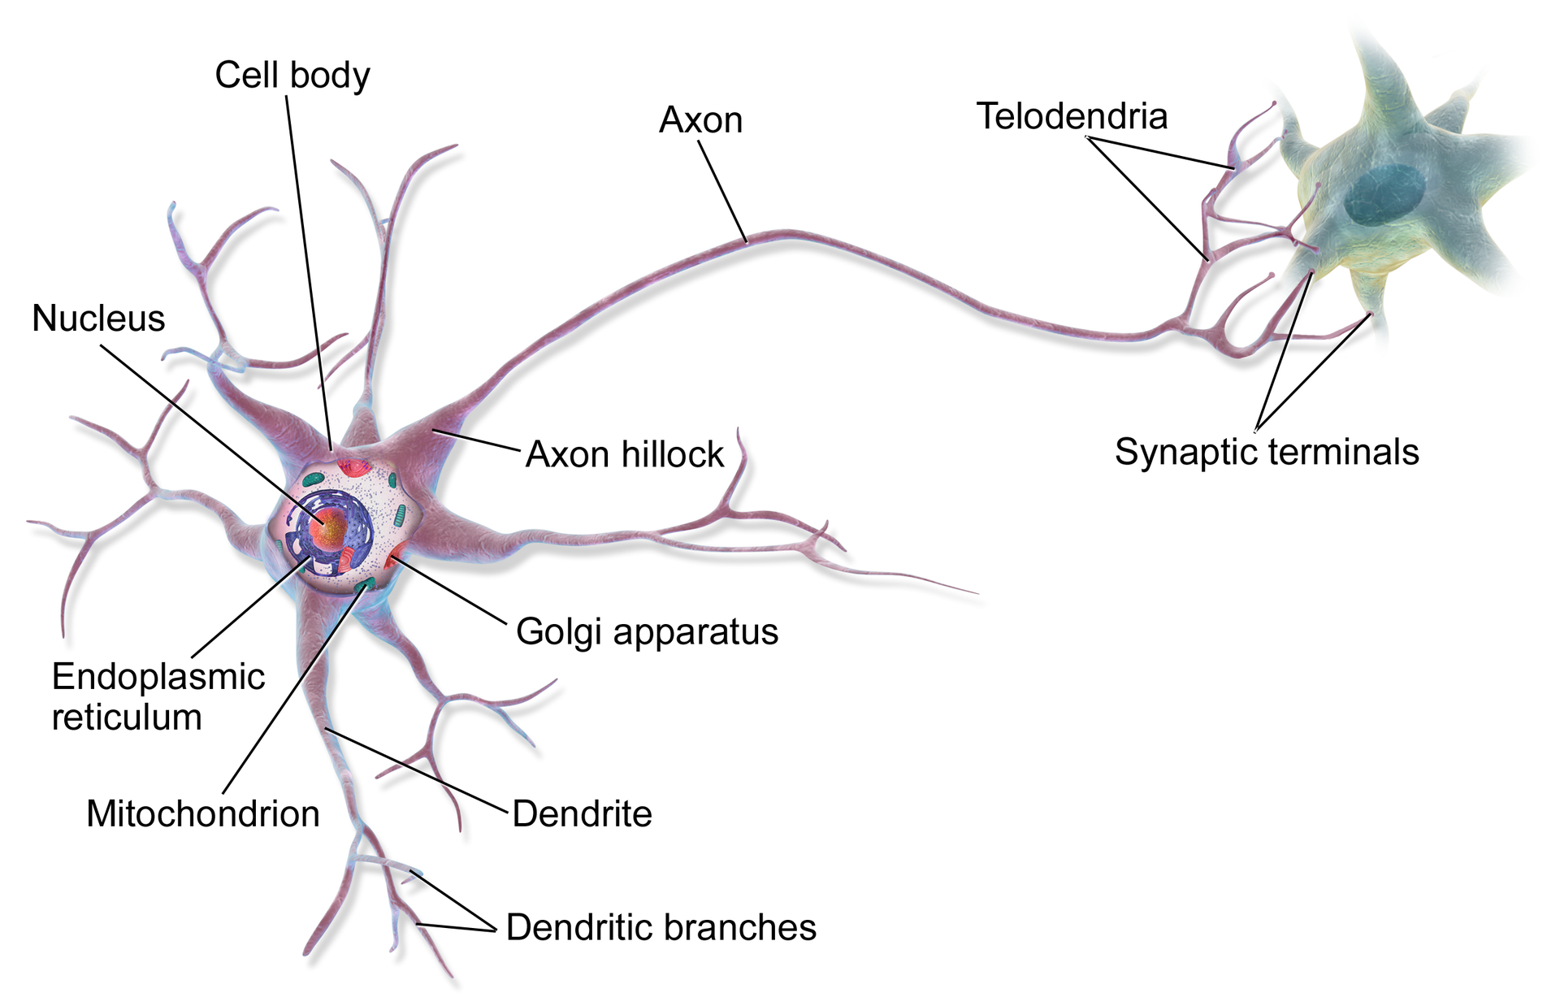
Biological Inspiration
Notes:
Neural Networks were inspired by the way brains store and process information
The core component of the brain is the Neuron
Each neuron can receive information from other neurons through its Axon
A neuron’s dendrites then send information to other neurons
Synapses are the junctions between the neurons

Slide 4
Neural Network Architecture
Input Layer
Hidden Layer
Output Layer
Neuron
Synapse
Notes:
The most basic neural network has an input layer, a hidden layer, and an output layer
Neurons in one layer are receive the value from neurons in the previous layer
Each neuron then applies a function to its inputs and produces an output that is read by subsequent layers

Slide 5
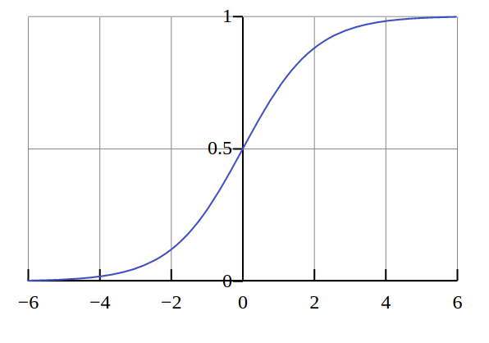

Activation Functions
Activation Functions are applied to the inputs at each neuron
A common activation function is the Sigmoid
Notes:
Neurons typically apply activation function to their inputs.
Activation functions are typically non-linear.
The sigmoid function produces a value between 0 and 1 (so it is often used when a probability is desired)
The Rectified Linear activation function is zero when the input is negative and is equal to the input when the input is positive
Rectified Linear activation functions have become more popular because they are faster to compute than the sigmoid or hyperbolic tangent

Slide 6
Inference
0.5
H1
H1 Weights = (1.0, -2.0, 2.0)
H2 Weights = (2.0, 1.0, -4.0)
H3 Weights = (1.0, -1.0, 0.0)
O1 Weights = (-3.0, 1.0, -3.0)
O2 Weights = (0.0, 1.0, 2.0)
O1
0.9
H2
O2
-0.3
H3
Notes:
This is an example that shows how the outputs of a neural network are computed
The listing on the right shows the weights of each neuron’s connections
A sigmoid activation function is used

Slide 7
Inference
0.5
.13
H1 Weights = (1.0, -2.0, 2.0)
H2 Weights = (2.0, 1.0, -4.0)
H3 Weights = (1.0, -1.0, 0.0)
O1 Weights = (-3.0, 1.0, -3.0)
O2 Weights = (0.0, 1.0, 2.0)
O1
0.9
.96
O2
-0.3
.40
H1 = S(0.5 * 1.0 + 0.9 * -2.0 + -0.3 * 2.0) = S(-1.9) = .13
H2 = S(0.5 * 2.0 + 0.9 * 1.0 + -0.3 * -4.0) = S(3.1) = .96
H3 = S(0.5 * 1.0 + 0.9 * -1.0 + -0.3 * 0.0) = S(-0.4) = .40
Notes:
The values of the hidden layer neurons are calculated by multiplying the weights by the input values then computing the sigmoid function

Slide 8
Inference
0.5
.13
H1 Weights = (1.0, -2.0, 2.0)
H2 Weights = (2.0, 1.0, -4.0)
H3 Weights = (1.0, -1.0, 0.0)
O1 Weights = (-3.0, 1.0, -3.0)
O2 Weights = (0.0, 1.0, 2.0)
.35
0.9
.96
.85
-0.3
.40
O1 = S(.13 * -3.0 + .96 * 1.0 + .40 * -3.0) = S(-.63) = .35
O1 = S(.13 * 0.0 + .96 * 1.0 + .40 * 2.0) = S(1.76) = .85
Notes:
The output values are calculated by applying the sigmoid function to the hidden layer values multiplied by the output layer weights
If this were a classification Neural Network, then the final step would be to select the largest value (in this case O2, which has value .85)
The label that corresponds to the largest value in the output layer is then outputted as the prediction

Slide 9
Matrix Formulation
H1 Weights = (1.0, -2.0, 2.0)
H2 Weights = (2.0, 1.0, -4.0)
H3 Weights = (1.0, -1.0, 0.0)
Hidden Layer Weights
Inputs
1.0 | -2.0 | 2.0
2.0 | 1.0 | -4.0
1.0 | -1.0 | 0.0
0.5
0.9
-0.3
Hidden Layer Outputs
S(
*
) = S(
-1.9 | 3.1 | -0.4
) =
.13 | .96 | 0.4
Notes:
The computation of the hidden layer neuron values can be accomplished as a matrix-vector multiplication
Expressing the operation as matrix-vector multiplication highlights the possibility of parallelizing the computation.
GPUs are extremely fast at performing matrix multiplications, so GPUs are commonly used to speed up neural network training and inference

Slide 10
Training Neural Networks
Procedure for training Neural Networks
Perform inference on the training set
Calculate the error between the predictions and actual labels of the training set
Determine the contribution of each Neuron to the error
Modify the weights of the Neural Network to minimize the error
Error contributions are calculated using Backpropagation
Error minimization is achieved with Gradient Descent
Notes:
Originally, the weights of a neural network are assigned randomly
The neural network then predicts the labels for the examples in the training set
The error between the prediction and the actual label is used to determine how the weights should be updated
The weights are slowly changed to minimize the error

Slide 11
Backpropagation
Problem: Which weights should be updated and by how much?
Insight: Use the derivative of the error with respect to weight to assign “blame”
Notes:
Since the weights of hidden layers do not directly change the output of the network, care must be taken to properly modify these weights
Intuitively, backpropagation assigns the “blame” based on how much each neuron contributed to the final answer

Slide 12


Backpropagation Example
I
0.5
.13
w
O
T (Ground Truth)
.35
0.9
0.9
.96
.85
-0.3
.40
Notes:
This example shows how to compute the error derivative with respect to a weight for the output layer

Slide 13
Gradient Descent
Gradient Descent minimizes the neural network’s error
At each time step the error of the network is calculated on the training data
Then the weights are modified to reduce the error
Gradient Descent terminates when
The error is sufficiently small
The max number of time steps has been exceeded
Notes:
Once the errors for each neuron weight have been calculated, the weights are updated to minimize the error
A learning rate (typically a small value like .0001) is multiplied by the error and this value is added to the weight that corresponds to the error
Gradient Descent is the process of modifying these weights iteratively until the overall error is small enough or the maximum number of iterations has occurred.
Stochastic Gradient Descent is a variation of Gradient Descent that uses a subset of the training data at each time step to approximate the overall derivative to update the weights

Slide 14
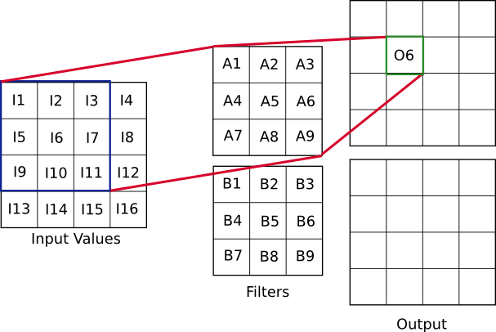
Convolutional Neural Networks
Notes:
Neural networks that operate on images, typically have convolutional layers
These layers include many filters of weights that perform much like the convolution filters that were taught in the computer vision module
Instead of specifying a filter to smooth the image or detect lines, the neural network learns weights for the filters that best differentiate the training examples
The example above show a convolutional layer with 18 weights (9 in the two filters). Inference occurs by sliding the filters across the image.
Notice that the output layer has is the number of filters times the original area of the input image

Slide 15
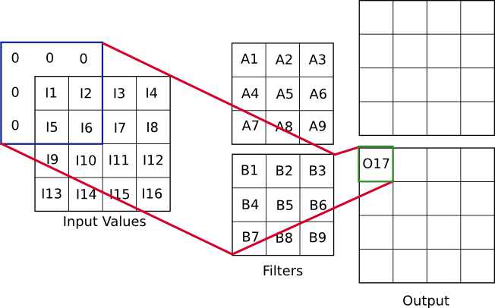
Convolutional Neural Networks
Notes:
This example shows how input values are often padded with zeros.
These zeros are used to ensure that the output of the convolution layer has the same dimensions as the input image

Slide 16
Max-Pooling
1 | 0 | 2 | 2
1 | 3 | 0 | 1
3 | 1 | 4 | 1
2 | 0 | 2 | 1
2x2 Max Pooling
3 | 2
3 | 4
Notes:
Since convolutional layers can produce a large number of output values, it is often useful to simplify the outputs
Max-pooling extracts the largest values in a layer
Max-pooling is defined with a kernel size (in this example, the kernel size is 2)

Slide 17
Thank you

