Slide 1
Lecture 4.1 - Energy­-based Learning

Slide 2

The GPU Teaching Kit is licensed by NVIDIA and New York University under the
Creative Commons Attribution-NonCommercial 4.0 International License.
Deck credit: Y. LeCun

Slide 3
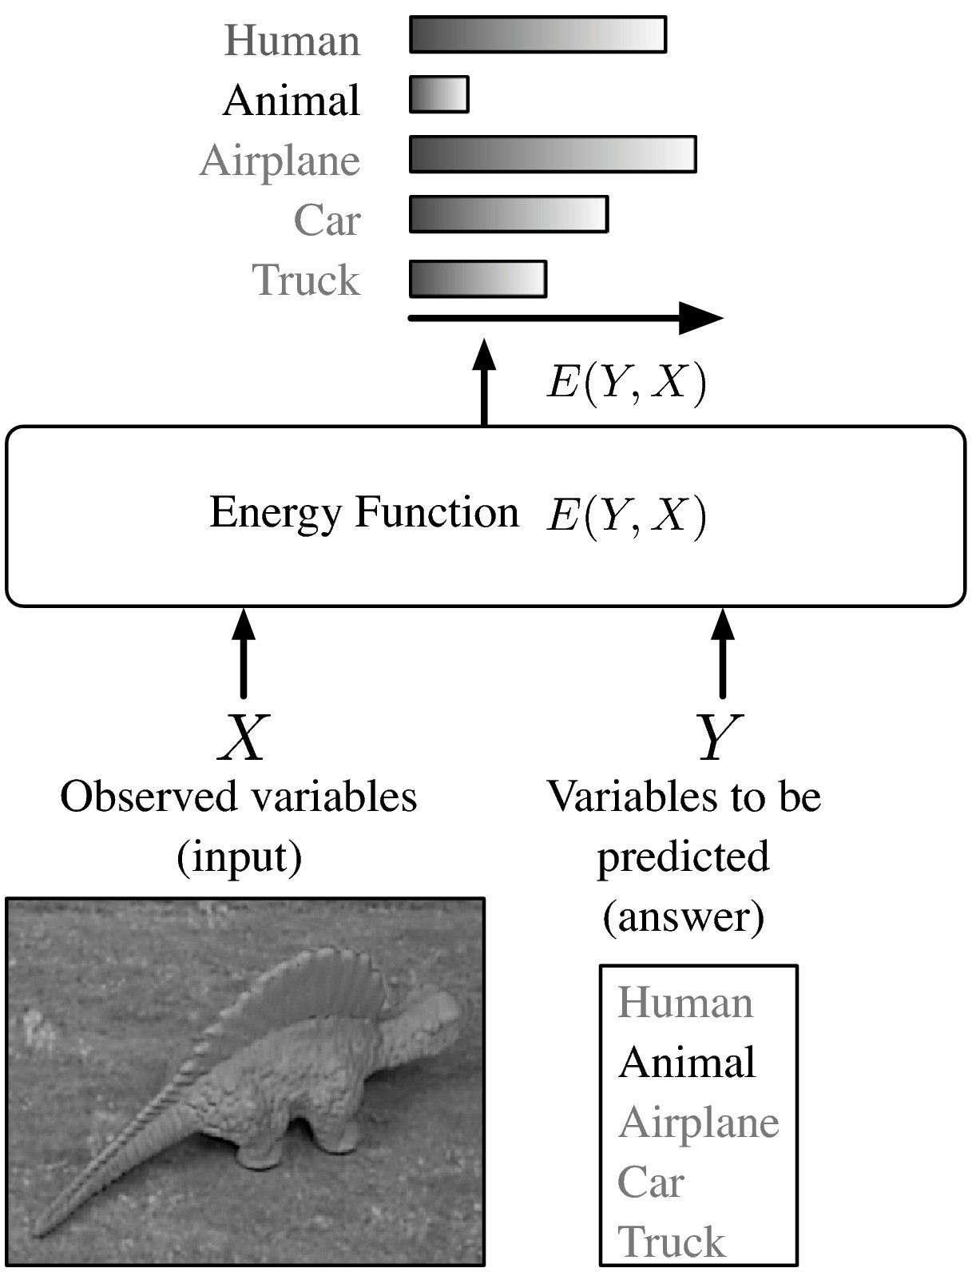

Energy­-based model for decision-­making
Model: Measures the compatibility between an observed variable X and a variable to be predicted Y through an energy function E(Y,X).
Inference: Search for the Y that minimizes the energy within a set
If the set has low cardinality, we can use exhaustive search.

Slide 4
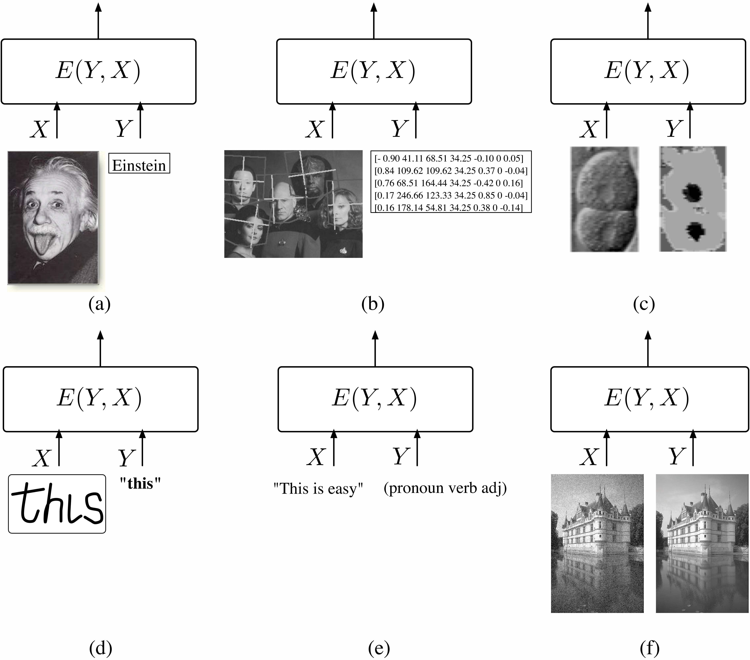
Complex Tasks: Inference is non­trivial
When the cardinality or dimension of Y is large, exhaustive search is impractical.
We need to use a “smart” inference procedure: min­sum, Viterbi, .....

Slide 5
What questions can a model answer?
Classification & decision making:
“Which value of Y is most compatible with X?” Applications: robot navigation,.....
Training: give the lowest energy to the correct answer
Ranking:
“Is Y1 or Y2 more compatible with X?” Applications: data-mining....
Training: produce energies that rank the answers correctly
Detection:
“Is this value of Y compatible with X”? Application: face detection....
Training: energies that increase as the image looks less like a face.
Conditional density estimation:
“What is the conditional distribution P(Y|X)?” Application: feeding a decision-making system training: differences of energies must be just so.

Slide 6
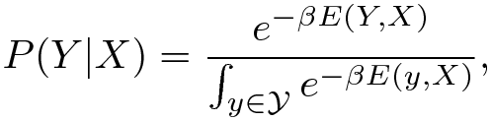
Decision­-making versus probabilistic modeling
Energies are uncalibrated
The energies of two separately-trained systems cannot be combined. The energies are uncalibrated (measured in arbitrary untis)
How do we calibrate energies?
We turn them into probabilities (positive numbers that sum to 1). Simplest way: Gibbs distribution
Other ways can be reduced to Gibbs by a suitable redefinition of the energy.
Partition function
Inverse temperature

Slide 7




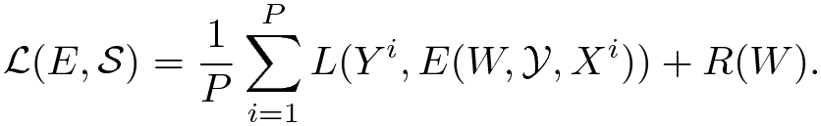
Architecture and loss function
Family of energy functions
Training set
Loss functional / Loss function
Measures the quality of an energy function
Training
Form of the loss functional
invariant under permutations and repetitions of the samples
Energy surface for a given Xi as Y varies
Per­sample loss
Desired answer
Regularizer

Slide 8
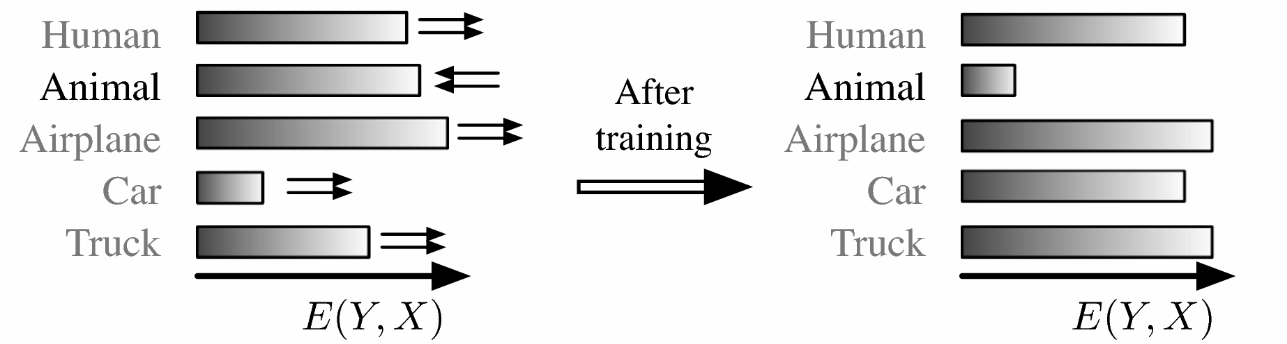
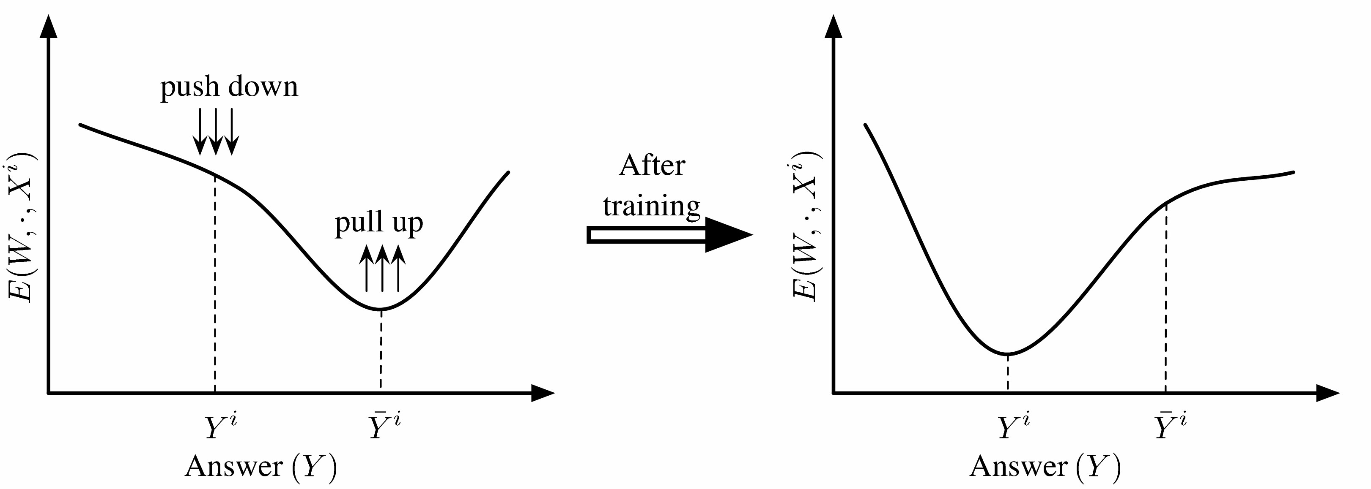
Designing a loss functional
Correct answer has the lowest energy ­> LOW LOSS
Lowest energy is not for the correct answer ­> HIGH LOSS

Slide 9
Designing a loss functional
Push down on the energy of the correct answer
Pull up on the energies of the incorrect answers, particularly if they are smaller than the correct one

Slide 10
Architecture + inference algo + loss function = model
Design an architecture: a particular form for E(W,Y,X).
Pick an inference algorithm for Y: MAP or conditional distribution, belief prop, min cut, variational methods, gradient descent, MCMC, HMC.....
Pick a loss function: in such a way that minimizing it with respect to W over a training set will make the inference algorithm find the correct Y for a given X.
Pick an optimization method.
PROBLEM: What loss functions will make the machine approach the desired behavior?
E(W,Y,X)
W
X
Y

Slide 11
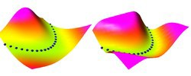
Several energy surfaces can give the same answers
Y
X
Both surfaces compute Y=X^2
MINy E(Y,X) = X^2
Minimum­-energy inference gives us the same answer

Slide 12
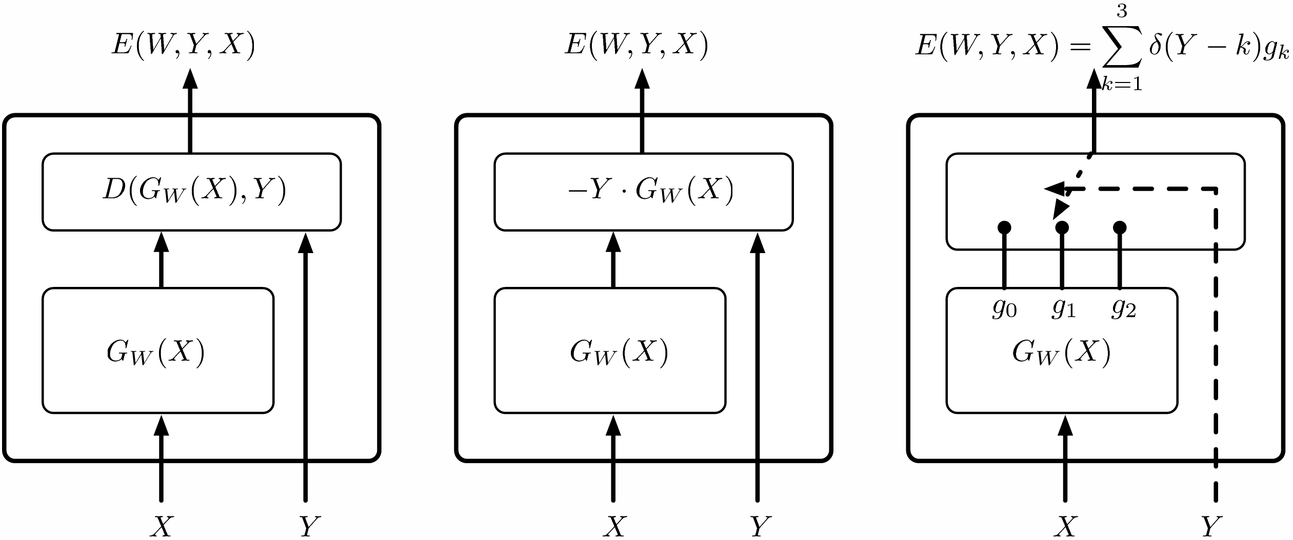


Simple architectures
Regression
Binary Classification
Multi­-class Classification

Slide 13
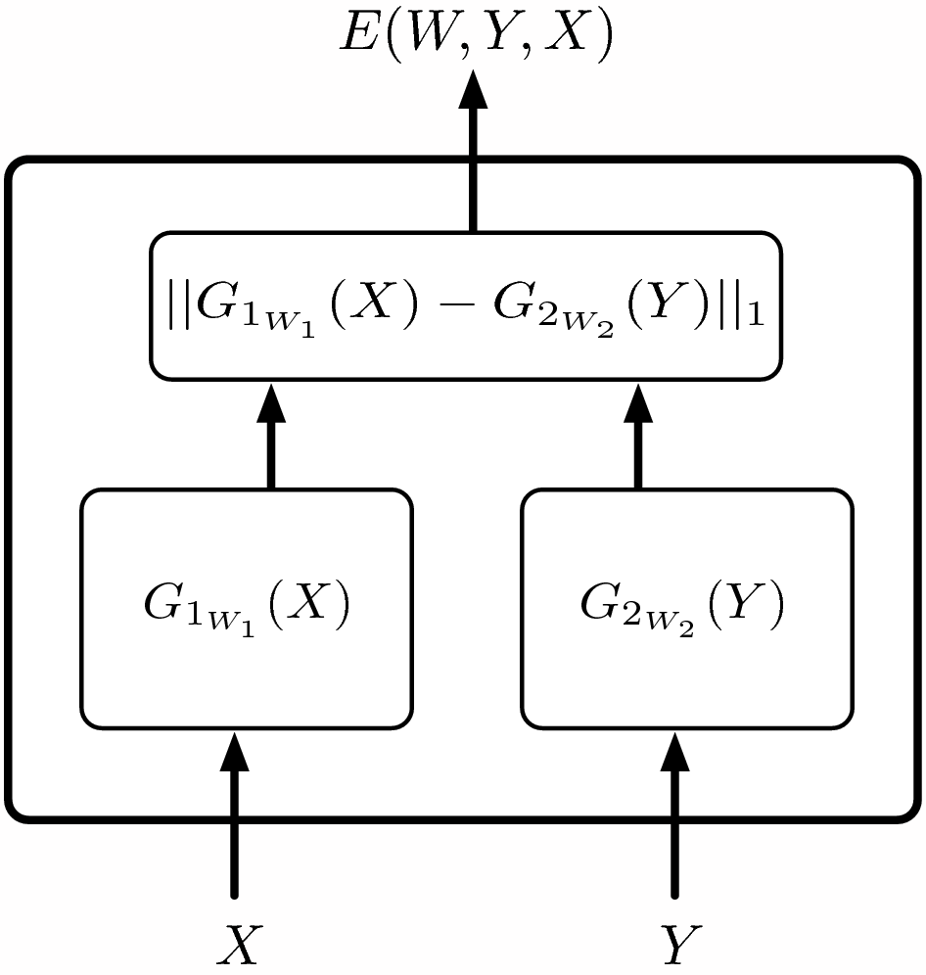
Simple architecture: implicit regression
The Implicit Regression architecture
allows multiple answers to have low energy.
Encodes a constraint between X and Y rather than an explicit functional relationship
This is useful for many applications Example: sentence completion: “The cat ate the {mouse,bird,homework,...}”
[Bengio et al. 2003]
But, inference may be difficult.

Slide 14
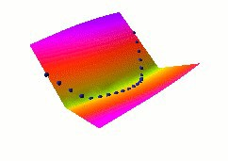
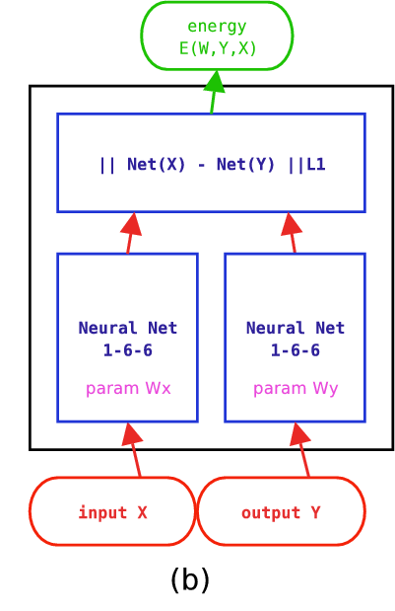
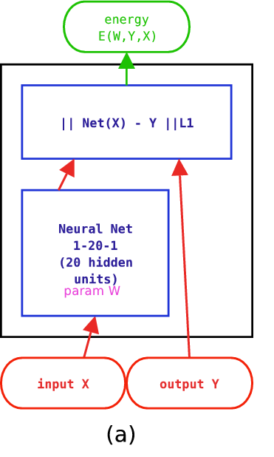
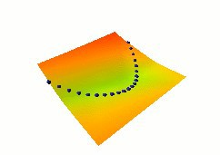
Examples of loss functions: energy loss
Energy Loss
Simply pushes down on the energy of the correct answer
WORKS!!!
COLLAPSES!!!

Slide 15
Examples of loss functions: perceptron loss
Perceptron Loss
Pushes down on the energy of the correct answer
Pulls up on the energy of the machine's answer
Always positive. Zero when answer is correct
No “margin”: technically does not prevent the energy surface from being almost flat.
Works pretty well in practice, particularly if the energy parameterization does not allow flat surfaces.

Slide 16
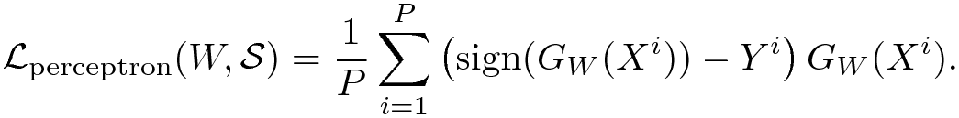


Perceptron loss for binary classification
Energy:
Inference:
Loss:
Learning Rule:
If Gw(X) is linear in W:

Slide 17
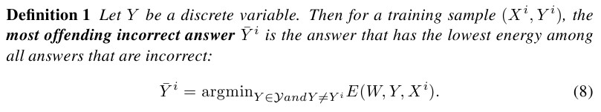
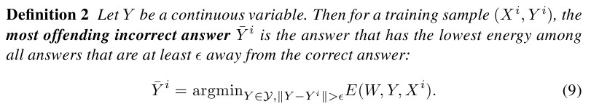
Examples of loss functions: generalized margin losses
First, we need to define the Most Offending Incorrect Answer
Most Offending Incorrect Answer: discrete case Definition 1 Let Y be a discrete variable. Then for a training sample (X^{i},Y^{i}), the most offending incorrect answer Y^{i} is the answer that has the lowest energy among all answers that are incorrect:
Most Offending Incorrect Answer: continuous case Definition 2 Let Y be a continuous variable. Then for a training sample (X^{i},Y^{i}), the most offending incorrect answer Y^{i} is the answer that has the lowest energy among all answers that are at least ϵ away from the correct answer:

Slide 18
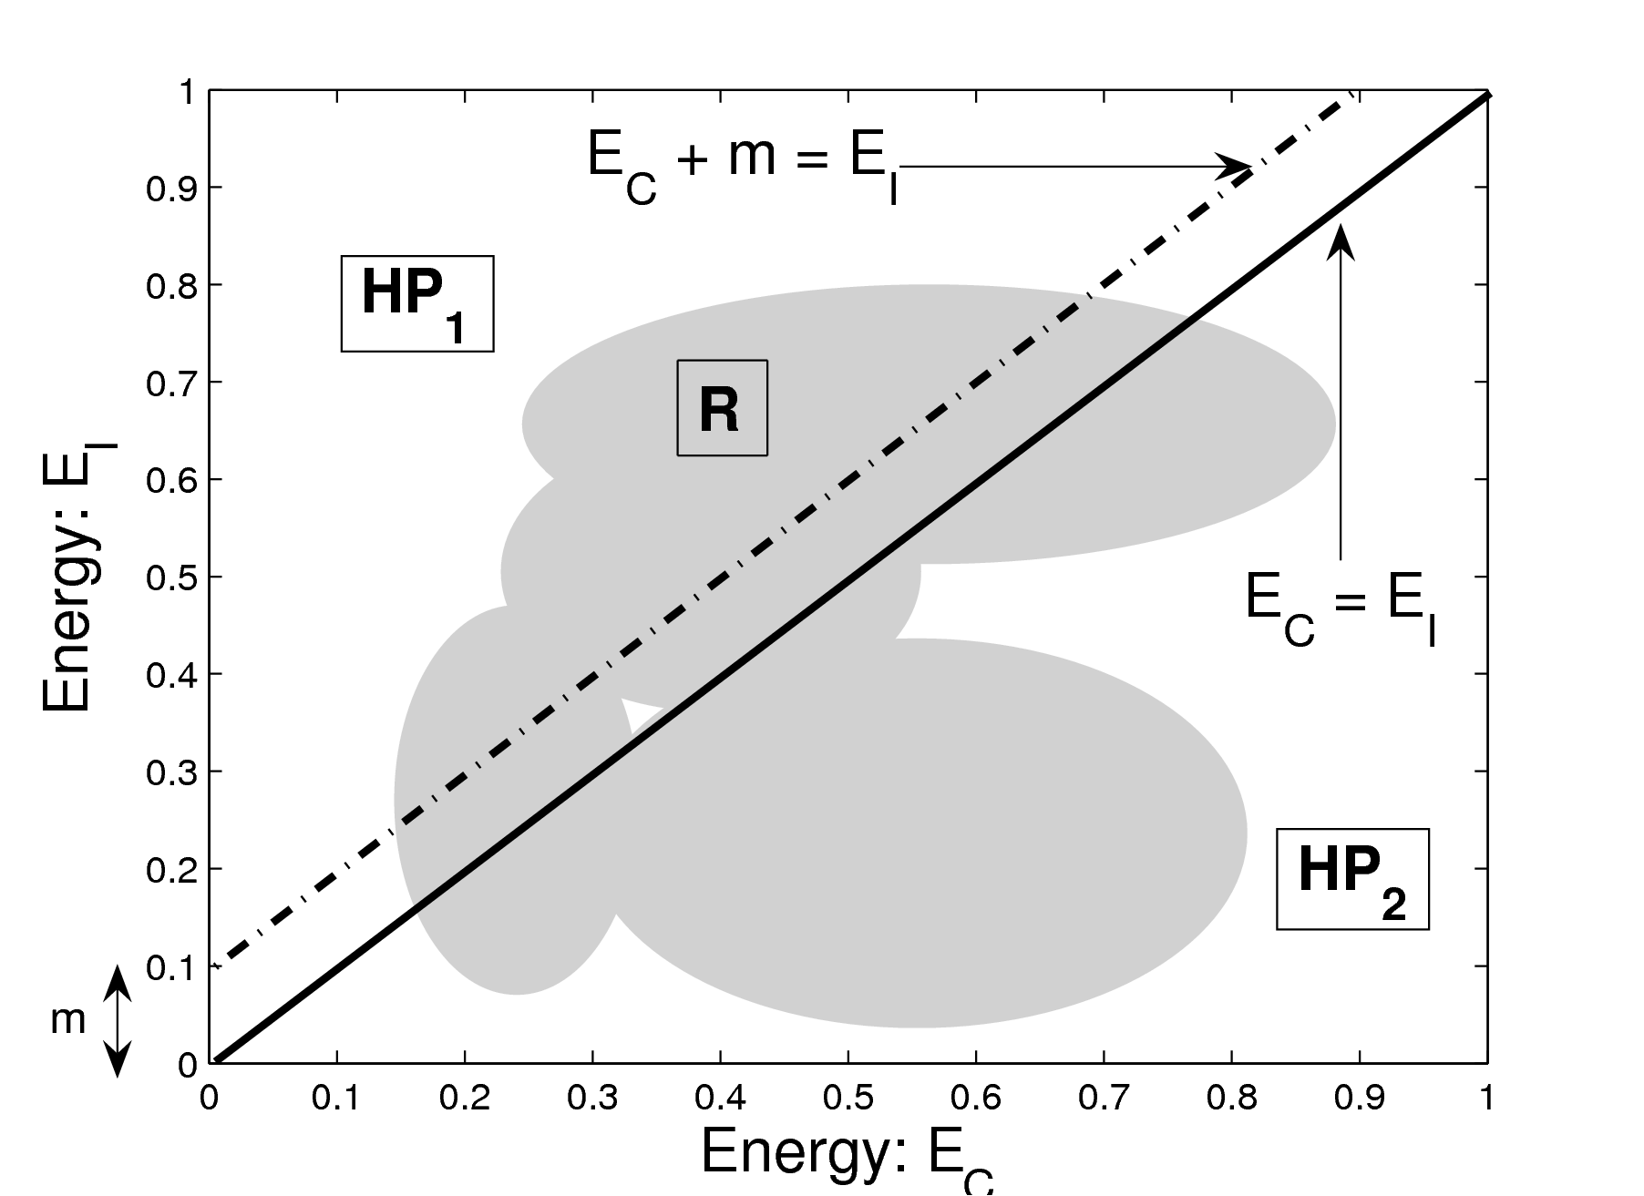
Examples of loss functions: generalized margin losses
Generalized Margin Loss
Qm increases with the energy of the correct answer
Qm decreases with the energy of the most offending incorrect answer
whenever it is less than the energy of the correct answer plus a margin m.

Slide 19
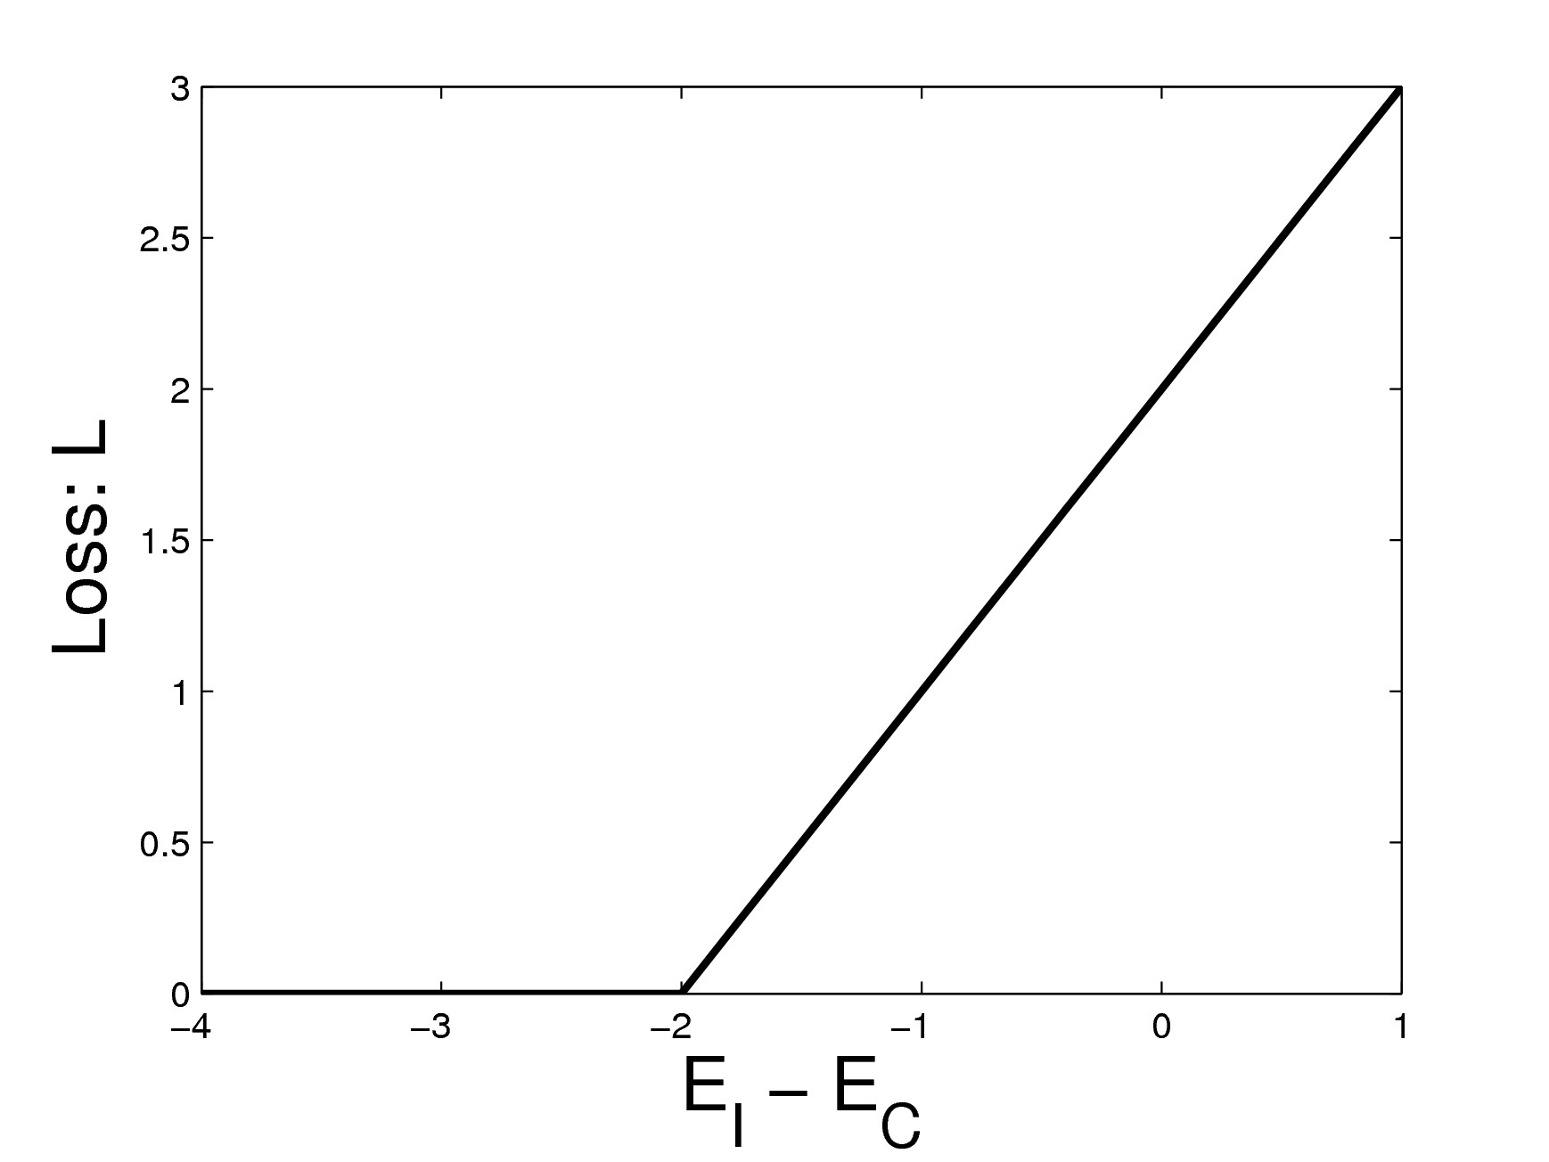
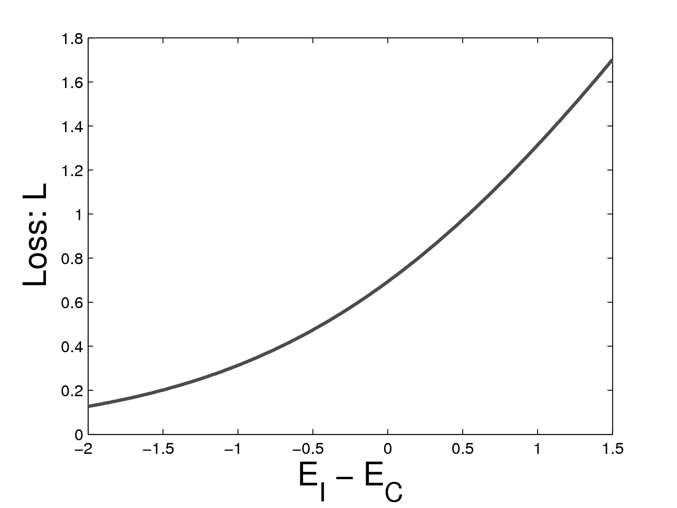
Examples of generalized margin losses
Hinge Loss
With the linearly-parameterized binary classifier architecture, we get linear SV
Log Loss
“soft hinge” loss
With the linearly-parameterized binary classifier architecture, we get linear Logistic Regression
Ms

Slide 20
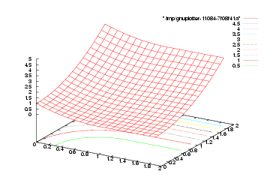
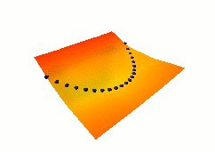
Examples of margin losses: square­-square loss
Square-­Square Loss
[LeCun-Huang 2005]
Appropriate for positive energy functions
Learning Y = X^2
NO COLLAPSE!!!

Slide 21

Other margin-­like losses
LVQ2 Loss [Kohonen, Oja], Driancourt­Bottou 1991]
Minimum Classification Error Loss [Juang, Chou, Lee 1997]
Square­-Exponential Loss [Osadchy, Miller, LeCun 2004]

Slide 22
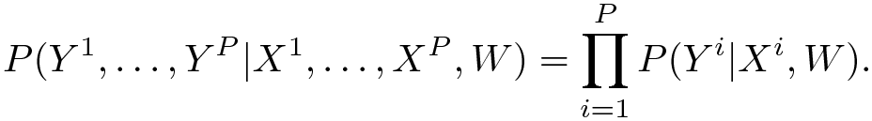
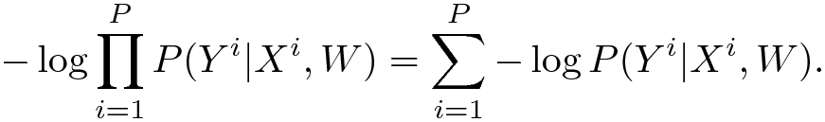
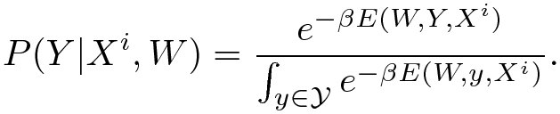
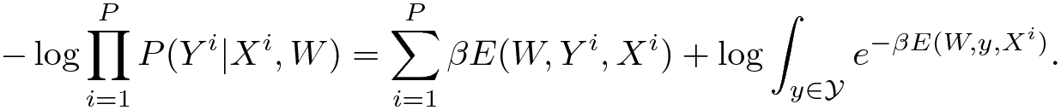
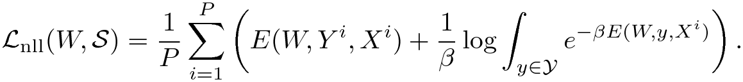
Negative log-­likelihood loss
Conditional probability of the samples (assuming independence)
Gibbs distribution:
We get the NLL loss by dividing by P and Beta:
Reduces to the perceptron loss when Beta­>infinity

Slide 23
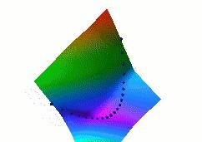
Negative log-­likelihood loss
Pushes down on the energy of the correct answer
Pulls up on the energies of all answers in proportion to their probability

Slide 24
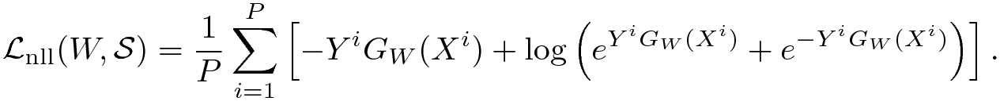
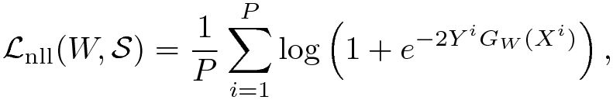
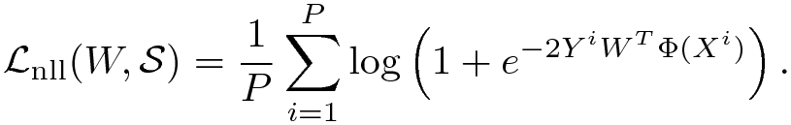
Negative log­-likelihood loss: binary classification
Binary Classifier Architecture:
Linear Binary Classifier Architecture:
Learning Rule: logistic regression

Slide 25
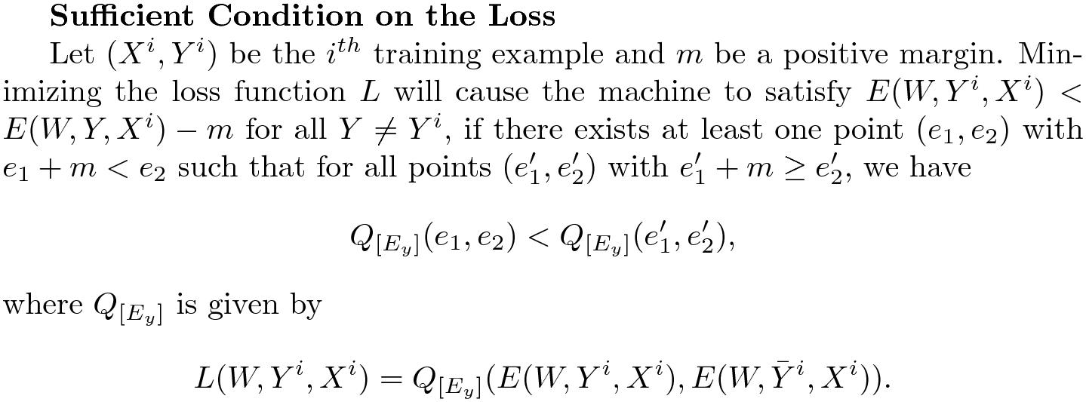
What makes a “good” loss function
Good loss functions make the machine produce the correct answer
Avoid collapses and flat energy surfaces
Sufficient condition on the loss
Let (Xi,Yi) be the ith training example and m be a positive margin. Minimizing the loss function L will cause the machine to satisfy E(W,Yi,Xi) < E(W,Y,Xi) – m for all Y ≠ Yi, if there exists at least one point (e1,e2) with e1 + m <e2 such that for all points

Slide 26
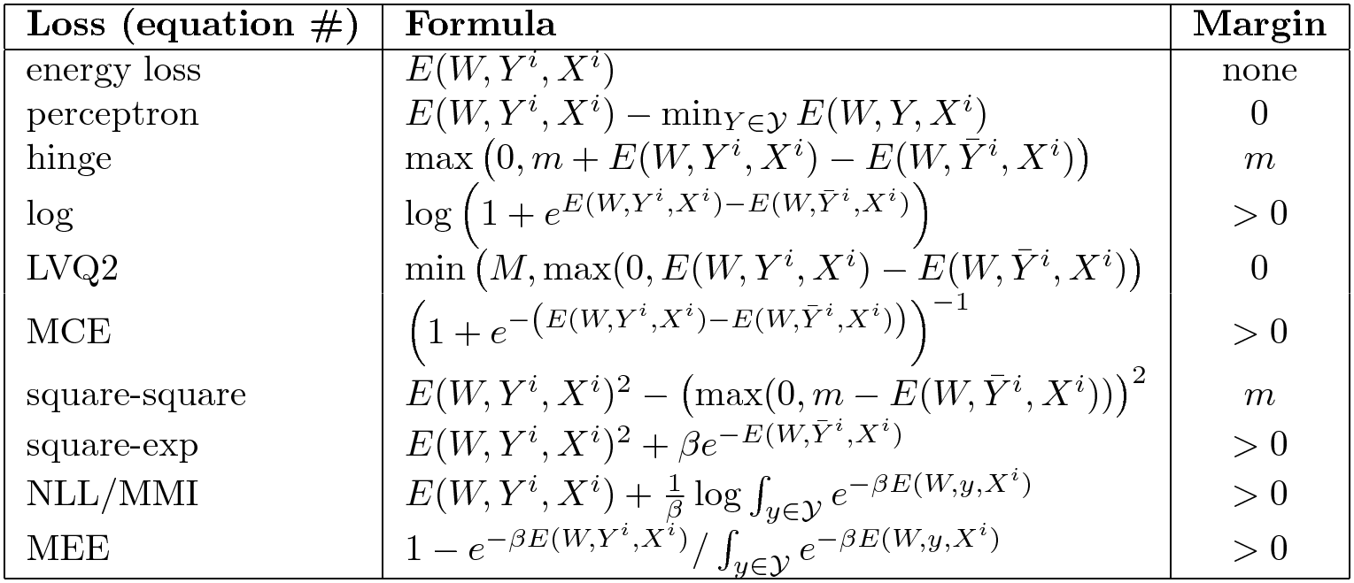
What make a “good” loss function
Good and bad loss functions

Slide 27
Advantages/disadvantages of various losses
Loss functions differ in how they pick the point(s) whose energy is pulled up, and how much they pull them up
Losses with a log partition function in the contrastive term pull up all the bad answers simultaneously.
This may be good if the gradient of the contrastive term can be computed efficiently
This may be bad if it cannot, in which case we might as well use a loss with a single point in the contrastive term
Variational methods pull up many points, but not as many as with the full log partition function.
Efficiency of a loss/architecture: how many energies are pulled up for a given amount of computation?
The theory for this is to be developed

Slide 28
Thank you

