Slide 1
6th LBRN Data & Protein Science Bootcamps Overview
Jason Li
HPC User Services
LONI HPC
sys-help@loni.org
Jul 31 – Aug 4, 2023

Slide 2
Outline
A very brief overview of scientific computing
Agenda for the bootcamp
Computing platform

Slide 3


What is Scientific Computing?
“Scientific Computing is the collection of tools, techniques, and theories required to solve on a computer mathematical models of problems in Science and Engineering.” – (Golub & Ortega 1992)
It is a rapidly growing multidisciplinary field that uses advanced computing capabilities to understand and solve complex problems.
Domain Problem Specific Modeling
Abacus, 2nd century BC
Scientific Computing
Computer Science
Numerical Methods
Calculating-Table by Gregor Reisch: Margarita Philosophica, 1503.
Notes:
https://www.scicomp.uni-kl.de/about/scientific-computing/

Slide 4

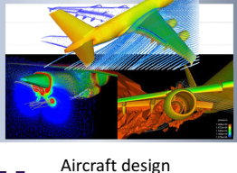
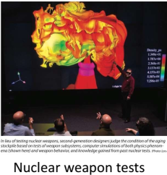
Why Scientific Computing?
Scientific Computing is nowadays:
The “third pillar of science”, in addition to theoretical analysis and experiments for scientific discovery.
Sometimes other means are:
Impossible
Costly (time and money)
Dangerous or undesirable

Slide 5
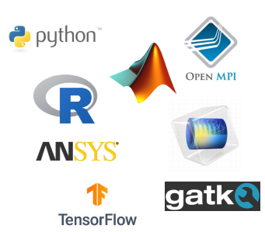

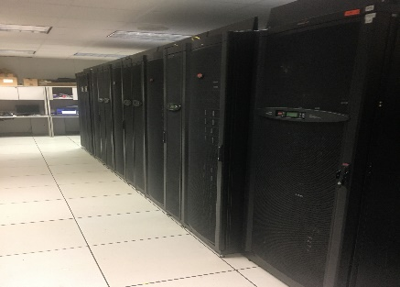

How to Conduct Scientific Computing?
Scientific theory and algorithm
From your own study/research background
Software
General purpose
Excel
Matlab
Python/R/Perl/C/Fortran, etc.
Dedicated software, such as:
Ansys (CFD, Structural/Solid Mechanics/Electronics)
Lammps/Gromacs/Amber (Molecular Dynamics)
Most cases, we need both
Hardware
Your laptop/desktop/lab server
Cloud Computing
Will be used in this bootcamp
Supercomputers
LONI QB3 cluster
Notes:
the practice of using a network of remote servers hosted on the Internet to store, manage, and process data, rather than a local server or a personal computer.

Slide 6
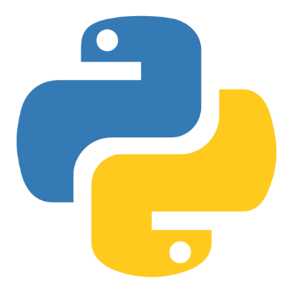
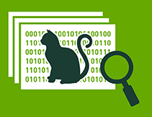
In This Bootcamp
Understand the basic usage of popular scientific computing programming tools
One application of the programming tools
Python
Deep Learning

Slide 7
Agenda
Day 1
Introduction to Python
Intermediate Python (NumPy)
Day 2
HPC User Env 1 + OOD
Introduction to Deep Learning
Our source code repository:
https://github.com/lsuhpchelp/lbrnworkshop/tree/main/2023 ( https://tinyurl.com/lbrnworkshop )
Computing Environment:
Google Colab
See https://colab.research.google.com/notebooks

Slide 8
Google Colaboratory
Colaboratory, or "Colab" for short, allows you to write and execute Python (or R) in your browser, with
Zero configuration required
Free access to GPUs
Easy sharing
Allows you to focus on learning the Python (or R) language itself instead of working on installing and configuring a programming environment.
Ref: https://colab.research.google.com/notebooks/intro.ipynb

Slide 9
Open Colab Notebook from Github
Open the below link:
https://github.com/lsuhpchelp/lbrnworkshop/blob/main/2023/day1/1.morning/Python101.ipynb
Or navigate yourself in the github repo:
https://github.com/lsuhpchelp/lbrnworkshop/tree/main/2023 ( https://tinyurl.com/lbrnworkshop )
Select "day1 > 1.morning > Python101.ipynb”
Click the “Open in Colab” link:

