Slide 1
QB3 Launch Workshop
9:00 - 9:15 Welcome
9:15 - 10:15 System overview
10:15 - 10:30 Break
10:30 - 11:30 Job management with SLURM
11:30 - 12:30 Performance benchmarks and tuning
12:30 - 2:00 Lunch break
2:00 - 4:00 Q&A + On-ramp sessions (breakout sessions)
HPC User Services - LONI HPC - sys-help@loni.org
October 1, 2020

Slide 2
Changes at a glance
New SLURM job scheduler
Upgraded RHEL operating system
More space in users' /home directories
Compute nodes: more memory & more cores
Upgraded software packages & compilers

Slide 3

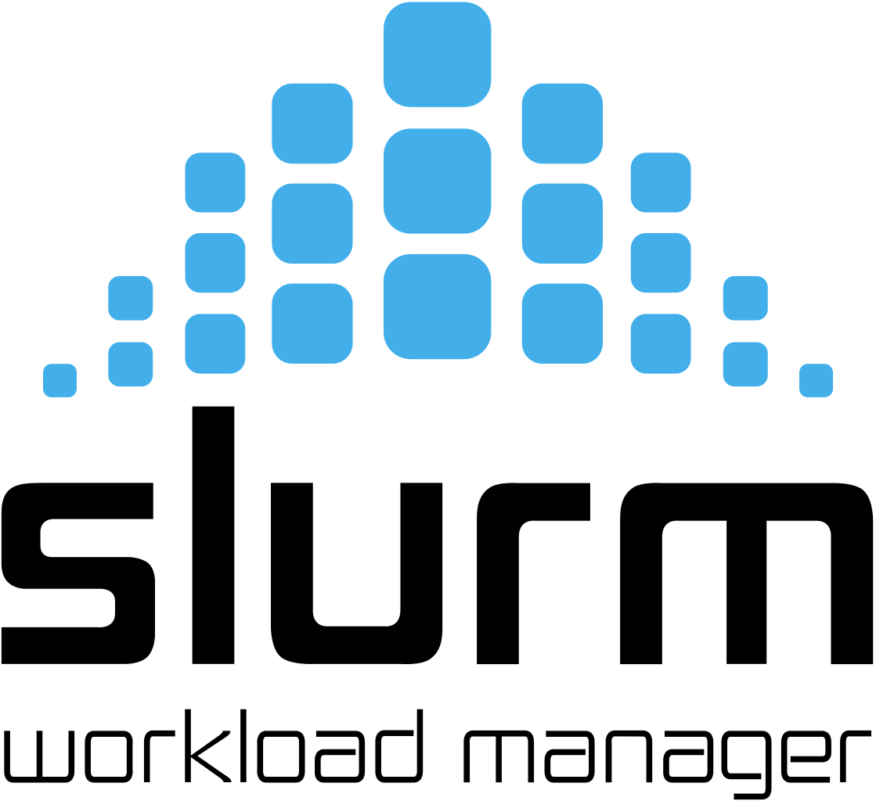
Job Submission
QB2
QB3
PBS (TORQUE)
+ Moab

Slide 4

Operating System
Upgraded version of same Linux operating system:
QB2
RHEL 6
QB3
RHEL 7

Slide 5
Bigger /home Quota
QB2 5GB
QB3 10GB

Slide 6
Hardware Changes
Faster Infiniband networking between nodes: 100 Gbps on QB3 vs. 56 Gbps on QB2.
QB3's compute nodes have 48 cores, while QB2's compute nodes have 20 cores.
QB3's GPU and compute nodes have 192 GB of memory, compared to QB2's 64 GB.

Slide 7
Software Modules
The module system for loading software packages on QB3 is the same as QB2.
The software stack is leaner than that on QB2.
Default compilers and default MPI flavors have not changed (different versions).
Most packages are built by Spack.

Slide 8
MPI and Compilers
MVAPICH2 compiled with the Intel 19 compiler is the default MPI implementation.
The same flavor as on QB2.
Similar or better performance compared to other flavors.
Intel MPI doesn't play well with cgroups.
Intel 19 is the default compiler.

Slide 9
Data Management
QB3 has a separate /home and /work filesystem.
To transfer files from between QB2 and QB3, please use scp or rsync.
/home
/home
/work
/work
QB3
QB2

Slide 10
Allocations and Accounts
QB2 and QB3 both use the same allocations – In other words, if you have access to a LONI allocation, it can be used on QB2 or QB3.
User accounts on QB3 and QB2 use your LONI account login and password.

Slide 11
SU Consumption on QB3
There is no weighting factor (it's not less expensive per core hour to run on QB3)
BUT, the higher number of cores per node (48 on QB3 vs. 20 on QB2) means the cost per NODE hour is 2.5 times higher – so be careful!

Slide 12
Should I run on QB2 or QB3?
QB3 might run faster, but for each node-hour, will burn over twice as many SUs. Depending on your code, it might not run any faster.
If your code is running on QB2 now, it may not be worth the effort to move over to QB3.
If you need the newer software and compilers installed on QB3, use QB3.
Don't assume your code will speed up dramatically on QB3 – test it yourself!

