Slide 1
Negotiating Your Career
Engineering Minority Groups
Sept 24, 2014

Slide 2
Introduction
Sorcha Clary
BSME LSU 2012
Interned with Marathon Petroleum
“Team”/Project Engineer at Marathon Petroleum (2012-present)
Alvin Lu
BSChBE Georgia Tech 2011
Interned with Kimberly-Clark and Honeywell
Process Engineer at ExxonMobil (2011-2014)
Process Engineer at Marathon Petroleum (2014-present)

Slide 3
Introduction
Clyde Smith
BSME Louisiana Tech University 2010
Interned with ExxonMobil
Fixed Equipment Engineer at ExxonMobil (2010-2013)
“Team”/Project Engineer at Marathon Petroleum (2013-Present)

Slide 4
Agenda
How to get an interview
How to ace an interview
Common interview questions
How to determine if a company is right for you
How to handle the offer process
What to expect from salary and benefits
How to stay fulfilled in your career

Slide 5
How to get an interview
Make yourself a good candidate
Importance of internships and related work experience
Grade point average
Be involved on campus
Use your resources
Career Fair, Engineering Events, Careers2Geaux, Mock Interview, Career Services
Resume preparation
Proofread and peer-review
Professional attire and behavior
Every handshake is a networking opportunity

Slide 6
How to ace an interview
Be prepared
Research the company
Have meaningful questions: you are interviewing the company as much as it is interviewing you
Be yourself – not every company is a perfect fit for everyone
Be aware - interview discourse has a purpose
Each question is designed to vet you in some way
Research common interview questions/participate in mock interviews
Be memorable – be appreciative and follow up

Slide 7
Common interview questions
Tell Me a Little About Yourself.
Brief biography as it would apply to the job: hobbies, experiences
Why Do You Want to Work for Us?
Research the company, answer directly with what you know
Example, "Based on the research I've done, you're company is great at (whatever it does) and I believe my background, history, and work ethics would be a good fit here.“
What Salary Are Your Looking For?
Know the standard pay rate in the industry you’re applying in and balance that with your experience

Slide 8
Common interview questions
What Are Your Strengths and Weaknesses?
Pick a skill that applies directly to the job (ex, detail oriented or motivated)
Choose a situational weakness, not a personal one or you can explain a personal failing and how you’re working to correct it
Can You Talk a Little About Your Work History?
Tell Me About a Problem You Solved at a Past Job/in School
Use the STAR method (Situation, Task, Action, Result)
Do You Have Any Questions for Me?
(the answer is always “yes”)

Slide 9
Is this company a good fit for you?
Explore the company’s website for insight
Evaluate values, community efforts, testimonials, etc.
Use the interview as an opportunity to learn about what isn’t online
Ask about corporate culture
Ask what it means to "be a team player," and what it takes to get promoted.
Find out if the company offers performance or responsibility rewards
Find out how close-knit the team is.
Ask, but don't dwell, on things like benefits, remote work, and perks
Measure the company against your needs
Source: http://lifehacker.com/how-to-find-out-if-a-company-is-a-cultural-fit-for-you-510587663

Slide 10
The offer process
Read and understand the full compensation package
Salary, benefits, vacation, etc.
If you have questions, ask.
Request a site visit and talk to people who are in your potential future role.
Research comparable job roles – explore average and median salaries/benefits
Know pre-employment contingencies
Drug test, background check
GPA requirements are hard-and-fast
This is true for internships and full-time offers
Offers expire – be aware of timing
Don’t be afraid to ask for an extension and be transparent about your timing constraints

Slide 11
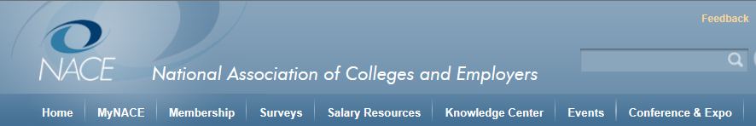
Salary and Benefit Research www.NACEweb.org
Resource for entry-level and experienced hire compensation metrics
Full time and internship information
Information includes (by location, education, GPA, and industry)
Benefits/Perks
Professional Salaries
Salary Calculator

Slide 12
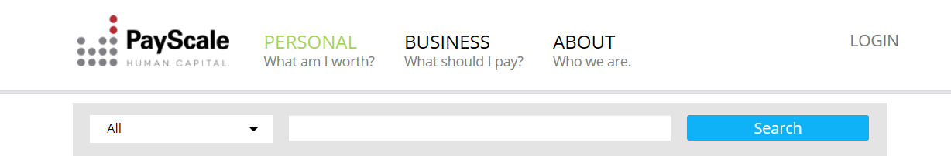
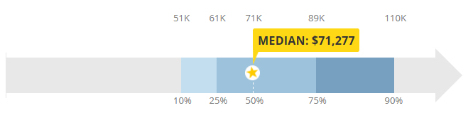
Salary and Career Path Research www.PAYSCALE.com
Resource for general information about
Salary
Bonus
Satisfaction
General demographic statistics

Slide 13
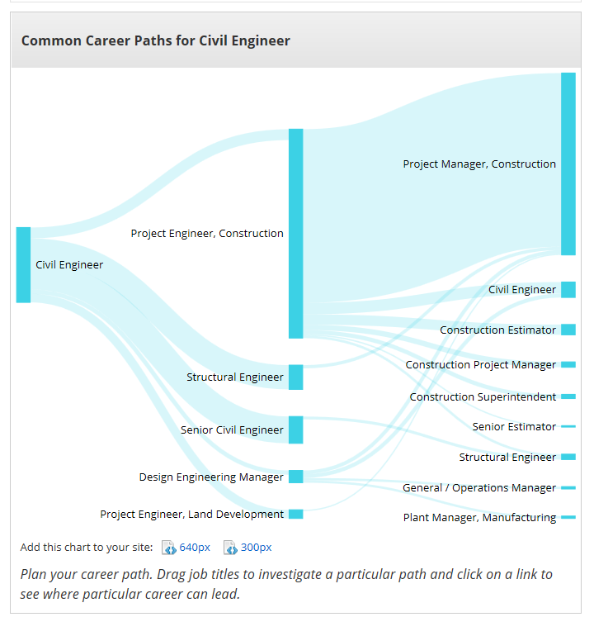
Salary and Career Path Research www.PAYSCALE.com

Slide 14
Make your job work for you
Continued Education – take advantage of training opportunities when they are available
Find a mentor and ask for feedback
Consider a mentor at a different location or job role
Ask for/schedule a yearly performance review
Ask for/schedule a yearly discussion on career expectations

Slide 15
Make your job work for you
Find purpose and value in what you do
If you are unhappy or unfulfilled, talk to someone you trust.
Department, location assignment, job function, supervisors, and team members can always change
Foster and maintain a healthy work-life balance

Slide 16
References
NACE Executive Summary
NACE (National Association of Colleges and Employers) Executive Summary for the Class of 2014 Survey Data: http://naceweb.org/uploadedFiles/Content/static-assets/downloads/executive-summary/2014-student-survey-executive-summary.pdf
Salary Information
www.glassdoor.com
www.salary.com
Keep in mind that salaries can vary by region, so taking a look at the cost of living in various areas may also help. This is a good one: http://money.cnn.com/calculator/pf/cost-of-living/

Slide 17
References
Determining Fit
Explore the company’s website for insight- Evaluate values, community efforts, testimonials, etc.
Do not underestimate the value of the information that youcan find on the Company’s website
Here is an article from Monster.com that may have a few helpful points: http://career-advice.monster.com/job-interview/interview-preparation/assess-company-culture-best-fit/article.aspx
Here is another article that had some good points: http://lifehacker.com/how-to-find-out-if-a-company-is-a-cultural-fit-for-you-510587663

