Slide 1
Problem Statement
‘Knowledge Representation and Insights Generation from Structured Dataset’
Objective:-
Our project aims to develop an AI-based solution that addresses this challenge by automating the analysis of structured datasets. This solution will represent knowledge effectively and generate insights, providing organizations with a powerful tool for data-driven decision-making and enhancing their ability to respond to evolving business needs.

Slide 2
Dataset
Source: Dataset Link
Attributes:
Nutrients: Nitrogen (N), Phosphorus (P), Potassium (K)
Environmental: Temperature, Humidity, pH, Rainfall
Target Column: Crop (Recommended crop based on attributes)
Significance:
Optimizes crop yield and resource usage.
Enhances sustainability and climate resilience.

Slide 3
Unique Idea Brief (Solution)
Our solution is an AI-based system designed to automate the analysis of structured data and generate actionable insights for better decision-making in agriculture. The system consists of the following components:
Data Pre-processing Module: Cleans and prepares the data for analysis.
Machine Learning Model: Analyzes the data and makes predictions.
Insight Generation Engine: Generates insights from the model's predictions.
Visualization Dashboard: Displays insights and data visualizations.

Slide 4
Features Offered
Data Cleaning and Normalization: Ensured the dataset is accurate and ready for analysis.
Machine Learning Predictions: Uses advanced algorithms to recommend optimal crops based on input data.
Insight Generation: Provides detailed insights into the best crop choices and their requirements.
Interactive Visualizations: Presents data through charts and graphs for better understanding.
User-friendly Interface: Easy-to-use web-based UI for input and viewing results.
Scalability: Handles large datasets efficiently.

Slide 5
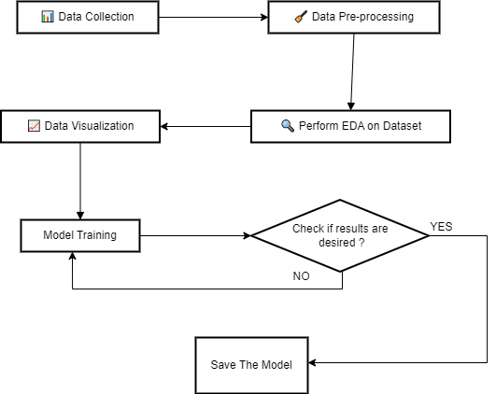
Model Training Process Flow

Slide 6
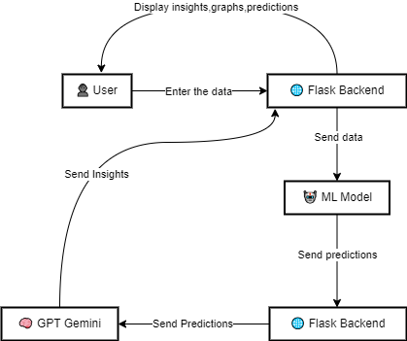
System Workflow

Slide 7
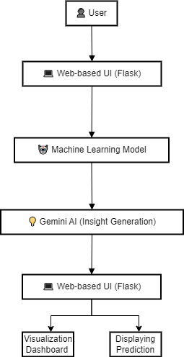
Architecture
👤 User: Inputs data through the web interface.
💻 Web-based UI (Flask): Sends user input to the backend.
🤖 Machine Learning Model: Predicts results from processed data.
💡 Gemini AI: Generates insights based on model predictions.
📊 Visualization Dashboard: Displays insights through interactive charts and graphs.

Slide 8











Technology Used

Slide 9
Team members and contribution
Member Name | Contribution
Vishawjeet Singh & Parmeet Kaur | Responsible for designing and developing the user interface, ensuring a smooth and intuitive user experience.
Arshdeep & Manjot Kaur | Focused on preparing and fine-tuning the machine learning model to ensure optimal performance and accuracy.
Rattanveer Singh | Led the effort in Exploratory Data Analysis and data cleaning, which was crucial for the integrity and accuracy of the data used in the project.

Slide 10
Conclusion
Our project showcases the successful integration of machine learning, comprehensive data analysis, and a user-friendly web interface to provide valuable agricultural insights. Through collaborative efforts, we developed a robust machine learning model for accurate crop recommendations, designed an intuitive web-based UI using Flask and Next.js, and conducted thorough data cleaning and exploratory data analysis. By utilizing Gemini AI, we transformed model predictions into actionable insights, offering meaningful information to users. This project highlights our technical capabilities and commitment to creating impactful solutions, bridging the gap between technology and agriculture to support the farming community effectively.

